Slide 1

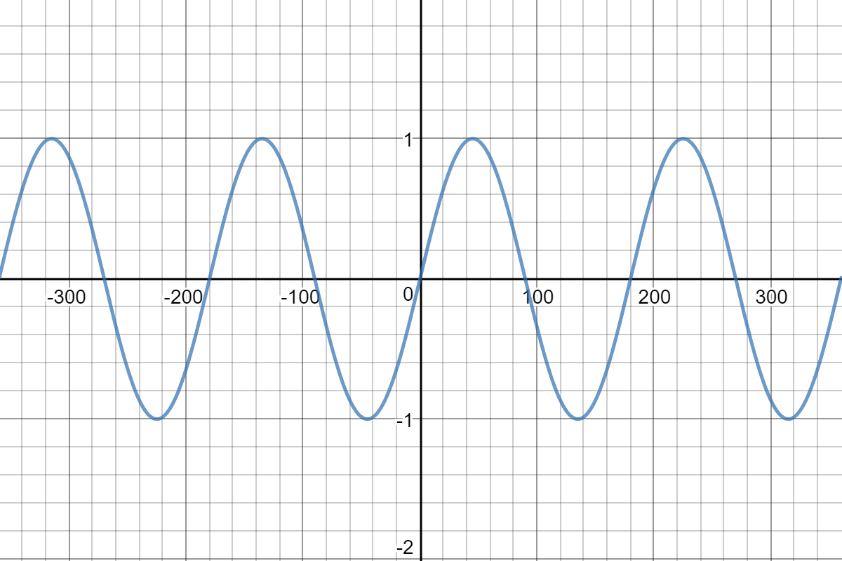
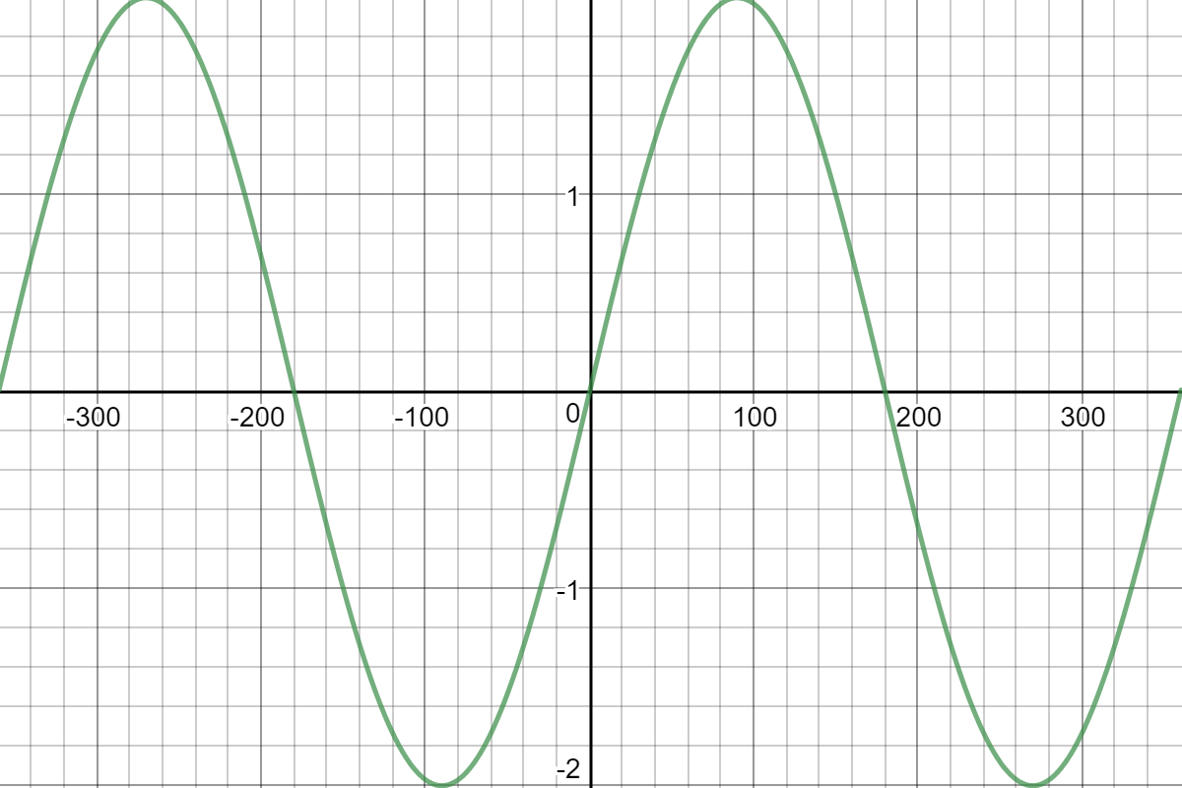
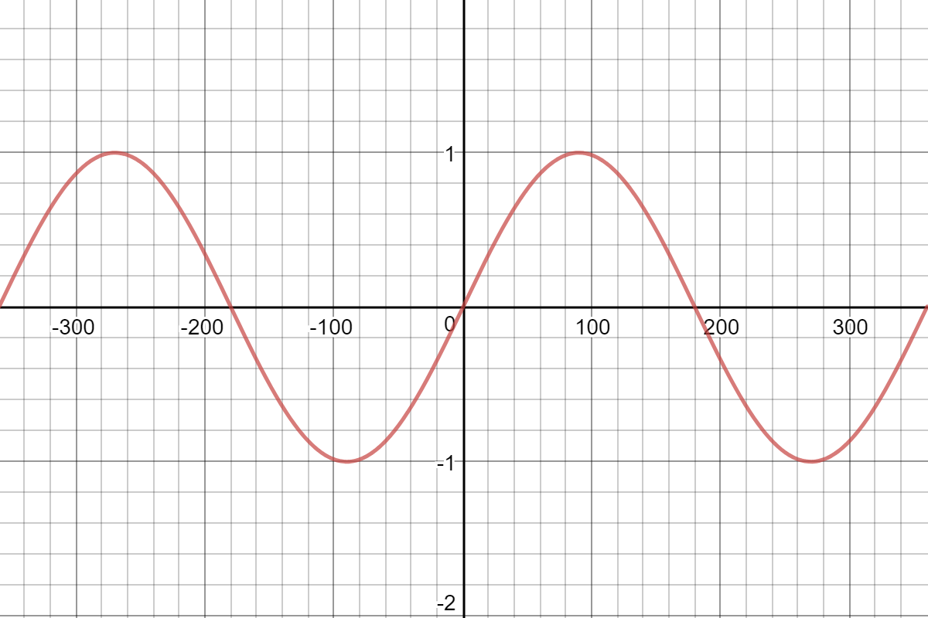
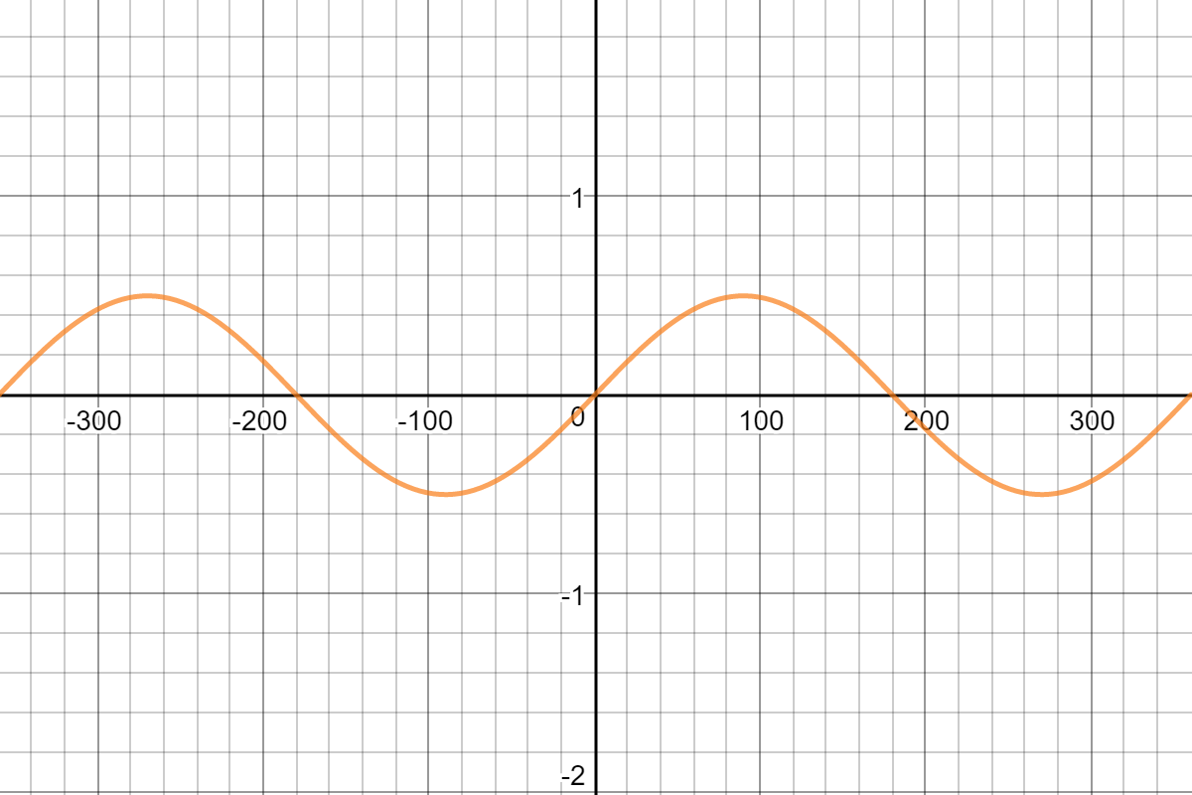
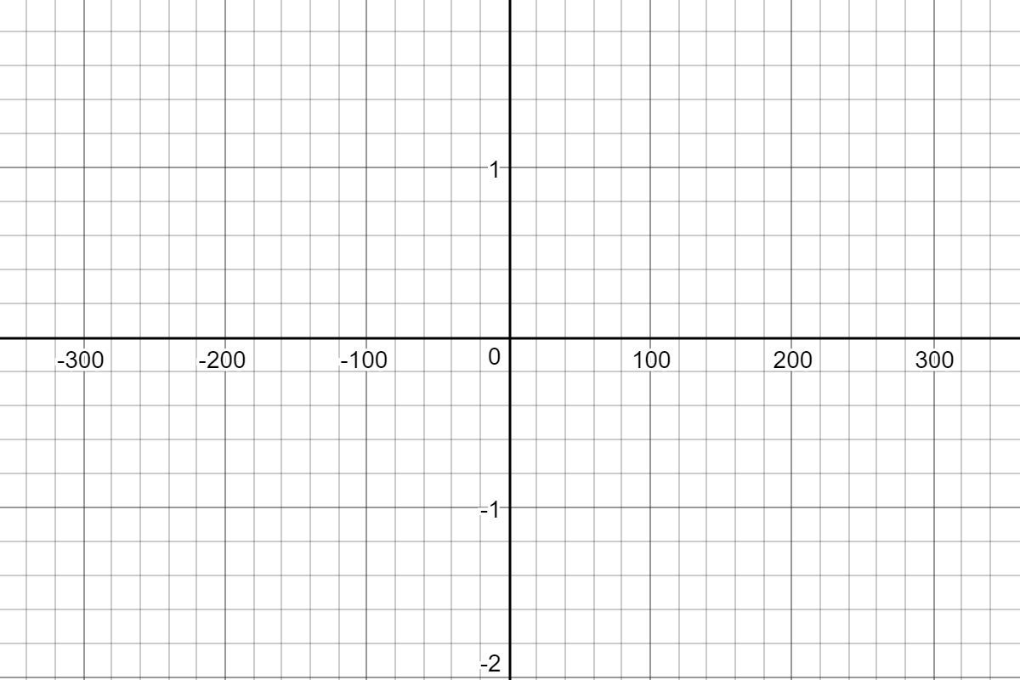
Mission Assignment: Describe the properties of sound
KS3-18-02
Look at the diagrams of sound waves below. Match the letters to the correct statements.
A
B
C
D
The loudest sound is _________________.
The quietest sound is _________________.
The highest pitch sound is _________________.
Two sounds with the same frequency are ______ and ______.
Two sounds with the same volume are ______ and ______.
On the blank graph opposite draw the sound wave that is twice the frequency and twice the amplitude of sound D.
Describe what you notice.
_______________________________________________________________________________________________________________________________________________________________________________________________________________________________________________________________________________________________
Developing Experts Copyright 2023 All Rights Reserved

Slide 2

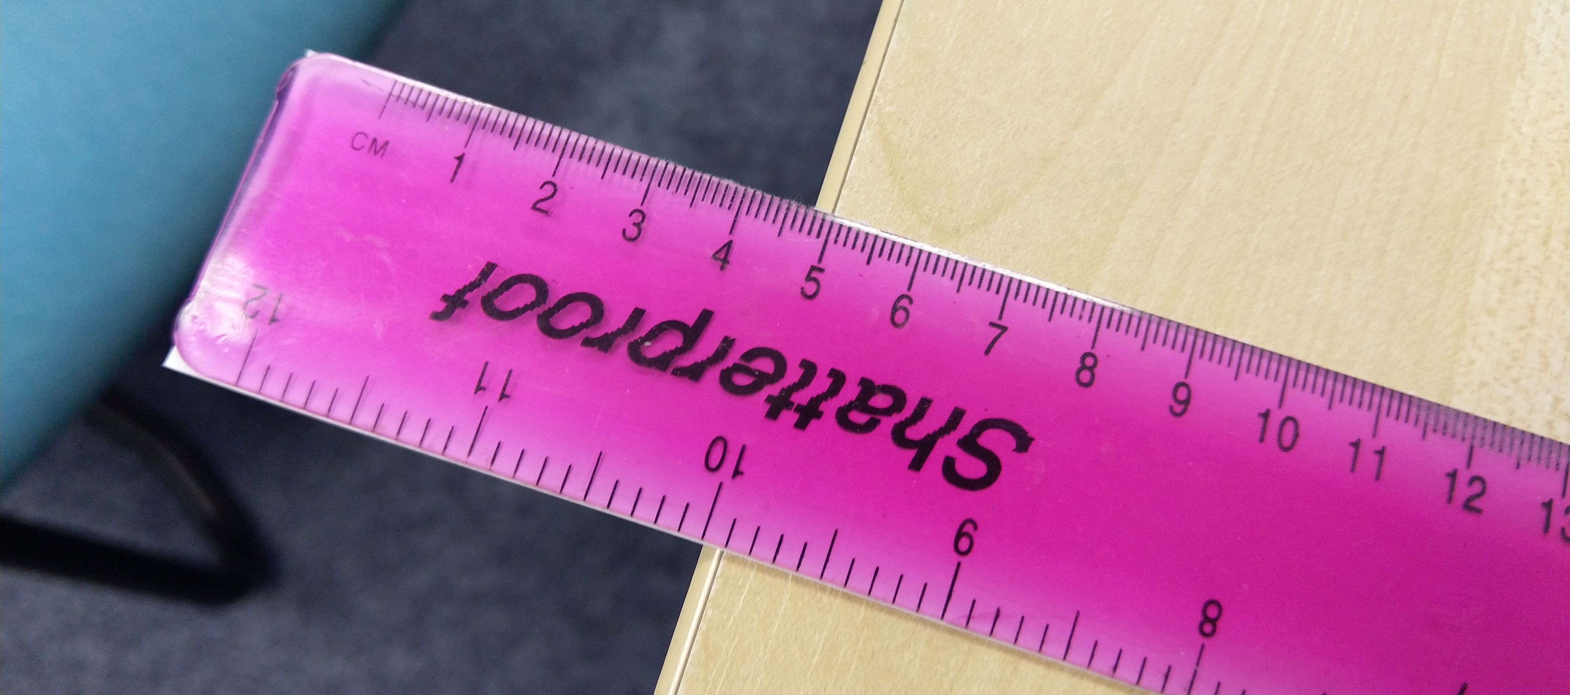
Mission Assignment: Describe the properties of sound
KS3-18-02
Investigate how the length of a ruler affects the volume and pitch it creates when “twanged”.
Method
Hang 5cm of your 30cm ruler over the edge of the desk.
Flick the end of the ruler.
Listen to the sound that is created.
In your table describe the sound you heard in terms of pitch and volume.
Repeat as above for 10cm, 15cm and 20cm
Length of ruler hanging over (cm) | Description of pitch. | Description of volume
5
10
15
25
At what length did the highest pitched sound occur? Suggest why this happened.
_______________________________________________________________________________________________________________________________________________________________________________________________________________________________________________________________________________________________________________________________________________________________________________________________________________________________
At what length did the loudest sound occur? Suggest why this happened.
_______________________________________________________________________________________________________________________________________________________________________________________________________________________________________________________________________________________________________________________________________________________________________________________________________________________________
Developing Experts Copyright 2023 All Rights Reserved

Slide 3
Mission Assignment: Describe the properties of sound ANSWERS
KS3-18-02
Look at the diagrams of sound waves below. Match the letters to the correct statements.
A
B
C
D
B
D
A
B C
A C
The loudest sound is _________________.
The quietest sound is _________________.
The highest pitch sound is _________________.
Two sounds with the same frequency are ______ and ______.
Two sounds with the same volume are ______ and ______.
On the blank graph opposite draw the sound wave that is twice the frequency and twice the amplitude of sound D.
Describe what you notice.
_______________________________________________________________________________________________________________________________________________________________________________________________________________________________________________________________________________________________
The period of the wave will halve, the speed will remain the same, the energy of the wave will be the same. The peaks will be higher.
Developing Experts Copyright 2023 All Rights Reserved

Slide 4
Mission Assignment: Describe the properties of sound ANSWERS
KS3-18-02
Investigate how the length of a ruler affects the volume and pitch it creates when “twanged”.
Method
Hang 5cm of your 30cm ruler over the edge of the desk.
Flick the end of the ruler.
Listen to the sound that is created.
In your table describe the sound you heard in terms of pitch and volume.
Repeat as above for 10cm, 15cm and 20cm
Length of ruler hanging over (cm) | Description of pitch. | Description of volume
5
10
15
25
At what length did the highest pitched sound occur? Suggest why this happened.
_______________________________________________________________________________________________________________________________________________________________________________________________________________________________________________________________________________________________________________________________________________________________________________________________________________________________
At what length did the loudest sound occur? Suggest why this happened.
_______________________________________________________________________________________________________________________________________________________________________________________________________________________________________________________________________________________________________________________________________________________________________________________________________________________________
The highest pitched sound occurred when the ruler was twanged at the shortest distance, which is 5cm. This is because when the ruler is twanged at a shorter distance, the length of the vibrating portion of the ruler is shorter, and as a result, the frequency of the sound wave produced by the ruler is higher.
It's likely that the loudest sound occurred when the ruler was twanged at the shortest distance, which is 5cm. This is because when the ruler is twanged at a shorter distance, the amplitude of the resulting sound wave is larger due to the greater displacement of the ruler, resulting in a louder sound.
Developing Experts Copyright 2023 All Rights Reserved

