Slide 1

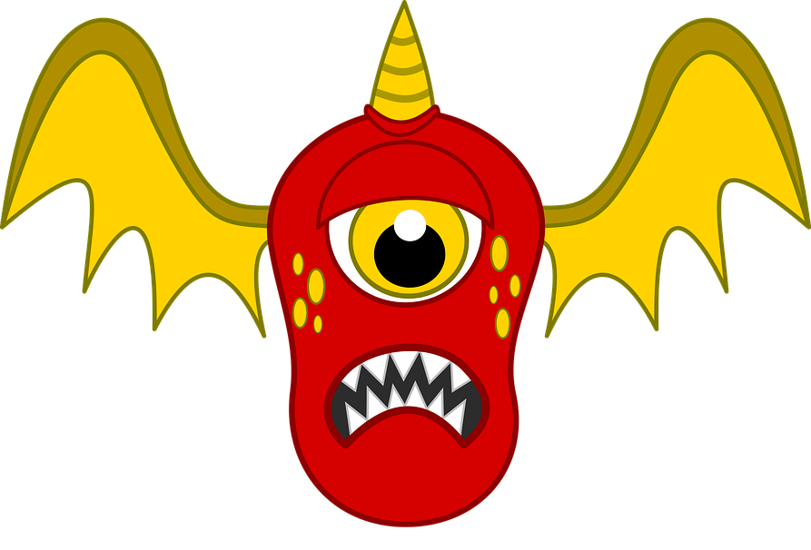
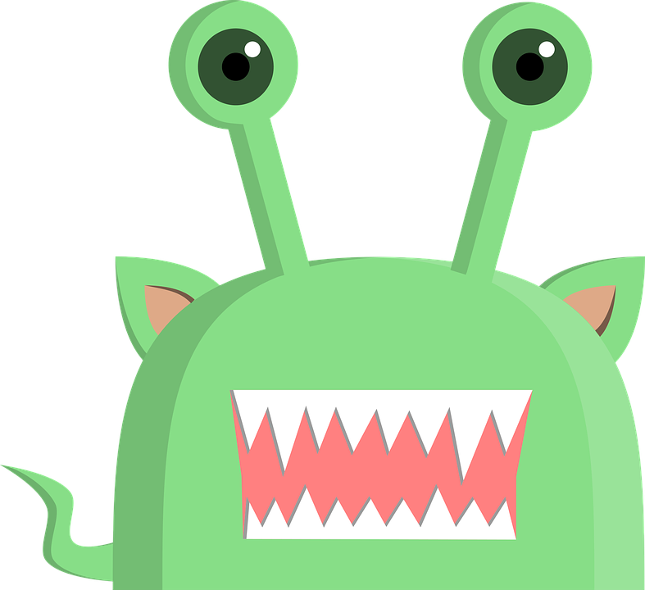
Monster Breeding
Look at the pictures of the monster mummies and daddies.
Then draw a baby monster that look a bit like both the mummy and daddy monster.
daddy monster
mummy monster
baby monster
daddy monster
mummy monster
baby monster

Slide 2
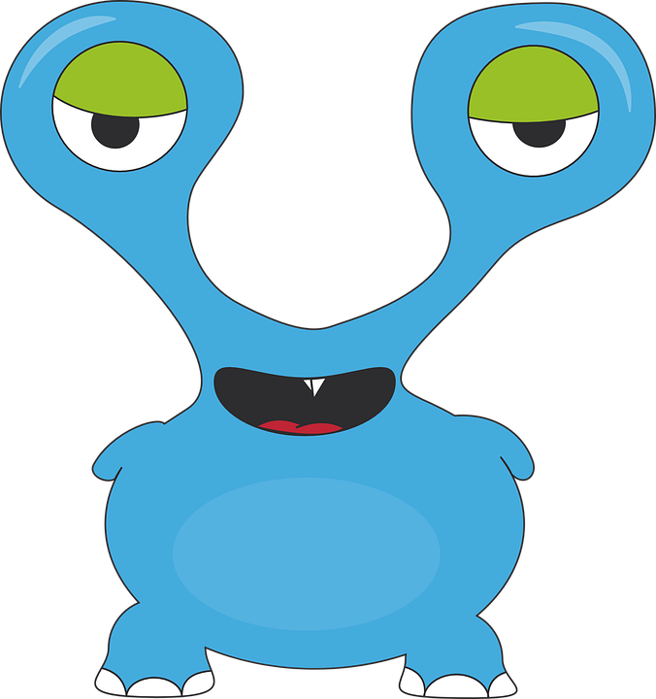
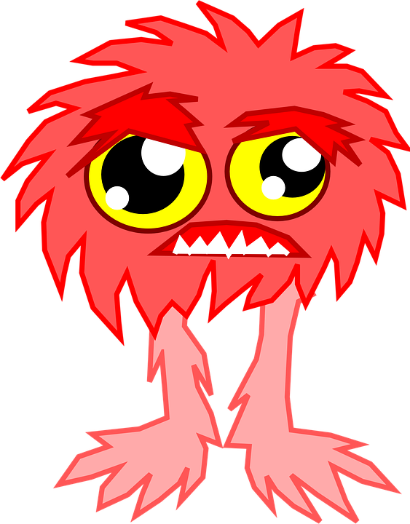
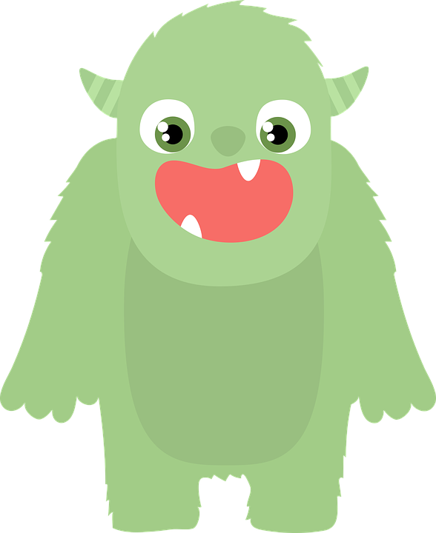
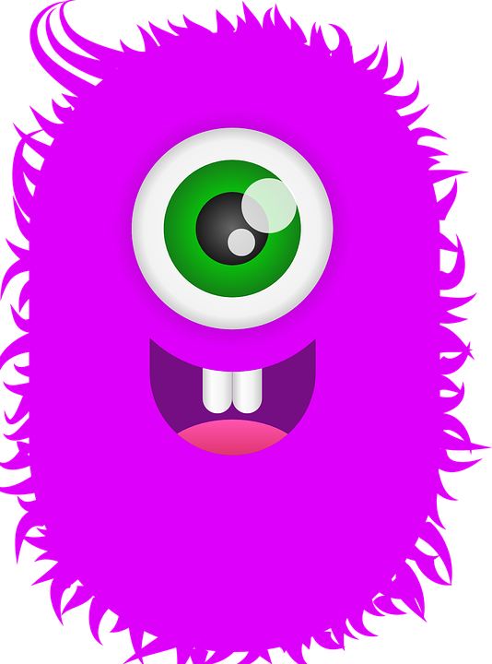
Challenge: read the descriptions and draw what you think the baby monster looks like.
Baby has daddy’s shape, colour & eyes.
Baby has mummy’s teeth, fur, & legs.
daddy monster
mummy monster
baby monster
Baby has daddy’s horns, arms & eyes.
Baby has mummy’s teeth, fur, & colour.
daddy monster
mummy monster
baby monster

