Slide 1

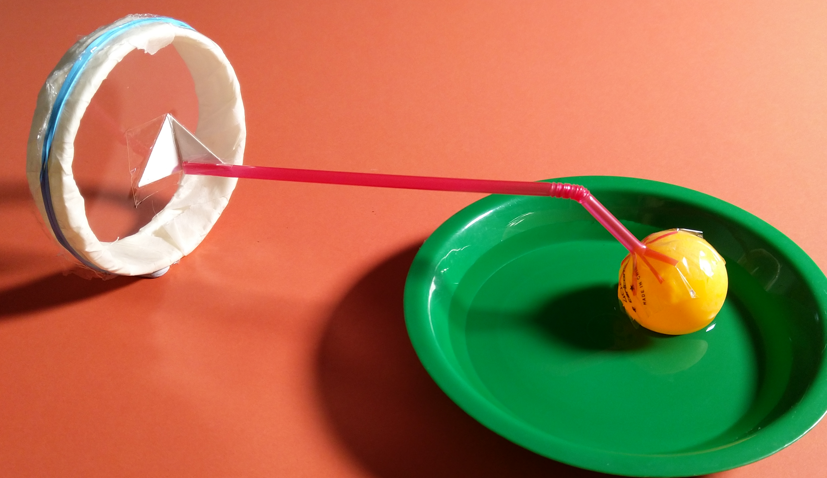
Mission Assignment: Explain how sounds are detected
KS3-18-04
Build a model ear and compare it to a working ear.
Cylinder
Bendy Straw
Rubber band
Ping pong ball
Clingfilm
Card Triangle
Bowl of water
Method
Stretch cling film tightly over a cylinder (the wider the better) and secure it in place with a rubber band.
Fold a small card triangle in half and tape a bendy straw to one half of the triangle. Tape a ping-pong ball to the other end of the straw.
Tape the other folded part of the triangle to the centre of the clingfilm.
Secure the cylinder to the table with tape or stick tack and rest the ping pong ball in a tray of water.
Place a speaker behind the cylinder, play some loud music and observe the surface of the water.
Identify which parts of the model represent the following parts of the ear and then explain your choice.
Ear drum:
________________________________________________________________________________________________________________________________________________________________________
The three inner ear bones:
________________________________________________________________________________________________________________________________________________________________________
The liquid filled cochlea:
________________________________________________________________________________________________________________________________________________________________________
Developing Experts Copyright 2023 All Rights Reserved

Slide 2
Mission Assignment: Explain how sounds are detected
KS3-18-04
Build a model ear and compare it to a working ear.
1. Is your ear model descriptive, predictive or explanatory? Explain your choice.
____________________________________________________________________________________________________________________________________________________________________________________________________________________________________________________________________________________________________________________________________________
2. Suggest a limitation of the model.
____________________________________________________________________________________________________________________________________________________________________________________________________________________________________________________________________________________________________________________________________________
3. Suggest how the model could be improved to create a more accurate representation of the ear.
____________________________________________________________________________________________________________________________________________________________________________________________________________________________________________________________________________________________________________________________________________
Challenge: Give two similarities and two differences between an ear and a microphone.
Similarities | Differences
Developing Experts Copyright 2023 All Rights Reserved

Slide 3
Mission Assignment: Explain how sounds are detected ANSWERS
KS3-18-04
Build a model ear and compare it to a working ear.
Cylinder
Bendy Straw
Rubber band
Ping pong ball
Clingfilm
Card Triangle
Bowl of water
Method
Stretch cling film tightly over a cylinder (the wider the better) and secure it in place with a rubber band.
Fold a small card triangle in half and tape a bendy straw to one half of the triangle. Tape a ping-pong ball to the other end of the straw.
Tape the other folded part of the triangle to the centre of the clingfilm.
Secure the cylinder to the table with tape or stick tack and rest the ping pong ball in a tray of water.
Place a speaker behind the cylinder, play some loud music and observe the surface of the water.
Identify which parts of the model represent the following parts of the ear and then explain your choice.
Ear drum:
________________________________________________________________________________________________________________________________________________________________________
The three inner ear bones:
________________________________________________________________________________________________________________________________________________________________________
The liquid filled cochlea:
________________________________________________________________________________________________________________________________________________________________________
Clingfilm due to the shape position and the fact it moves like the eardrum
The ping pong ball as it will make vibrations in the water similar to the way the bones do
The water in the bowl as it is liquid
Developing Experts Copyright 2023 All Rights Reserved

Slide 4
Mission Assignment: Explain how sounds are detected ANSWERS
KS3-18-04
Build a model ear and compare it to a working ear.
1. Is your ear model descriptive, predictive or explanatory? Explain your choice.
____________________________________________________________________________________________________________________________________________________________________________________________________________________________________________________________________________________________________________________________________________
2. Suggest a limitation of the model.
____________________________________________________________________________________________________________________________________________________________________________________________________________________________________________________________________________________________________________________________________________
3. Suggest how the model could be improved to create a more accurate representation of the ear.
____________________________________________________________________________________________________________________________________________________________________________________________________________________________________________________________________________________________________________________________________________
An explanatory model because it is designed to explain how the ear works and why it works that way rather than simply describing or predicting.
The parts of the model do not move like the inner ear and cannot respond to changes in loudness and pitch like a real ear.
Add the ability for parts to more and detect changes to loudness and pitch. This could be connecting it to a computer and oscilloscope.
Challenge: Give two similarities and two differences between an ear and a microphone.
Similarities | Differences
Convert sound waves into electrical signals
Use diaphragms to detect sound vibrations
Ears respond to air pressure, microphones to sound pressure
Ears convert signals for neural transmission, microphones for electronic recording
Developing Experts Copyright 2023 All Rights Reserved

