Slide 1
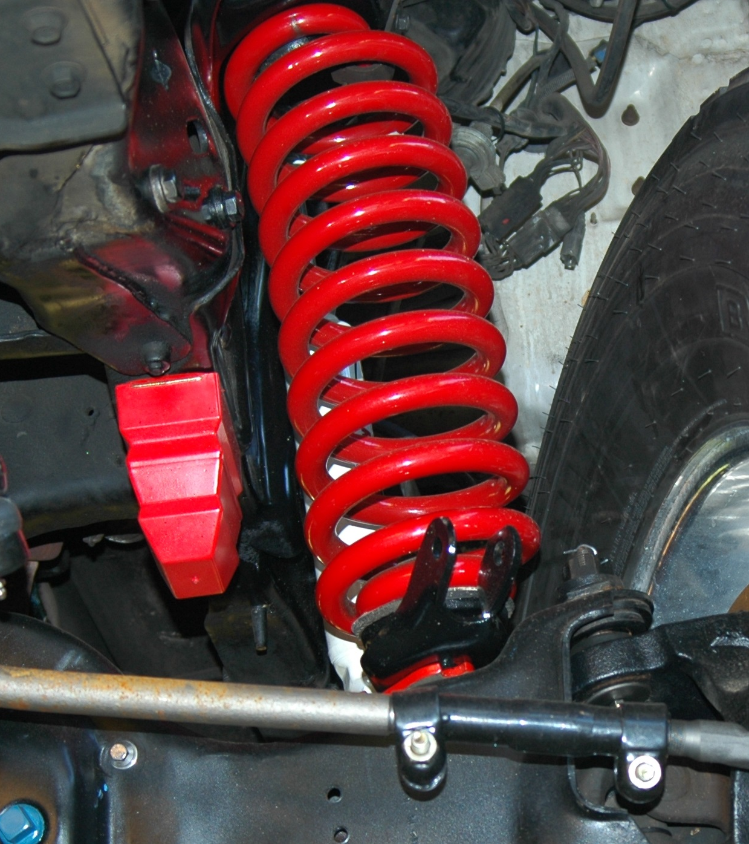
Explore the elastic potential store
Describe what's meant by elastic potential energy.
Calculate the elastic potential energy stored in a stretched spring.
Developing Experts All rights reserved © 2021

Slide 2
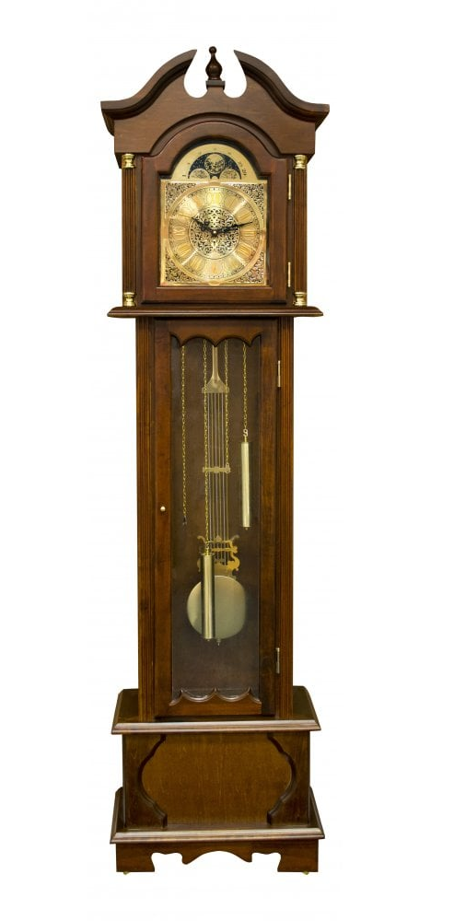

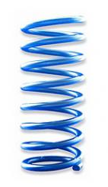
Developing Experts All rights reserved © 2021

Slide 3
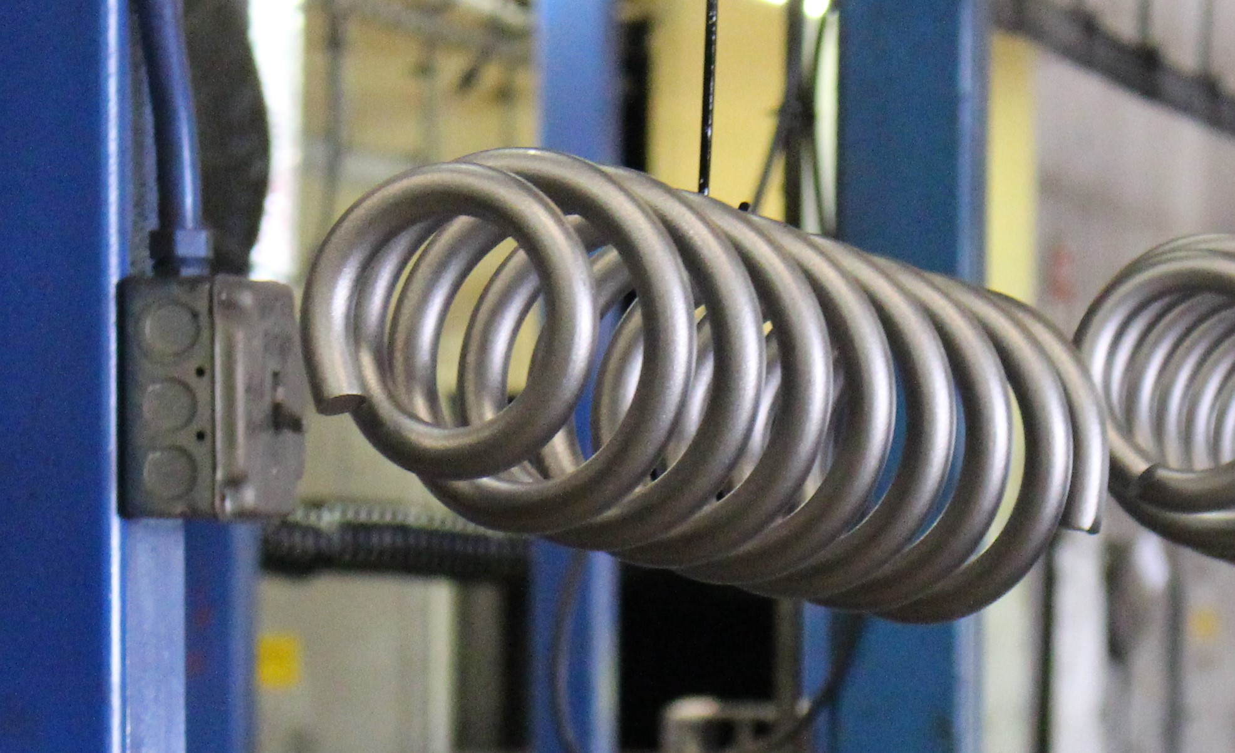
Explore the elastic potential store
When we stretch a spring, the length of the spring increases.
As the length of the spring increases work is done. Work done is energy transferred when one object exerts a force on another.
Energy is transferred to the stretched spring and is stored as elastic potential energy.
Developing Experts All rights reserved © 2021

Slide 4
No extension
no force
10 N
extension
(e)
Developing Experts All rights reserved © 2021

Slide 5
Load on spring (N) | Length of spring (cm) | Extension (cm)
0 | 2 | 0
5 | 2.7 | 0.7
10 | 3.4 | 1.4
15 | 4.1 | 2.1
20 | 4.8 | 2.8
Developing Experts All rights reserved © 2021

Slide 6
3
2.5
Extension of spring, e (cm)
2
1.5
1
0.5
5
10
15
20
Load on spring (N)
Developing Experts All rights reserved © 2021

Slide 7
3
2.5
Extension of spring, e (cm)
2
limit of proportionality
1.5
1
0.5
5
10
15
20
Load on spring (N)
Developing Experts All rights reserved © 2021

Slide 8
Elastic potential energy
E_{e}
=
0.5
×
k
×
e²
elastic potential energy (J)
spring constant
(N/m)
extension
(m)
Developing Experts All rights reserved © 2021

Slide 9
Elastic potential energy
E_{e}
=
0.5
×
k
×
e²
elastic potential energy (J)
spring constant
(N/m)
extension
(m)
The extension must be in metres, so if it's in centimetre you’ll need to convert to metres.
2. The value of the spring constant depends on the spring.
Developing Experts All rights reserved © 2021

Slide 10
A spring has an extension of 20 cm. Calculate the elastic potential energy stored in this spring. (k=100 N/m).
E
=
0.5
×
k
×
e
2
e
Developing Experts All rights reserved © 2021

Slide 11
A spring has an extension of 20 cm. Calculate the elastic potential energy stored in this spring. (k=100 N/m).
E
=
0.5
×
k
×
e
2
e
E
=
0.5
×
100
×
0.2
2
e
Developing Experts All rights reserved © 2021

Slide 12
A spring has an extension of 20 cm. Calculate the elastic potential energy stored in this spring. (k=100 N/m).
E
=
0.5
×
k
×
e
2
e
E
=
0.5
×
100
×
0.2
2
e
E
=
2 J
e
Developing Experts All rights reserved © 2021

