Slide 1
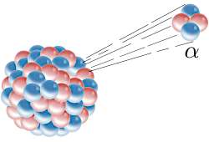
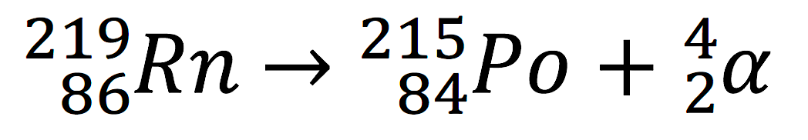
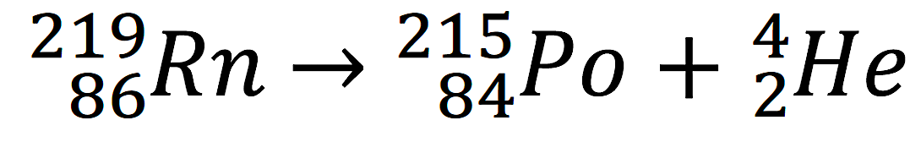
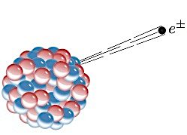
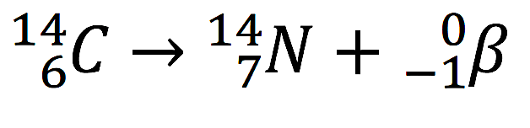
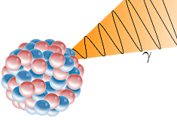
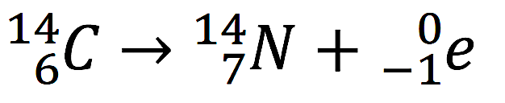
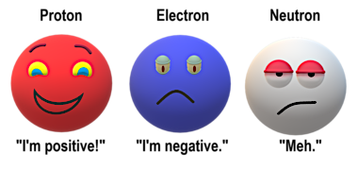
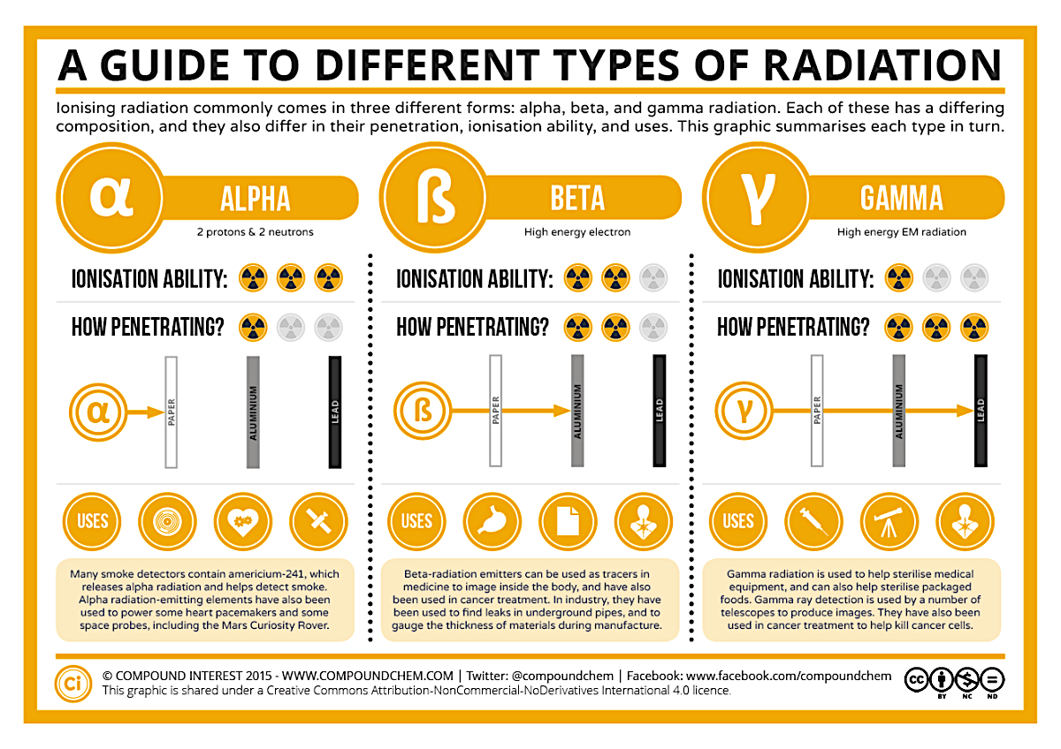
What is an alpha particle?
Radioactive decay is unpredictable and can happen in 4 forms. Rutherford isolated alpha decay in his alpha scattering experiment. Due to the trace lines of the particle, he was able to identify the alpha α particle as helium with an atomic mass of 4 and 2 protons. When a nucleus decays through alpha α it loses 2 protons, which mean that its atomic number decreases by 2 and its atomic mass by 4:-
This can also be written like this:-
When radon-219 becomes polonium-215 it loses 2 protons and its atomic number is reduced by 4.
4
2
He
4
2
α
Beta decay
When a nucleus decays through beta β decay, a neutron changes to a proton that is kept by a nucleus and an electron is emitted at high speed from the atom to balance the charge of the atom. This means that the atomic number increases by 1 and the atomic mass remains unchanged. The decay of carbon-14 to nitrogen-14 can be written :-
Or like this:-
0
1
β
e
_
0
1
_
Gamma γ radiation does not cause the atomic mass or the atomic number to change.
Gravitational
field strength
10N/kg
Neutron emission can happen when nuclear fission occurs; a neutron is released from the parent atom when it splits. The mass number decreases by 1 and the atomic number stays the same.
You will always be given all the information that you need in the examination question, but it is a good idea to learn the different properties of the different types of radiation.

Slide 2

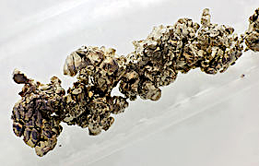
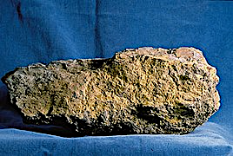
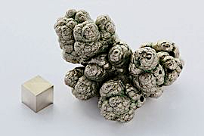
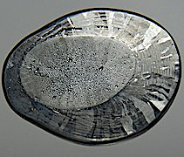
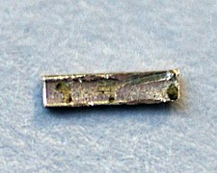
Equation practice
Write the equations for the following decay:-
Polonium-224 decay by alpha emissions:-
204
84
+
Po
Strontium-90 decay by beta emissions:-
90
38
+
Sr
Uranium-235 decay by beta emissions:-
235
92
+
U
Nickel-63 decay by beta emissions:-
63
28
+
Ni
Lead-209 decay by beta emissions:-
209
82
+
Pb
Radium-224 decay by alpha emissions:-
224
86
+
Rn

Slide 3
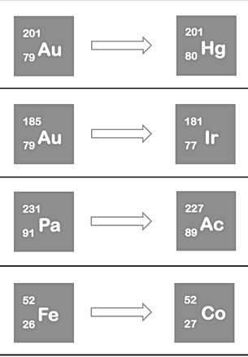

Half-life and emissions
If gallium-68 has a half-life of 68.3 minutes, how much of a 10mg sample is left after 2 half-lives?
________________________________________________________________________________________________________________________________________________________________________
If the passing of 5 half-lives leaves 25mg of a strontium-90 sample, how much was present in the beginning?
________________________________________________________________________________________________________________________________________________________________________
The radioisotope ceasium-137 has a half life of 30 years. A sample decays at 544/minute (544 cpm) in 1985. In what year will it decay to 17 cpm?
________________________________________________________________________________________________________________________________________________________________________
Complete the equation | Alpha or beta?

