Slide 1


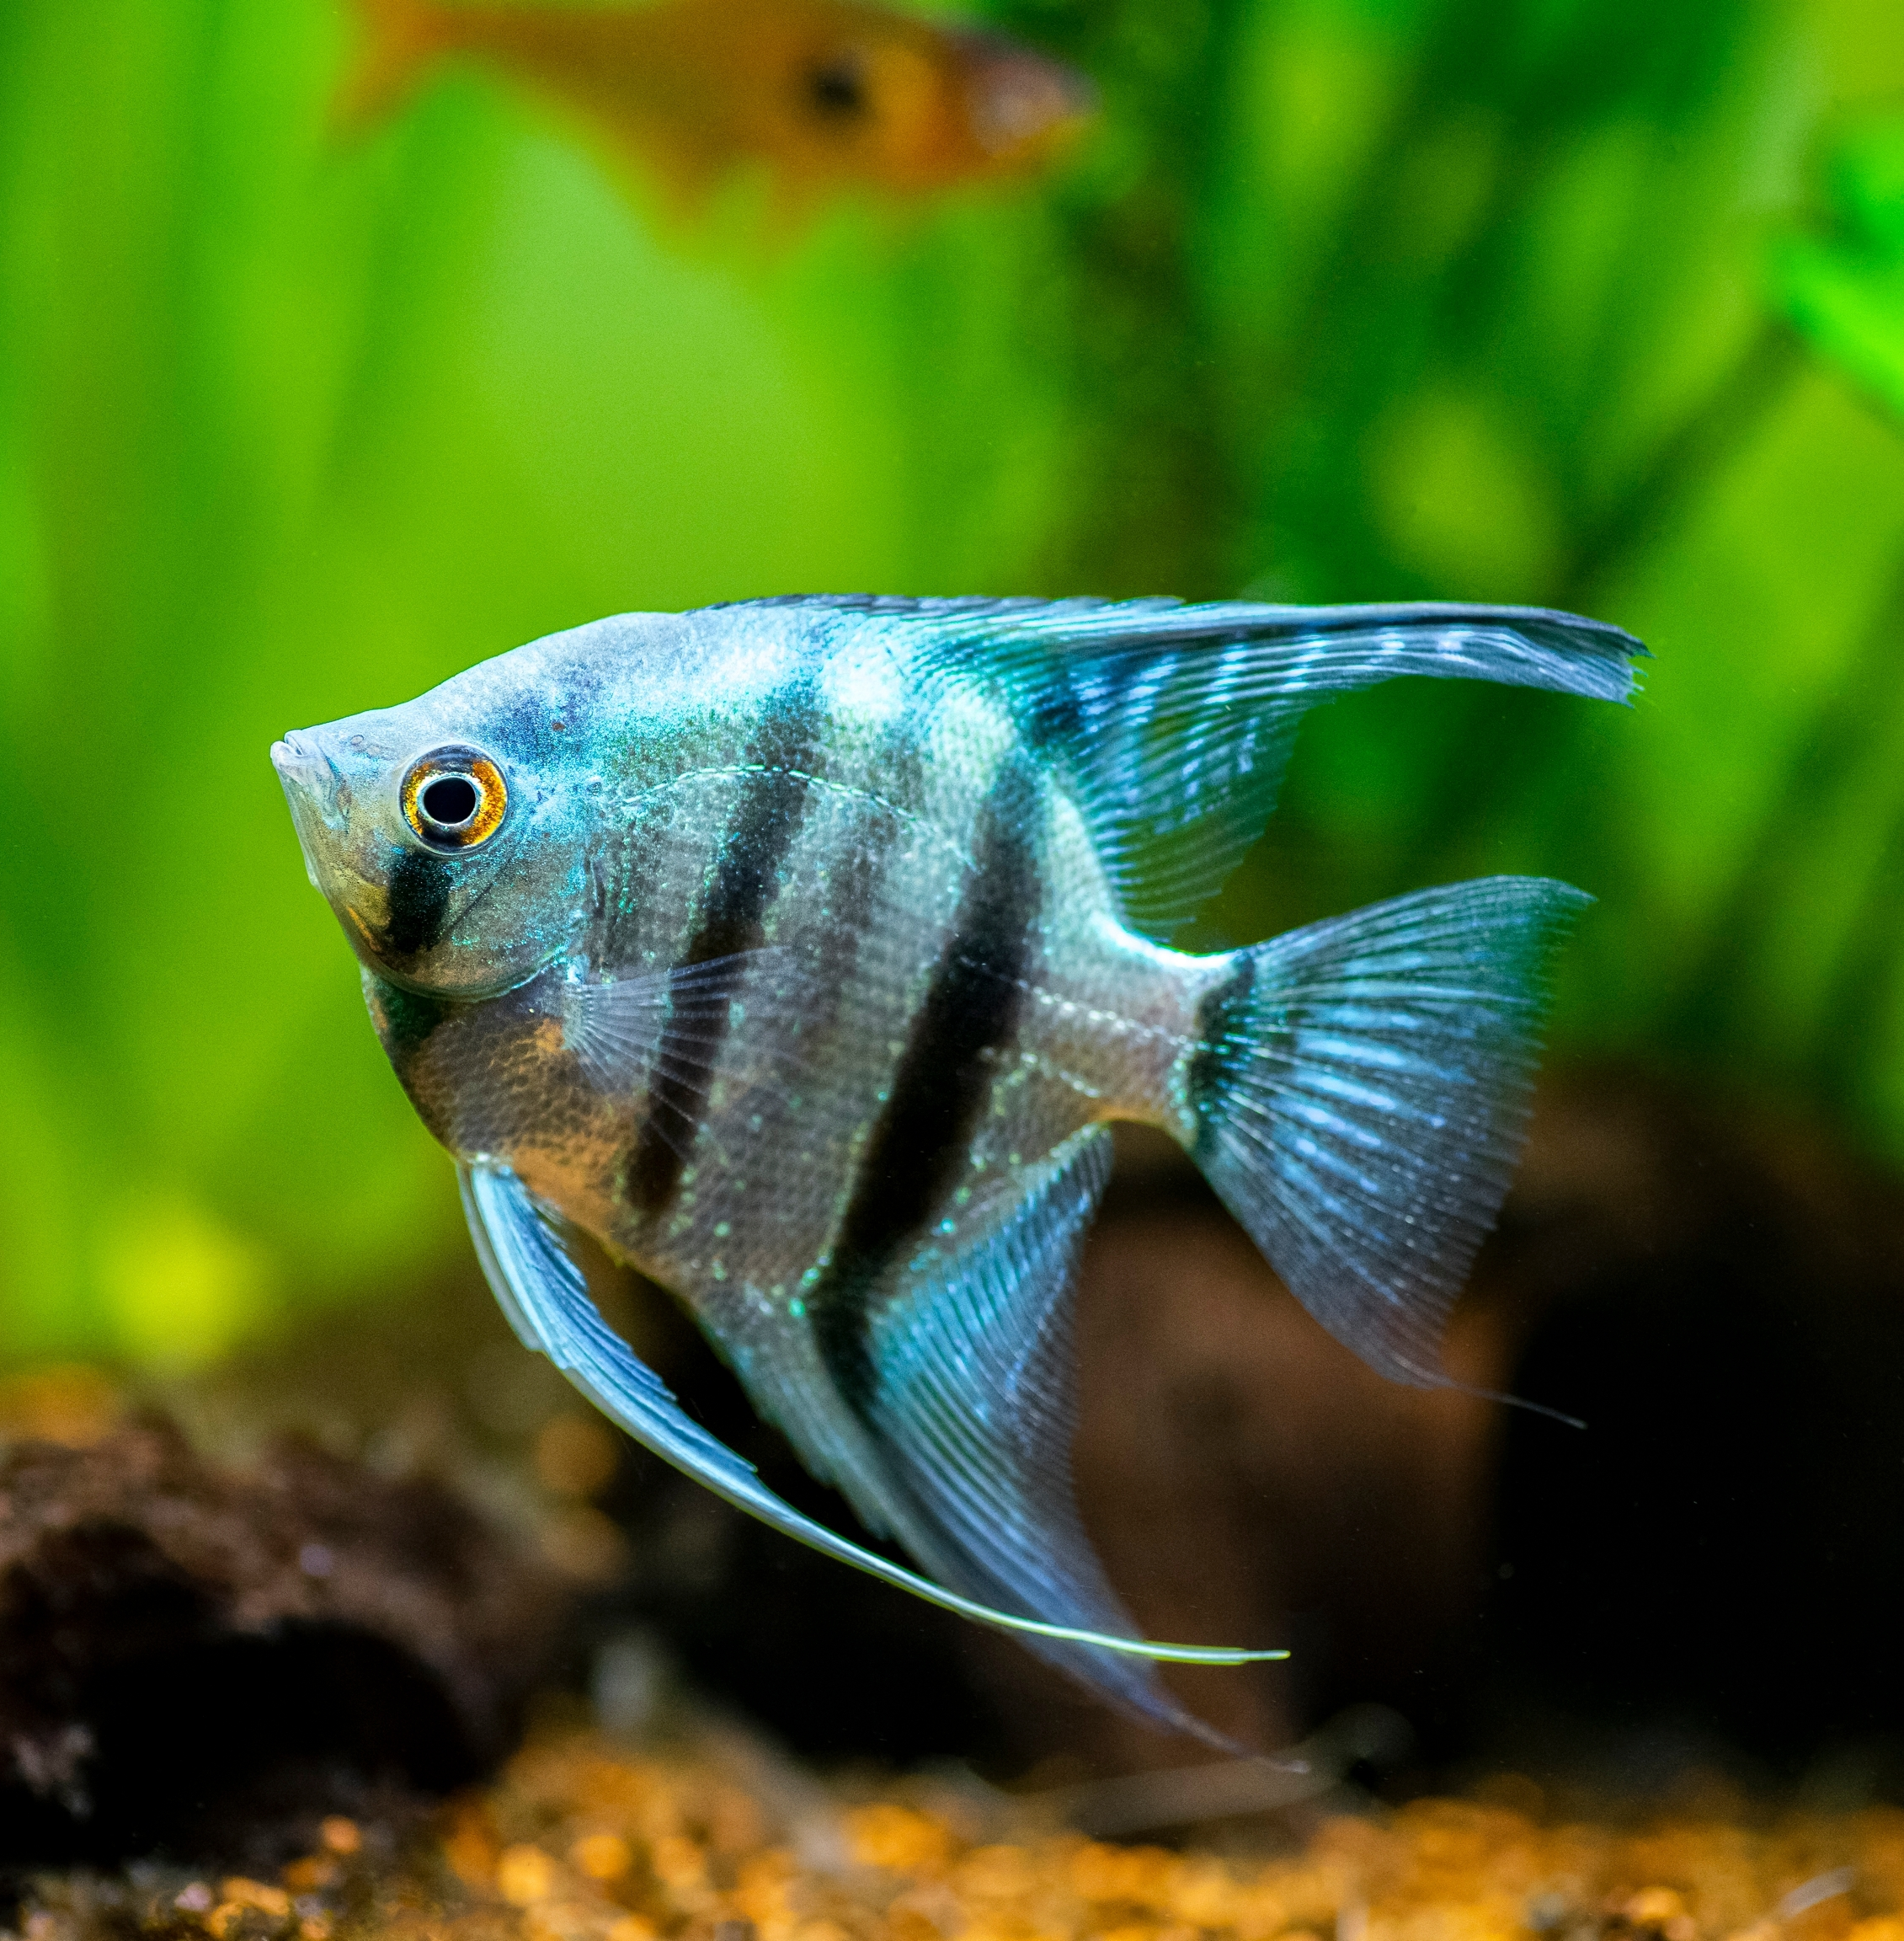
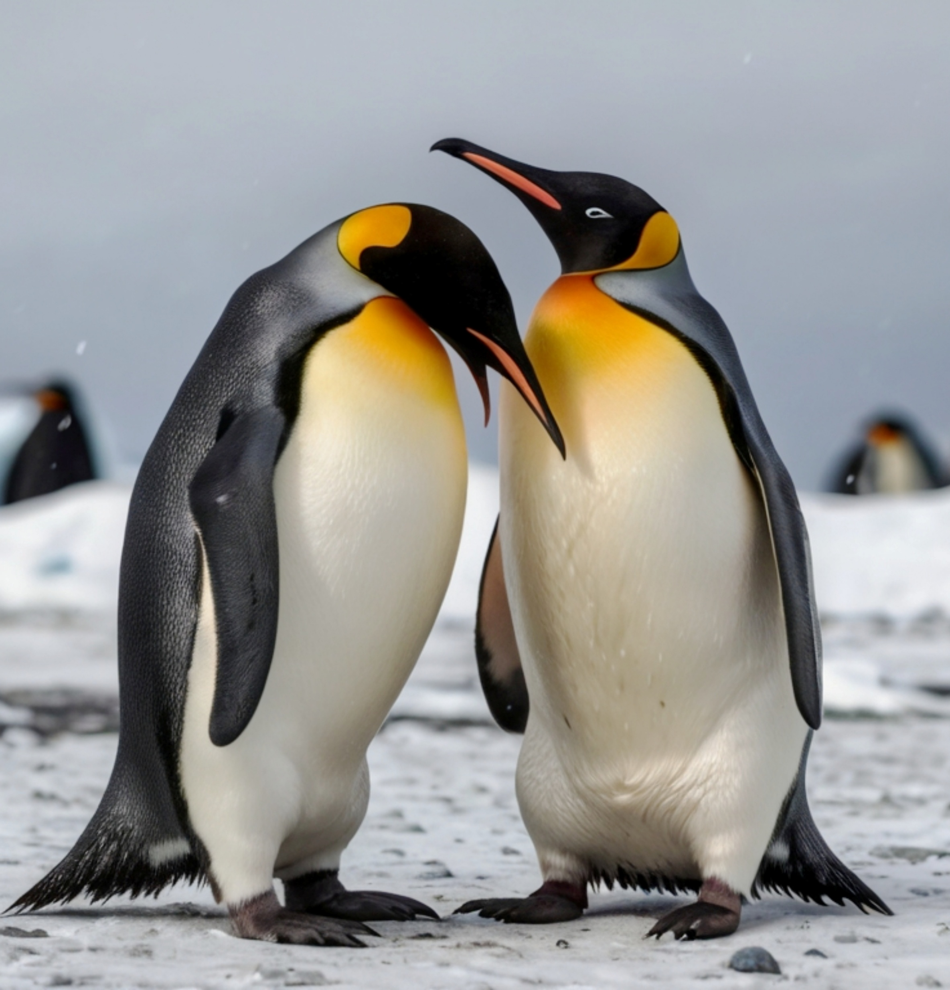
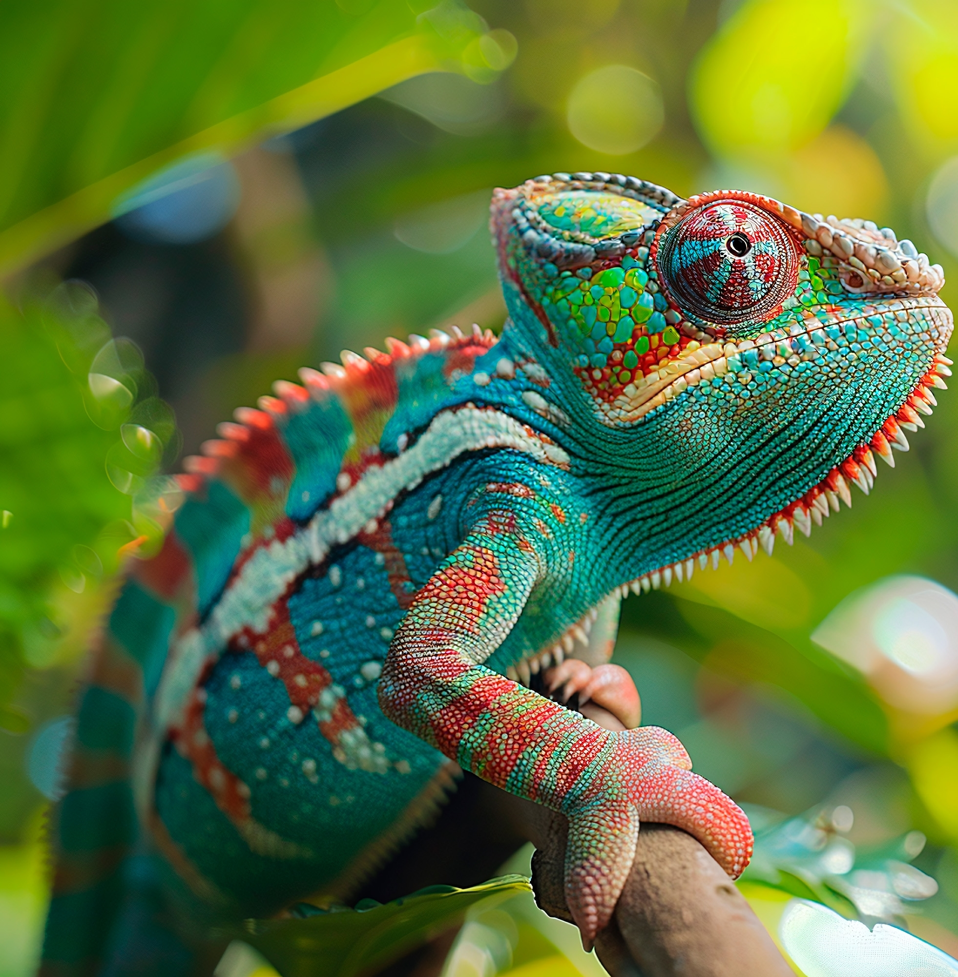
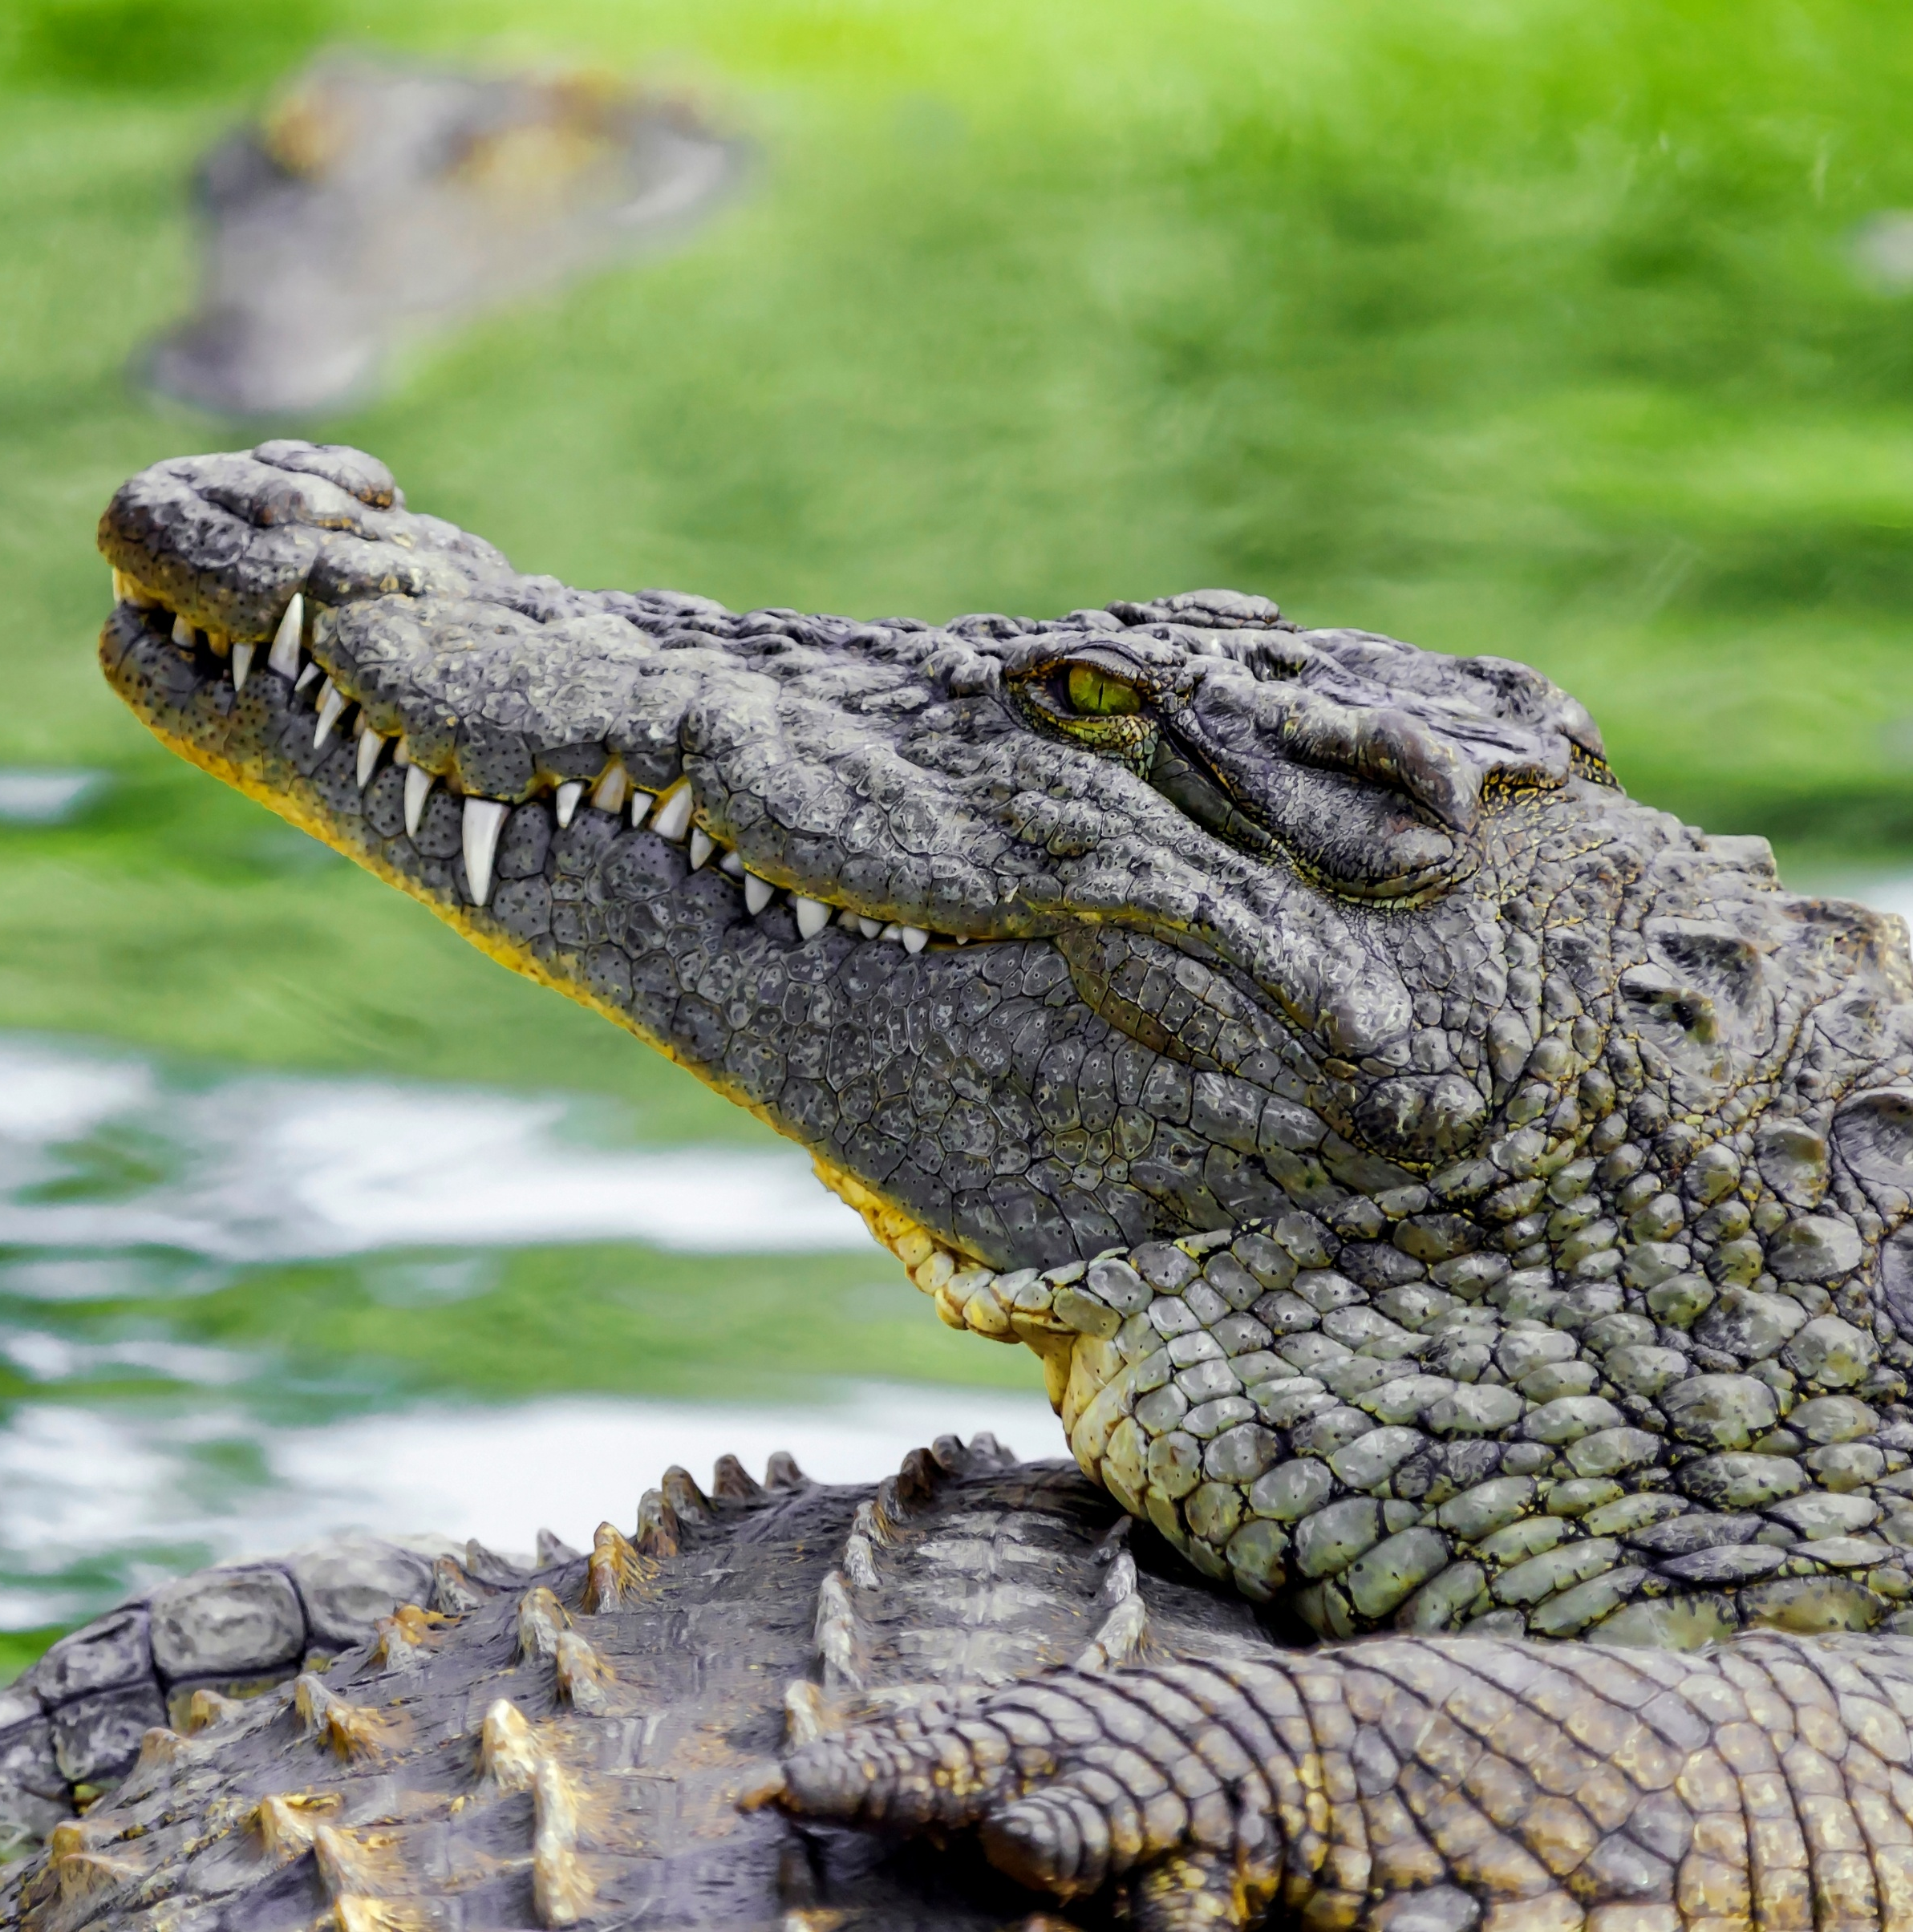
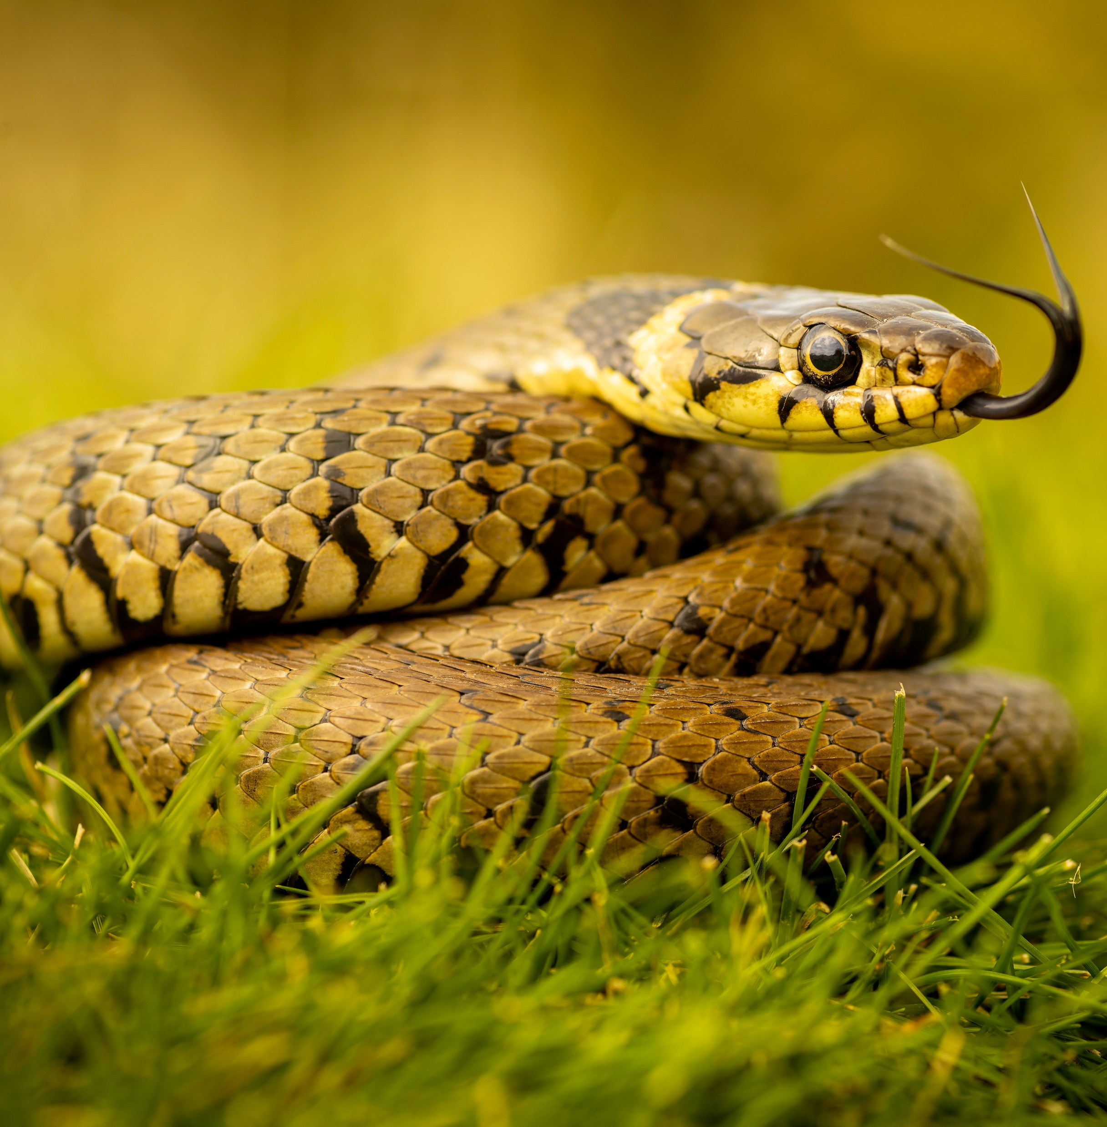
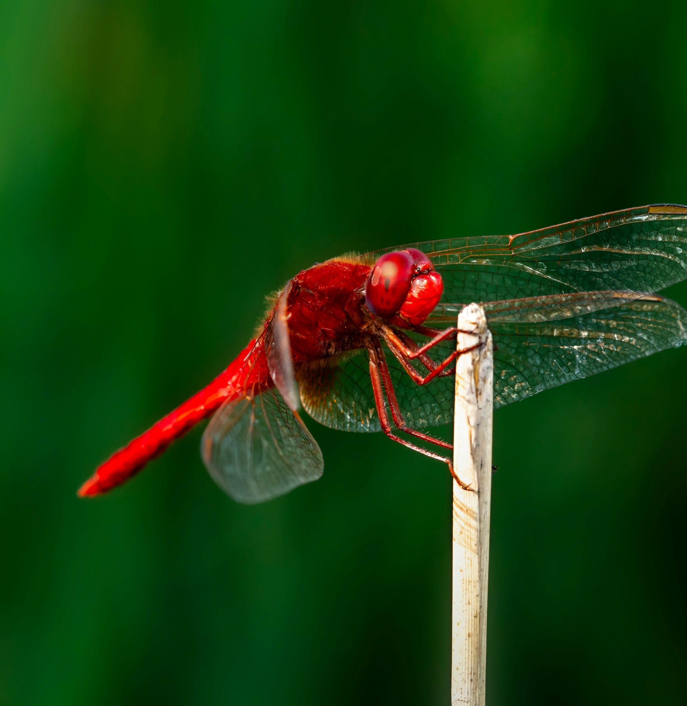
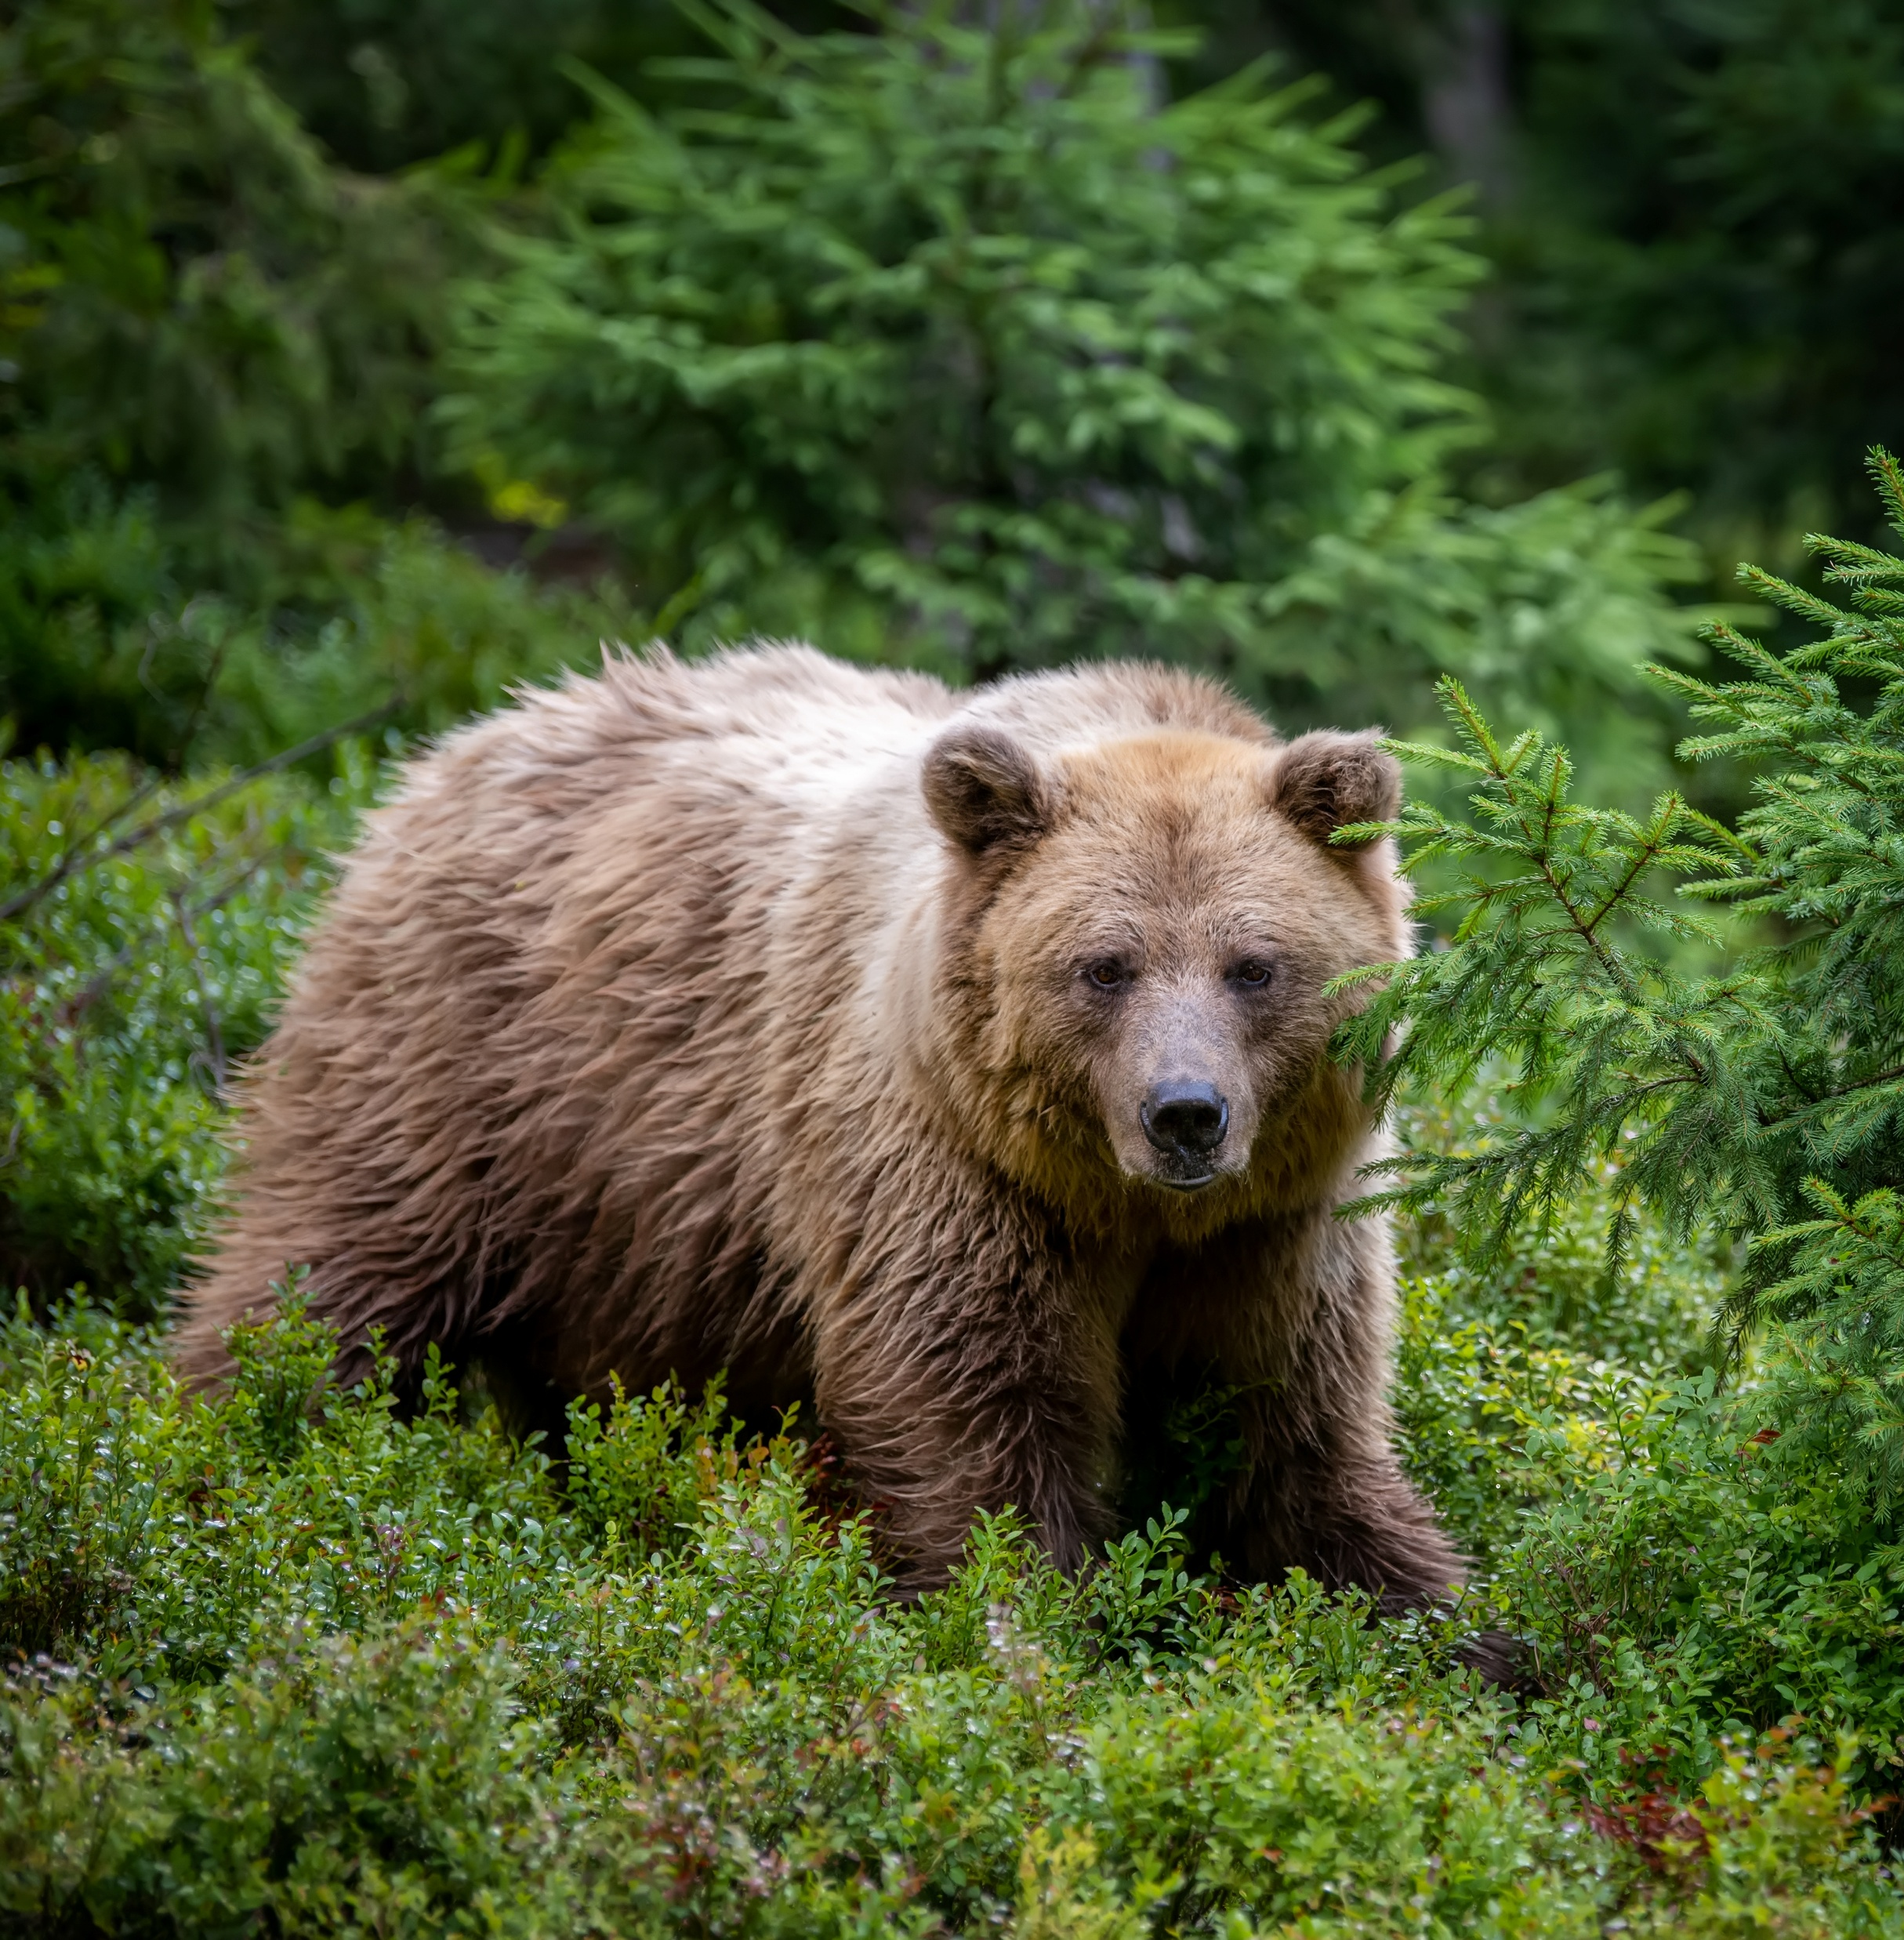
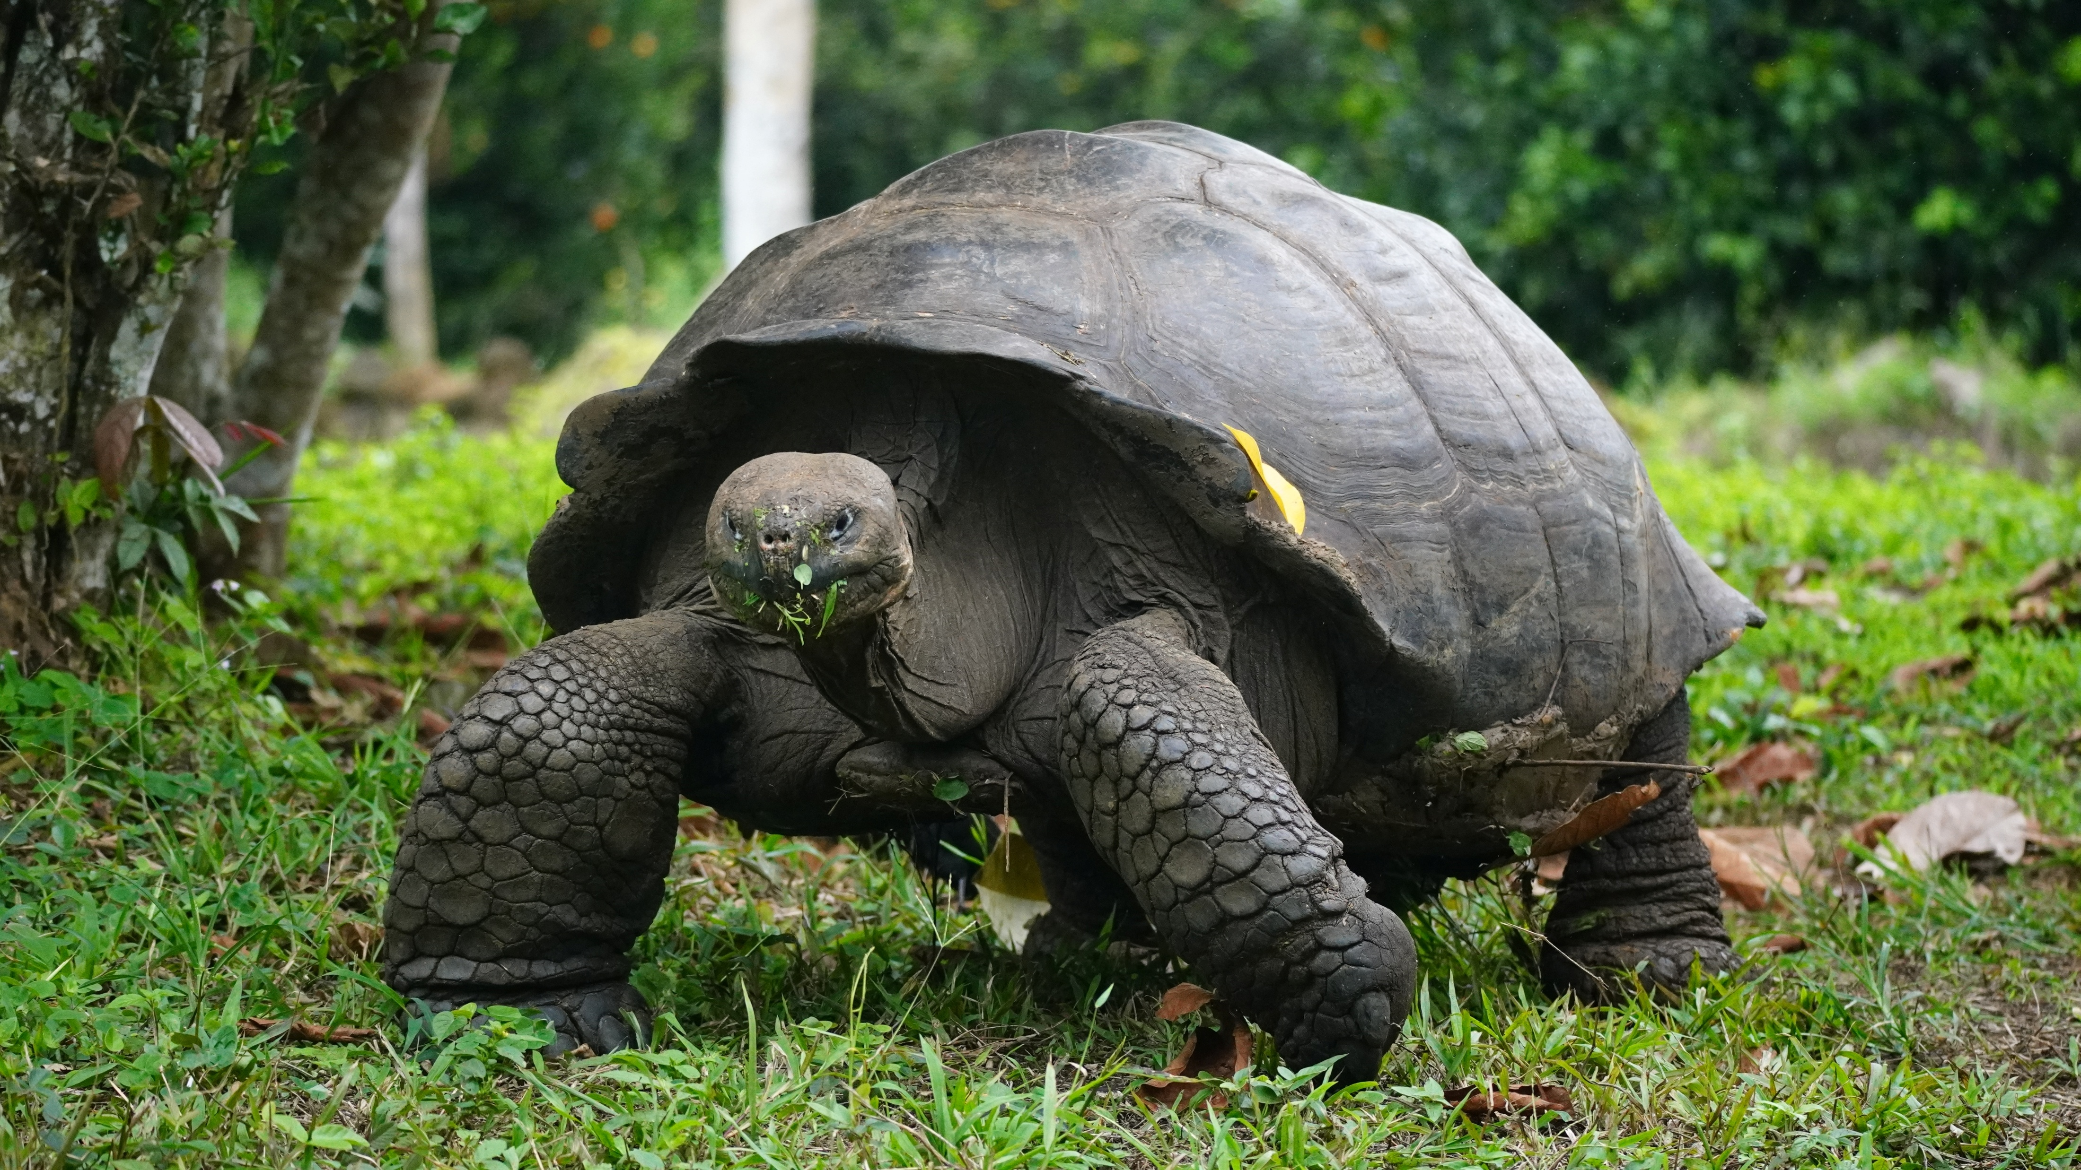
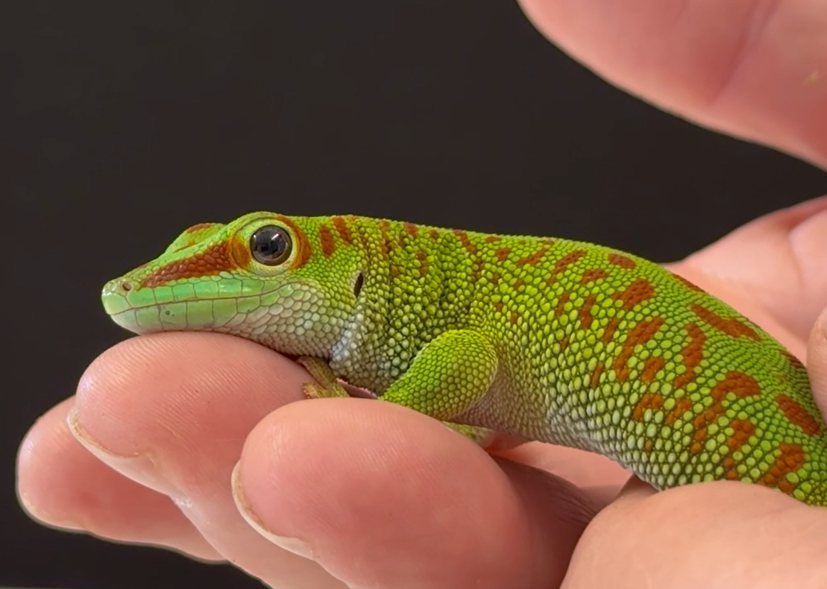
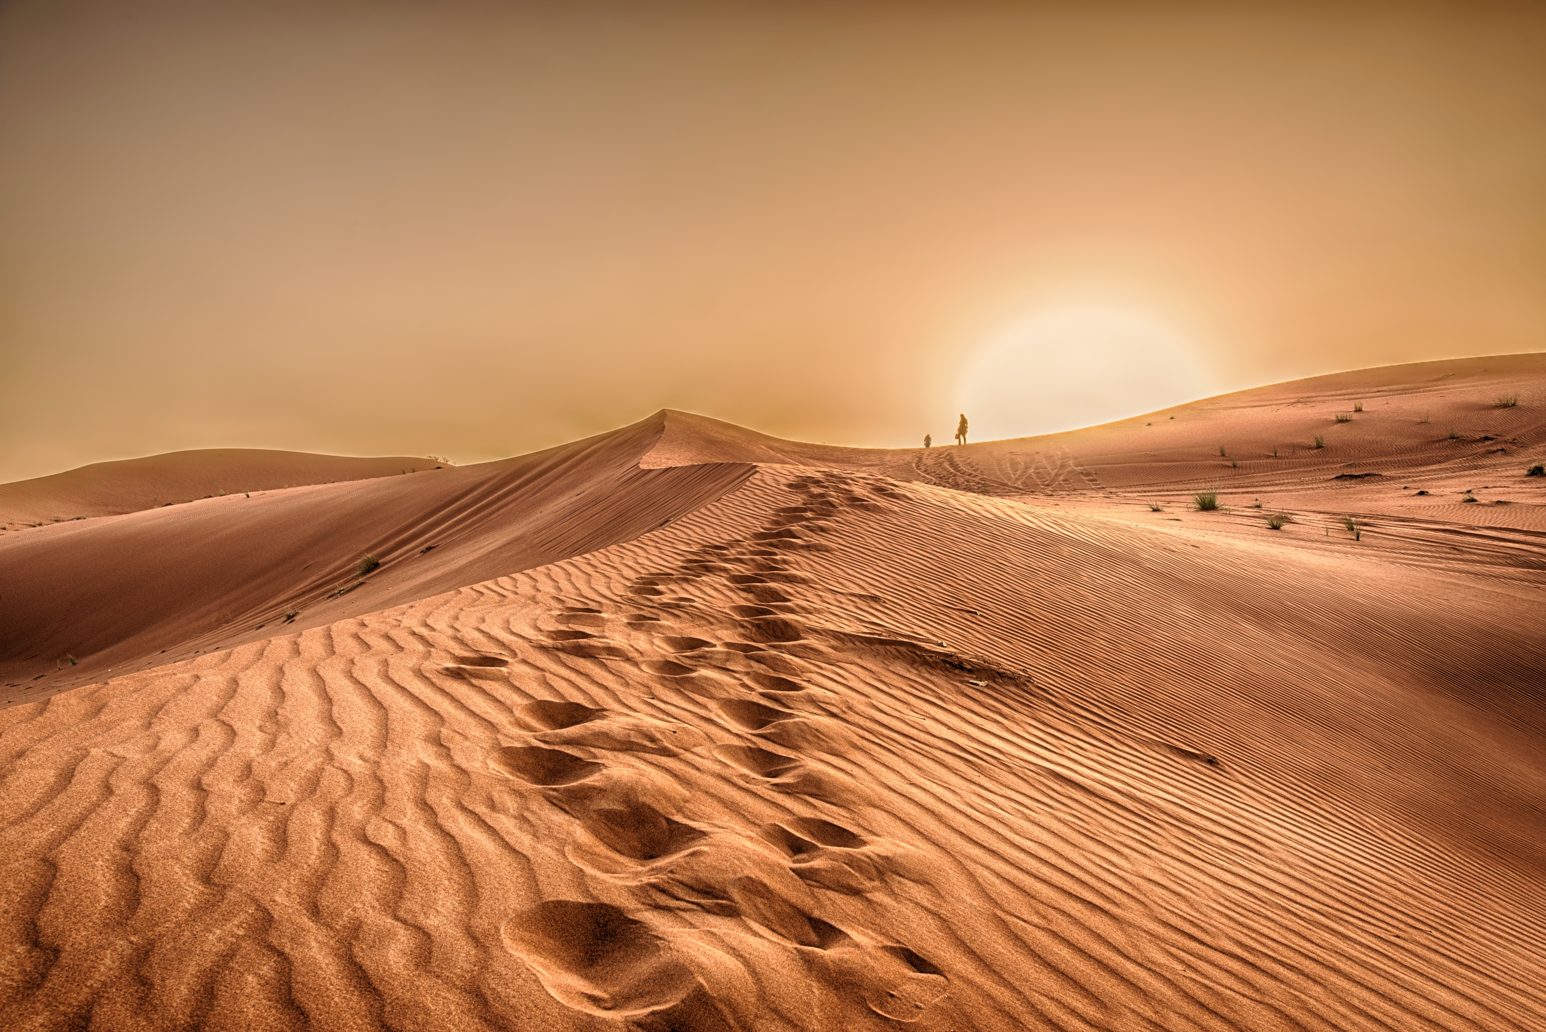
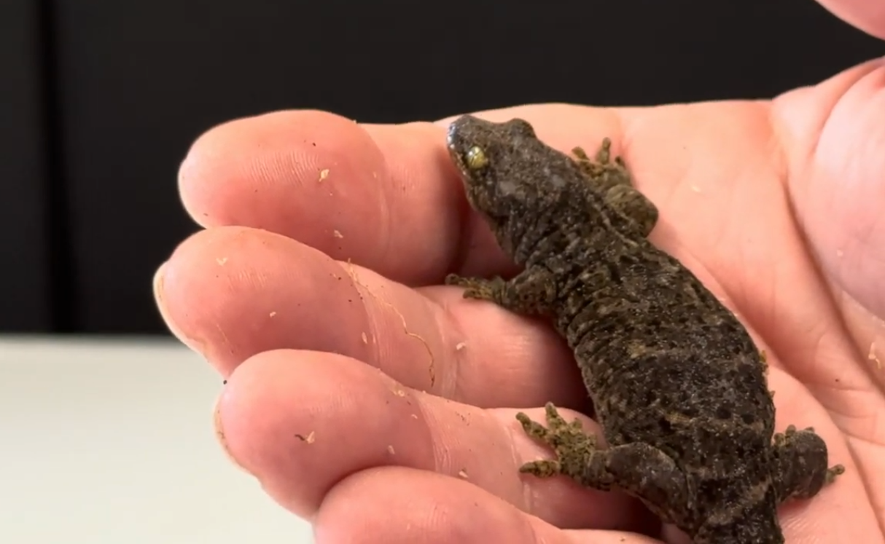
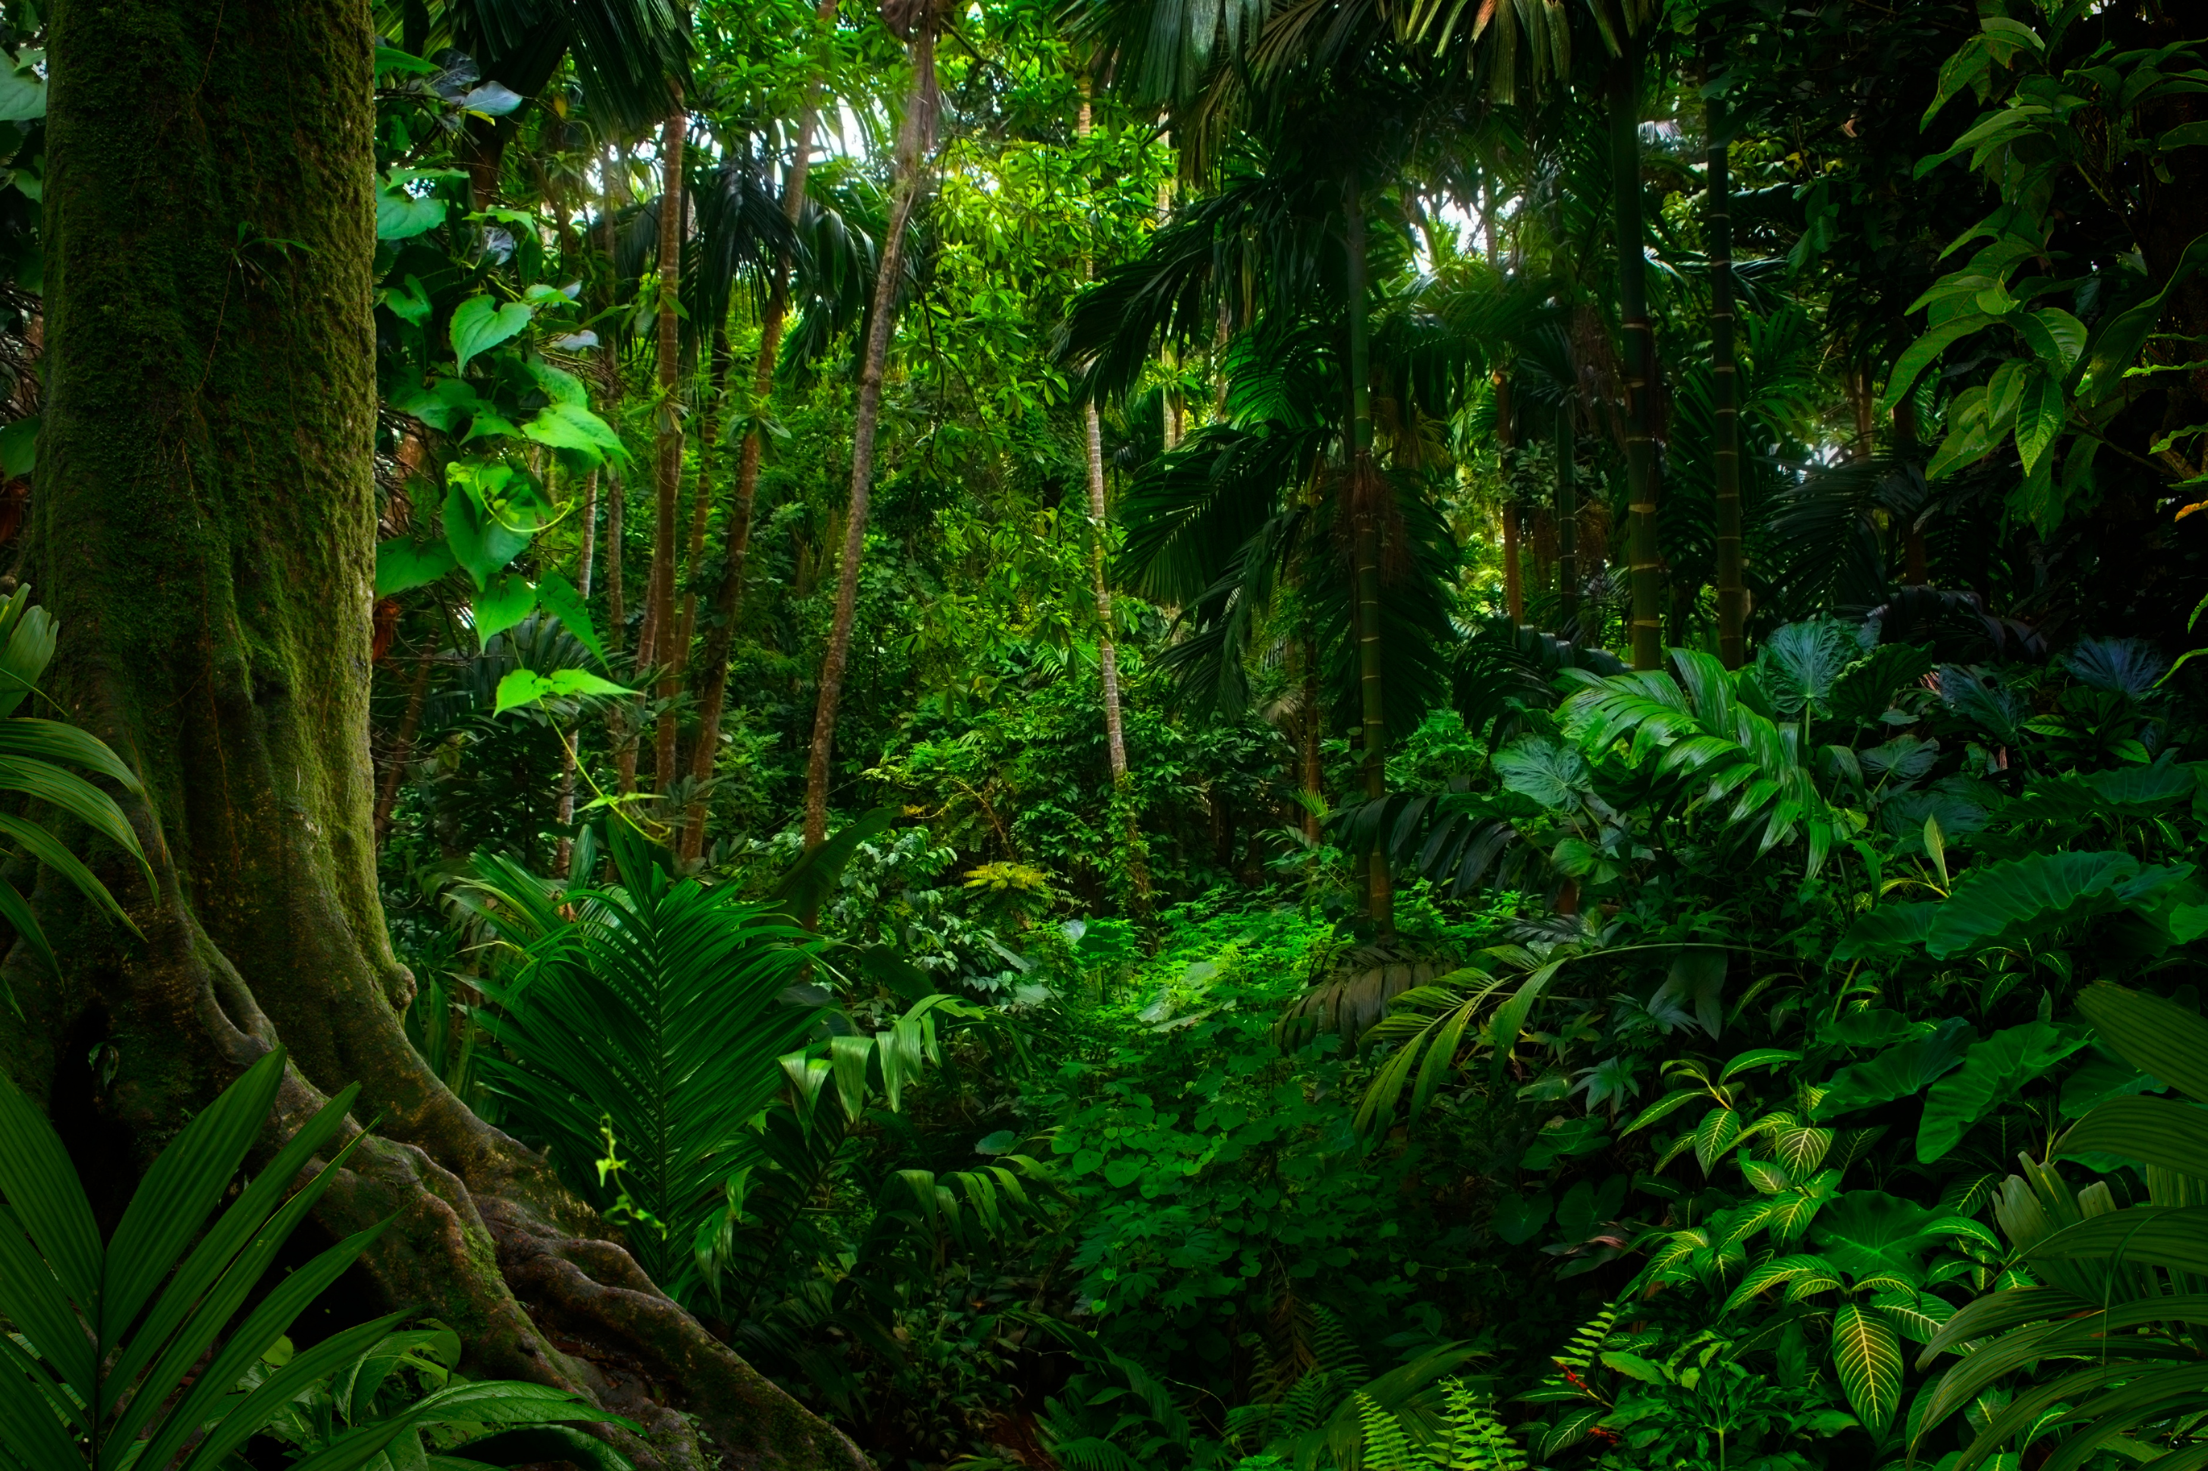
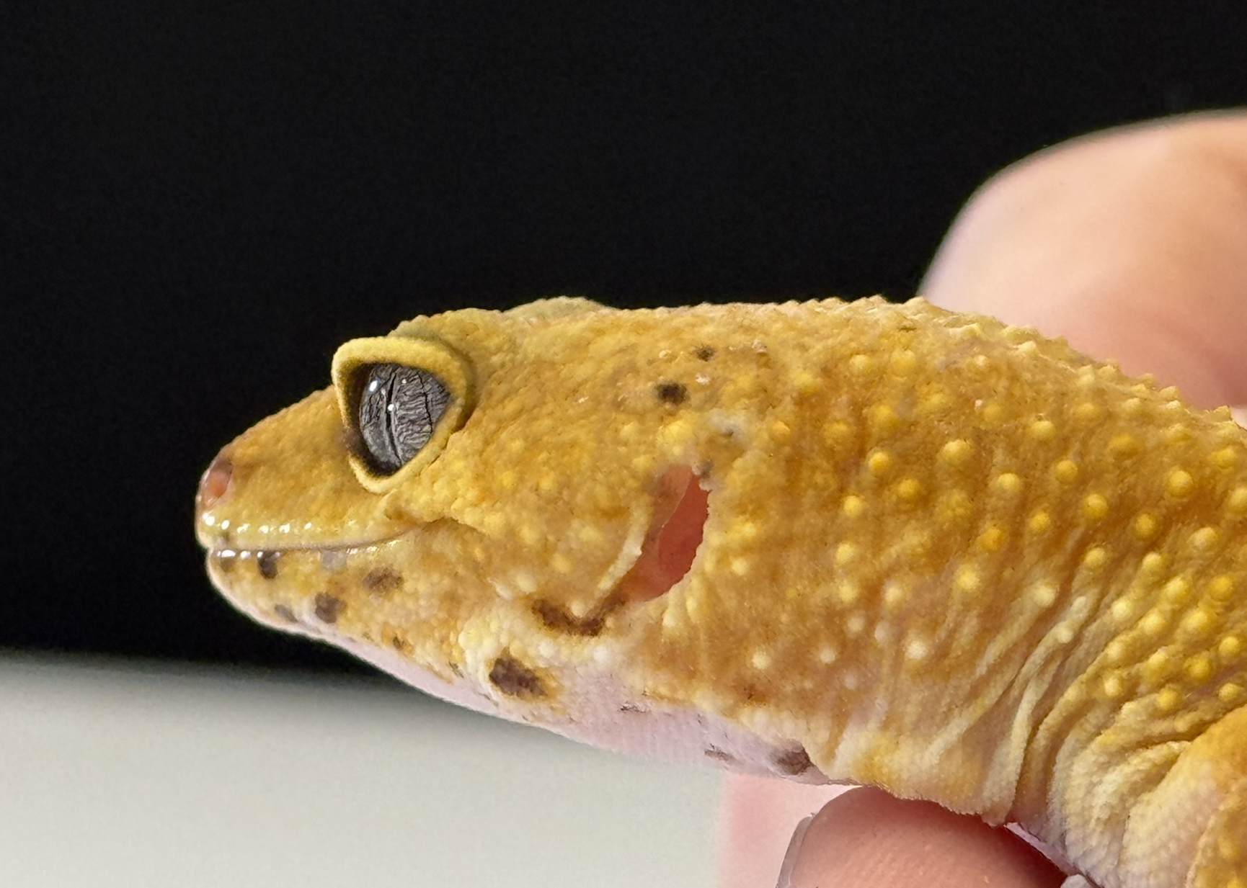
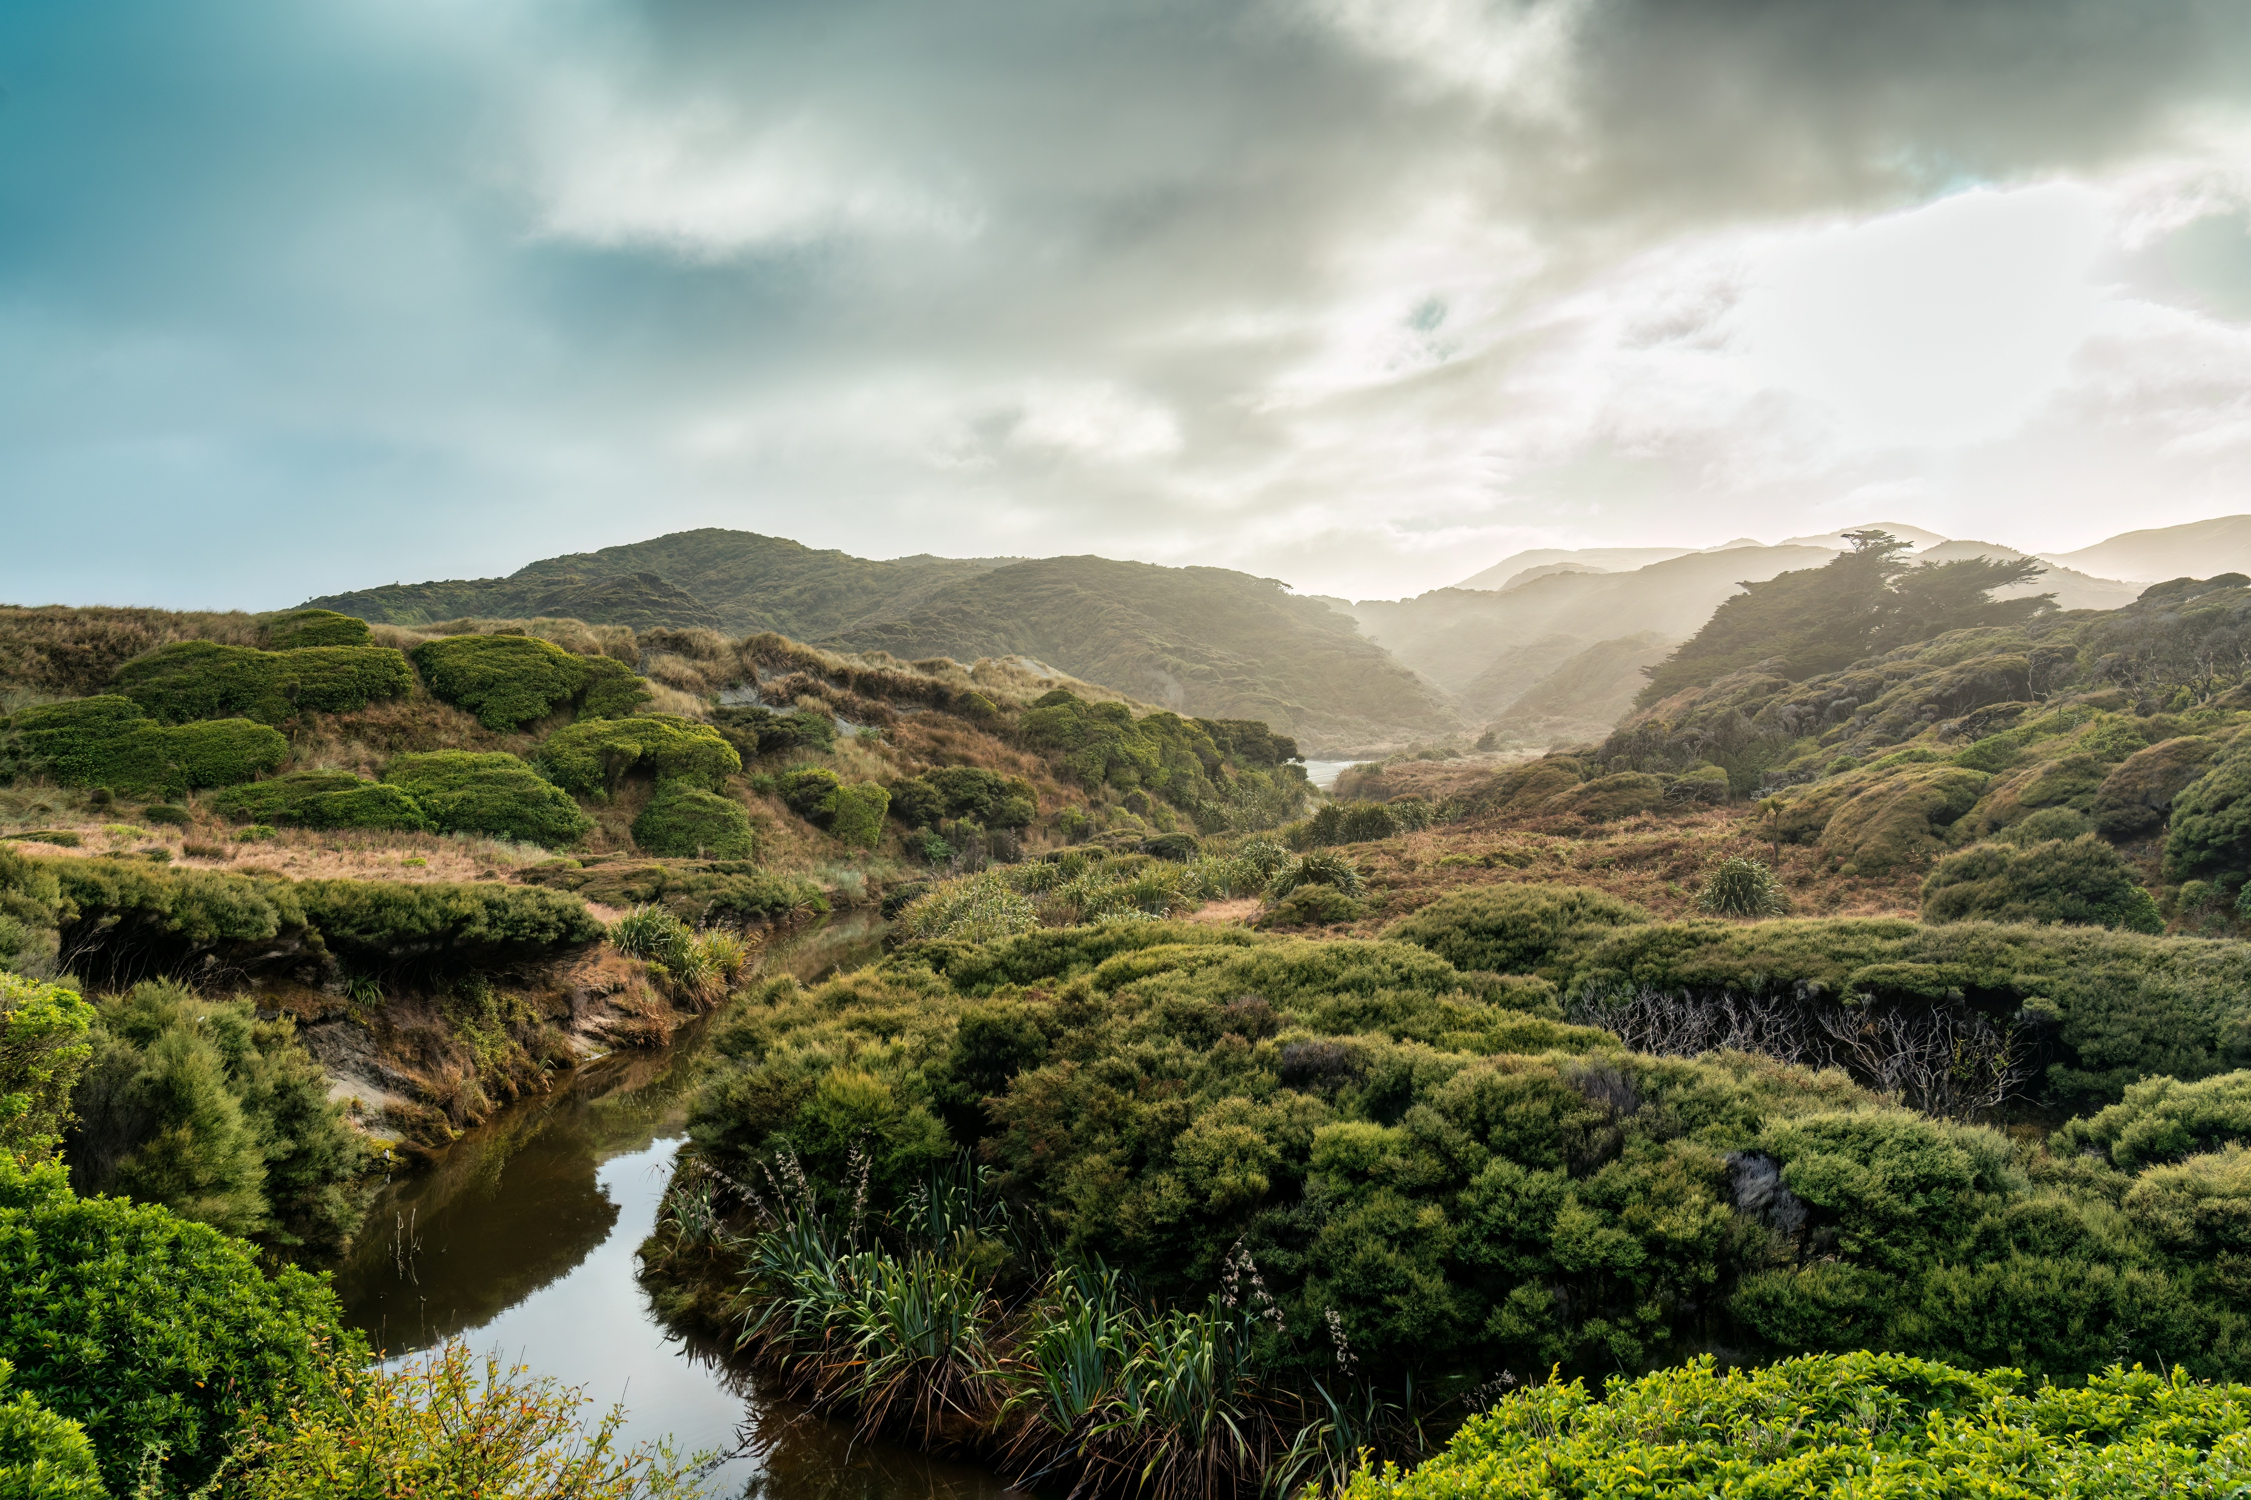
Science Week 2025
Remarkable Reptiles: Their Changes Over Time
EYFS – Teacher Pack and Answers
Session 2
Activity 1: Tick the reptiles. ✓
angelfish
penguins
chameleon
crocodile
✓
✓
snake
dragonfly
brown bear
tortoise
✓
✓
Activity 2: Draw a line to match the gecko with where it lives. ✓
Madagascar day gecko
desert
New Zealand gecko
tropical rainforest
leopard gecko
forest
1
Developing Experts Copyright 2025 All Rights Reserved

Slide 2
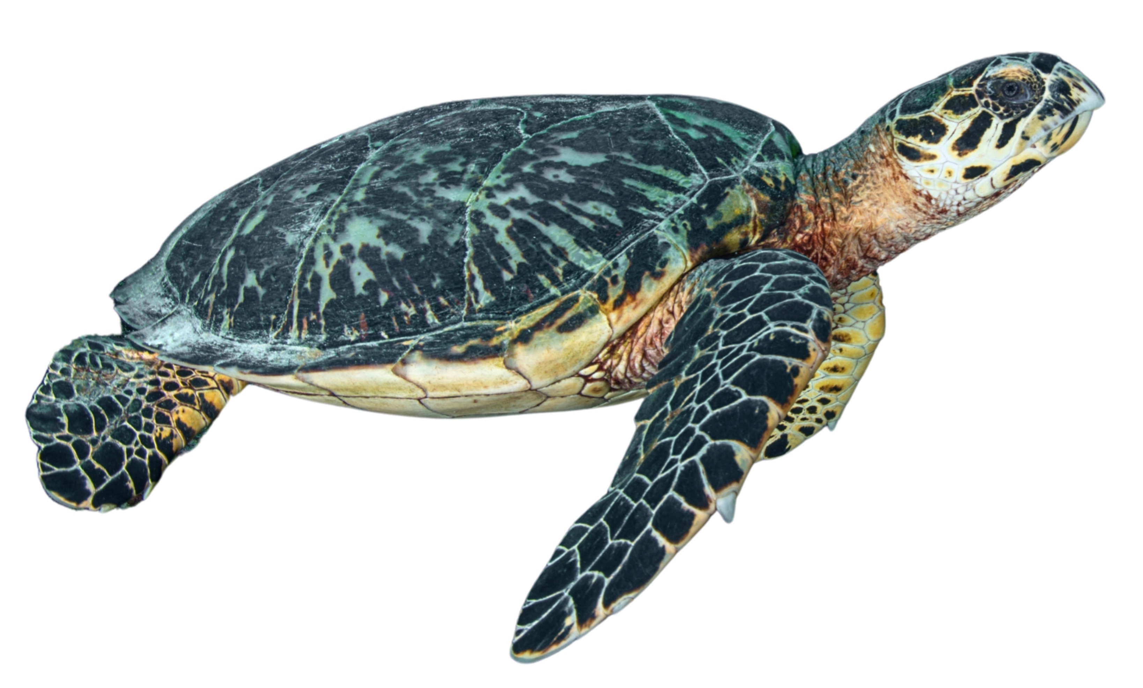
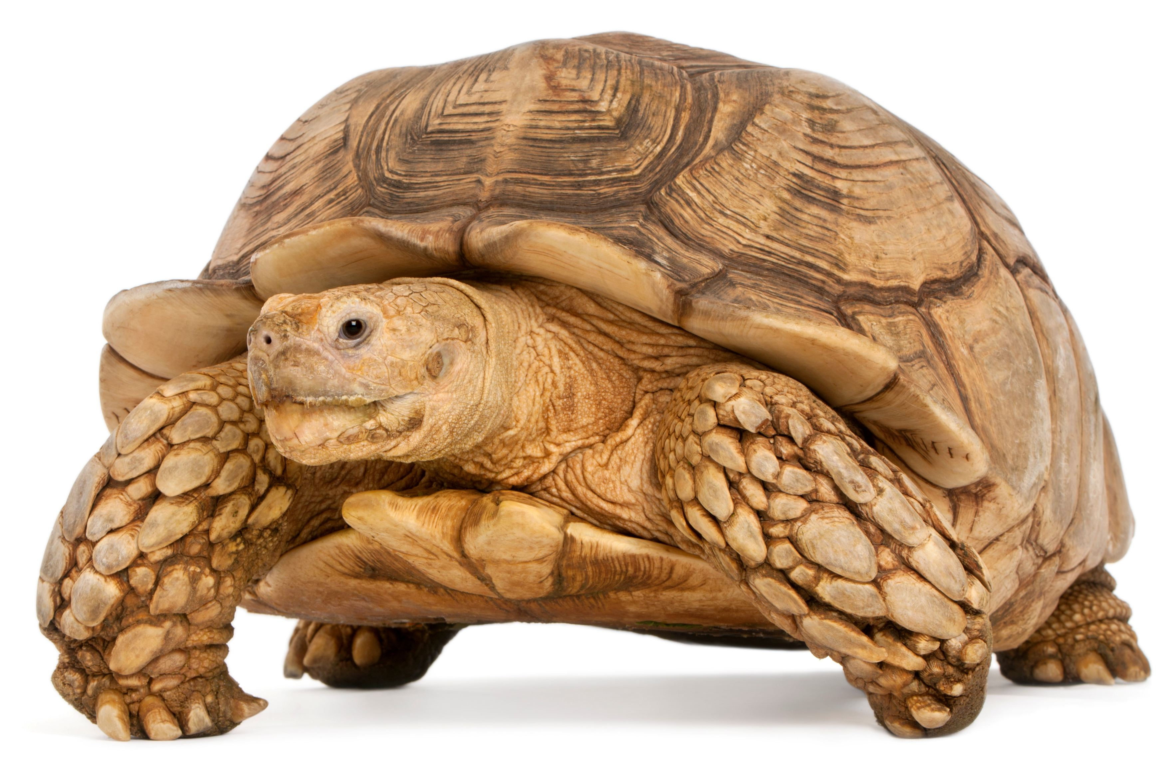
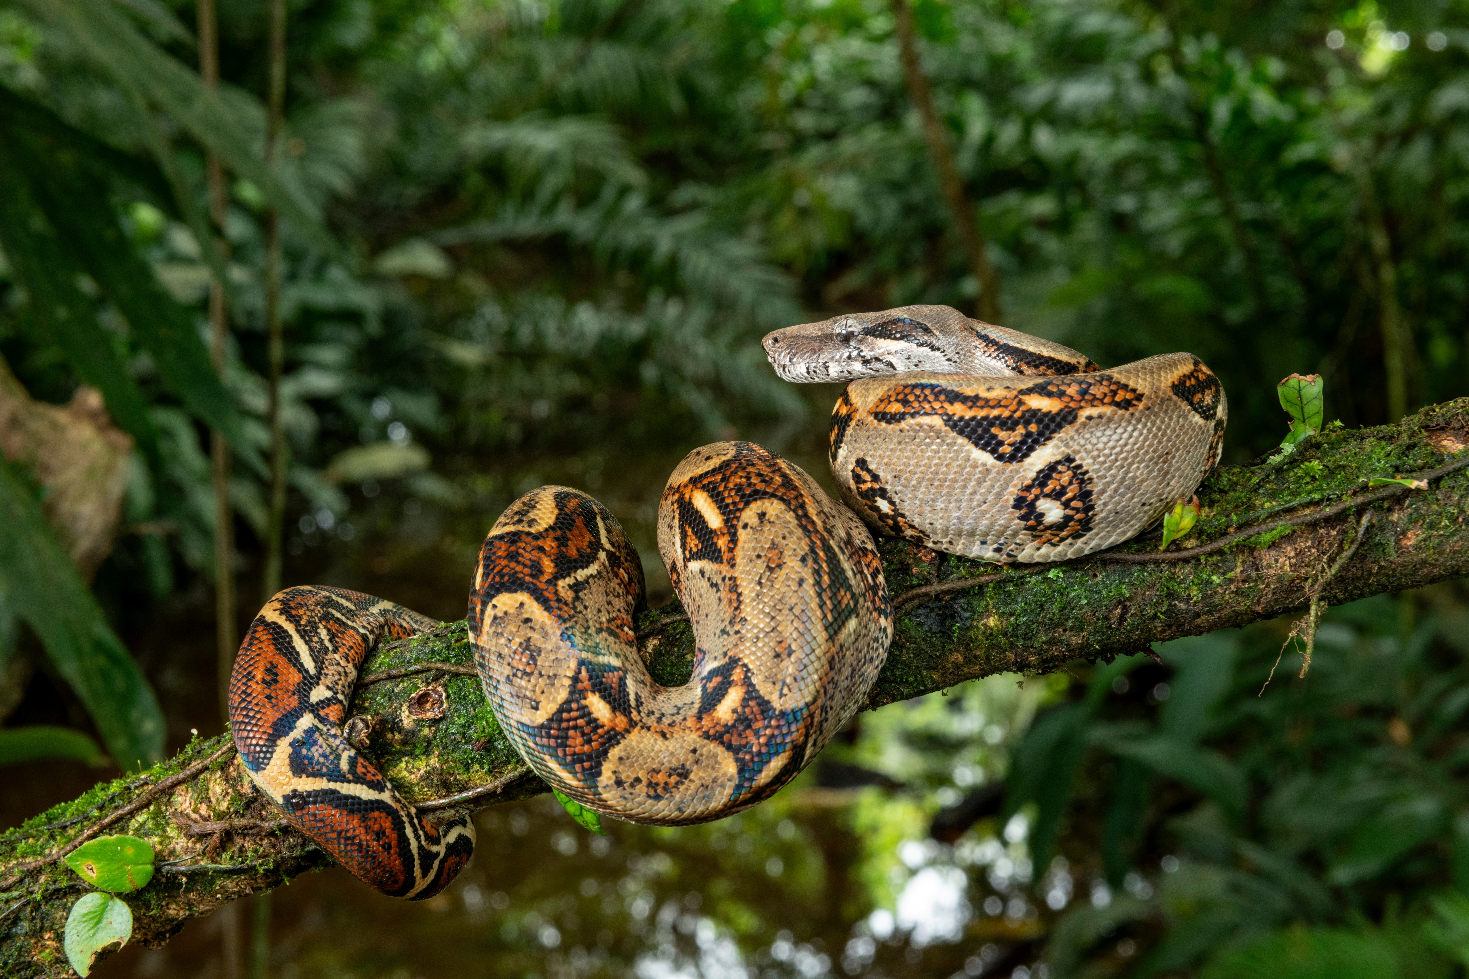
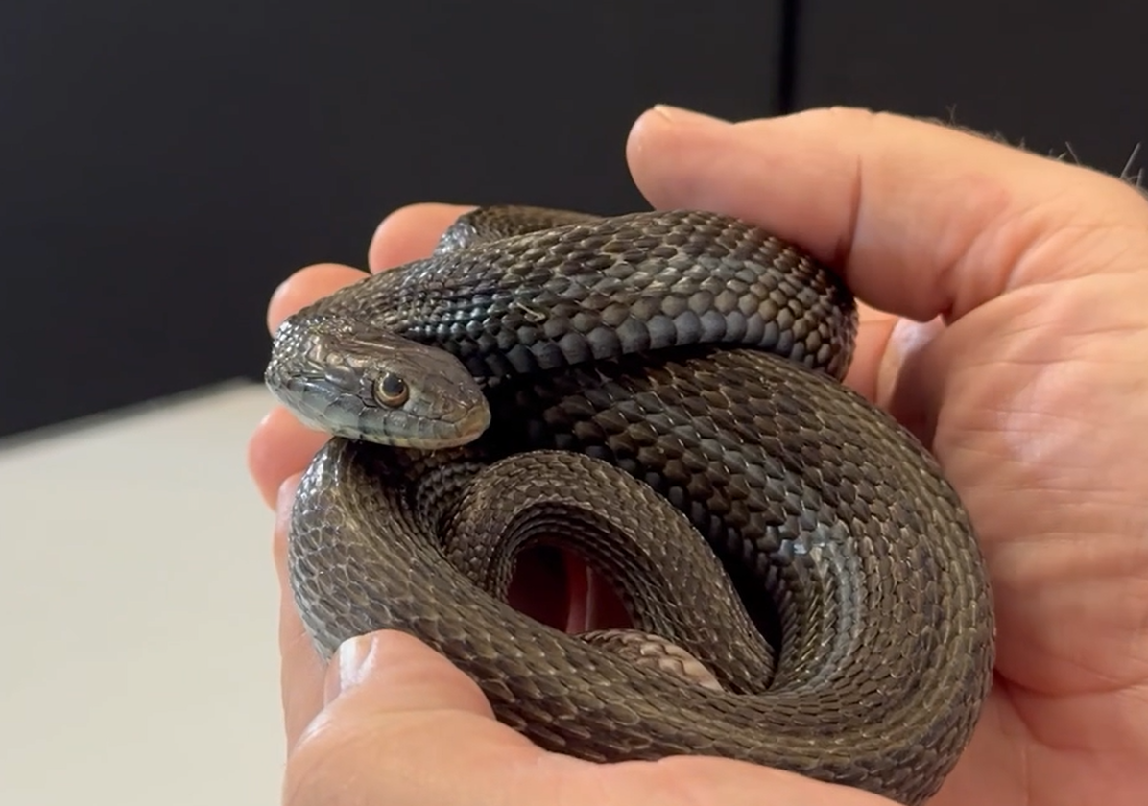
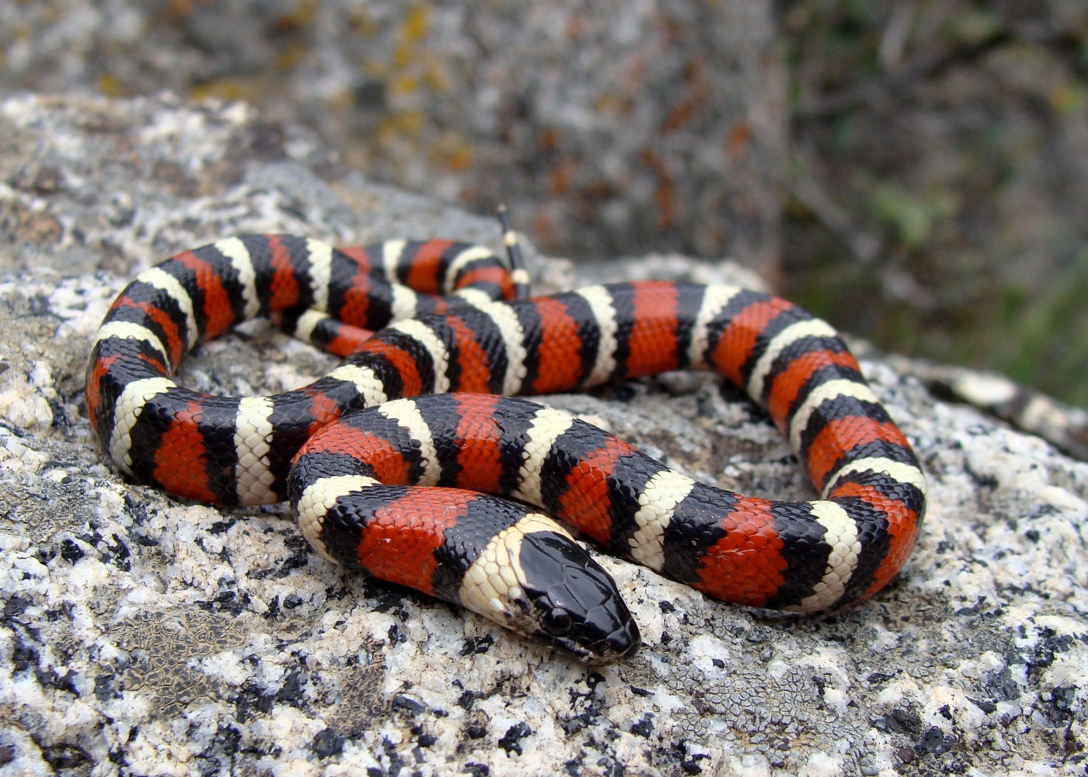
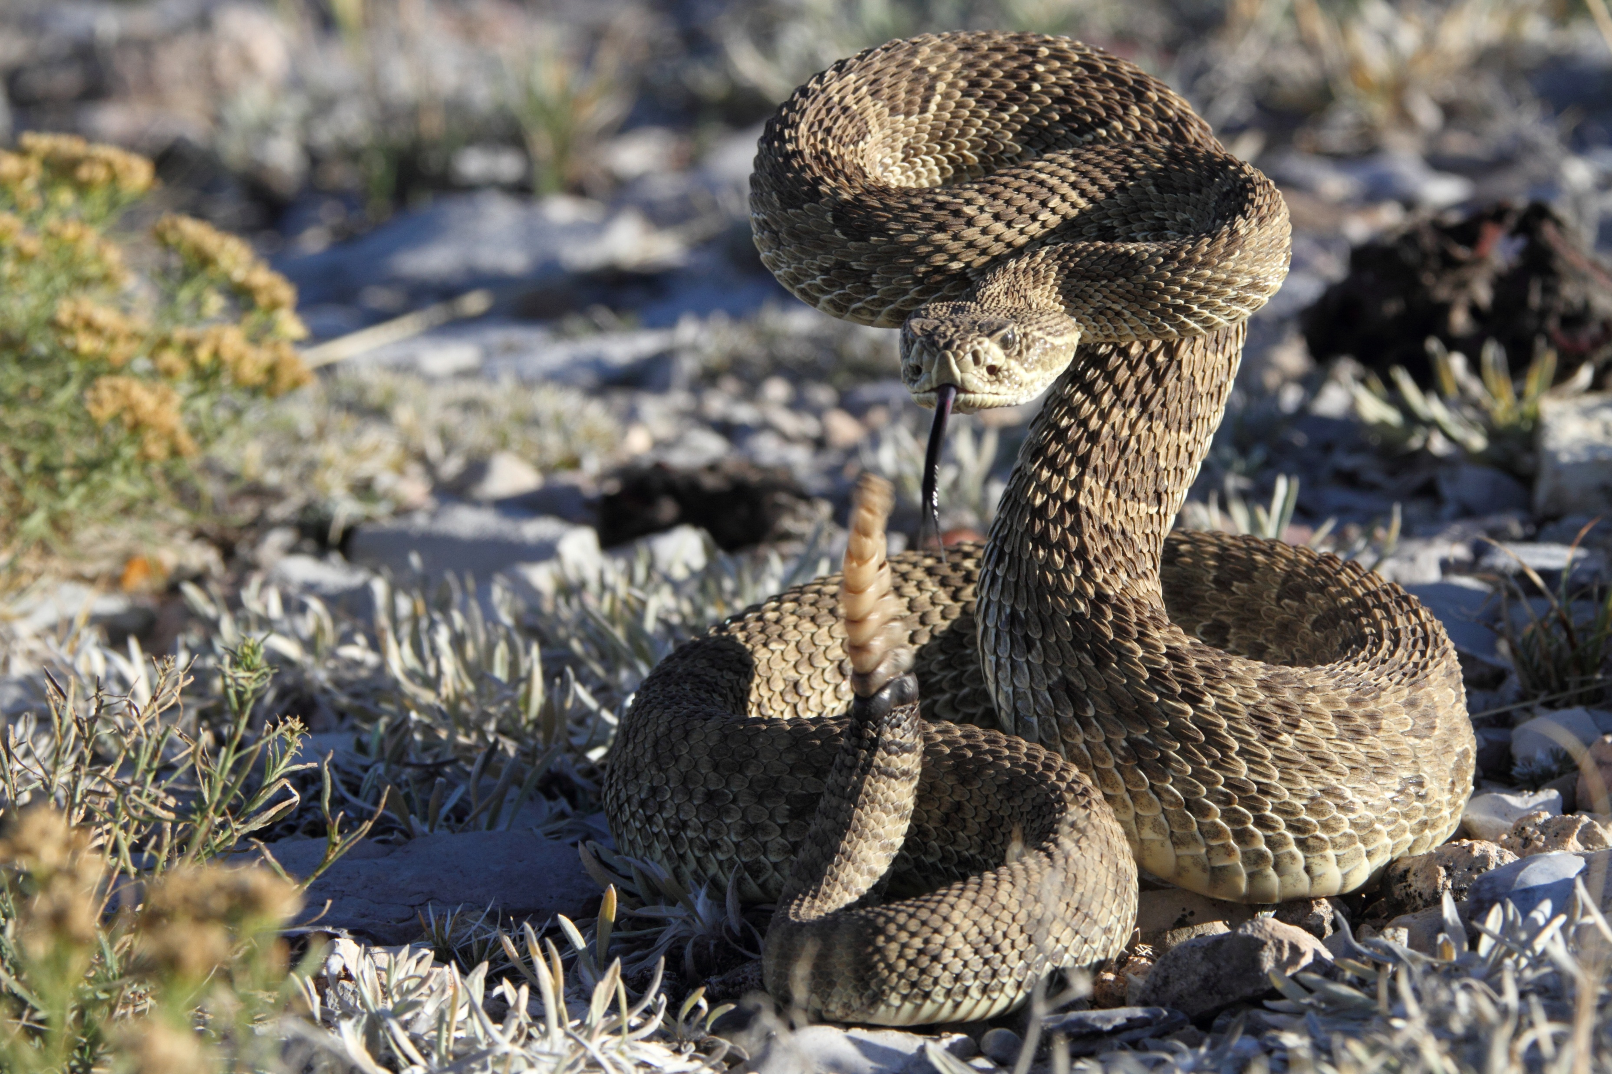
Science Week 2025
Remarkable Reptiles: Their Changes Over Time
EYFS – Teacher Pack and Answers
Session 2
Activity 3: What is the same? What is different?
turtle
tortoise
Activity 4: Discuss the facts you remember about these snakes. ✓
boa constrictor
garter snake
king snake
rattlesnake
Where does the snake live?
What does the snake like to eat?
What colours and shapes can you spot on the snakes?
2
Developing Experts Copyright 2025 All Rights Reserved

Slide 3

Science Week 2025
Remarkable Reptiles: Their Changes Over Time
EYFS – Teacher Pack and Answers
Session 2
Activity 3 - word cards. Cut out the cards to assist children when comparing a turtle and tortoise.
shell
scales
eggs
legs
cold-blooded
head
flippers
claws
ocean
land
3
Developing Experts Copyright 2025 All Rights Reserved

Slide 4
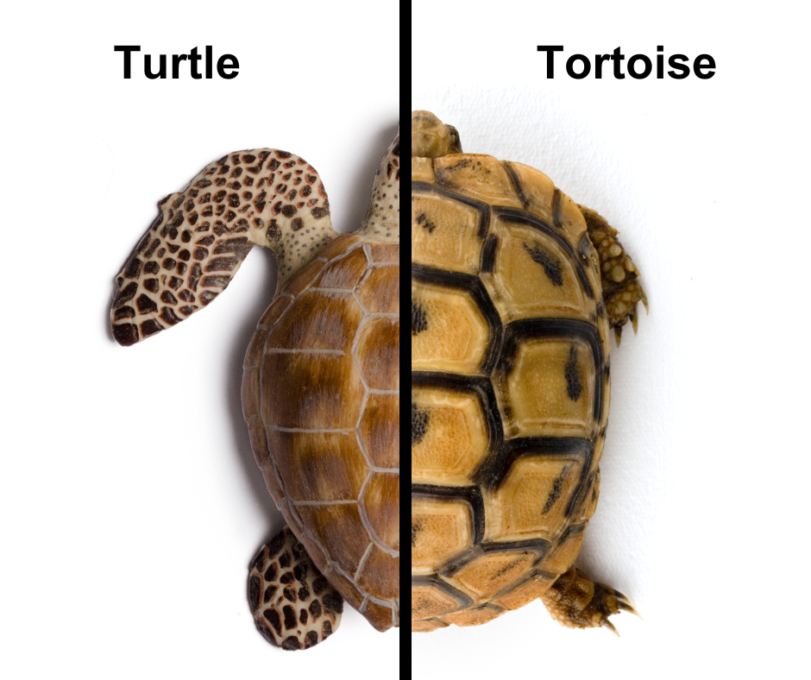
Science Week 2025
Remarkable Reptiles: Their Changes Over Time
KS1 – Teacher Pack and Answers
Session 2
Activity 3: Use the word bank to label the tortoise and turtle. Can you discuss their similarities and differences?
head
leg
flipper
foot
dome-shaped shell
flat shell
claw
tail
Tortoises live on land; turtles live in water and have flippers or webbed feet for swimming. Tortoises have domed, bumpy shells for protection. Turtles have smooth, streamlined shells.
2
Developing Experts Copyright 2025 All Rights Reserved

Slide 5
Science Week 2025
Remarkable Reptiles: Their Changes Over Time
KS1 – Teacher Pack and Answers
Session 2
Activity 4: Discuss the facts you remember about these snakes. ✓
Where does each snakes live? What is its habitat?
What does each snake eat?
king snake
Forests, grasslands and deserts (North America)
Rodents, other snakes, eggs, small reptiles
boa constrictor
Rainforests (South America)
Small mammals and other reptiles
garter snake
Forests, grasslands, marshes (North America)
Fish, frogs and newts
rattlesnake
Deserts (North America)
Warm-blooded animals – birds, mice etc.
3
Developing Experts Copyright 2025 All Rights Reserved

