Slide 1
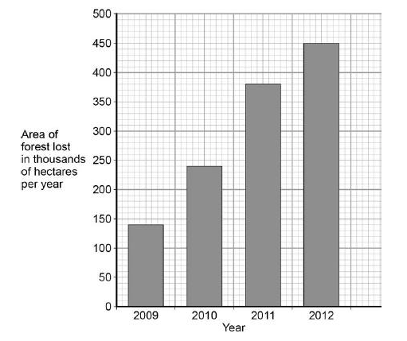
Mission Assignment: Explore biodiversity
Code: KS4_07_14
Interpret graphs and answer questions related to deforestation
Task 1: This graph shows the area of forest lost in Madagascar from 2009 to 2012.
(A) The area of forest lost each year in Madagascar increased between the years 2009 and 2012. Determine the total area of forest lost from the start of 2009 to the end of 2012.
_____________________________________________________________________________________________________________________________________________________________________________________________________________________________________________
(B) What are the possible reasons for the change in the area of forest lost per year between 2009 and 2012? Tick two boxes.
The local people stop growing rice
Fewer new houses are needed for the population
The local people decided to farm cattle
More trees have been planted
A company starts growing plants for fuel
Developing Experts Copyright 2022 All Rights Reserved

Slide 2
Mission Assignment: Explore biodiversity
Code: KS4_07_14
(C) More forest was lost in 2012 than in 2009. Use words from the box to complete the sentences.
The increase in the area of forest lost has caused an increase in the gas ___________________
The increase of this gas has been caused because less of the gas is being absorbed by plants for the process of ___________________ .
(D) Deforestation can have negative effects on our ecosystems. What are the negative effects of deforestation? Tick two boxes.
Animals and birds migrate because there is less food
More habitats are destroyed
There is less acid rain
There is more biodiversity
The global temperature decreases
(E) Scientists try to reduce the negative effects of human activity on our ecosystems. One way is to protect rare habitats. Give one other way of reducing the negative effects of human activity on our ecosystems.
____________________________________________________________________________________________________________________________________________________________________________________________________________________________________________________________________________________________________________________________
Task 2: Complete the following sentences:
(A) The increased population means that more ___________________ are being used and more ___________________ is being produced, which leads to
___________________.
(B) More land is also being used for ___________________, ___________________, ___________________ and ___________________.
(C) In addition, trees are being cut down so there is more room for ___________________ and crops for ___________________ and ___________________.
Developing Experts Copyright 2022 All Rights Reserved

