Slide 1


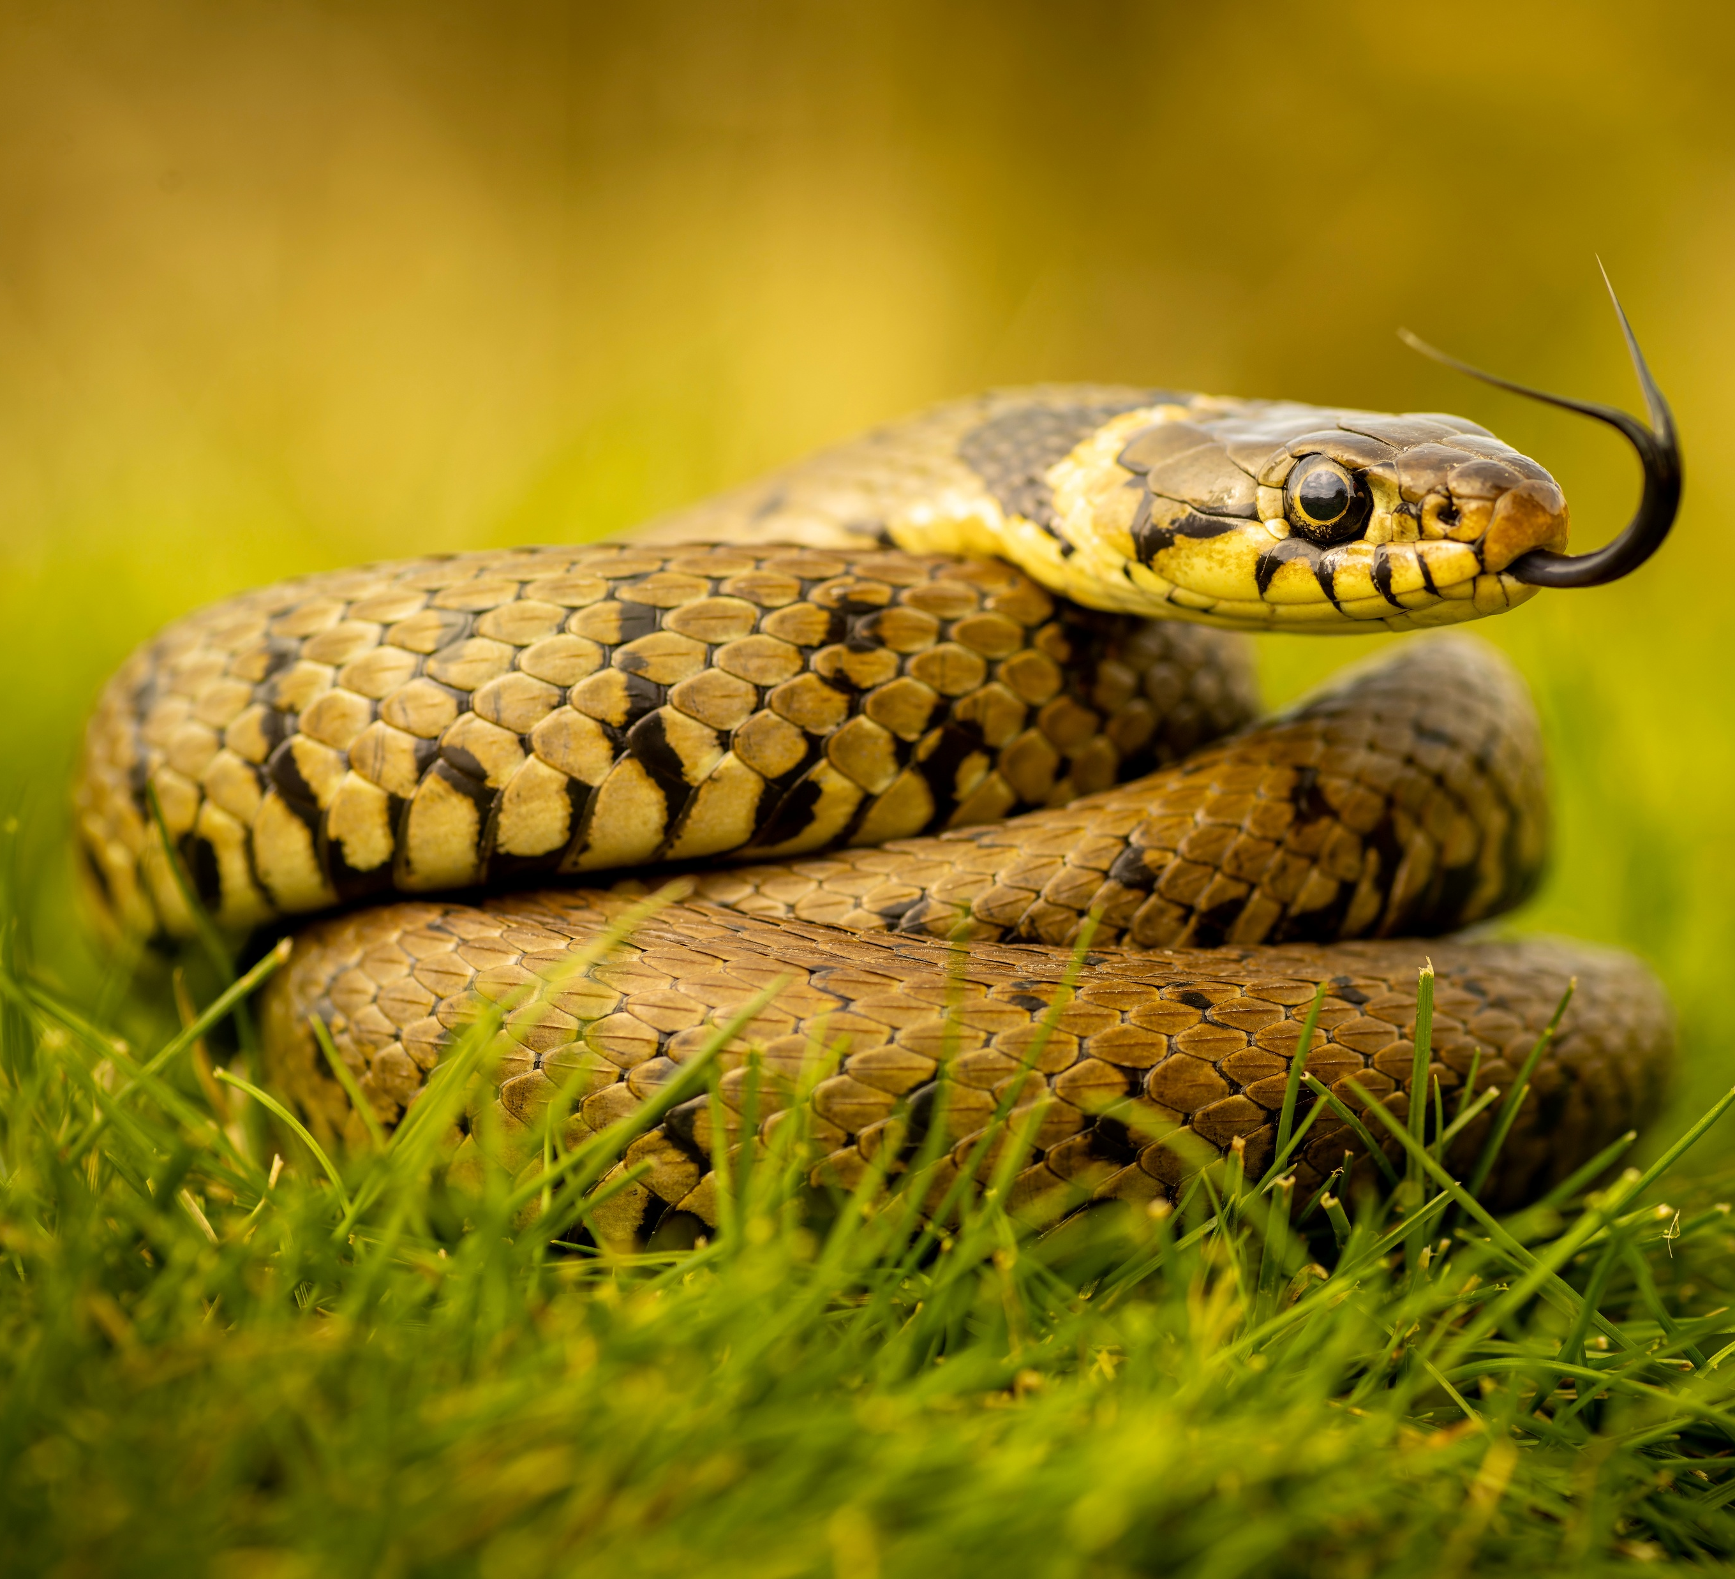
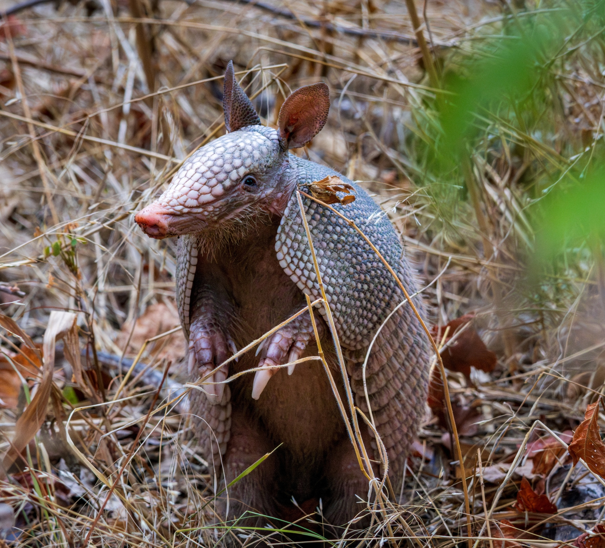
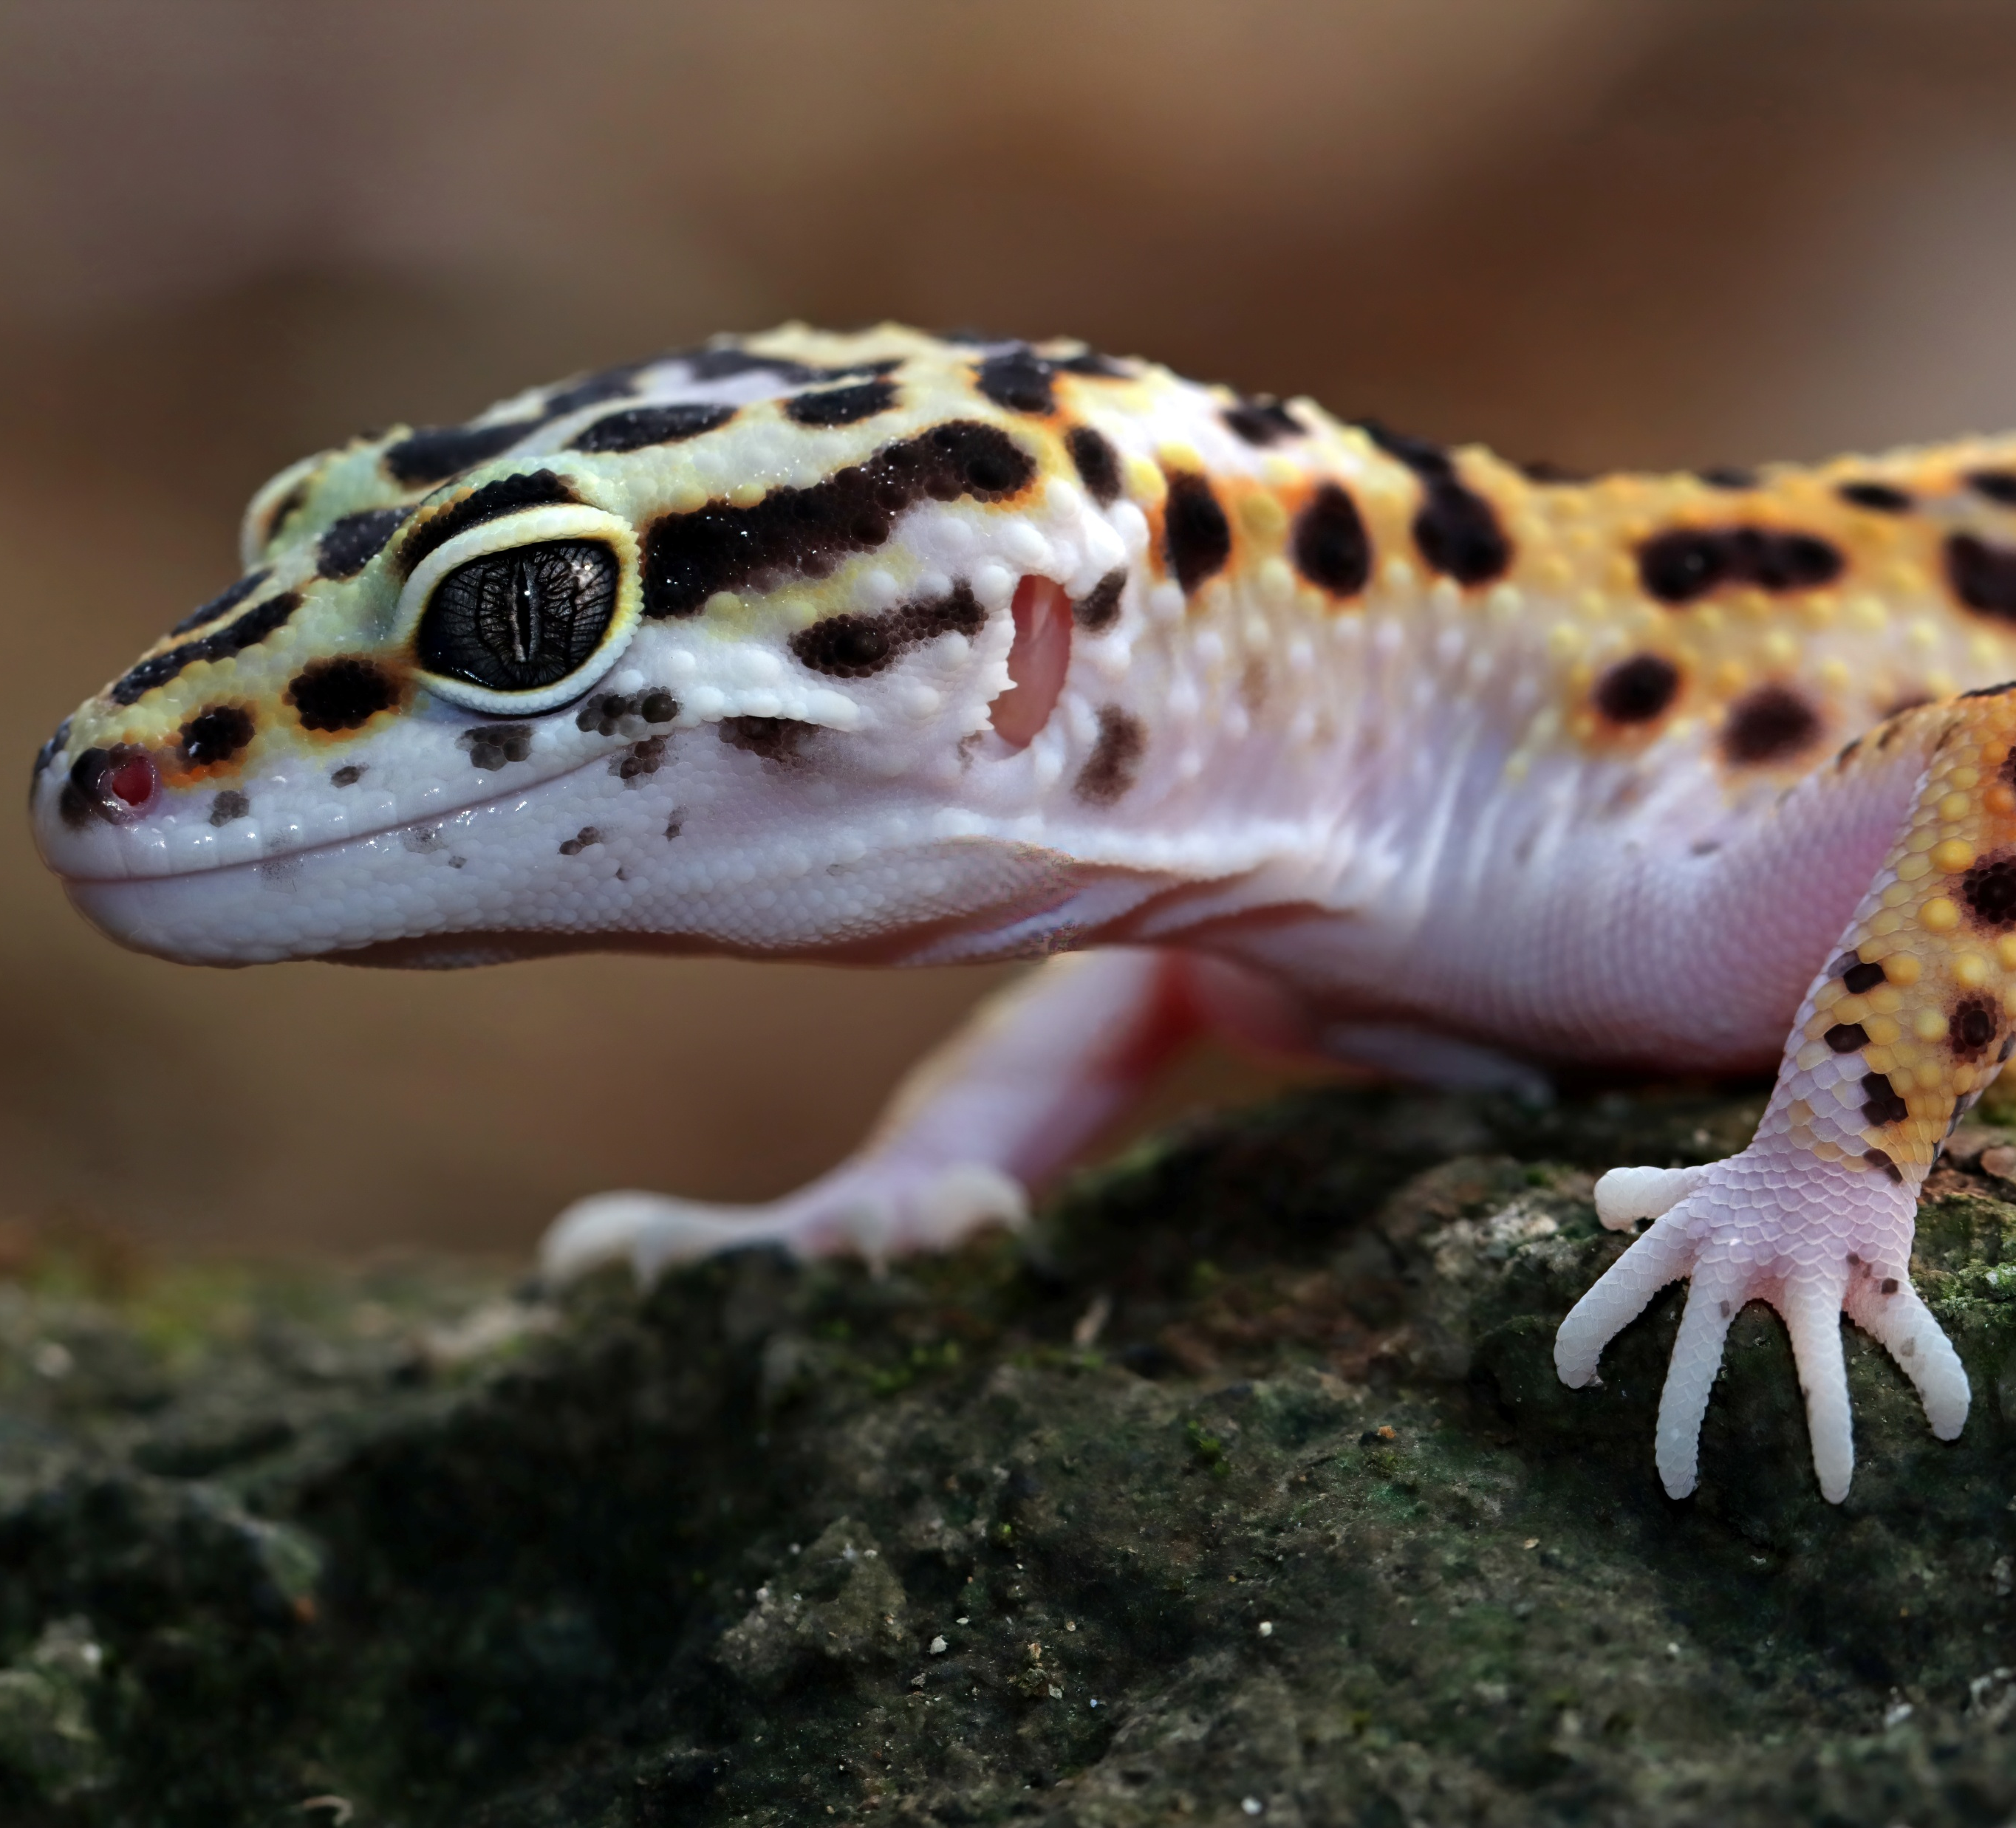
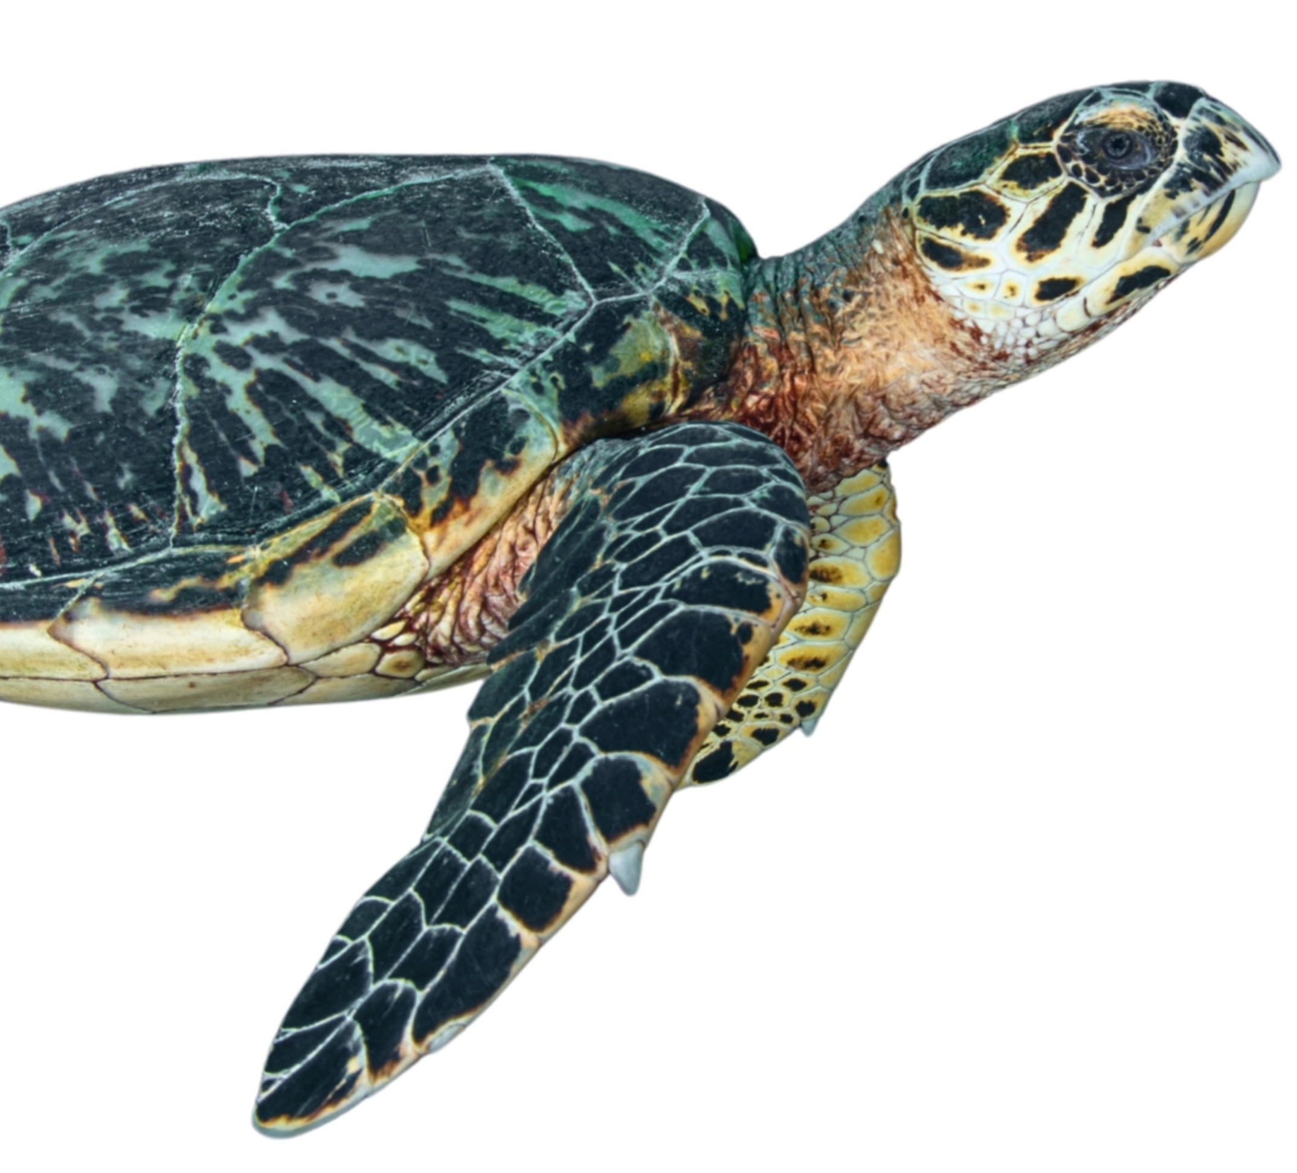
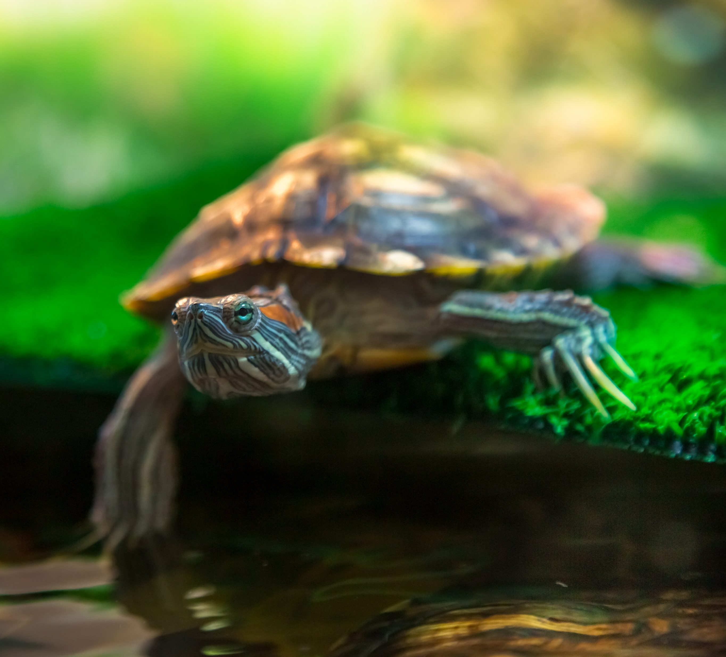
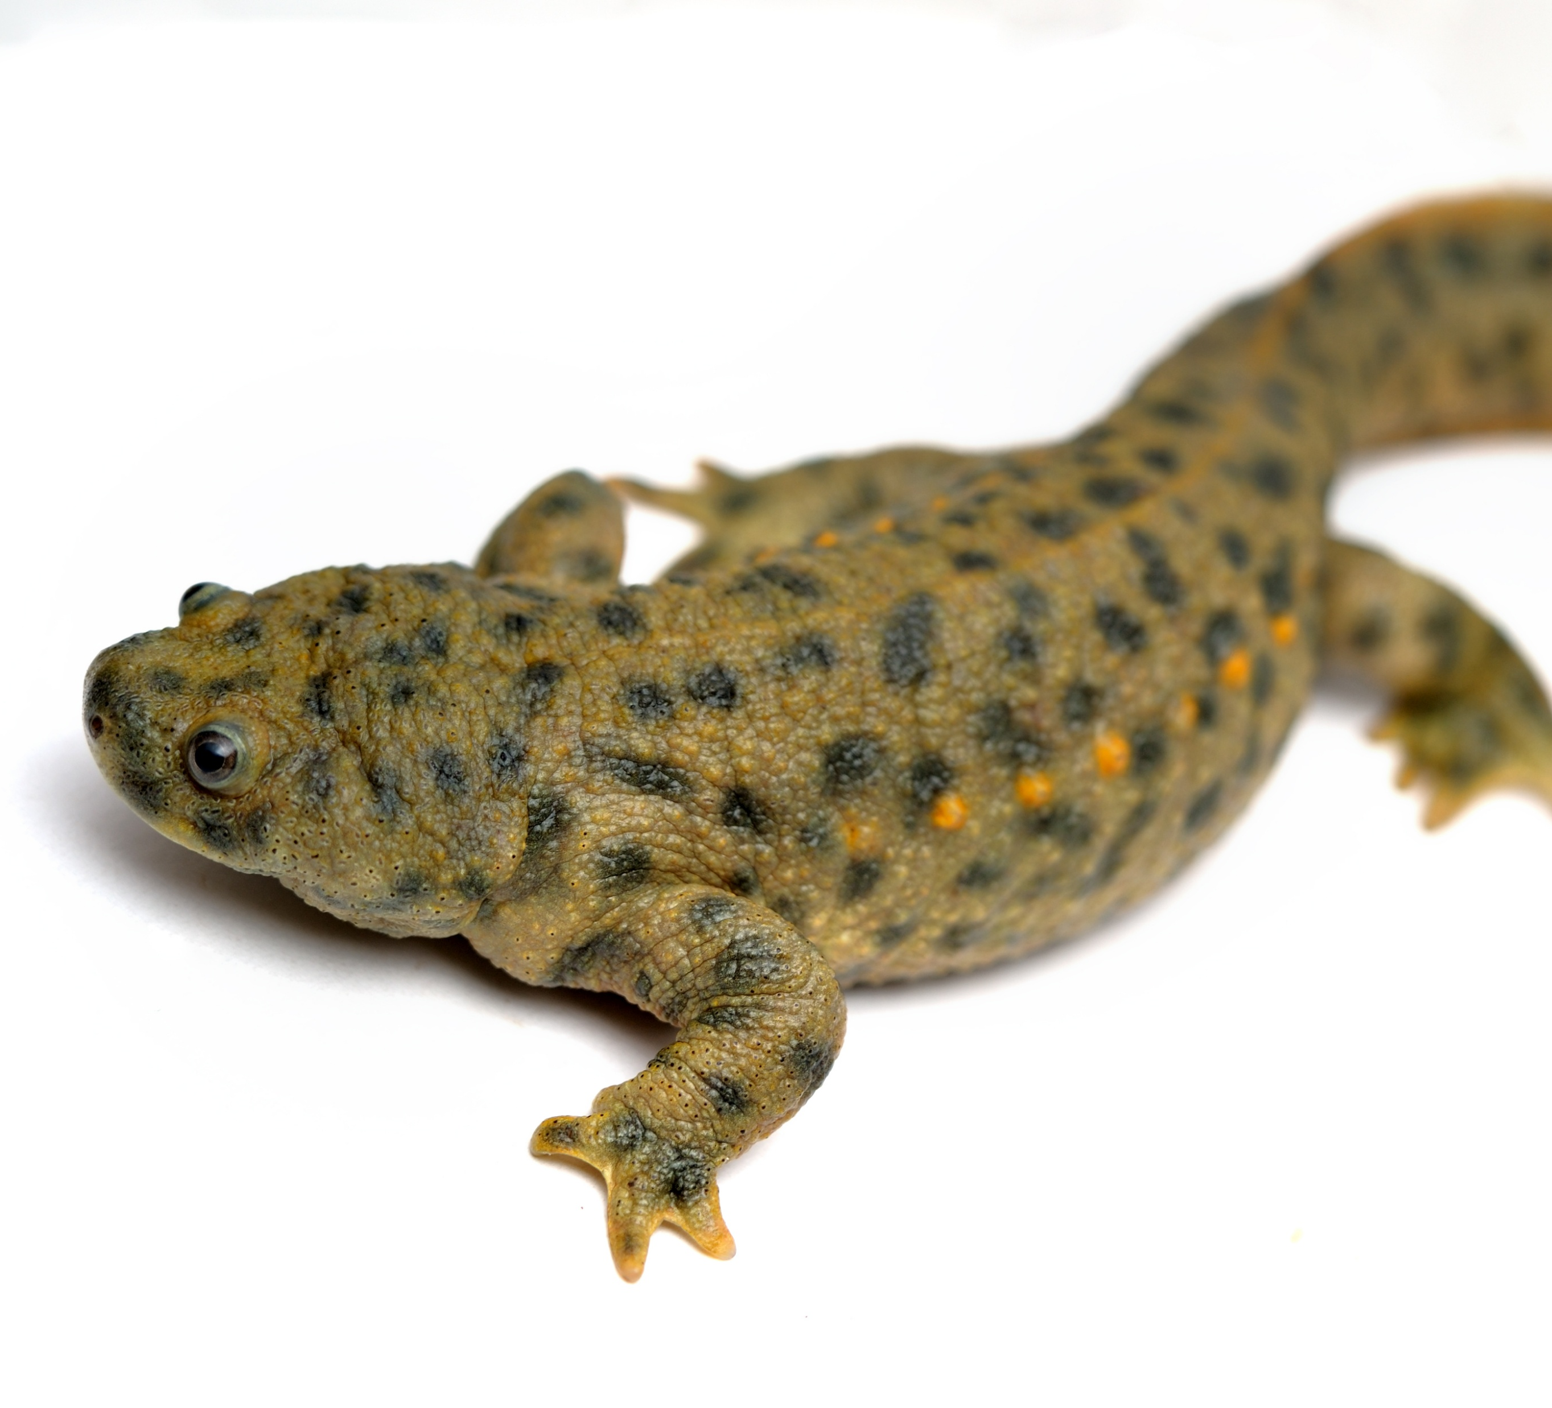
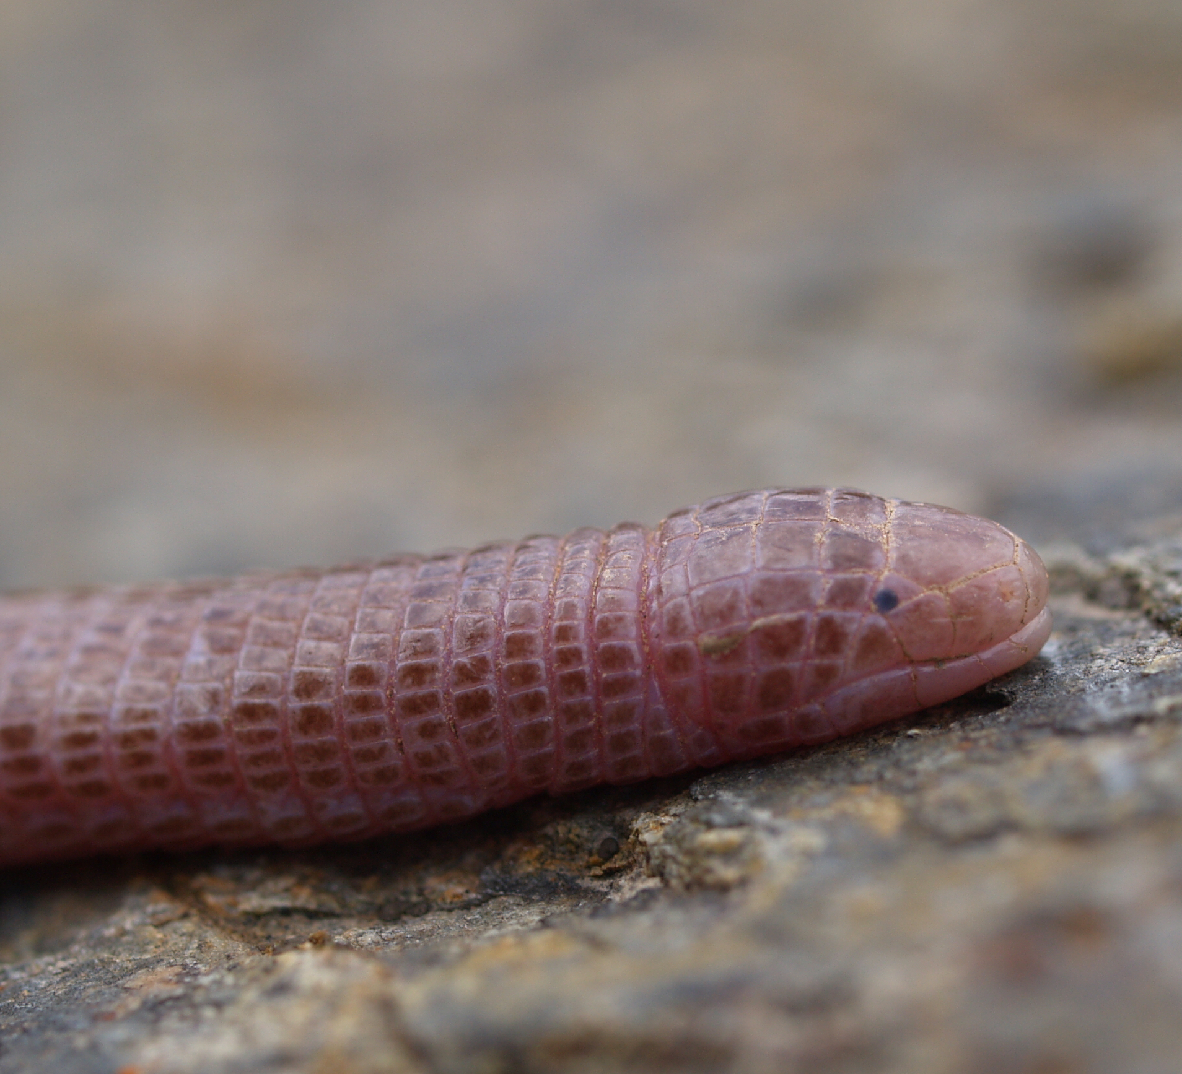
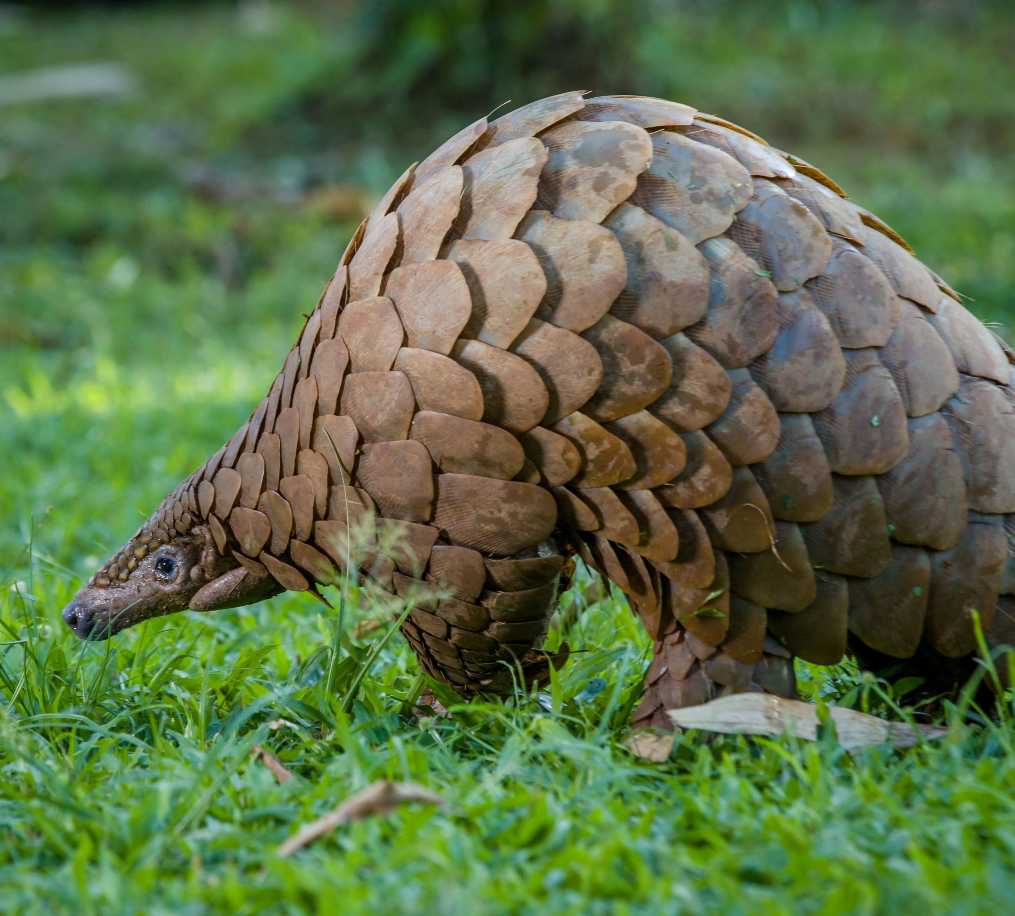
Science Week 2025
KS3 - From Scales to Tails: The Evolution and Adaptation of Reptiles
Session 2
Activity 1: Tick the reptiles.
✓
snake
armadillo
gecko
turtle
terrapin
newt
blanus
pangolin
Activity 2: Answer the questions below.
✓
1. In activity 1, you ticked the animals that are reptiles. Explain why the other animals aren’t reptiles. What type of animal are they? What are the features of a reptile? __________________________________________________________________________________________________________________________________________________________________________________________________________________________________________________________________________________________________________________________________________________________________________________________________________________________
2. Do all reptiles lay eggs? Why / why not? __________________________________________________________________________________________________________________________________________________________________________________________________________________________________________________________________________________________________________________________________________________________________________________________________________________________
1
Developing Experts Copyright 2025 All Rights Reserved

Slide 2
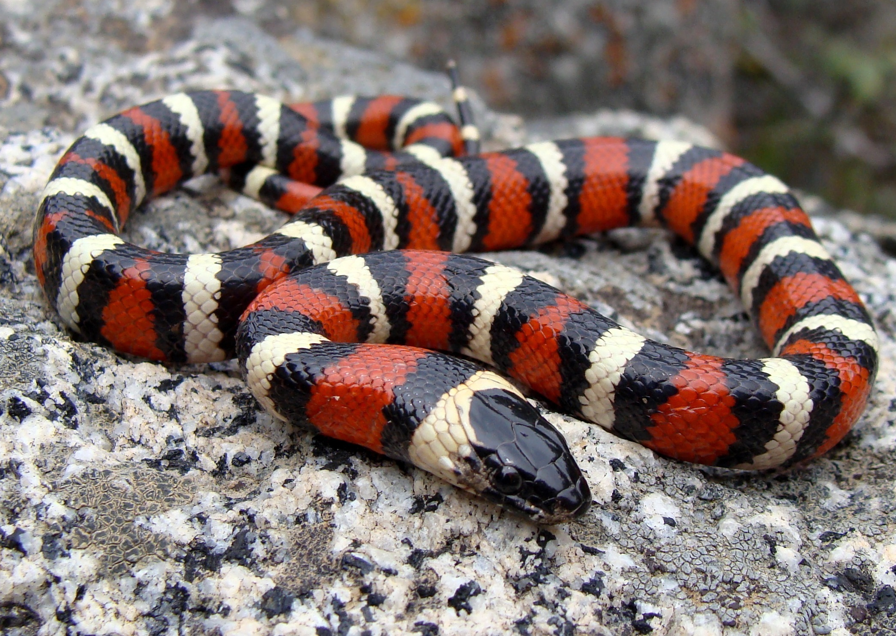
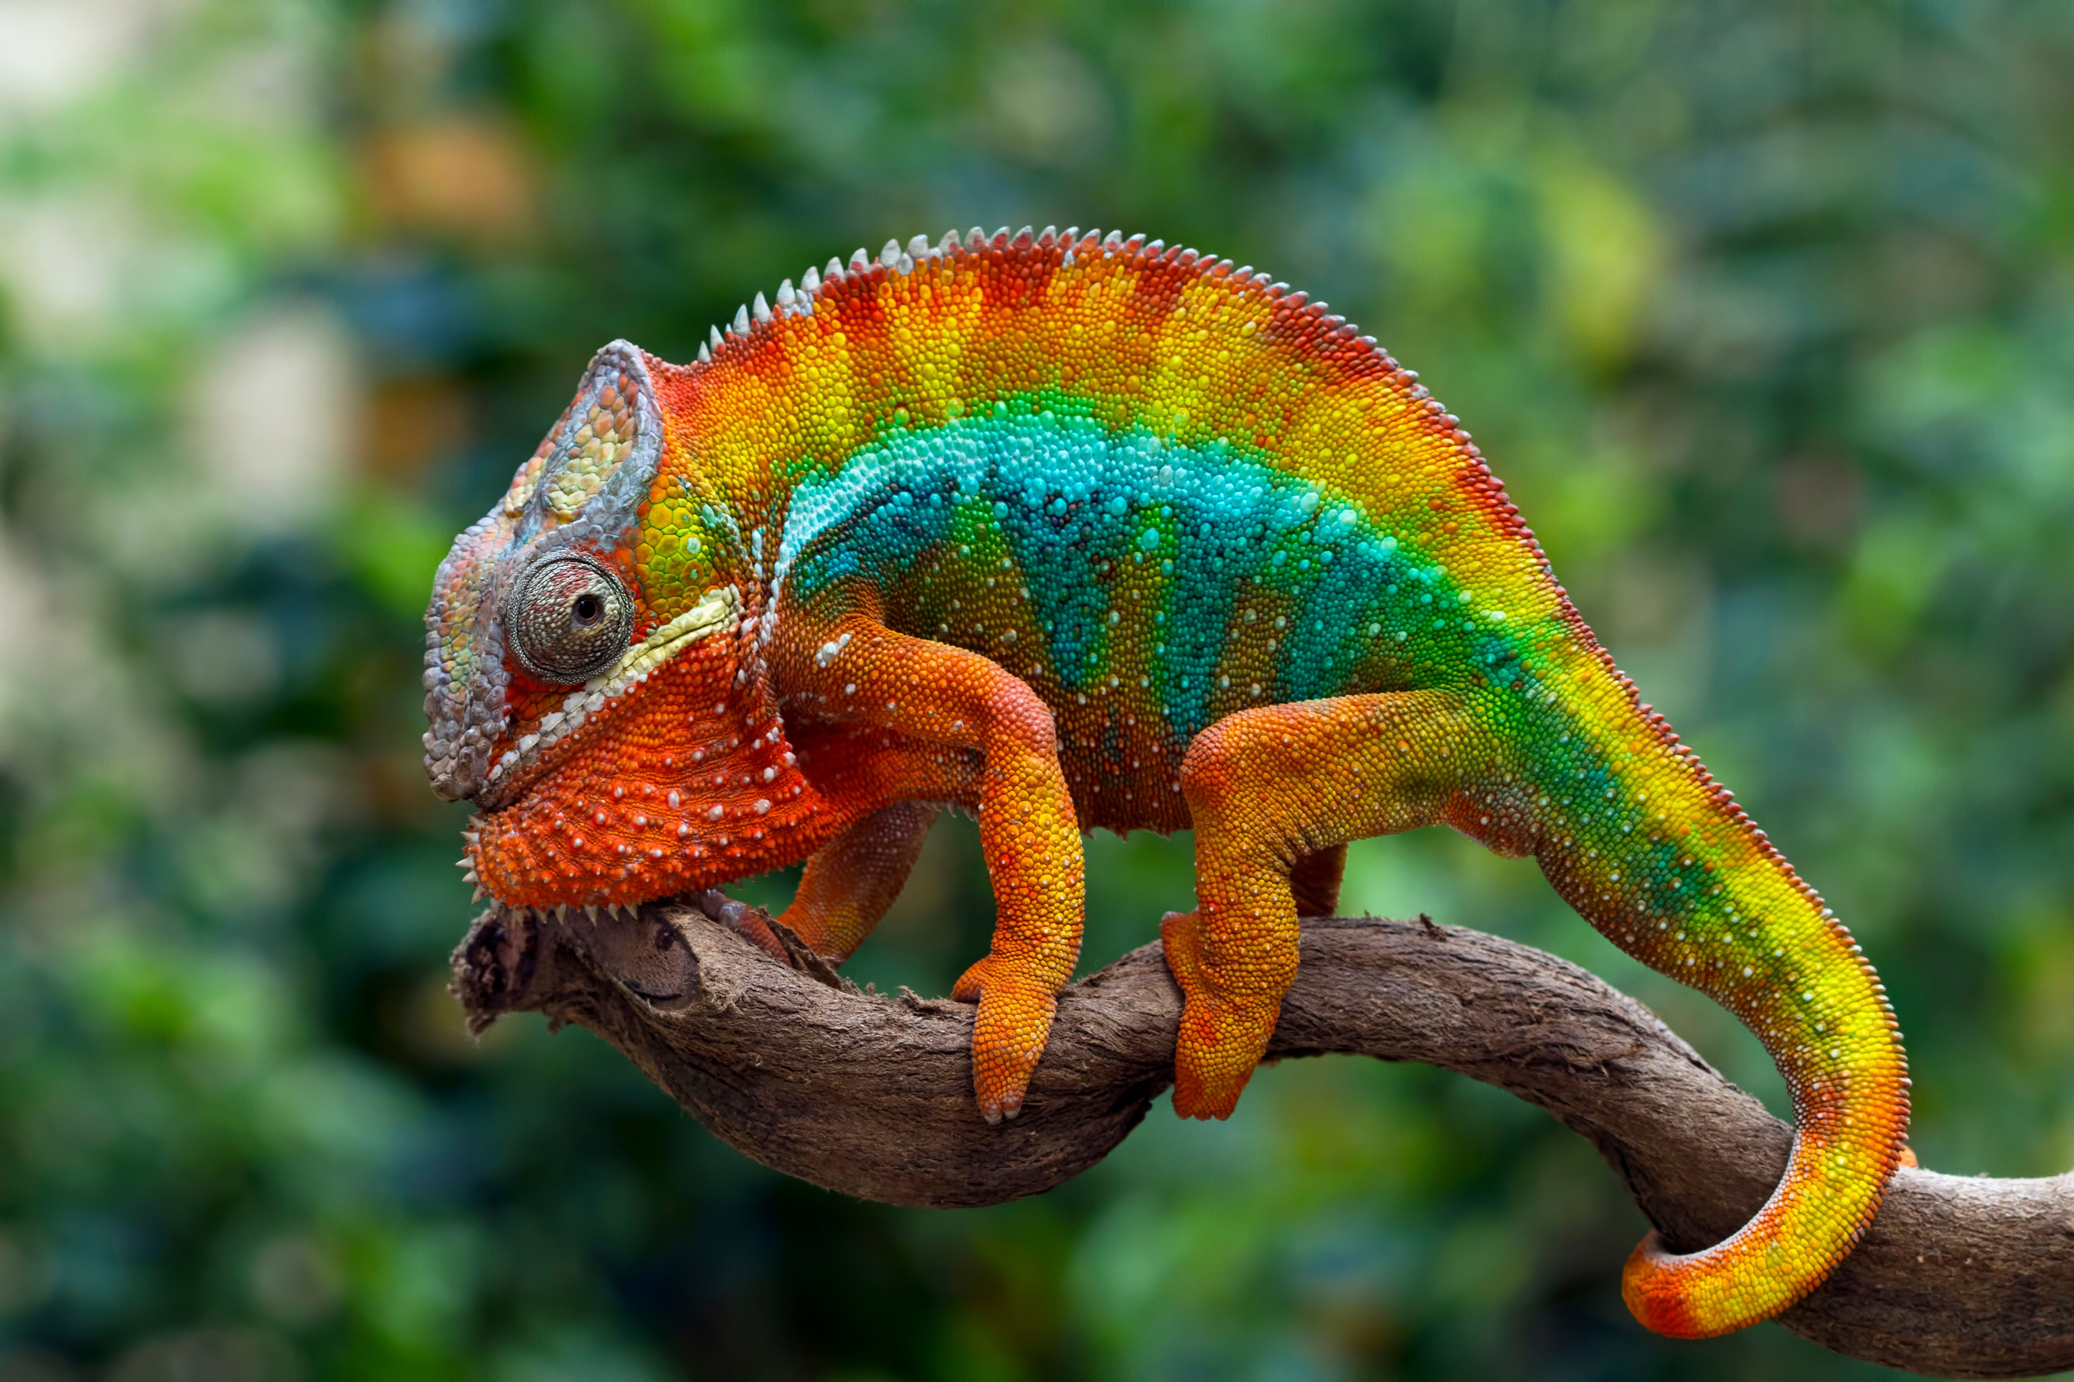
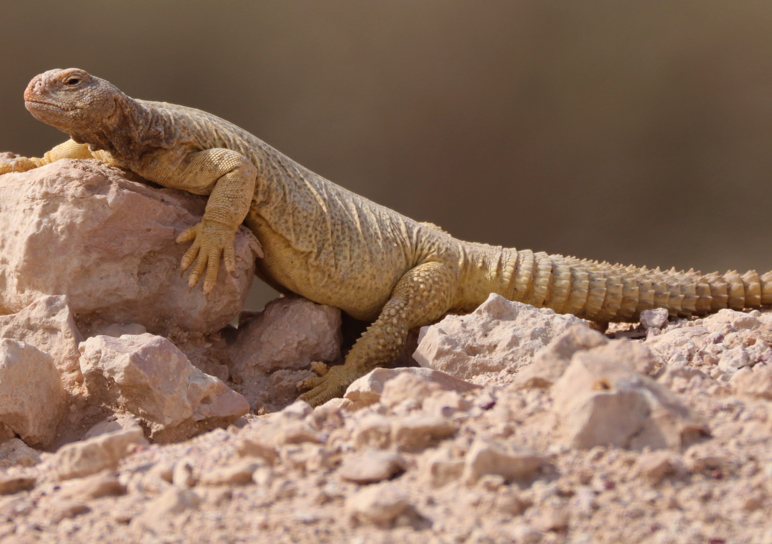
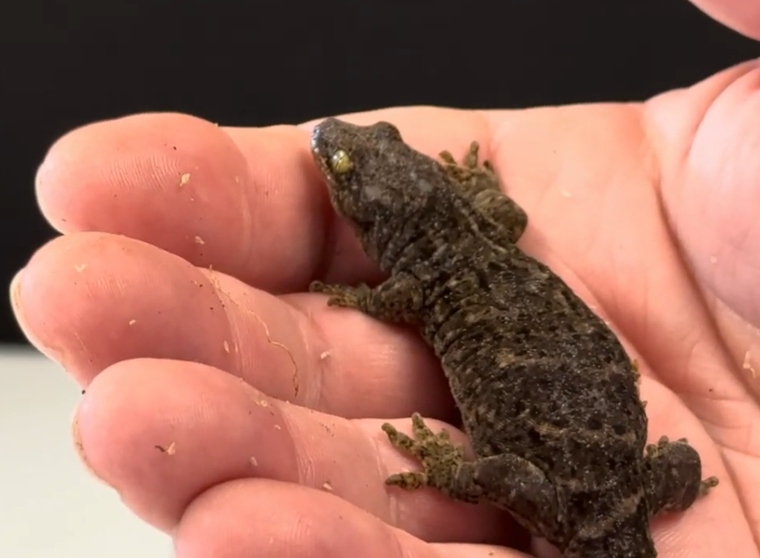
Science Week 2025
KS3 - From Scales to Tails: The Evolution and Adaptation of Reptiles
Session 2
Activity 3: Analyse adaptations. Each of the reptiles below have different adaptations and habitats. Underneath each image, describe the reptile’s habitat and how it has adapted for survival. You could include: their skin / scales; their limbs and movement; their feeding method; their defence mechanisms or how they reproduce.
king snake
chameleon
________________________________________________________________________________________________________________________________________________________________________________________________________________________________________________________________________________________________________________________
________________________________________________________________________________________________________________________________________________________________________________________________________________________________________________________________________________________________________________________
spiny-tailed mastigure
New Zealand gecko
________________________________________________________________________________________________________________________________________________________________________________________________________________________________________________________________________________________________________________________
________________________________________________________________________________________________________________________________________________________________________________________________________________________________________________________________________________________________________________________
2
Developing Experts Copyright 2025 All Rights Reserved

Slide 3
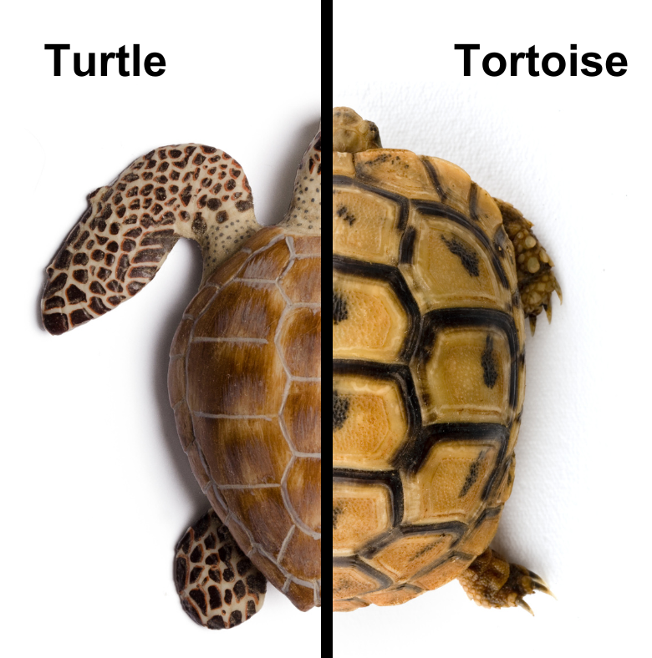

Science Week 2025
KS3 - From Scales to Tails: The Evolution and Adaptation of Reptiles
Session 2
Activity 4: Compare a turtle, tortoise and terrapin. Label the image below, including any adaptations.
________________
_____________
________________
______________
What are the key differences between a turtle, tortoise and terrapin? _________________________________________________________________________________________________________________________________________________________________________________________________________________________________________________________________________________________________________________________________________________________________________________________________
terrapin
3
Developing Experts Copyright 2025 All Rights Reserved

Slide 4
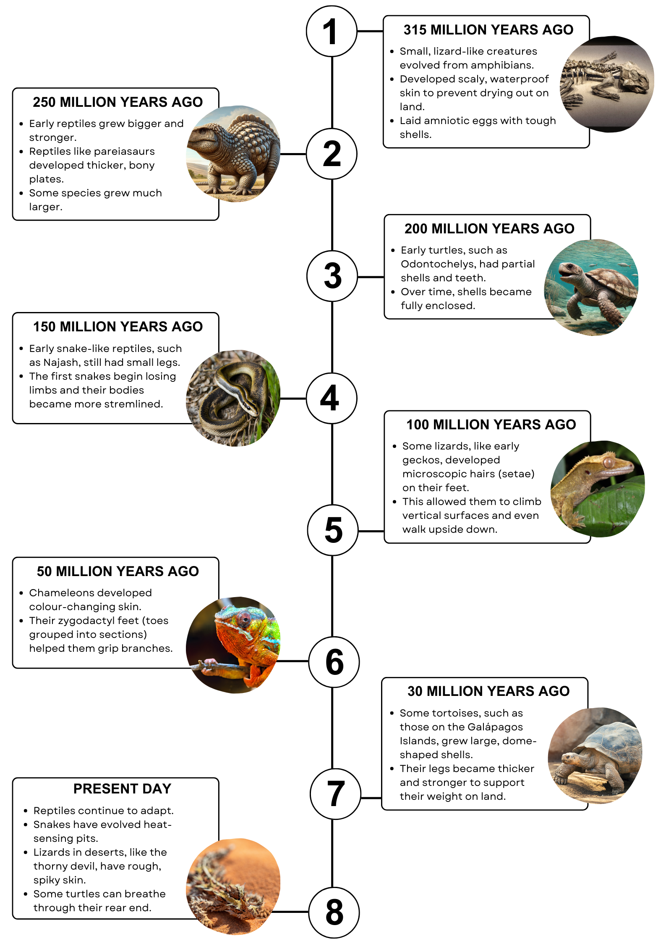
Science Week 2025
KS3 - From Scales to Tails: The Evolution and Adaptation of Reptiles
Session 2
Activity 5: Examine the reptile evolution timeline below. How did climate, predators and food sources affect these physical changes? What adaptations helped reptiles survive in different environments?
4
Developing Experts Copyright 2025 All Rights Reserved

