Slide 1
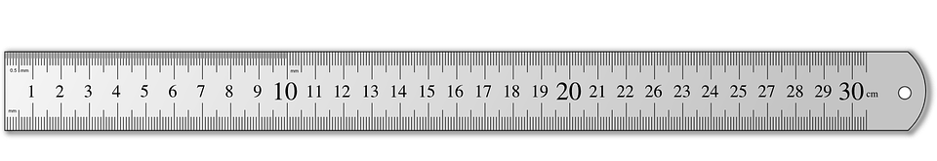
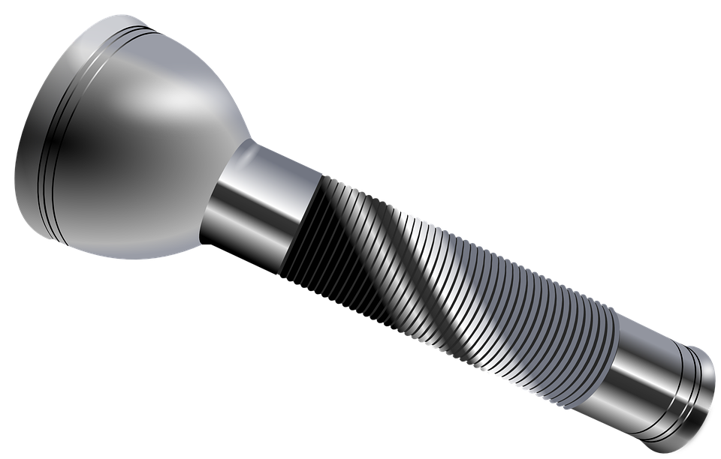
You are going to investigate how the distance an object
is from a wall affects the size of the shadow cast.
Method
This experiment should be in a dark room.
Fix a torch in position at least 1m
away from a wall. Shine the torch
directly at the wall.
Place the acetate slide 20cm away
from the wall, so that it casts a shadow.
Measure the width of the shadow and
record this in the table.
Repeat this with the acetate back to
40, 60, 80, 100cm away in turn.
Measuring the width of the shadow each time.
Equipment
Metre ruler
30cm ruler
Torch
Acetate with 1cm x 1cm black square
Distance of slide from wall (cm) | Width of shadow (cm)
20
40
60
80
100
Stretch:
Describe how the torch beam would change if the torch moved closer to the wall.
Describe how the shadow changes as the acetate moves further away from the wall.
________________________________________________________________________________________________________________________
Which part of the shadow is darkest. Suggest why it is darkest. ________________________________________________________________________________________________________________________
Challenge:
Explain why a square is a better shape than a circle to use in this investigation.

Slide 2
Print this sheet onto acetate. Then cut
out a strip for each pair of students.

