Slide 1

Mission Assignment: Explain how echolocation is used
KS3-18-05
Set up a simple obstacle course and then try to navigate it using echolocation.
Equipment
A3 Card
Bamboo sticks
Flower pots
Blindfold
Tape
Method
Stand a bamboo stick in an upturned flower pot and tape a sheet of card to the top of the stick. The sheet of card should be roughly head height.
Make 5 of these but you can make more and arrange them in a path that would require navigating.
Blindfold a volunteer but leave their ears uncovered.
Positions the volunteer at the start of your course.
The volunteer should make a noise (or just say allow). By listening to the noise they should be able to find their way through the course.
When you have completed the course, answer the following questions.
Describe how you could tell that an obstacle was in front of you.
________________________________________________________________________________________________________________________________________________________________________________________________________________________________________________________
Suggest what you think would happen if you used a different material instead of card.
________________________________________________________________________________________________________________________________________________________________________________________________________________________________________________________
Developing Experts Copyright 2023 All Rights Reserved

Slide 2

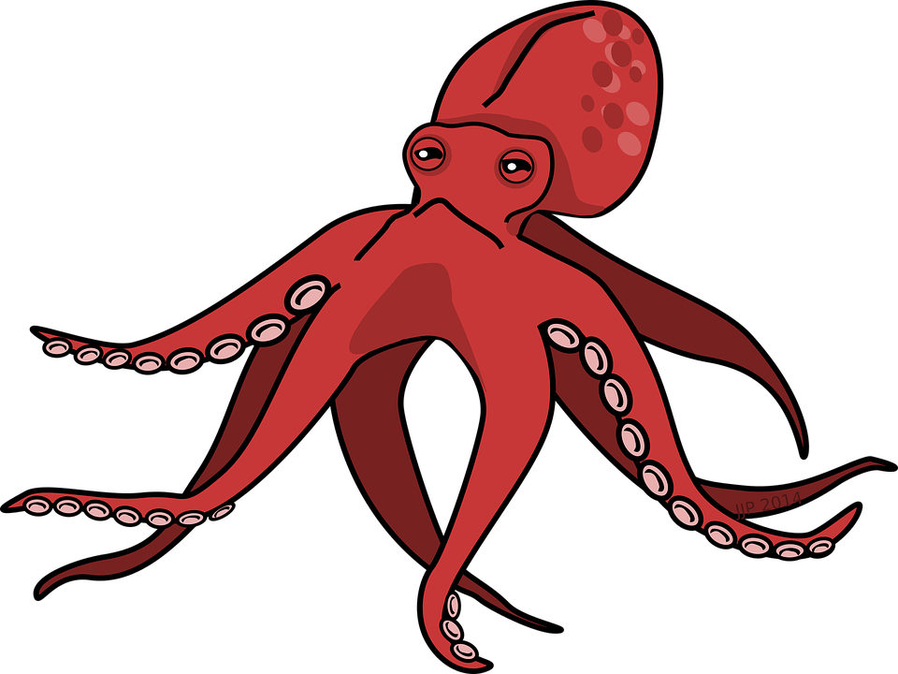
Mission Assignment: Explain how echolocation is used
KS3-18-05
Echolocation
Complete the diagram below to show how the dolphin would locate the squid. Then explain the process you have drawn.
____________________________________________________________________________________________________________________________________________________________________________________________________________________________________________________________________________________________________________________________________________
An ultrasound scanner is used to examine unborn babies. Explain how this is an example of echolocation.
____________________________________________________________________________________________________________________________________________________________________________________________________________________________________________________________________________________________________________________________________________
Challenge: Suggest two advantages and two disadvantages of an animal using echolocation.
Advantage | Disadvantage
Developing Experts Copyright 2023 All Rights Reserved

Slide 3
Mission Assignment: Explain how echolocation is used ANSWERS
KS3-18-05
Echolocation
Complete the diagram below to show how the dolphin would locate the squid. Then explain the process you have drawn.
____________________________________________________________________________________________________________________________________________________________________________________________________________________________________________________________________________________________________________________________________________
An ultrasound scanner is used to examine unborn babies. Explain how this is an example of echolocation.
____________________________________________________________________________________________________________________________________________________________________________________________________________________________________________________________________________________________________________________________________________
Emitted wave
Reflected wave
Dolphins use echolocation to locate objects in water. They emit high-frequency sounds from their forehead, which bounce off objects in the water and return to the dolphin as echoes. The dolphin then interprets the echoes to identify the location, size, and shape of the squid.
An ultrasound scanner emits high-frequency sound waves into the body, which bounce off the foetus and surrounding tissues, creating echoes that are detected by the scanner. The echoes are then used to create an image of the foetus
Challenge: Suggest two advantages and two disadvantages of an animal using echolocation.
Advantage | Disadvantage
Can locate prey or predators in dark or murky environments
Can identify the size and shape of objects to decide if the object is a predator or prey
May cause noise pollution
Limited range and accuracy in cluttered environments
Predators might be adapted to detect their sound wave and hunt them
Developing Experts Copyright 2023 All Rights Reserved

