Slide 1

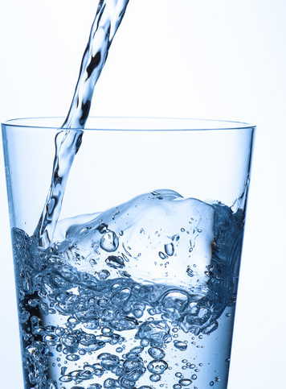
0001.01
Mission Assignment
Task
Developing skills
Think about…
Analysis and purification of water samples from different sources, including pH, dissolved solids and distillation.
Describe the process of desalination.
Give reasons for the steps used to produce potable water.
KS4-17-10:
Using Resources - Explore potable water - practical

