Slide 1
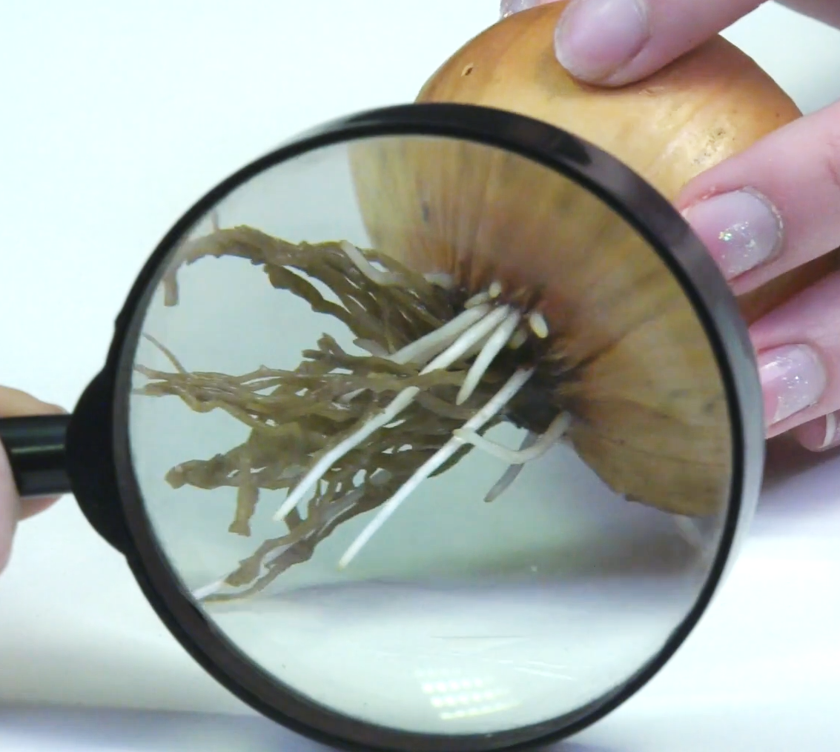
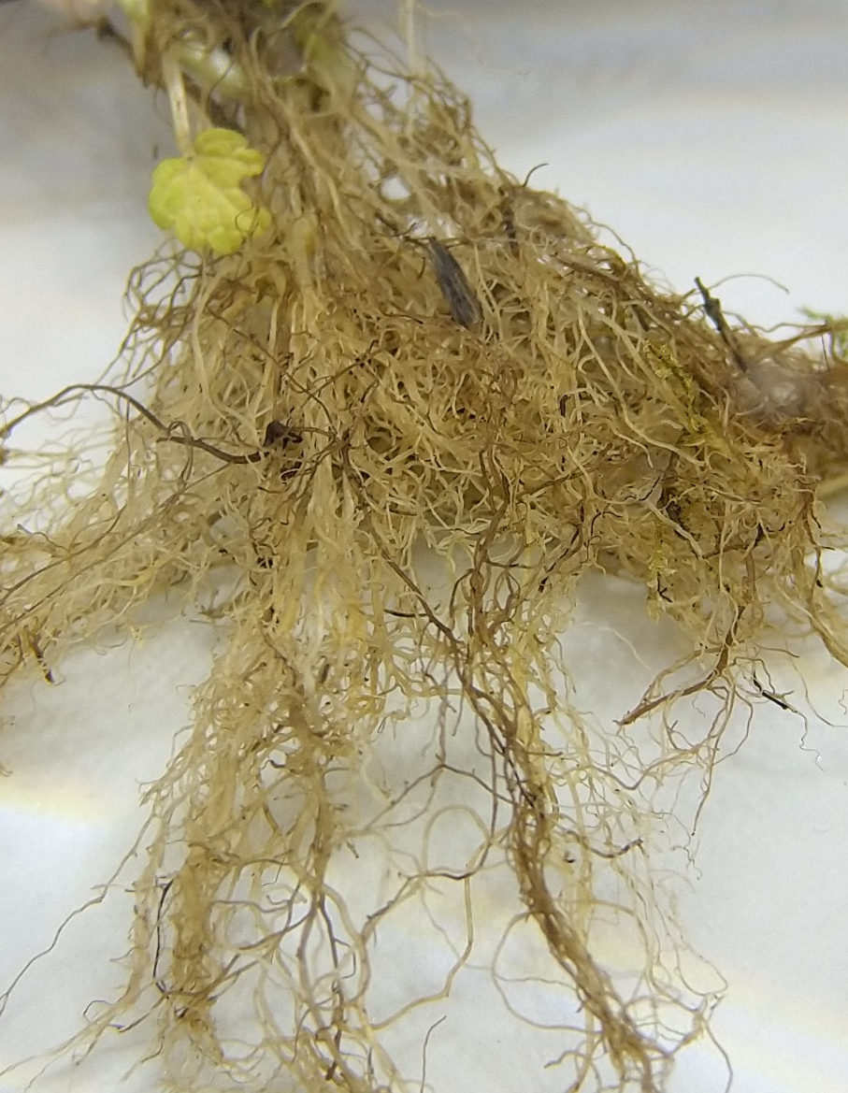
In the space below make a detailed observational labelled diagram of your onion’s roots.
Highlight any interesting features.
Stretch:
Explain why roots are not green.
Challenge:
List all the useful functions roots have.
Plants roots are covered in microscopic hairs. Explain what the hairs do and why they are important.
_____________________________________________________________________________________________________________________________________________________________________________________________________________________________________________________

