Slide 1

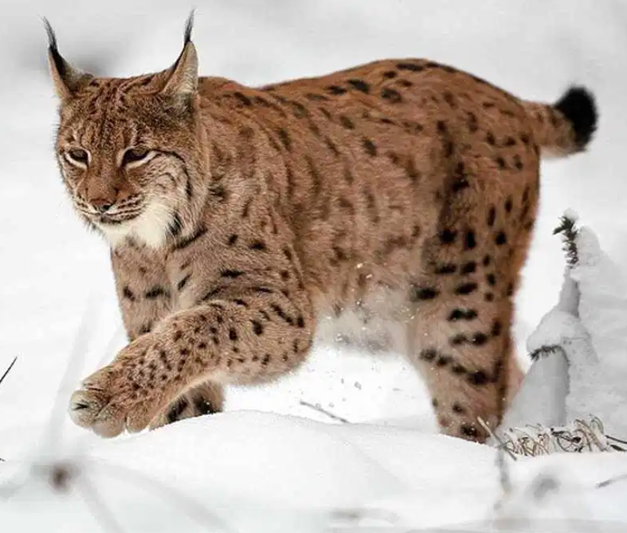
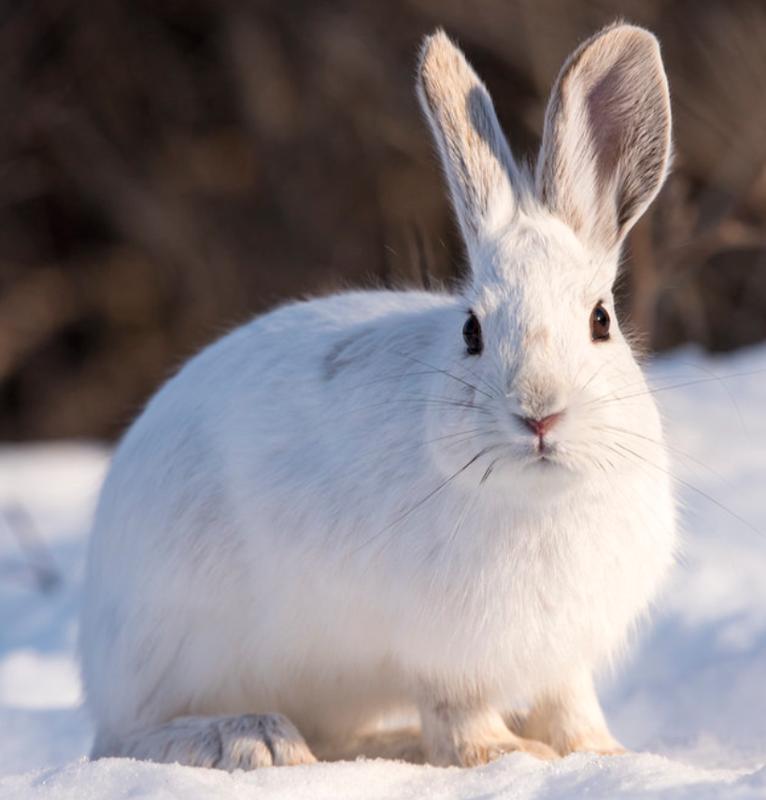
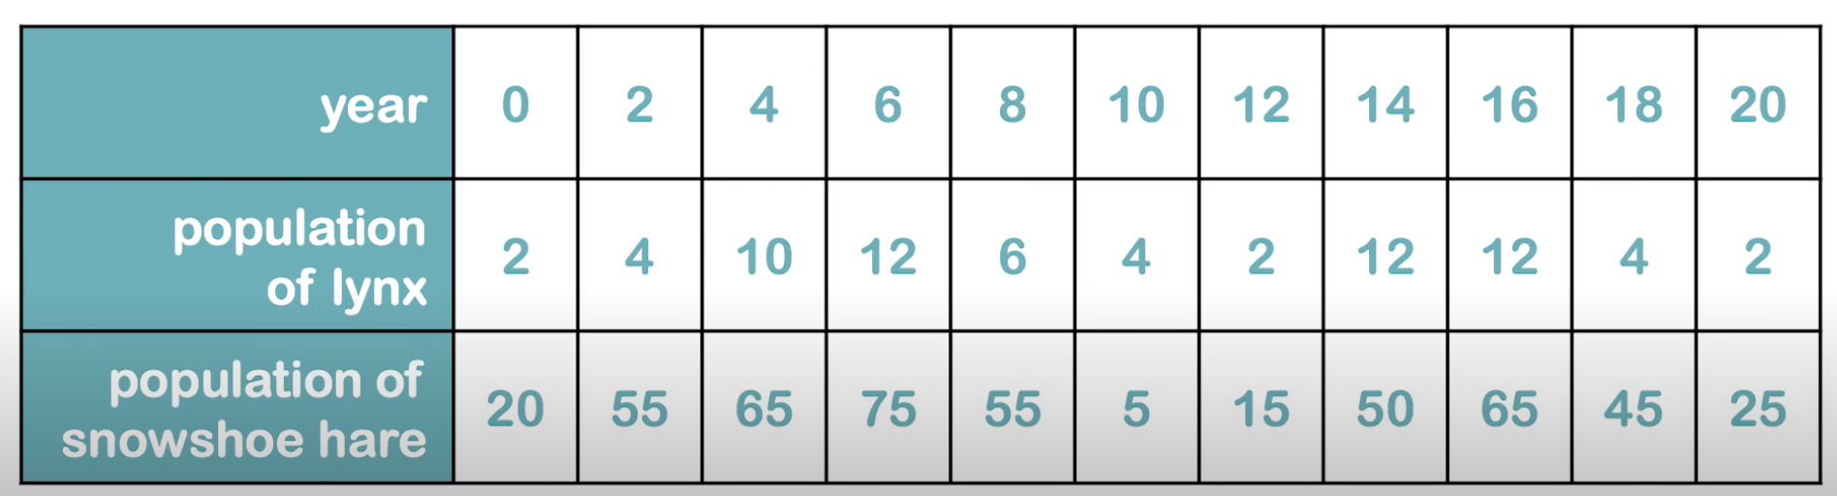
Resource Handout: S04.05.08 Handout
Know about the balance of nature.
Plot a graph to show the amount of show-shoe hares and lynx for each year. What deductions can you make about the number in each year - is there a correlation?
100
Stretch:
Explain the correlation between the number of show-shoe hares and lynx in each year.
90
80
70
Challenge:
Accurately plot the graph showing the number of show-shoe hares and lynx in each year.
60
50
Population
40
30
20
10
0
0 2 4 6 8 10 12 14 16 18 20
Year
Developing Experts Ltd. © 2022
.

Slide 2
Resource Handout: S04.05.08 Handout
Know about the balance of nature.
What deductions can you make about the number in each year - is there a correlation?
________________________________________________________________________________________________________________________________________________________________________________________________________________________________________________________________________________________________When the population of the lynx increases or decreases explain the reasons why you think this has happened? ________________________________________________________________________________________________________________________________________________________________________________________________________________________________________________________________________________________________
When the population of the snowshoe hare increases or decreases explain the reasons why you think this has happened?
________________________________________________________________________________________________________________________________________________________________________________________________________________________________________________Why is it important for scientists to gather data which monitors the balance of nature?
________________________________________________________________________________________________________________________________________________________________________________________________________________________________________________
Stretch:
Explain the correlation between the number of show-shoe hares and lynx in each year.
Challenge:
Accurately plot the graph showing the number of show-shoe hares and lynx in each year.
Developing Experts Ltd. Copyright 2020 All rights reserved.

