Slide 1
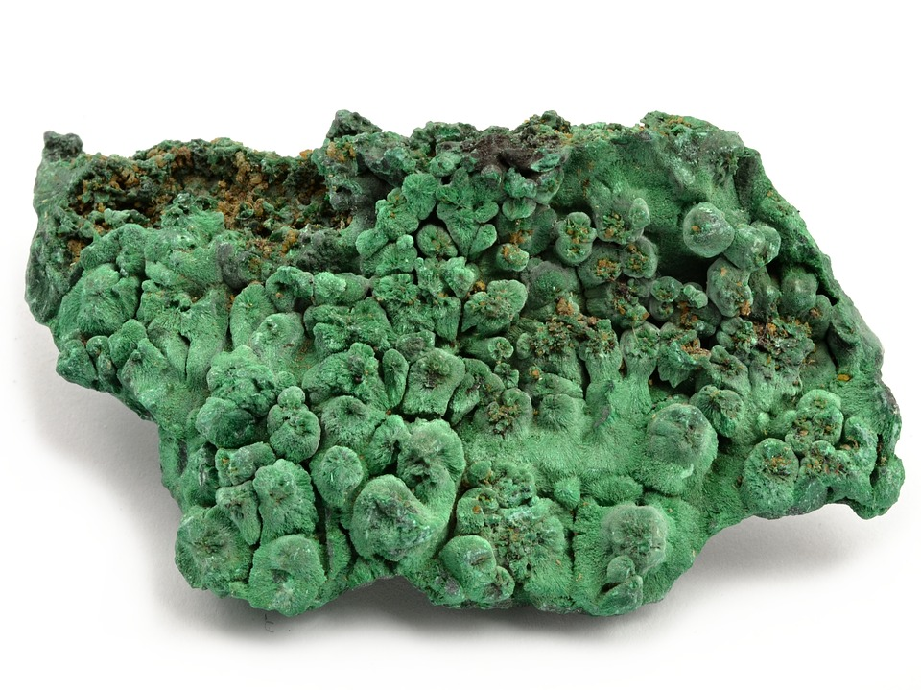
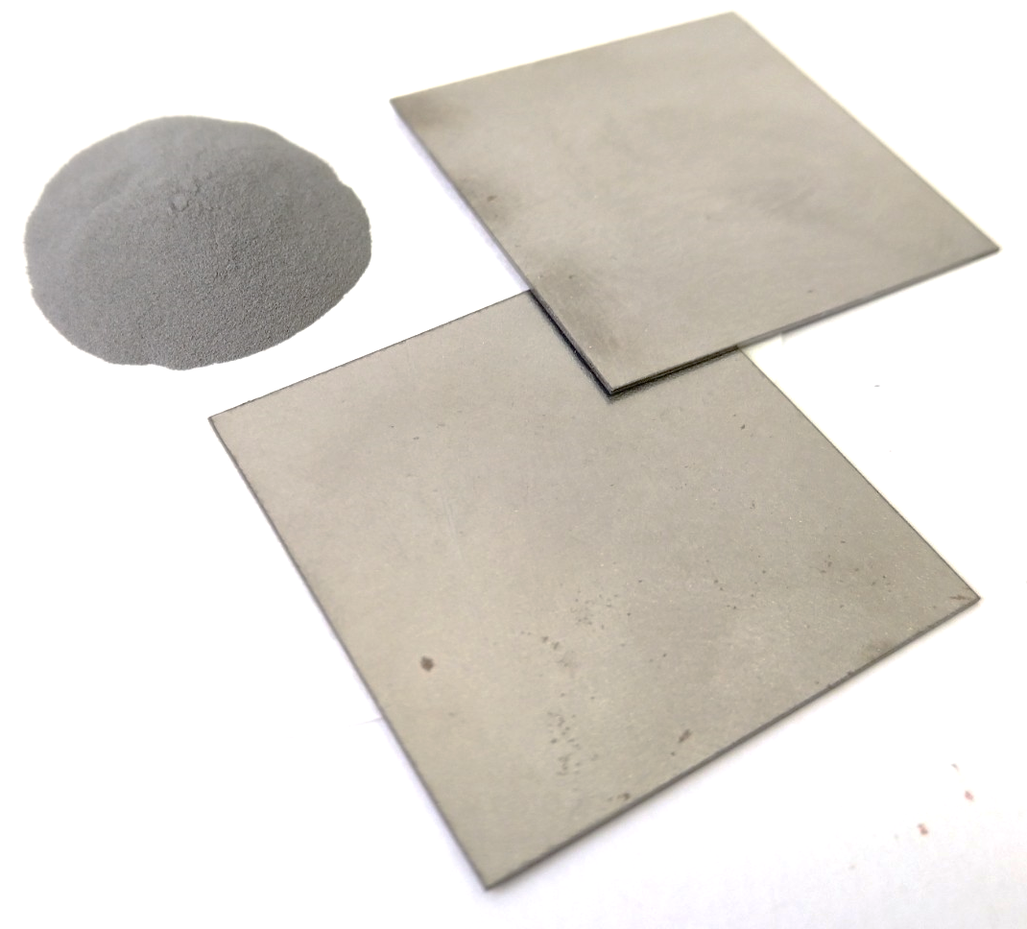
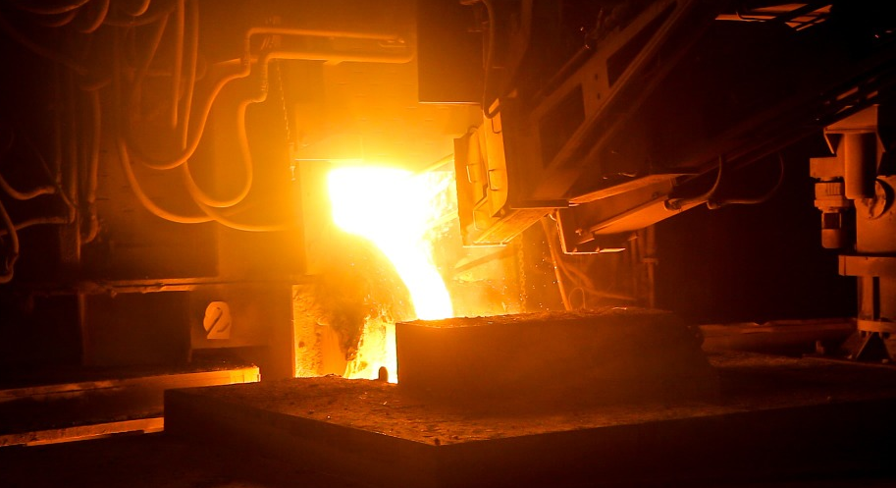
Mission Assignment: Explain how metals can be extracted from ores
KS3-17-02
Extracting Metals - Read the information about the extraction of copper, iron and aluminium from their ores.
Copper
Copper is believed to be the first metal to be extracted from its ore,
around 7000BC. The copper ore malachite (containing copper
carbonate) was heated to a high temperature to form copper oxide.
copper carbonate → copper oxide + carbon dioxide
Then the copper oxide was heated with coke (a form of carbon) to
form pure copper.
copper oxide + carbon → copper + carbon dioxide
This was then poured out into moulds or ingots.
Iron
Historically iron was mined in the form of haematite and heated to a
high temperature in a furnace with charcoal. The carbon in the
charcoal helps to displace the iron from the haematite. However this
made very impure iron.
The modern technique uses a blast furnace.
Coke is inside the furnace and hot air (oxygen) is blasted into the
furnace reacting with the coke to form carbon dioxide.
carbon + oxygen → carbon dioxide
More coke is then added to the furnace reacting with the carbon
dioxide forming carbon monoxide.
carbon + carbon dioxide → carbon monoxide
The carbon monoxide is then used to displace the iron
from hematite ore.
iron oxide + carbon monoxide → iron + carbon dioxide
Aluminium
Aluminium is extracted from the ore bauxite. Aluminium
is high on the reactivity series so it is difficult to displace.
In 1845 Friedrich Wöhler successfully displaced aluminium
from aluminium chloride using potassium. However this only
yielded a small amount and it was from an aluminium
compound not the ore.
aluminium chloride + potassium → potassium chloride + aluminium
The modern technique involves melting aluminium oxide, this require a lot of energy so cryolite is added to reduce the melting point. Then an electric current is passed through the molten mixture separating it into aluminium and oxygen. This process is called electrolysis.
aluminium oxide → aluminium + oxygen
malachite ore
copper metal
haematite ore
iron metal
iron blast
furnace
bauxite
Developing Experts Copyright 2023 All Rights Reserved

Slide 2
Mission Assignment: Explain how metals can be extracted from ores
KS3-17-02
1. Carbon is included in the reactivity series. Explain why carbon is included despite being a non-metal. _________________________________________________________________________________________________________________________________________________________________________________________________________________________________________________________
2. Copper was first extract about 7000 BC, iron was first extracted 3500 BC and aluminum was first successfully extracted in 1824. Use the reactivity series to suggest why these metals were first extracted in this order. __________________________________________________________________________________________________________________________________________________________________________________________________________________________________________________________________________________________________________________________________________________________________________________________________________________________________________________________________________________________________________________
3. Explain why carbon is used in the extraction of iron from its ore. You should mention the displacement reaction in your answer. ___________________________________________________ ___________________________________________________ ___________________________________________________ ___________________________________________________ ___________________________________________________ ___________________________________________________
4. Explain why heating aluminium with carbon will not extract aluminium.
______________________________________________________ ______________________________________________________________________________________________________________________________________________________________________
5. Lithium and cobalt are two important metals used to manufacture the rechargeable batteries used in mobile phones. Which methods are used to obtain the metal from its ore? Lithium is between potassium and calcium in the reactivity series. Cobalt is between lead and iron.
Lithium _____________________ Cobalt _______________________
Most Reactive
Calcium – Ca
Aluminium – Al
Carbon – C
Zinc – Zn
Iron – Fe
Lead – Pb
Copper – Cu
Gold – Au
Least Reactive
Developing Experts Copyright 2023 All Rights Reserved

Slide 3
Mission Assignment: Explain how metals can be extracted from ores
KS3-17-02
Challenge: Explain why it more efficient, economical and ecologically responsible to recycle metals instead of extracting them from their ores. ________________________________________________________________________________________________________________________________________________________________________________________________________________________________________________________________________________________________________________________________________________________________________________________________________________________________________________________________________________________________________________________________________________________________________________________________________________________________________________________________________________________________________________________________________________________________________________________________________________________________________________________________________________________________________________________________________________________________________________________________________________________________________________
Balance the following equations for the reactions that take place in the extraction of copper, iron and aluminium.
CuO + C → Cu + CO₂
C + CO₂ → CO
Fe₂O₃ + CO → Fe + CO₂
AlCl₃ + K → KCl + Al
Al₂O₃ → Al + O₂
Developing Experts Copyright 2023 All Rights Reserved

Slide 4
Mission Assignment: Explain how metals can be extracted from ores
ANSWERS
KS3-17-02
1. Carbon is included in the reactivity series. Explain why carbon is included despite being a non-metal. _________________________________________________________________________________________________________________________________________________________________________________________________________________________________________________________
2. Copper was first extract about 7000 BC, iron was first extracted 3500 BC and aluminum was first successfully extracted in 1824. Use the reactivity series to suggest why these metals were first extracted in this order. __________________________________________________________________________________________________________________________________________________________________________________________________________________________________________________________________________________________________________________________________________________________________________________________________________________________________________________________________________________________________________________
3. Explain why carbon is used in the extraction of iron from its ore. You should mention the displacement reaction in your answer. ___________________________________________________ ___________________________________________________ ___________________________________________________ ___________________________________________________ ___________________________________________________ ___________________________________________________
4. Explain why heating aluminium with carbon will not extract aluminium.
______________________________________________________ ______________________________________________________________________________________________________________________________________________________________________
5. Lithium and cobalt are two important metals used to manufacture the rechargeable batteries used in mobile phones. Which methods are used to obtain the metal from its ore? Lithium is between potassium and calcium in the reactivity series. Cobalt is between lead and iron.
Lithium _____________________ Cobalt _______________________
Carbon is included in reactivity series as metals that are below carbon in the reactivity series can be extracted from their ore by heating with carbon. The carbon can displace the less reactive metal from its compound.
Copper was the first metal to be extracted because it is one of the least reactive metals and occurs in its native form in nature. Iron was next to be extracted because it is slightly more reactive than copper and can be extracted by heating with carbon. Finally, aluminum was extracted last because it is a highly reactive metal and occurs mainly in the form of its oxide, which requires a more complex extraction process so had to wait until electricity was discovered.
Most Reactive
Calcium – Ca
Aluminium – Al
Carbon – C
Zinc – Zn
Iron – Fe
Lead – Pb
Copper – Cu
Gold – Au
Least Reactive
Carbon is used in the extraction of iron from its ore because it is able to displace iron from iron oxide. The reaction between carbon and iron oxide is a displacement reaction in which carbon displaces iron from its oxide to form carbon dioxide and iron.
Heating aluminium with carbon will not extract aluminium
because aluminium is a more reactive metal than carbon and does not displace carbon from its oxide. Instead, the carbon reacts with oxygen to form carbon dioxide, leaving
the aluminium oxide unchanged
electrolysis
heating carbon
Developing Experts Copyright 2023 All Rights Reserved

Slide 5
Mission Assignment: Explain how metals can be extracted from ores
ANSWERS
KS3-17-02
Challenge: Explain why it more efficient, economical and ecologically responsible to recycle metals instead of extracting them from their ores. ________________________________________________________________________________________________________________________________________________________________________________________________________________________________________________________________________________________________________________________________________________________________________________________________________________________________________________________________________________________________________________________________________________________________________________________________________________________________________________________________________________________________________________________________________________________________________________________________________________________________________________________________________________________________________________________________________________________________________________________________________________________________________________
Balance the following equations for the reactions that take place in the extraction of copper, iron and aluminium.
CuO + C → Cu + CO₂
C + CO₂ → CO
Fe₂O₃ + CO → Fe + CO₂
AlCl₃ + K → KCl + Al
Al₂O₃ → Al + O₂
Energy savings: Recycling metals requires less energy than extracting them from their ores. Extracting metals from their ores requires a lot of energy to melt the ores and to separate the metal from other impurities. Recycling, on the other hand, requires less energy since the metal is already in a usable form.
Resource conservation: Recycling metals helps conserve natural resources because it reduces the need to mine new ores. This helps preserve natural habitats, reduces the impact of mining on the environment, and prolongs the lifespan of existing mines.
Reduction of greenhouse gas emissions: Extracting metals from their ores is a significant source of greenhouse gas emissions. Recycling metals reduces the amount of emissions produced by mining and refining metals, which helps reduce the environmental impact of metal production.
Cost savings: Recycling metals is often more cost-effective than extracting them from their ores. Recycling facilities can process large amounts of metal quickly and efficiently, reducing the cost of production.
2
2
2
3
2
3
3
3
2
4
3
Developing Experts Copyright 2023 All Rights Reserved

