Slide 1


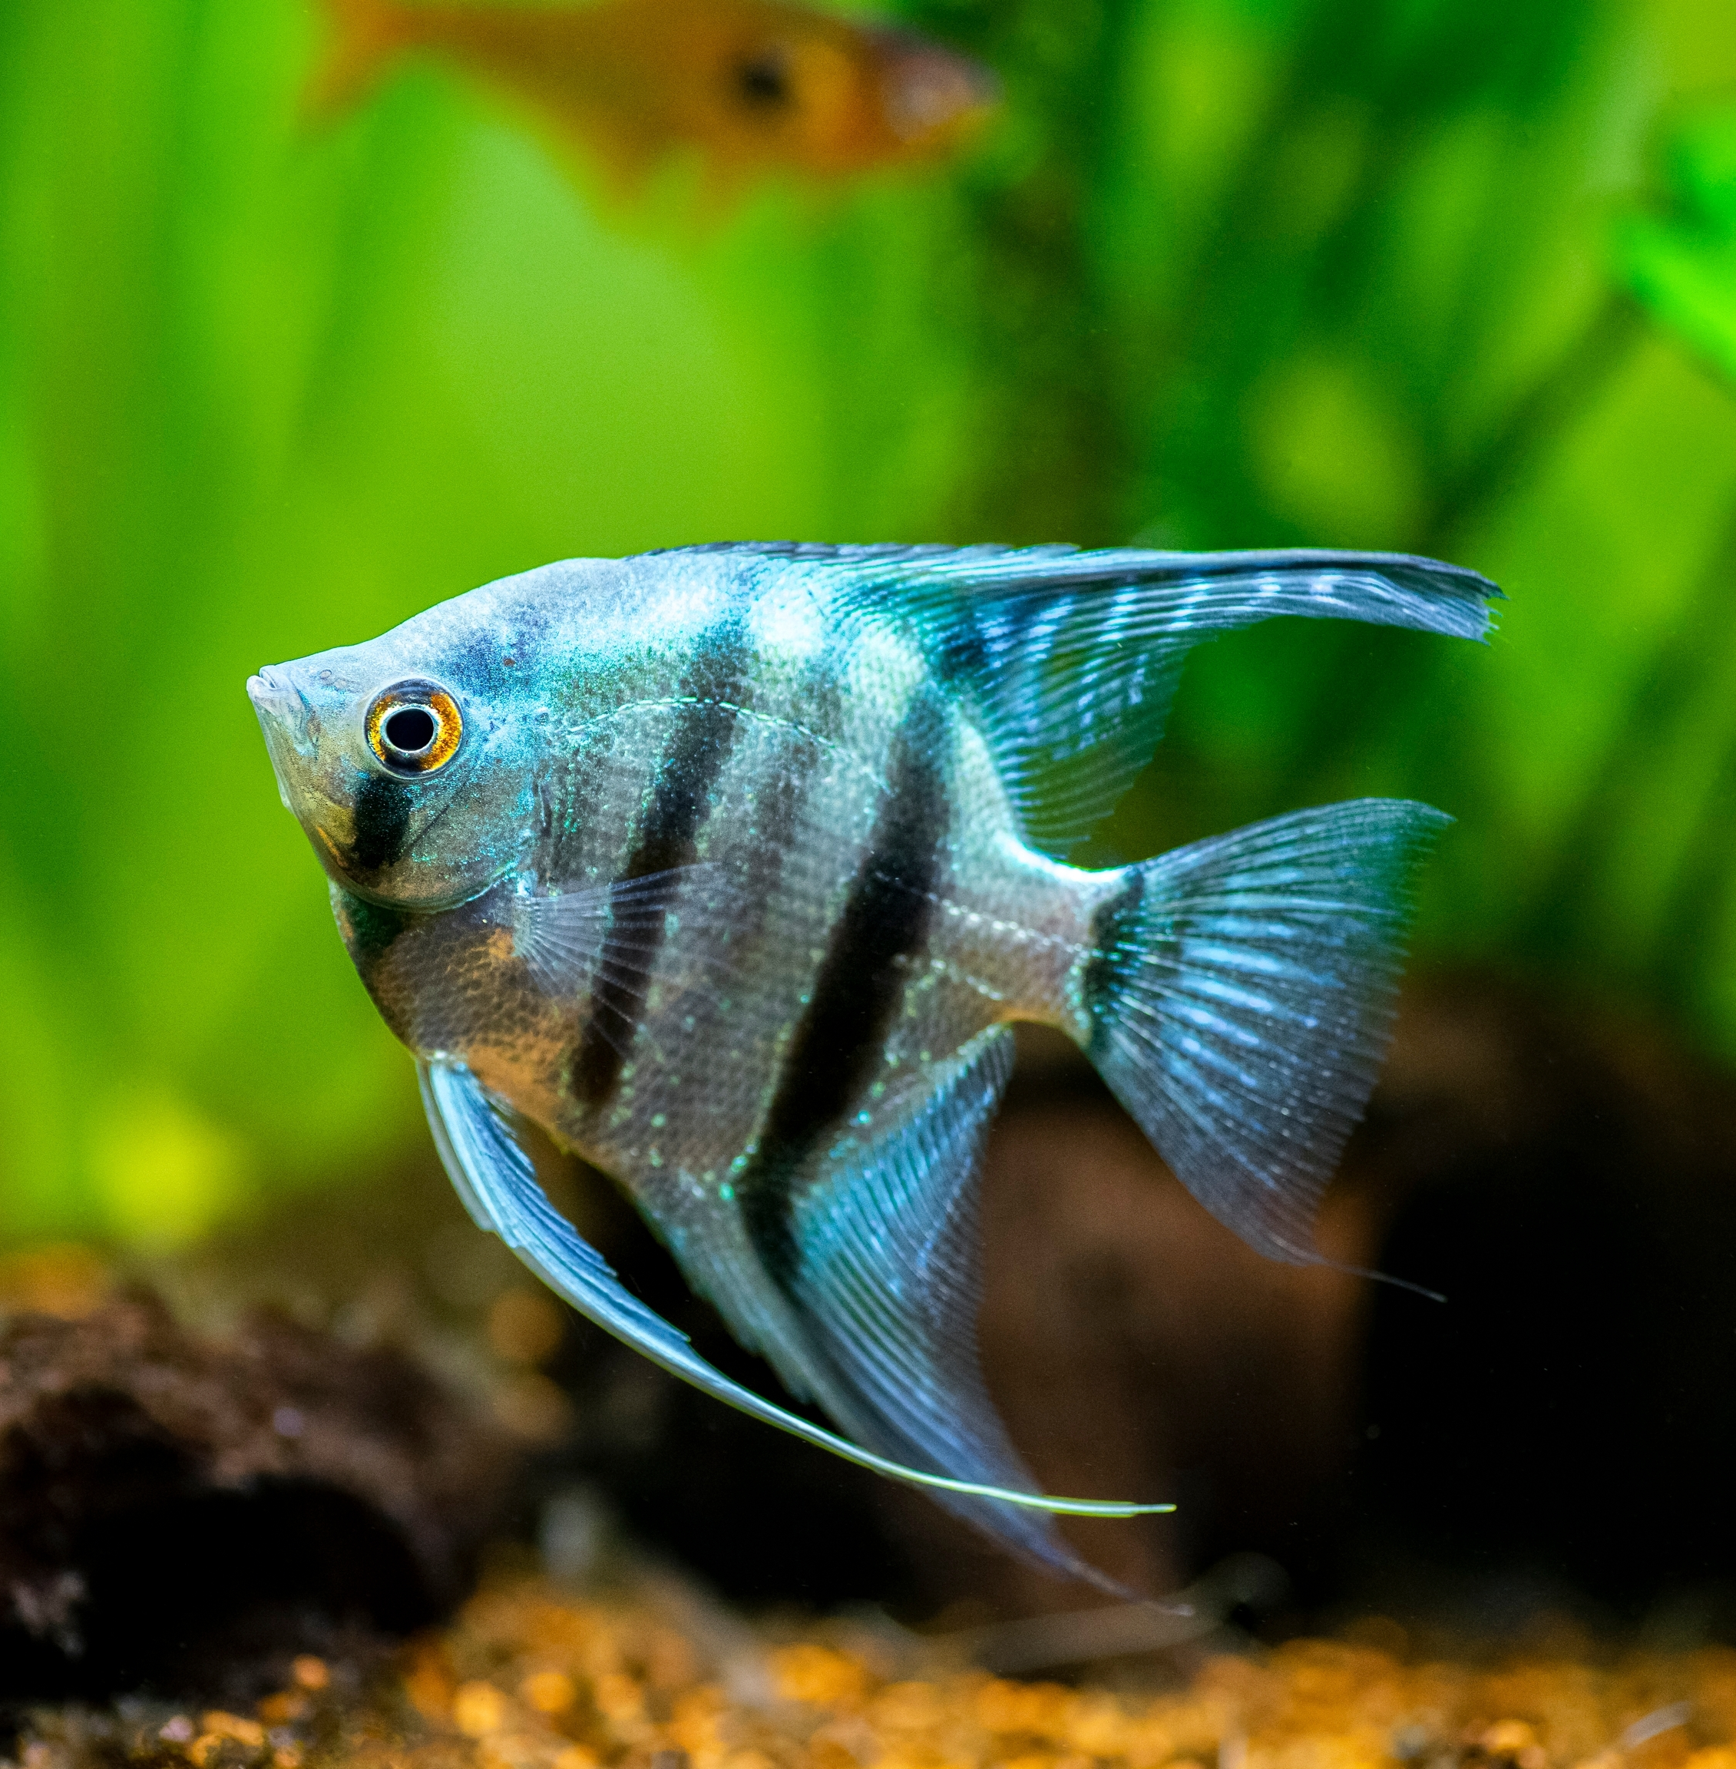
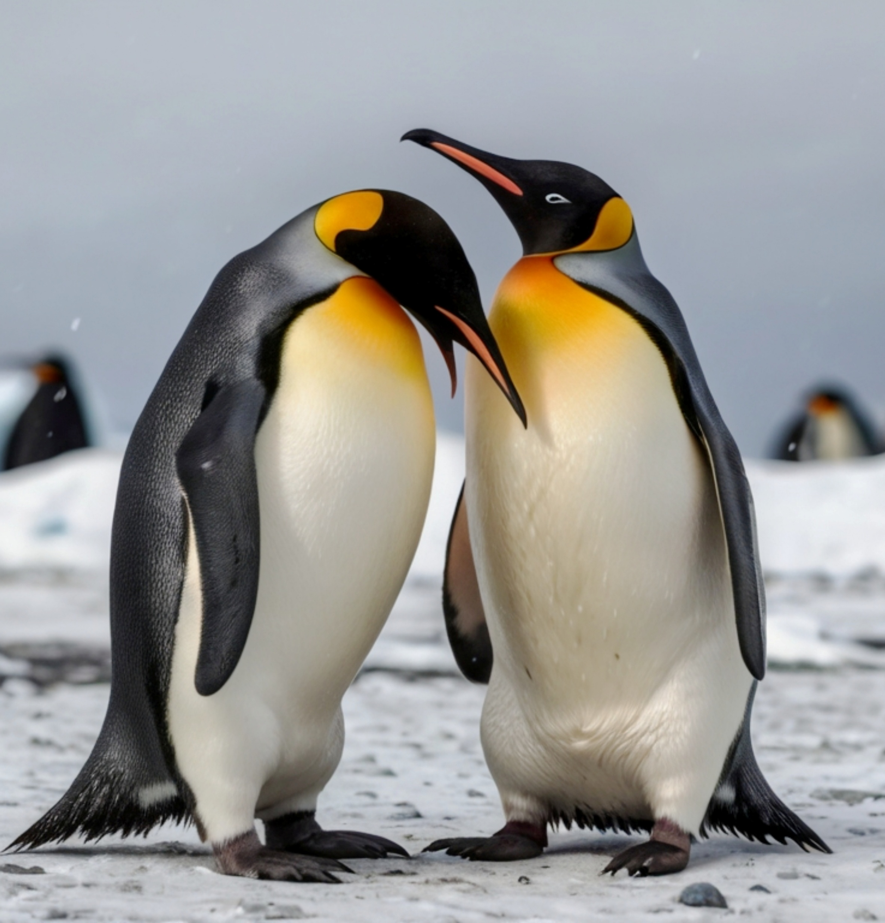
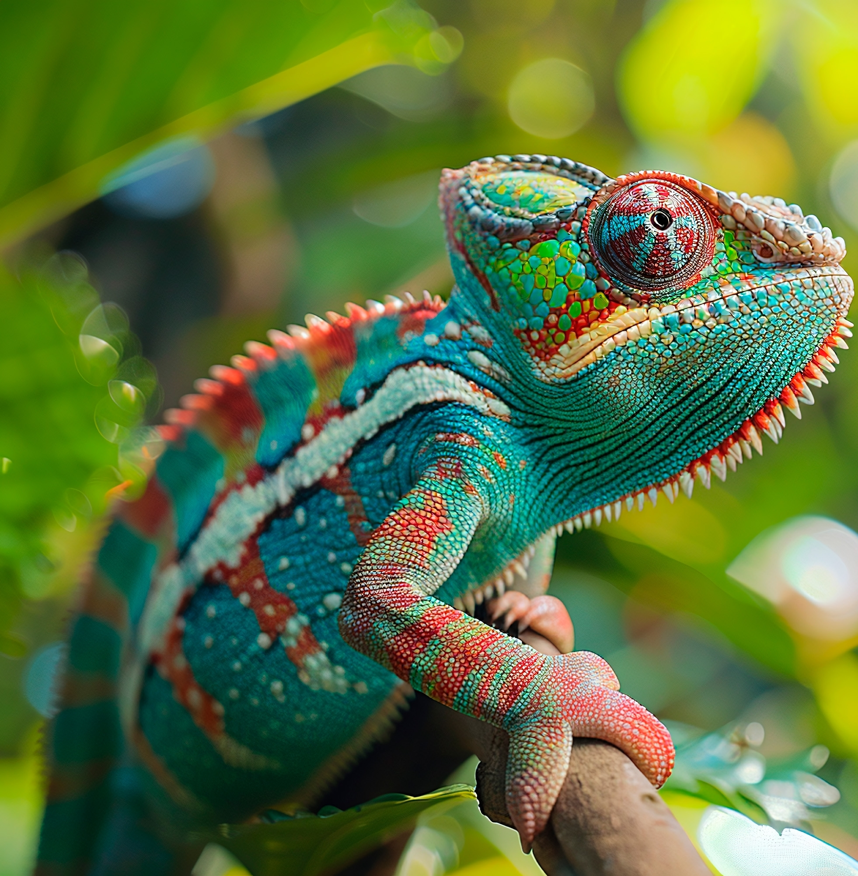
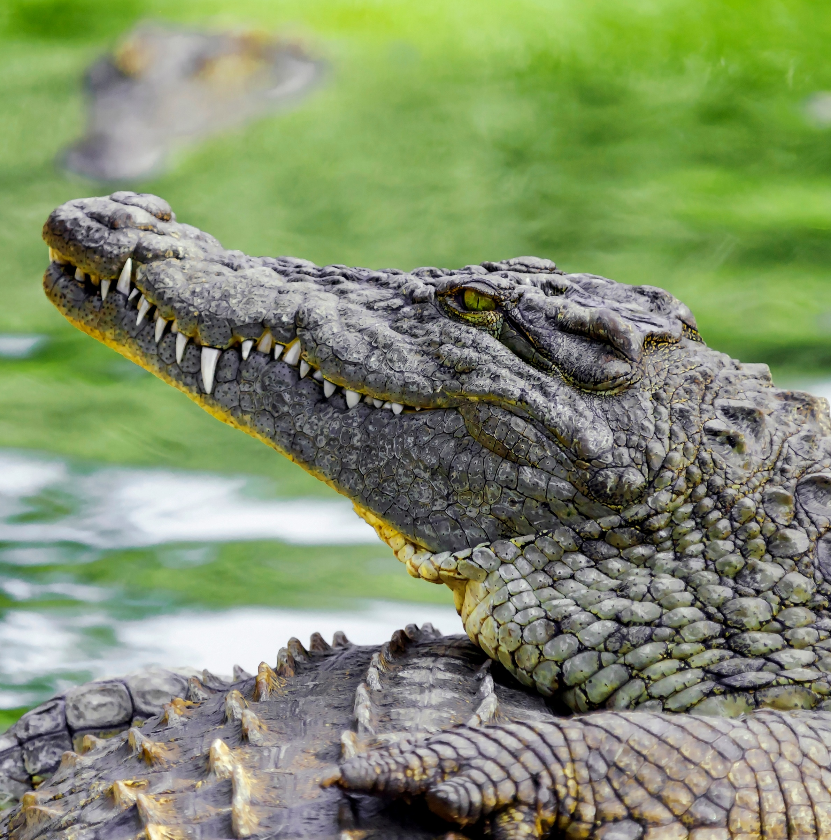
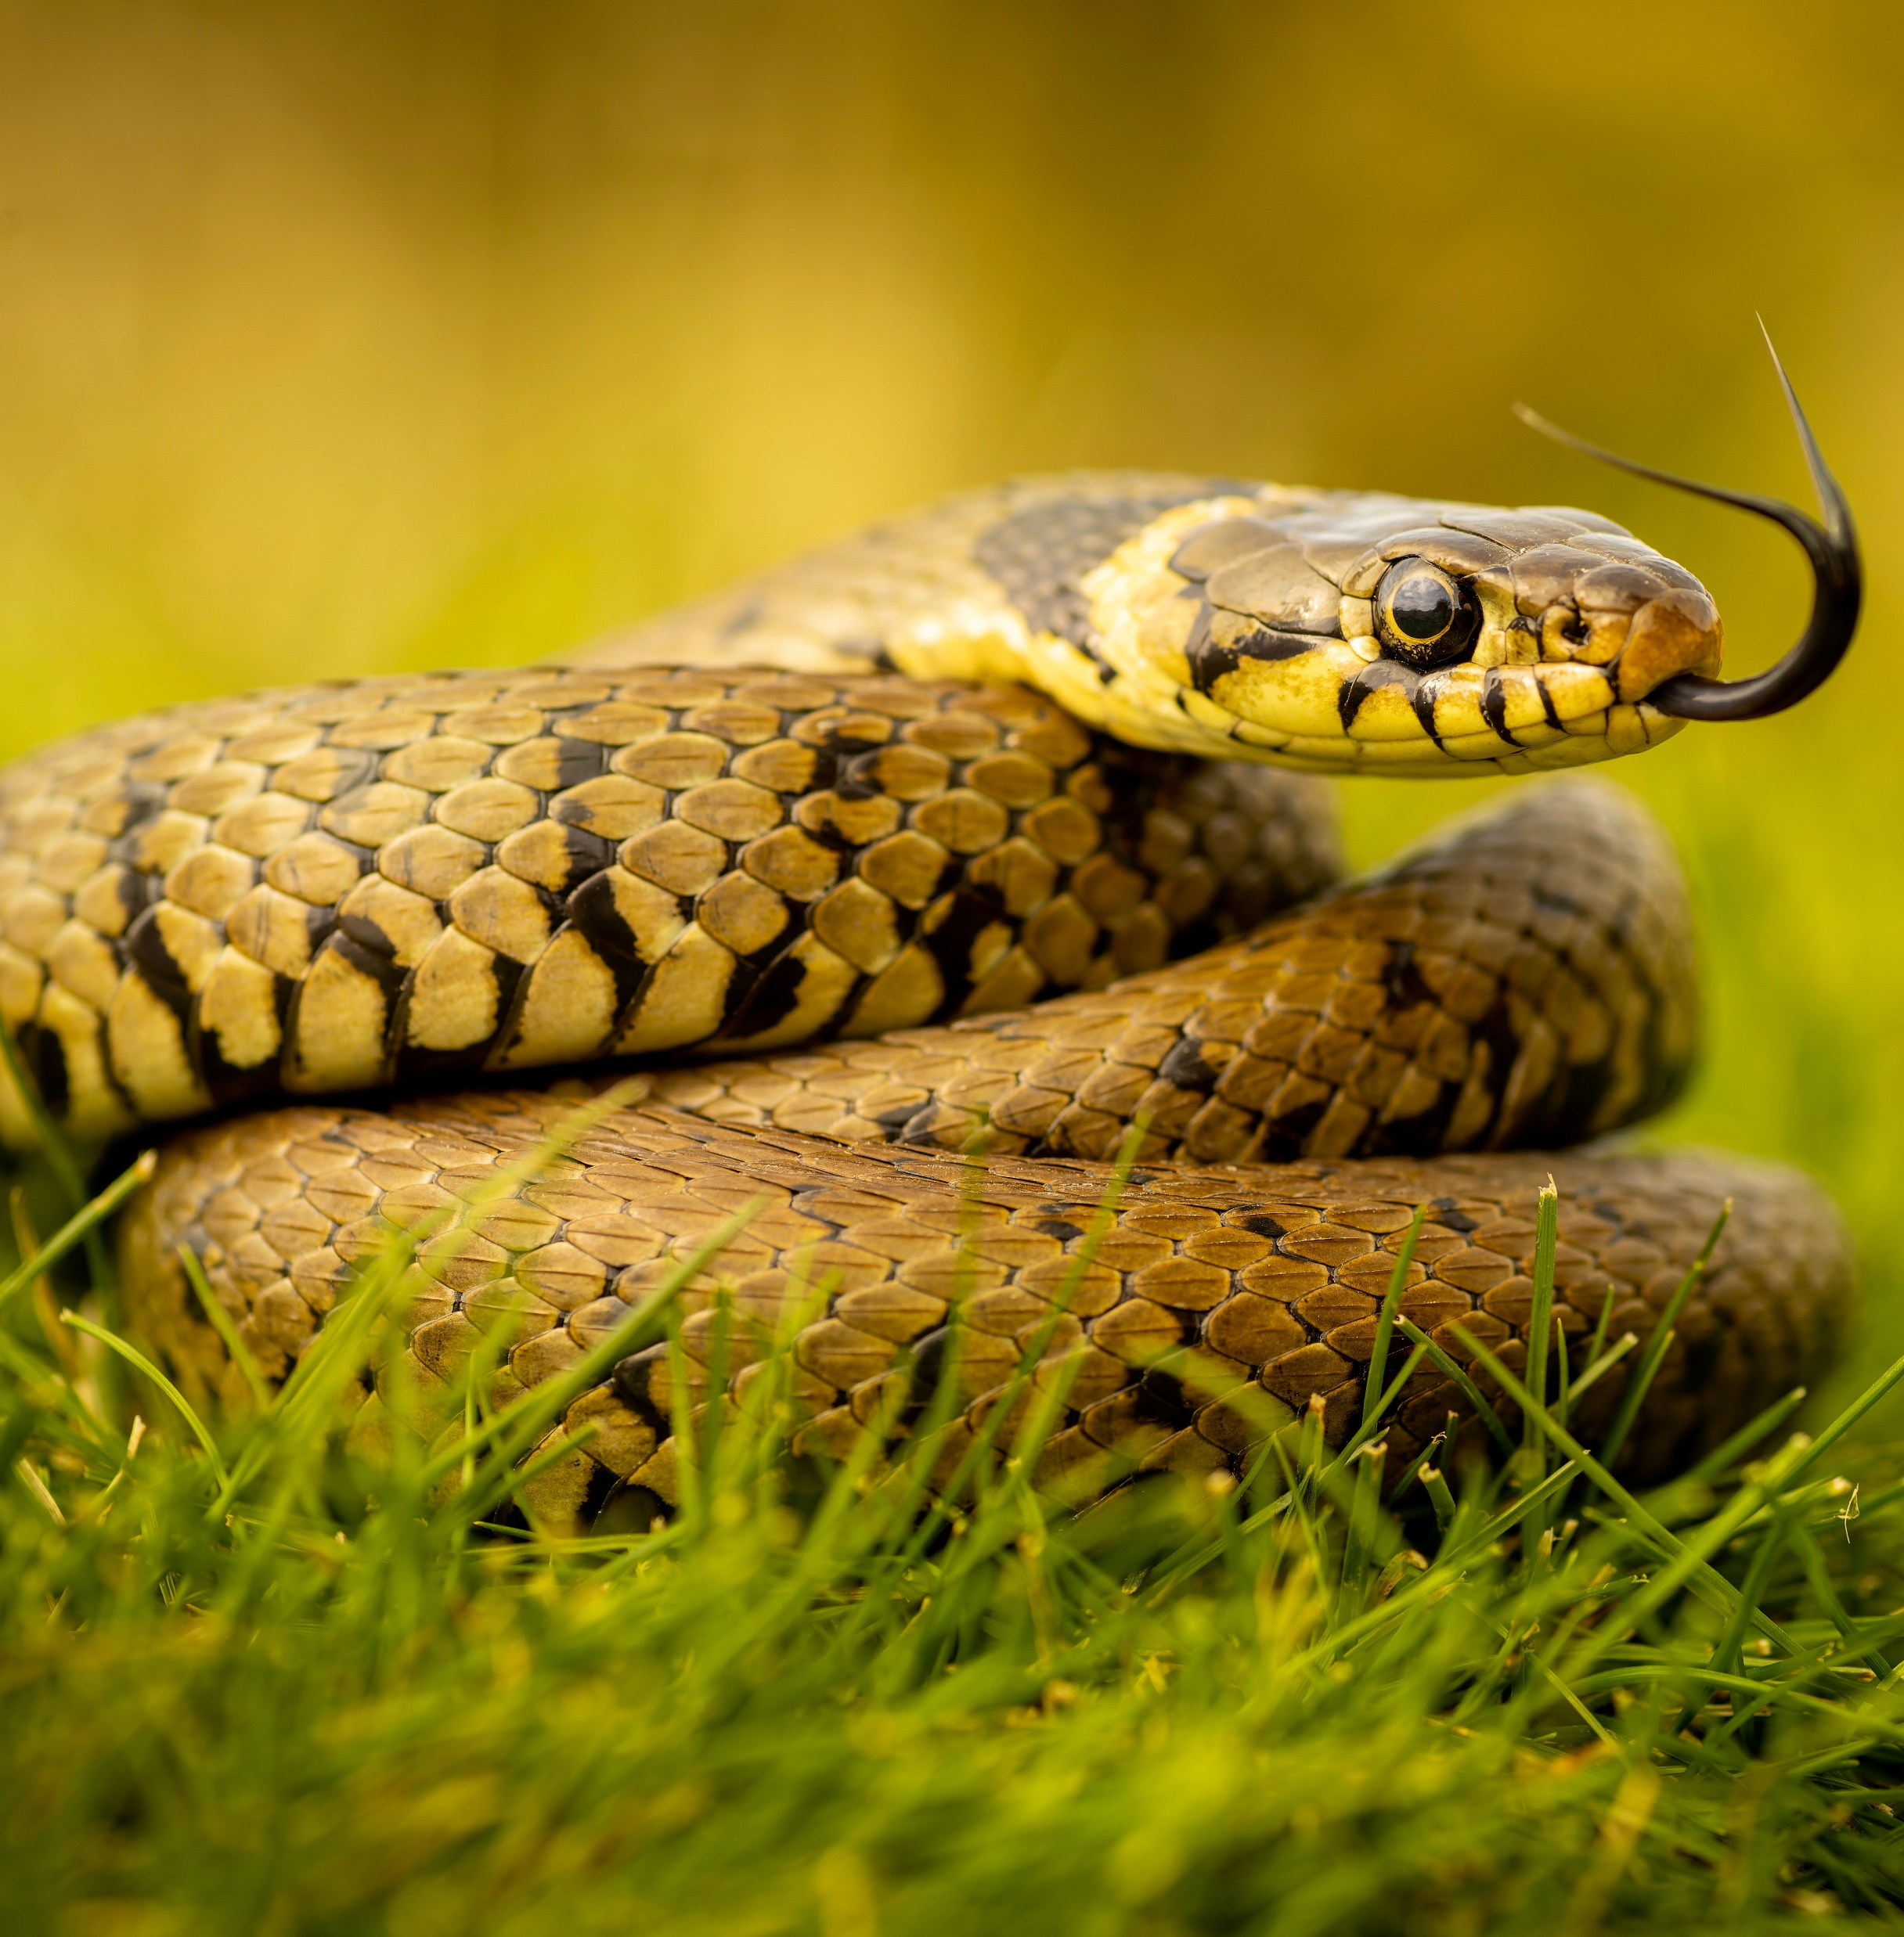
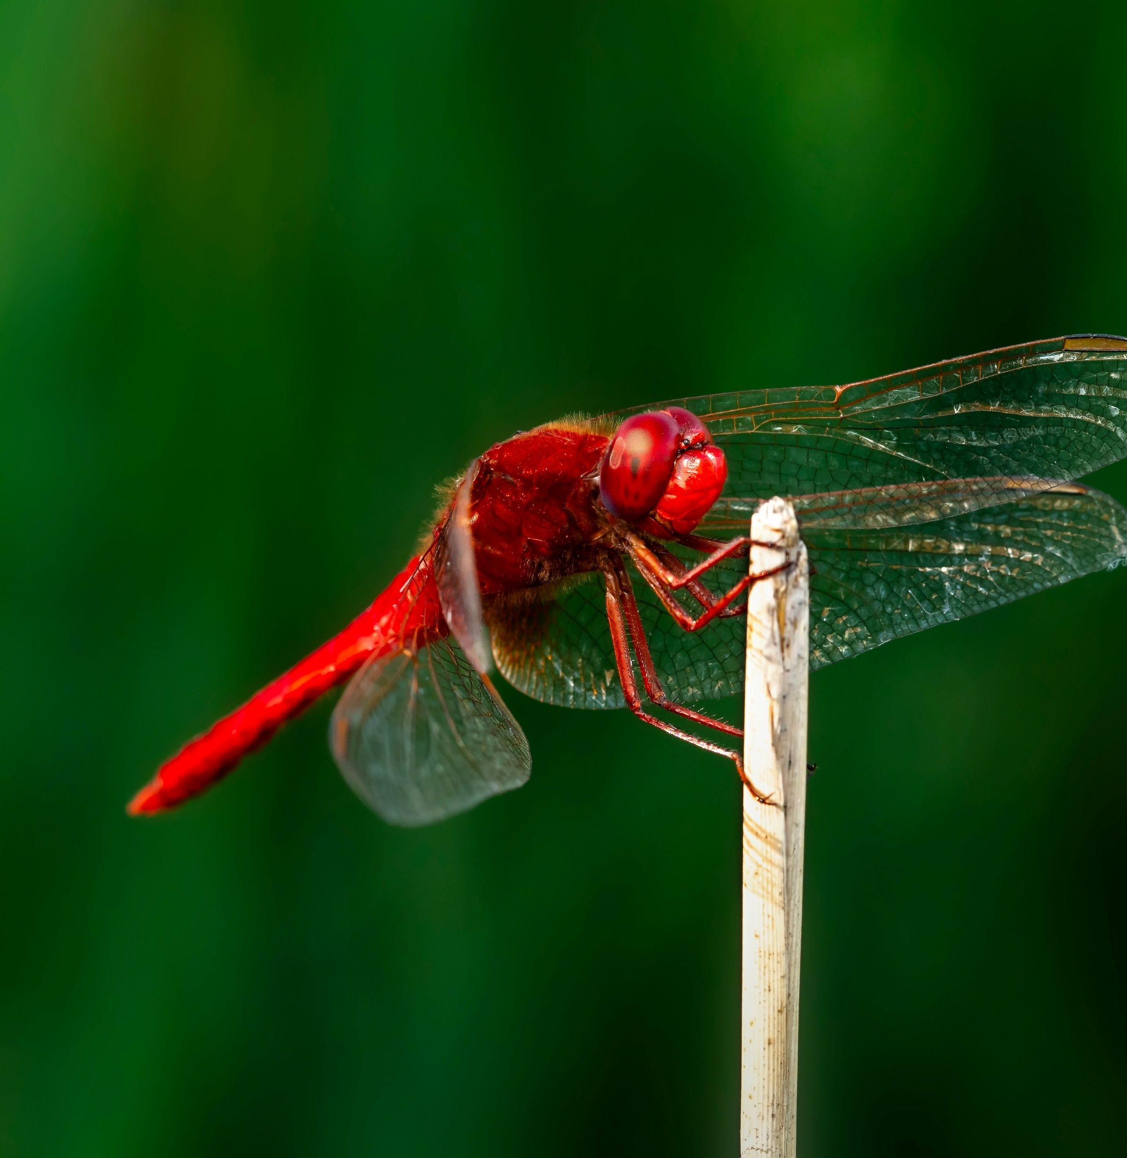
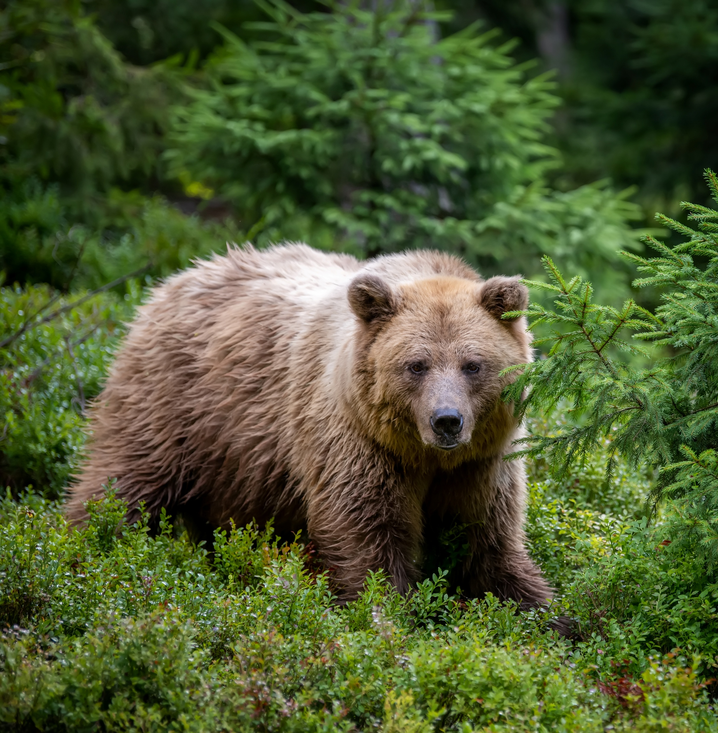
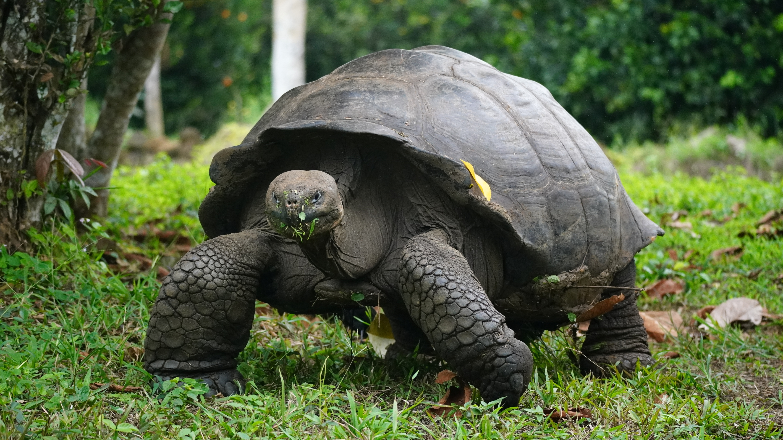
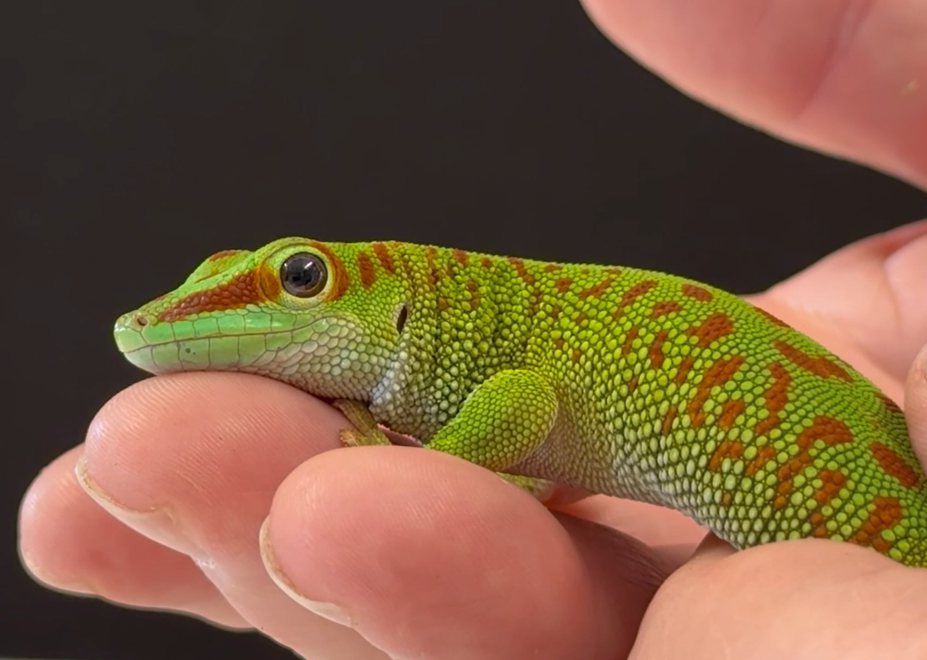
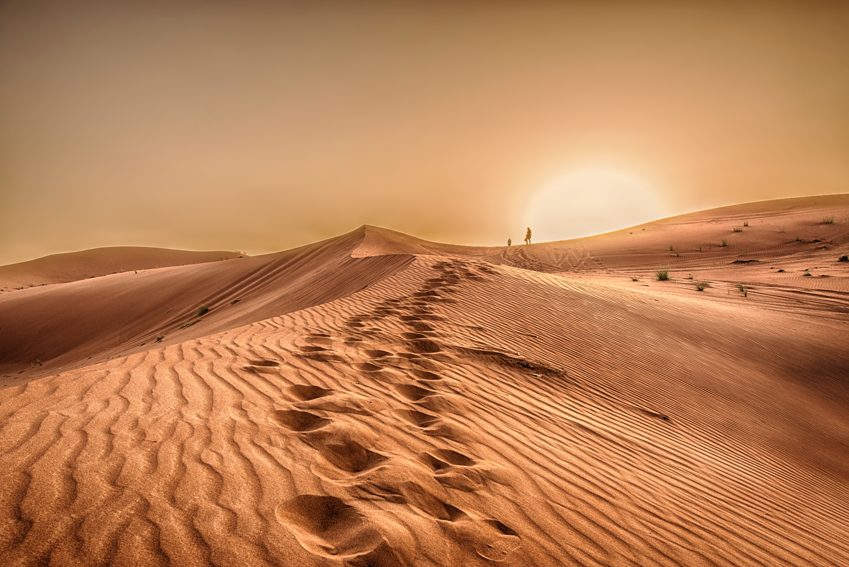
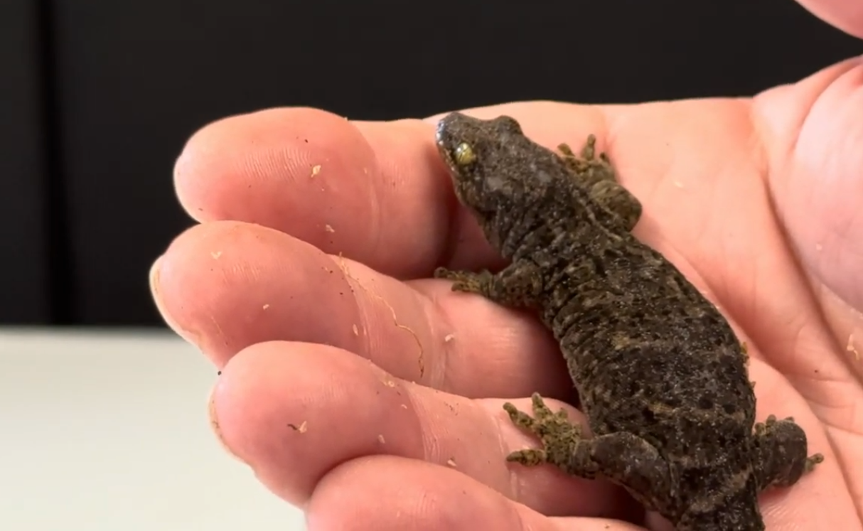
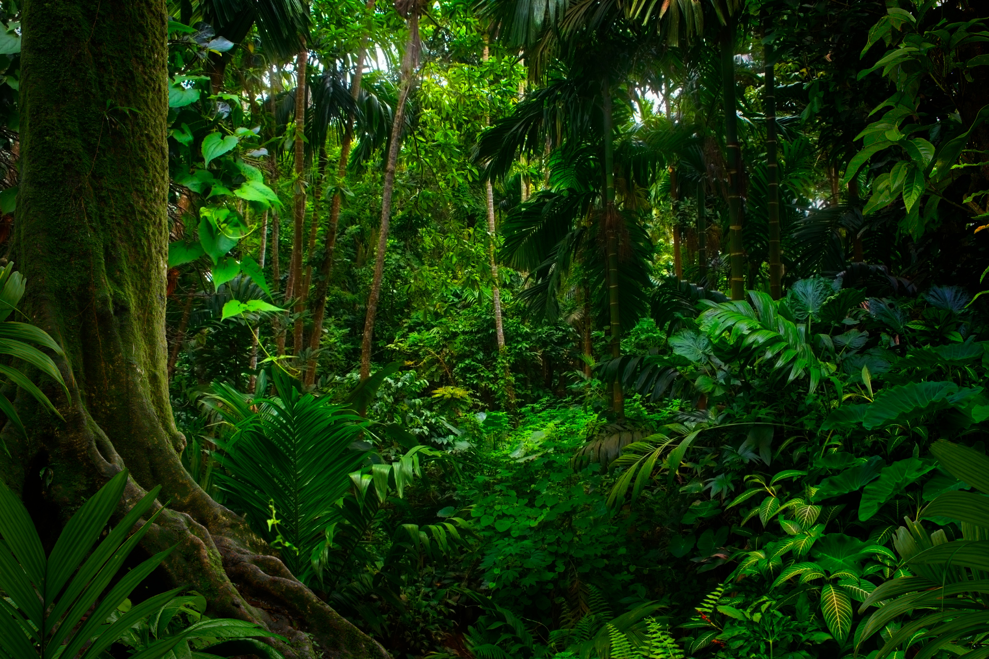
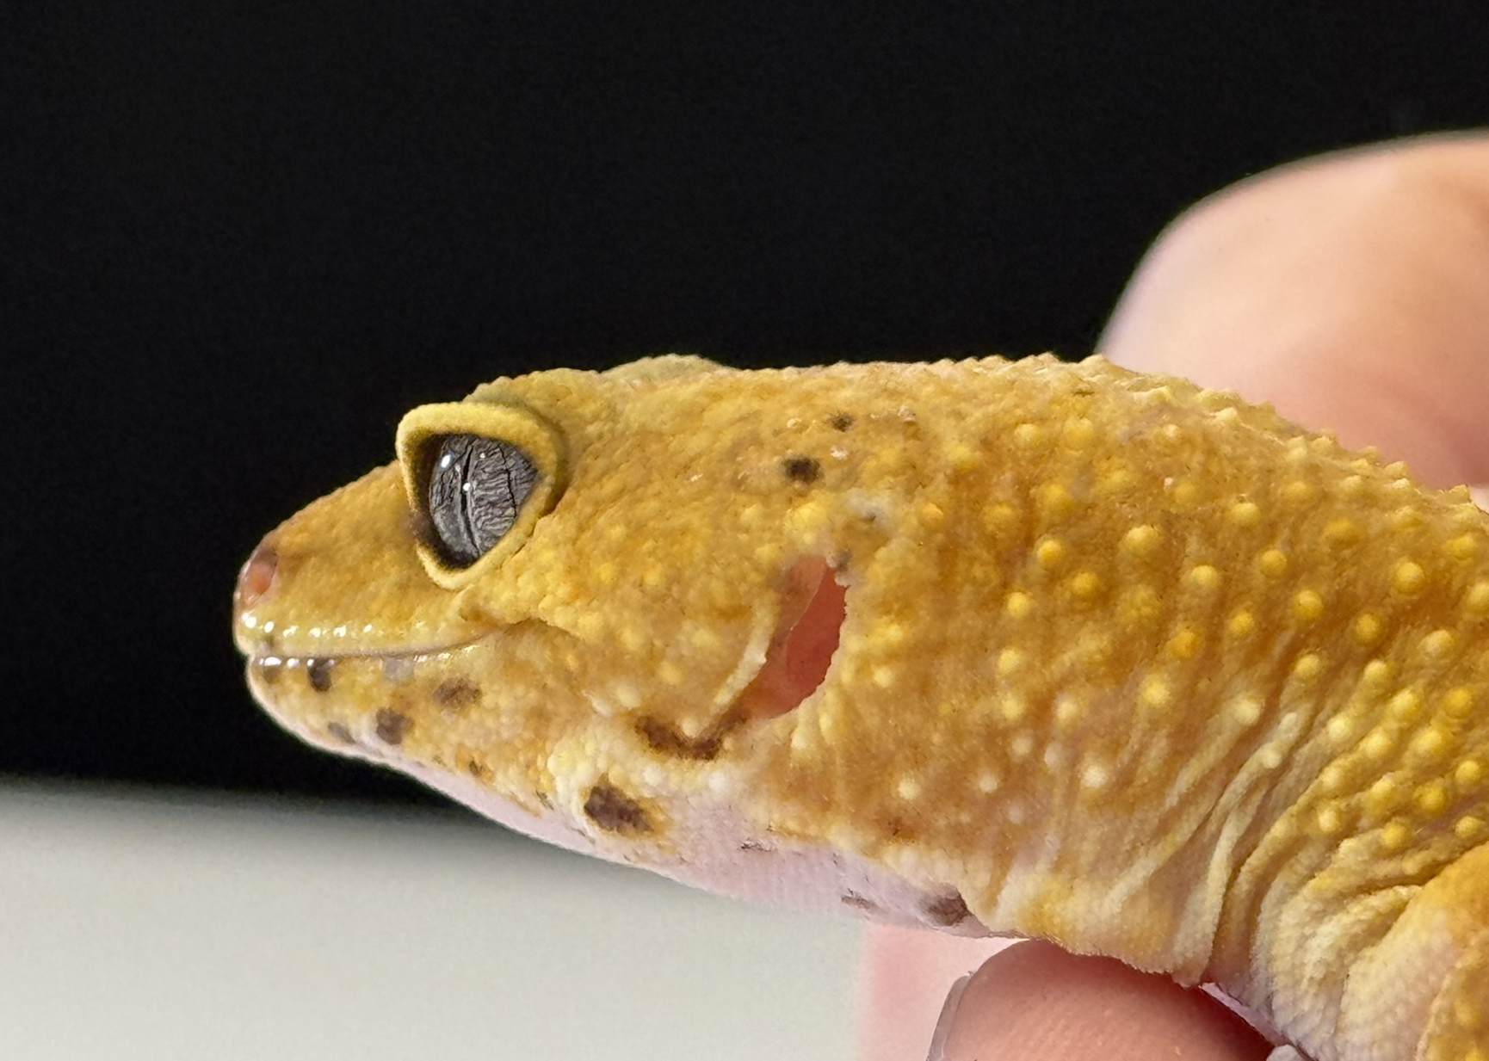
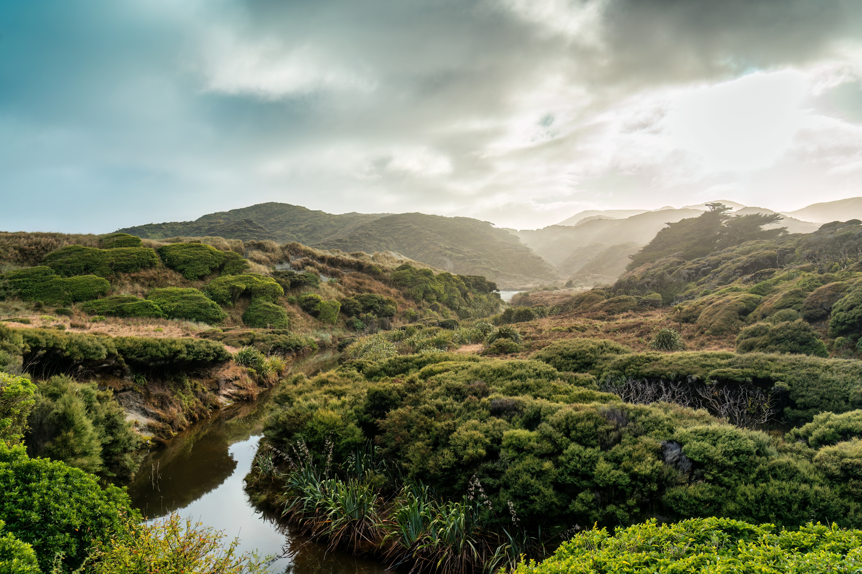
Science Week 2025
Remarkable Reptiles: Their Changes Over Time
EYFS Handout
Session 2
Activity 1: Tick the reptiles. ✓
Activity 2: Draw a line to match the gecko with where it lives. ✓
Madagascar day gecko
New Zealand gecko
leopard gecko
1
Developing Experts Copyright 2025 All Rights Reserved

Slide 2
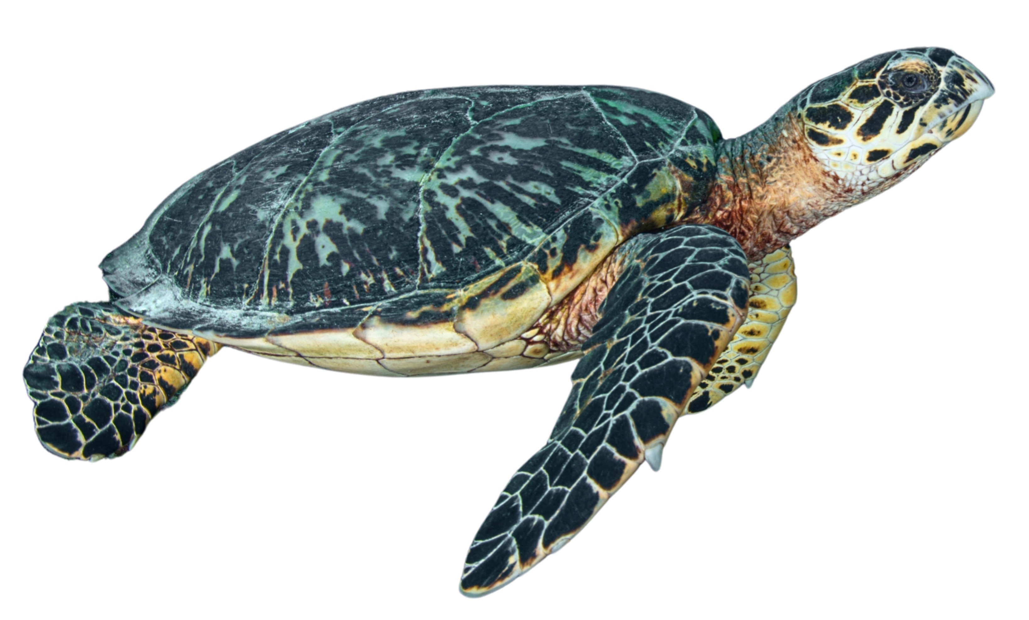
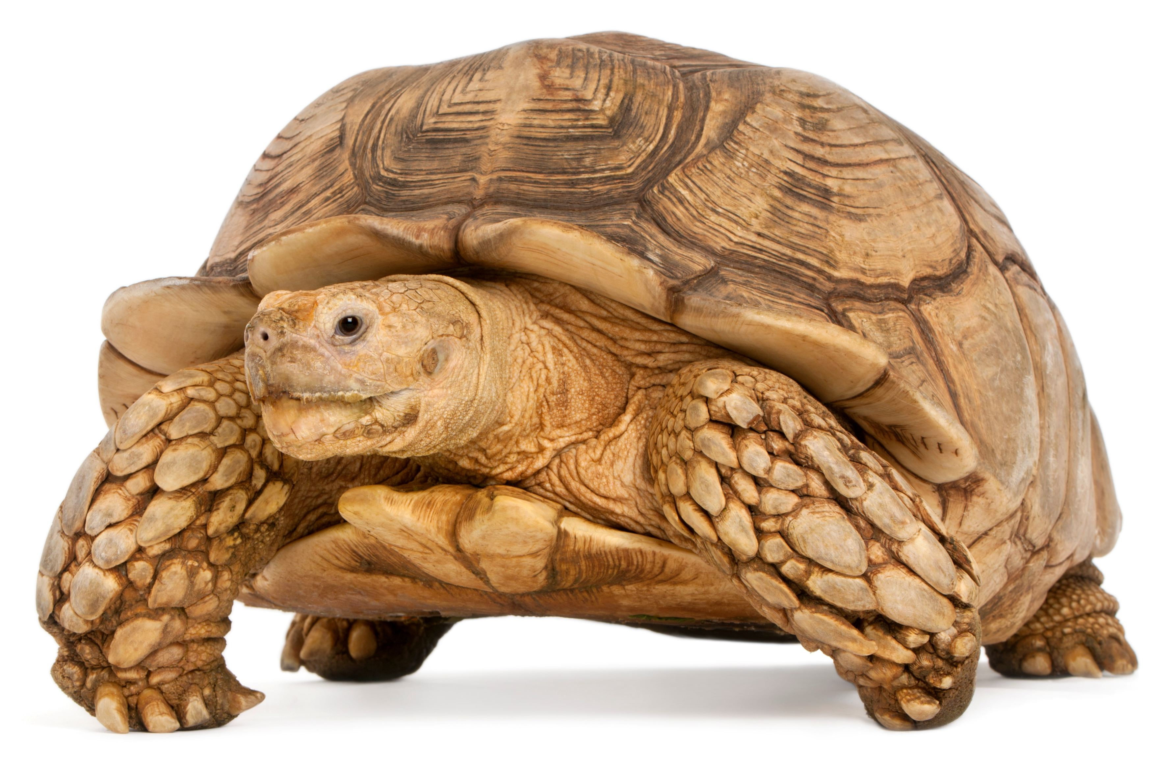
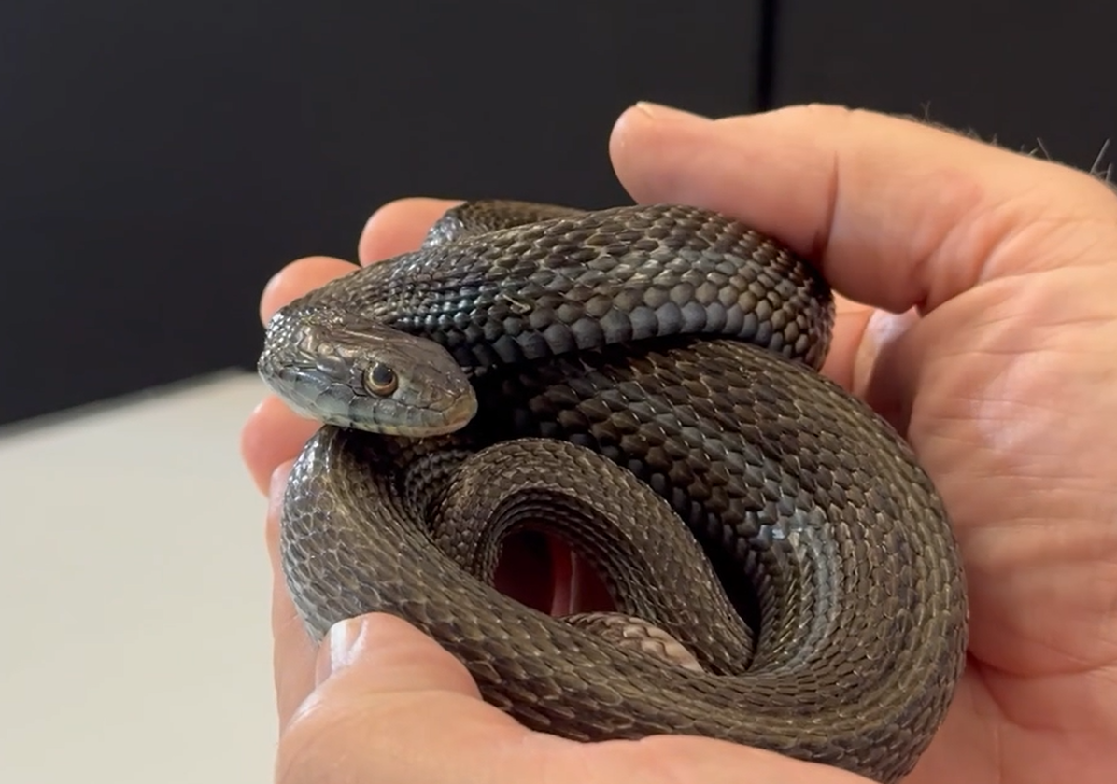
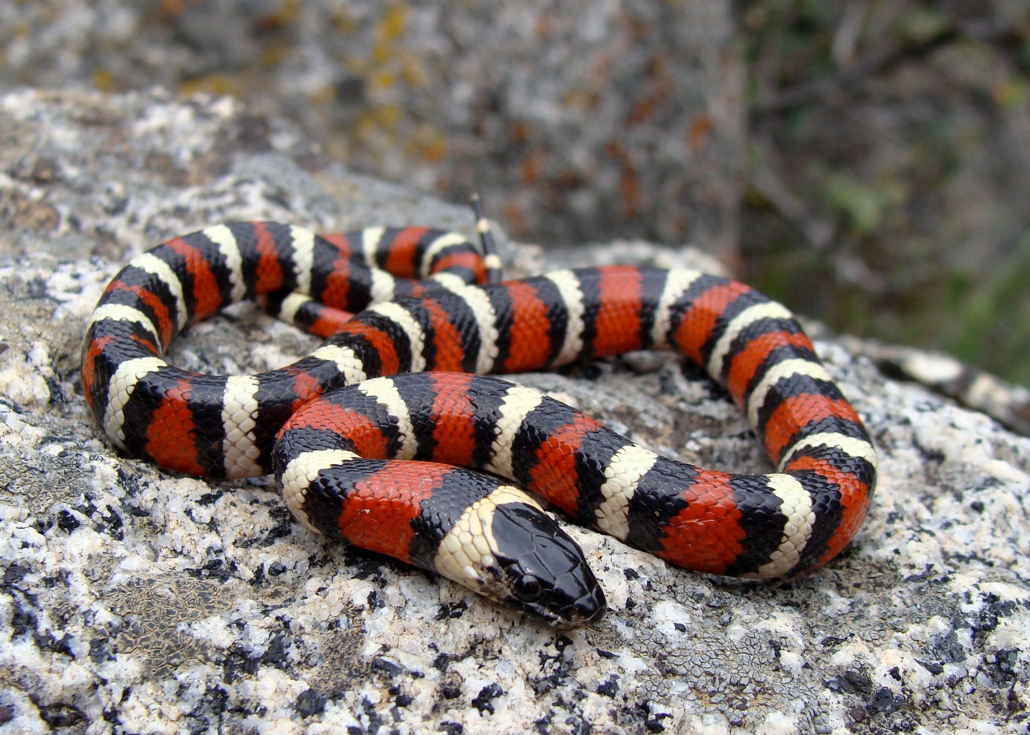
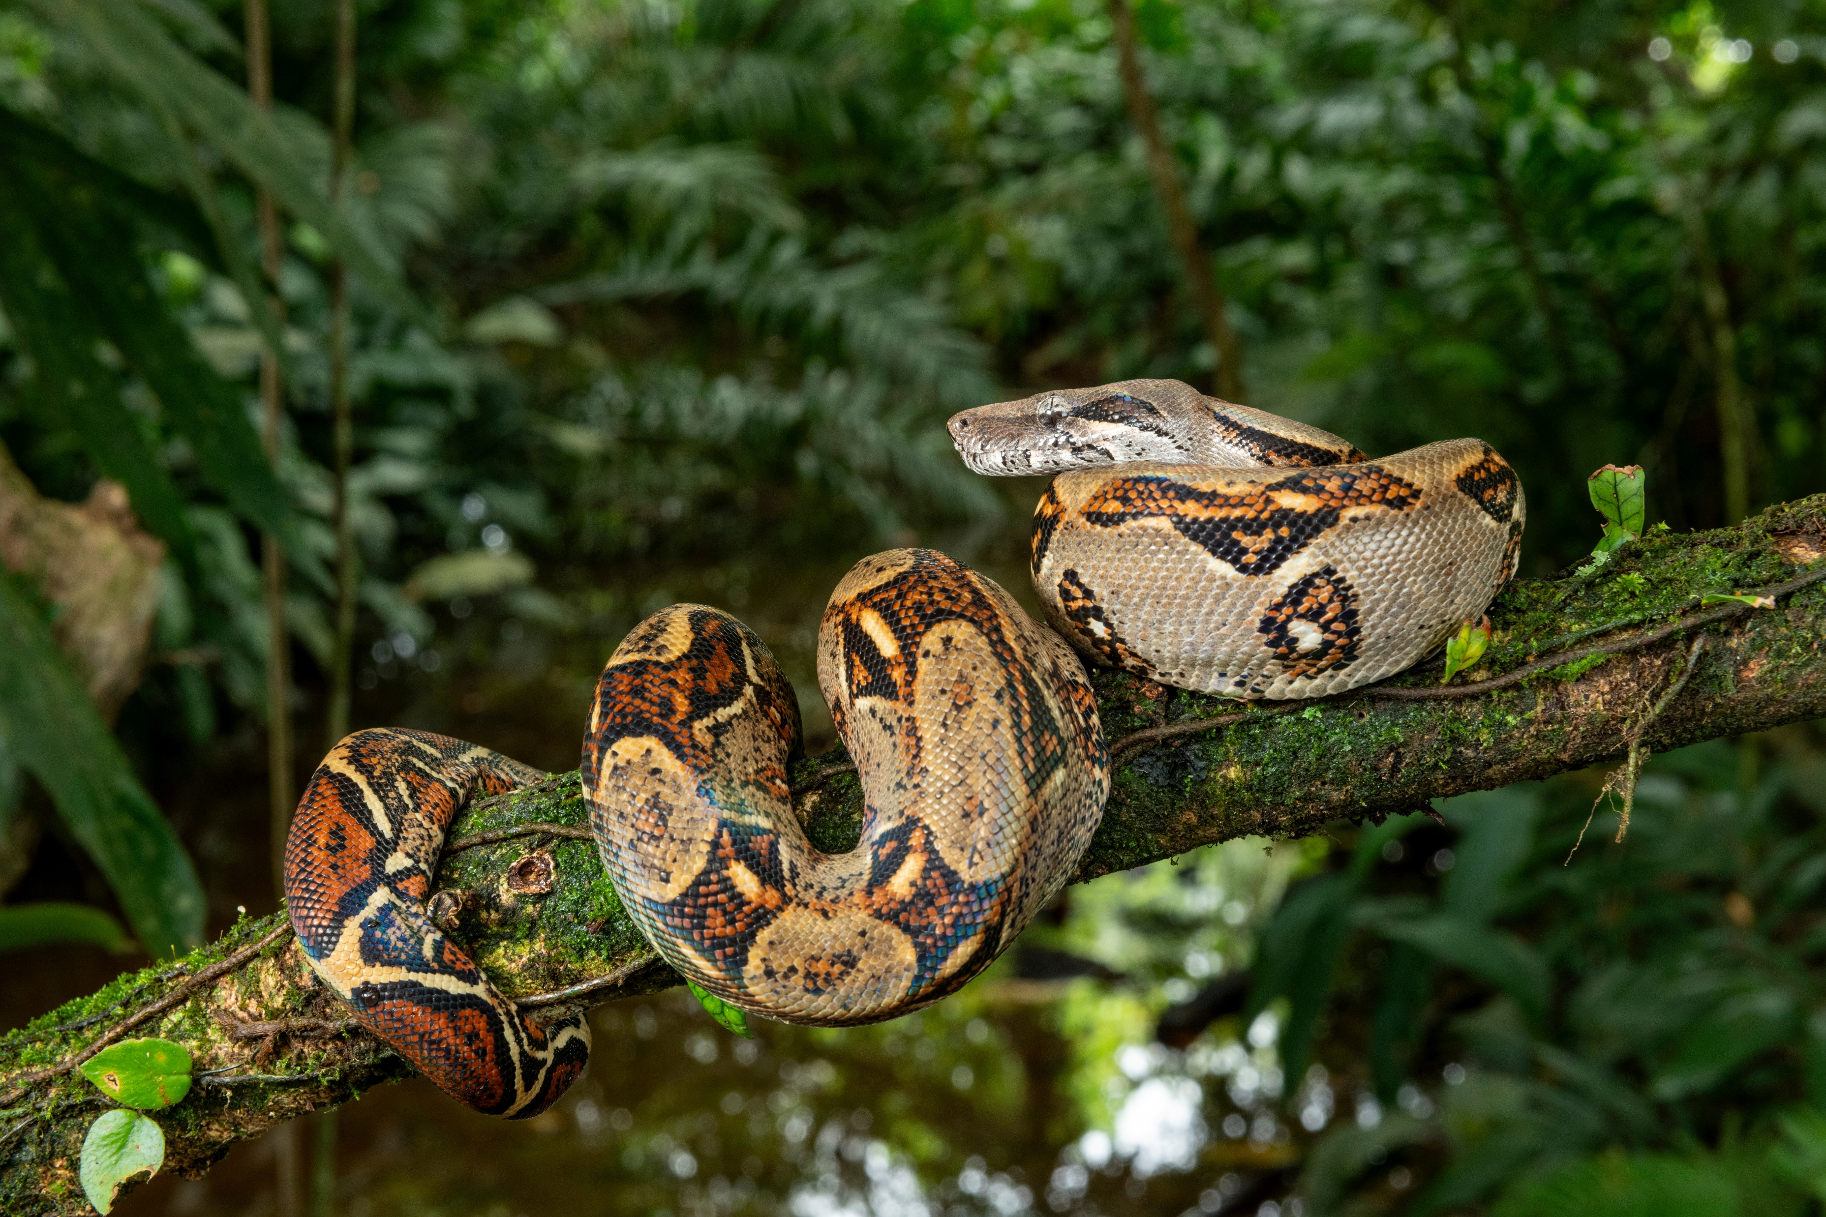
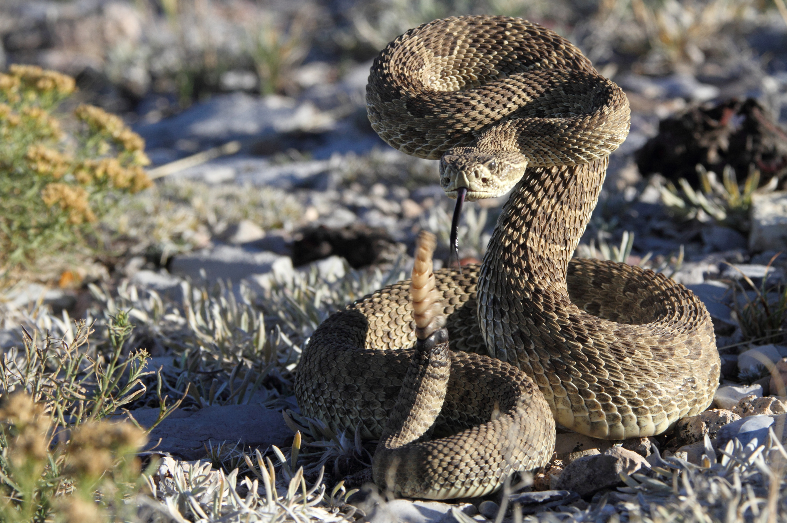
Science Week 2025
Remarkable Reptiles: Their Changes Over Time
EYFS – Teacher Pack and Answers
Session 2
Activity 3: What is the same? What is different?
turtle
tortoise
Activity 4: Discuss the facts you remember about these snakes. ✓
garter snake
king snake
boa constrictor
rattlesnake
Where does the snake live?
What does the snake like to eat?
What colours and shapes can you spot on the snake?
2
Developing Experts Copyright 2025 All Rights Reserved

