Slide 1
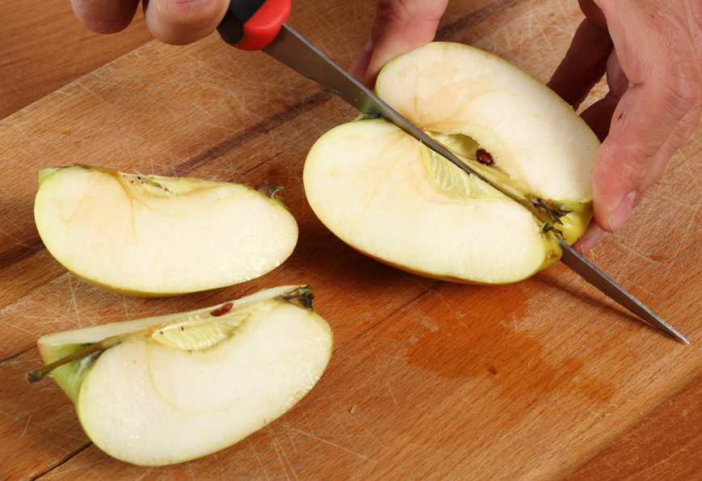
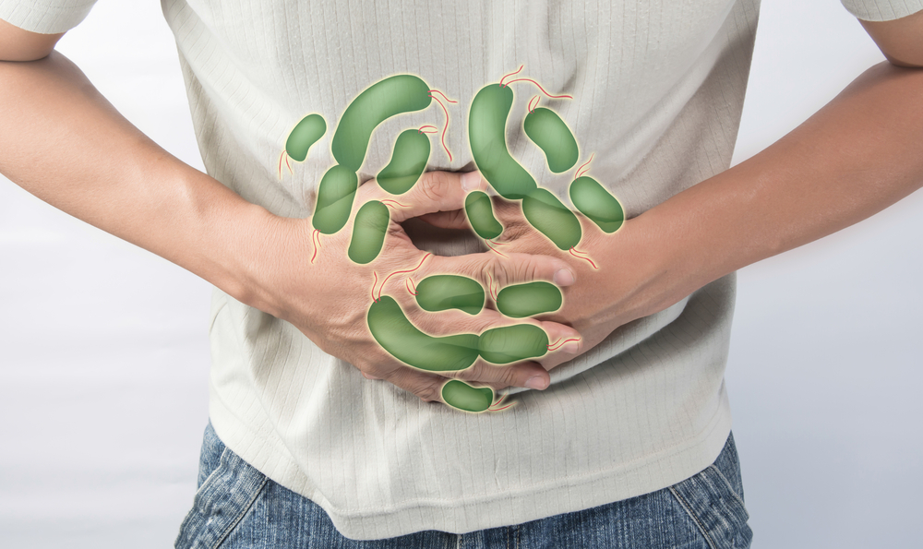
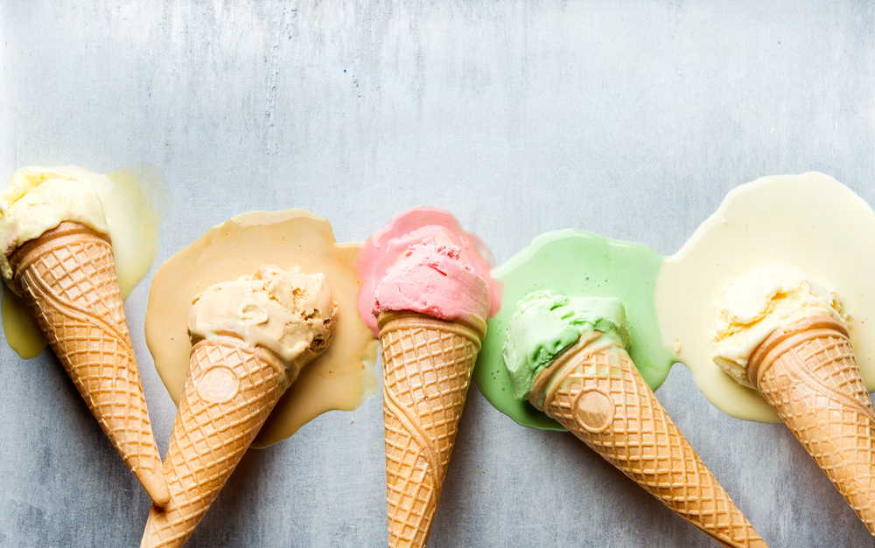
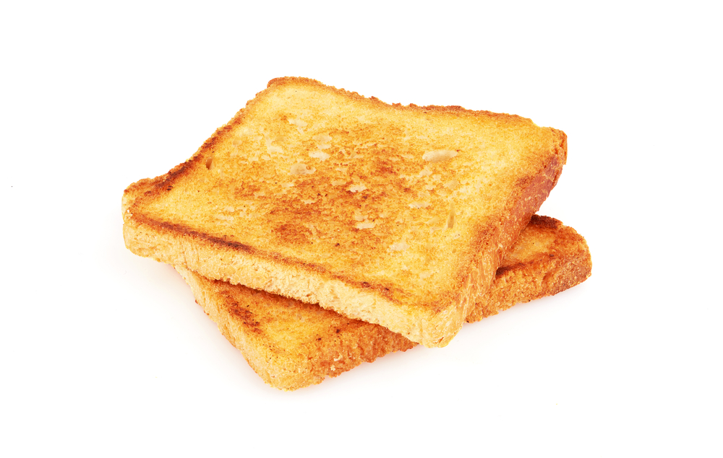
Explain if the items have undergone a permanent or temporary change. Then explain if the molecules have changed.
cutting an apple | This is a permanent / temporary change because… __________________________________________________________________________________ Explain if the molecules have changed. __________________________________________________________________________________
digesting food | This is a permanent / temporary change because… __________________________________________________________________________________ Explain if the molecules have changed. __________________________________________________________________________________
fireworks exploding | This is a permanent / temporary change because… __________________________________________________________________________________ Explain if the molecules have changed. __________________________________________________________________________________
melting ice cream | This is a permanent / temporary change because… __________________________________________________________________________________ Explain if the molecules have changed. __________________________________________________________________________________
making toast | This is a permanent / temporary change because… __________________________________________________________________________________ Explain if the molecules have changed. __________________________________________________________________________________

Slide 2
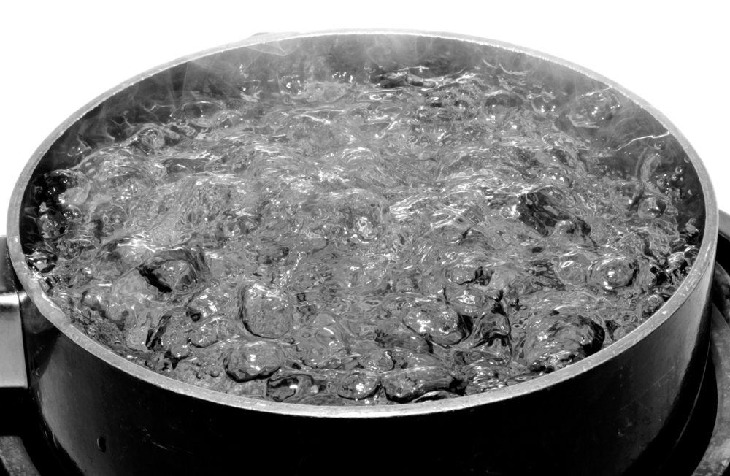
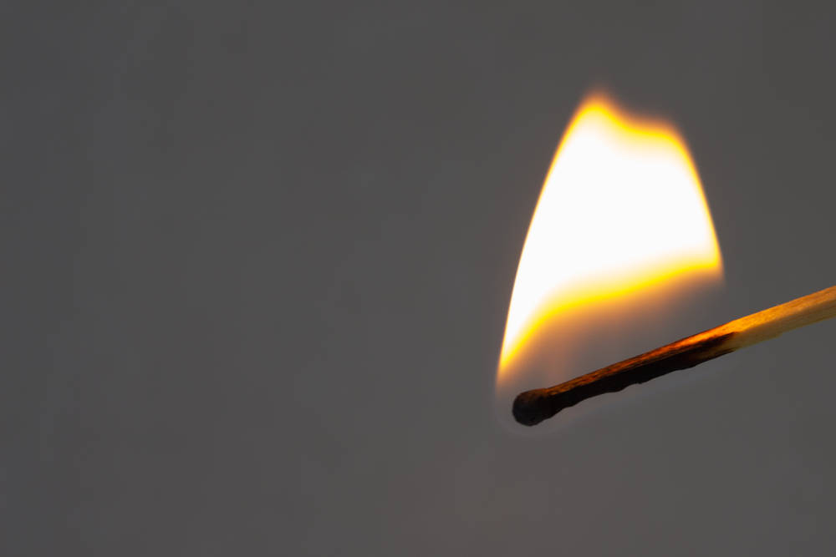
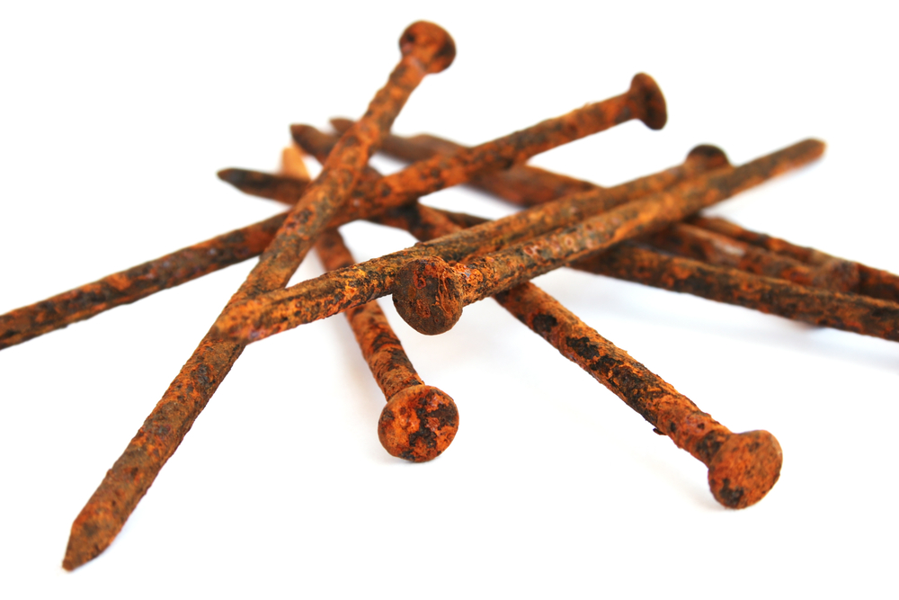
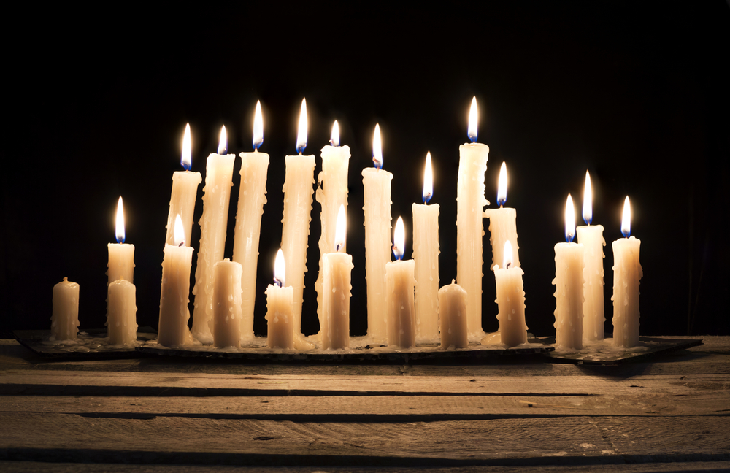
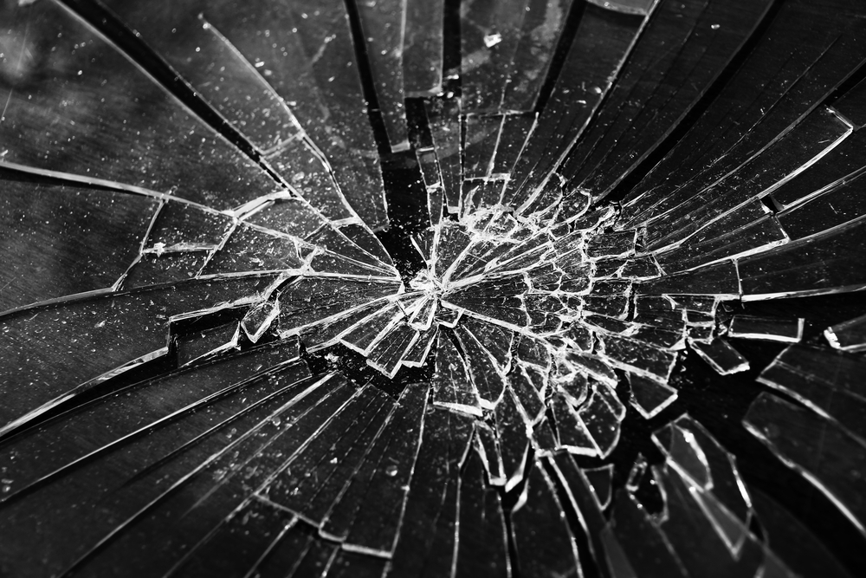
Explain if the items have undergone a permanent or temporary change. Then explain if the molecules have changed.
boiling water | This is a permanent / temporary change because… __________________________________________________________________________________ Explain if the molecules have changed. __________________________________________________________________________________
burning match | This is a permanent / temporary change because… __________________________________________________________________________________ Explain if the molecules have changed. __________________________________________________________________________________
rusting nails | This is a permanent / temporary change because… __________________________________________________________________________________ Explain if the molecules have changed. __________________________________________________________________________________
melting wax | This is a permanent / temporary change because… __________________________________________________________________________________ Explain if the molecules have changed. __________________________________________________________________________________
breaking glass | This is a permanent / temporary change because… __________________________________________________________________________________ Explain if the molecules have changed. __________________________________________________________________________________

