Slide 1


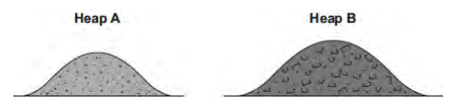
Mission Assignment: Explain decay
Code: KS4_07_11
Answer questions related to compost and decomposition in gardens
Task 1: A gardener investigates if turning over the waste in a compost heap makes the waste decay more quickly. The gardener:
makes two separate heaps of garden waste, heap A and heap B
turns over the material in heap A every 2 weeks
does not turn over the material in heap B
estimates the amount of decay in the two heaps after 6 months.
The diagram shows the two heaps of garden waste at the beginning of the investigation:
(A) Suggest two factors, other than time, the gardener should control to make the investigation fair.
1.____________________________________________________________________________________________________________________________________________________________________________________________________________________________________________________ 2.____________________________________________________________________________________________________________________________________________________________________________________________________________________________________________________
(B) Name one type of living thing that causes decay.
__________________________________________________________________________________
Developing Experts Copyright 2022 All Rights Reserved

Slide 2
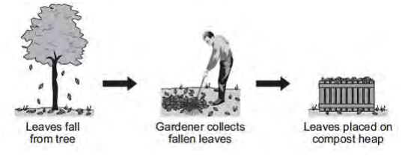
Mission Assignment: Explain decay
Code: KS4_07_11
Task 1 continued:
(C) The gardener’s results are shown in the table.
Compost heap | Estimated amount of decay
A | A lot
B | Very little
(i) Why does turning over the material in heap A make the material decay faster?
____________________________________________________________________________________________________________________________________________________________________
(ii) The gardener puts decayed material around his plants to help them grow. Suggest why the plants in a woodland grow well each year without material from compost heaps being added.
________________________________________________________________________________________________________________________________________________________________________________________________________________________________________________________________________________________________________________________________________
Task 2: Gardeners often collect fallen leaves in autumn and place them on compost heaps in the garden.
(A) Over the next year the leaves decay. Which living things cause decay?
__________________________________________________________________________________
(B) The leaves decay more quickly in summer than in winter. Give one reason why.
____________________________________________________________________________________________________________________________________________________________________
(C) The compost heap has holes in its sides to let gases enter. Which gas is needed for decay? Tick one box.
  Carbon dioxide
  Nitrogen
  Oxygen
Developing Experts Copyright 2022 All Rights Reserved

