Slide 1
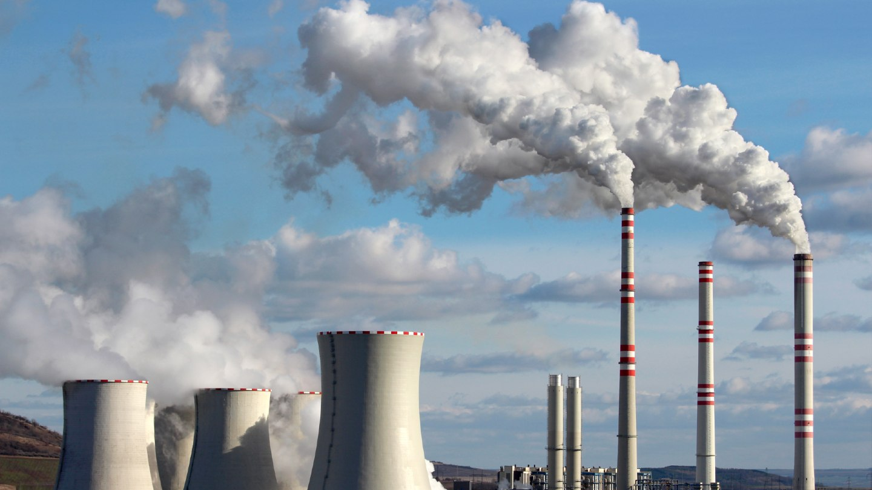
Developing Experts All rights reserved © 2021

Slide 2
Fossil fuels are:
coal, oil, and gas.
Developing Experts All rights reserved © 2021

Slide 3

Explore non-renewable energy resources - fossil fuels
Define a non-renewable energy resource.
Name some non-renewable energy resources.
Describe the environmental impact of using some non-renewable resources.
Explain the scientific, environmental, social, ethical and economic considerations when using some non-renewable resources.
Developing Experts All rights reserved © 2021

Slide 4
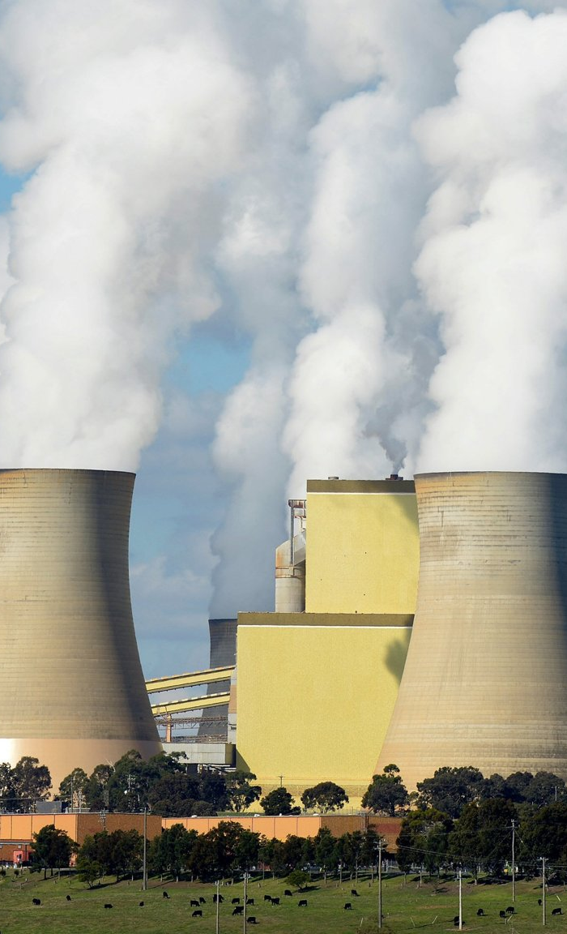


Uses of energy
Transport
Generating Electricity
Heating
Developing Experts All rights reserved © 2021
Developing Experts All rights reserved © 2021

Slide 5
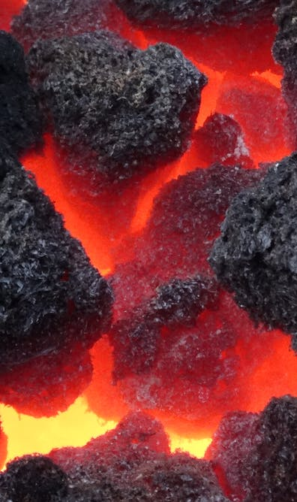

Coal
Oil
Gas
Coal
Generating Electricity
Developing Experts All rights reserved © 2021
Developing Experts All rights reserved © 2021

Slide 6

Developing Experts All rights reserved © 2021

Slide 7
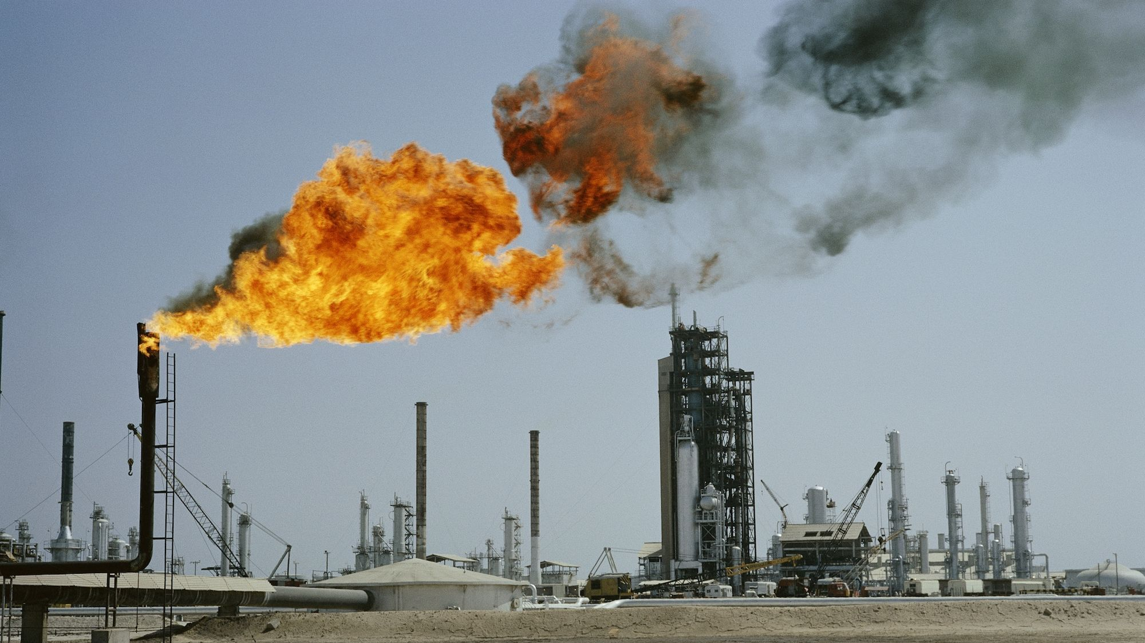
Developing Experts All rights reserved © 2021

Slide 8
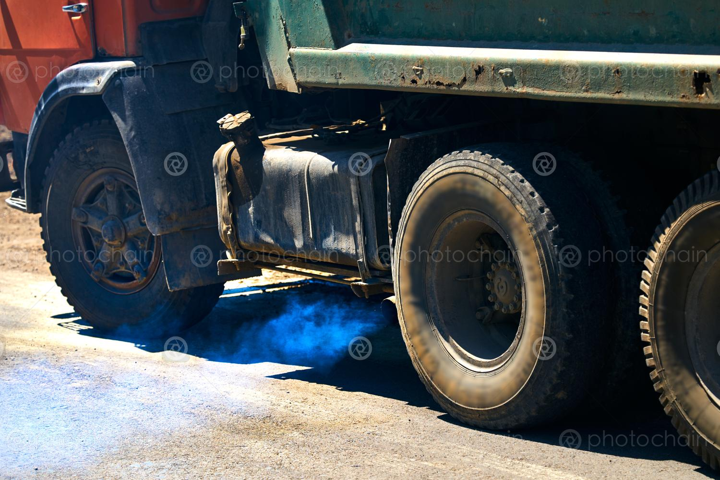
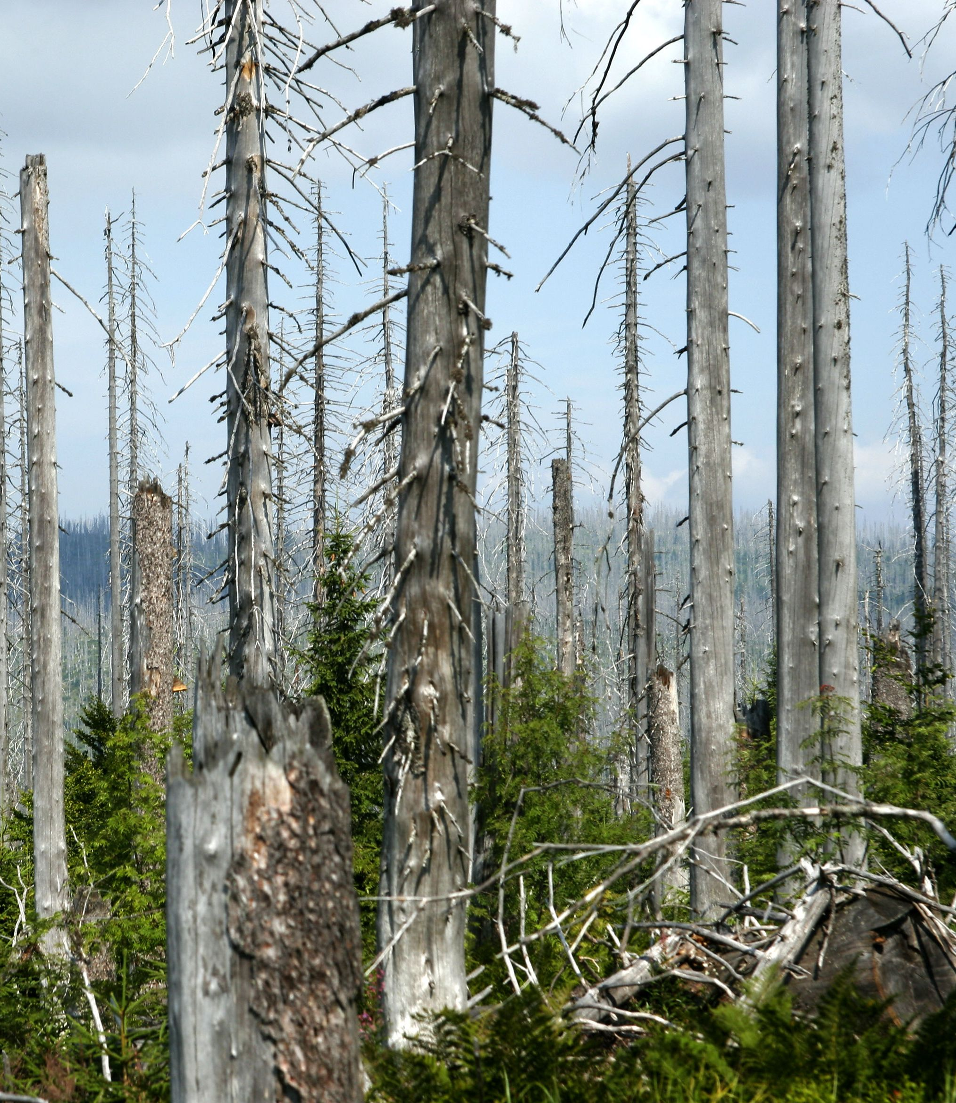
exhaust fumes
acid rain
Developing Experts All rights reserved © 2021

Slide 9
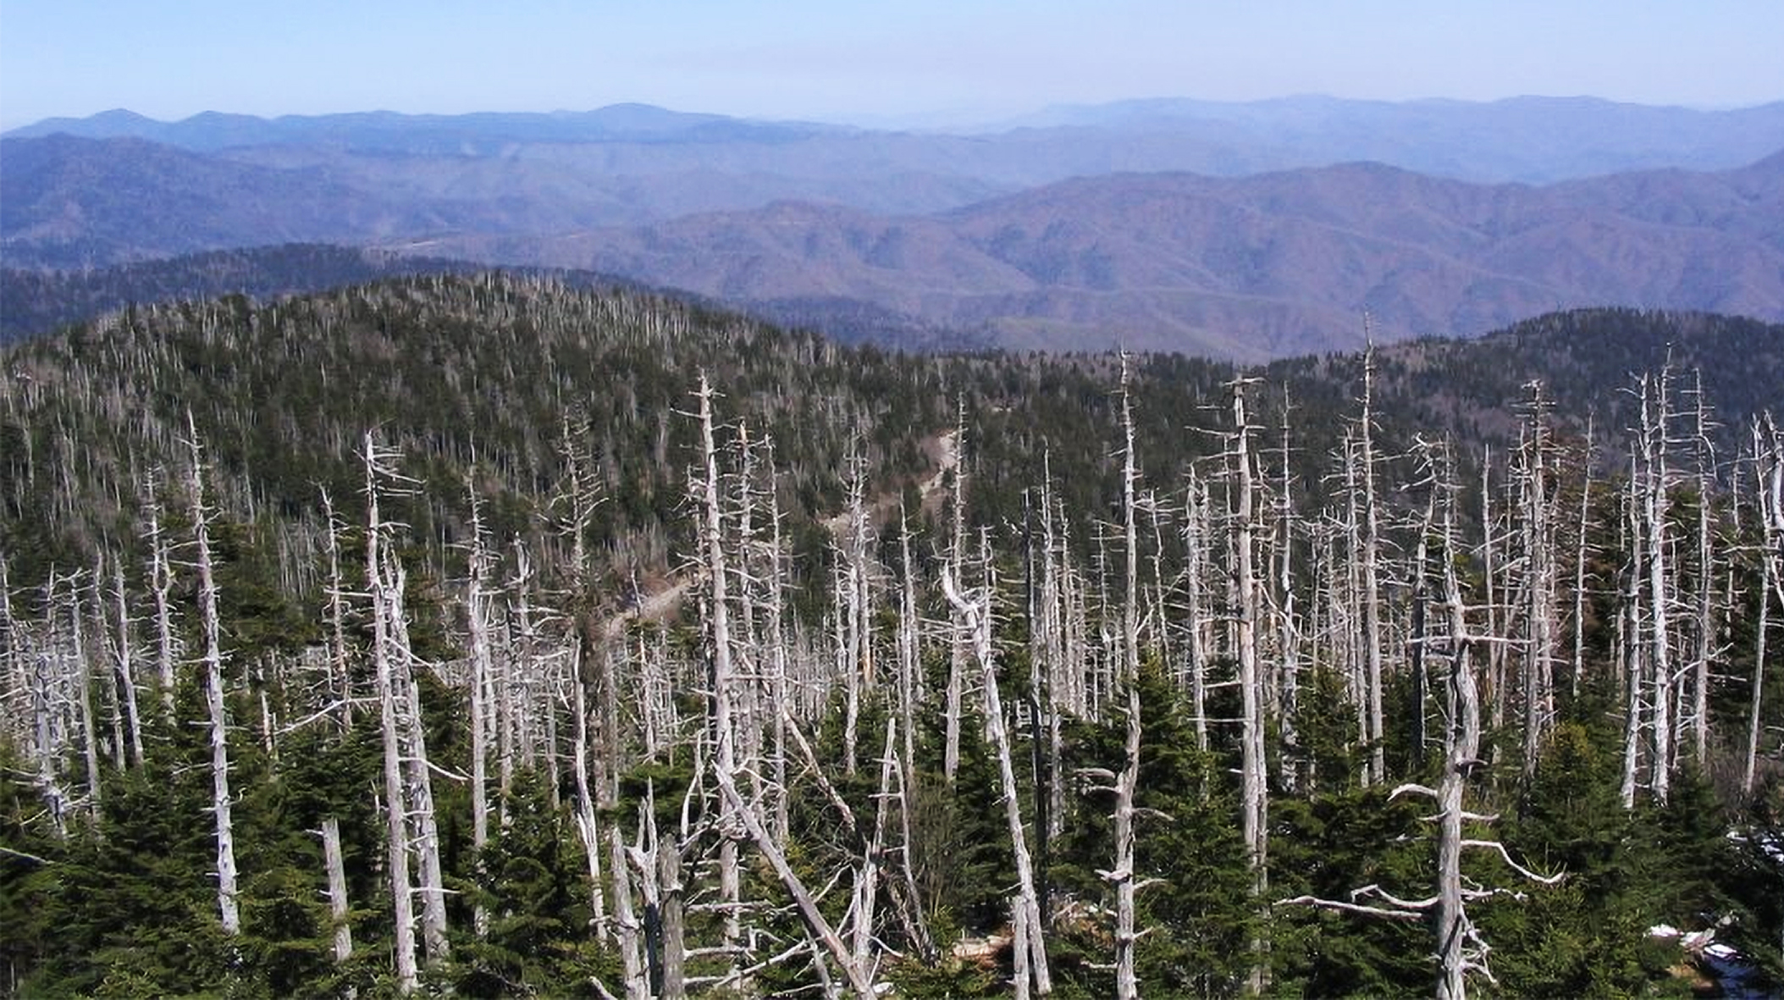
Developing Experts All rights reserved © 2021

