Slide 1
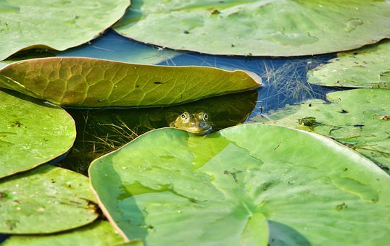
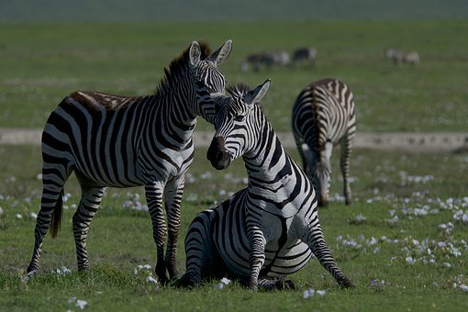
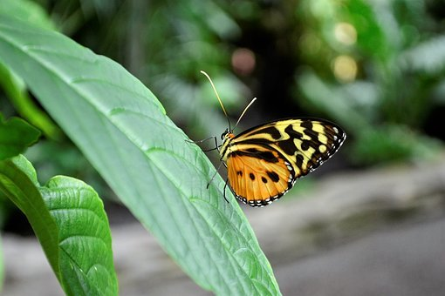
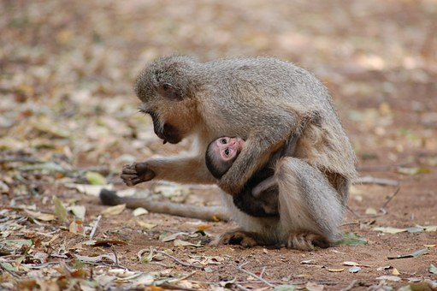

Slide 2

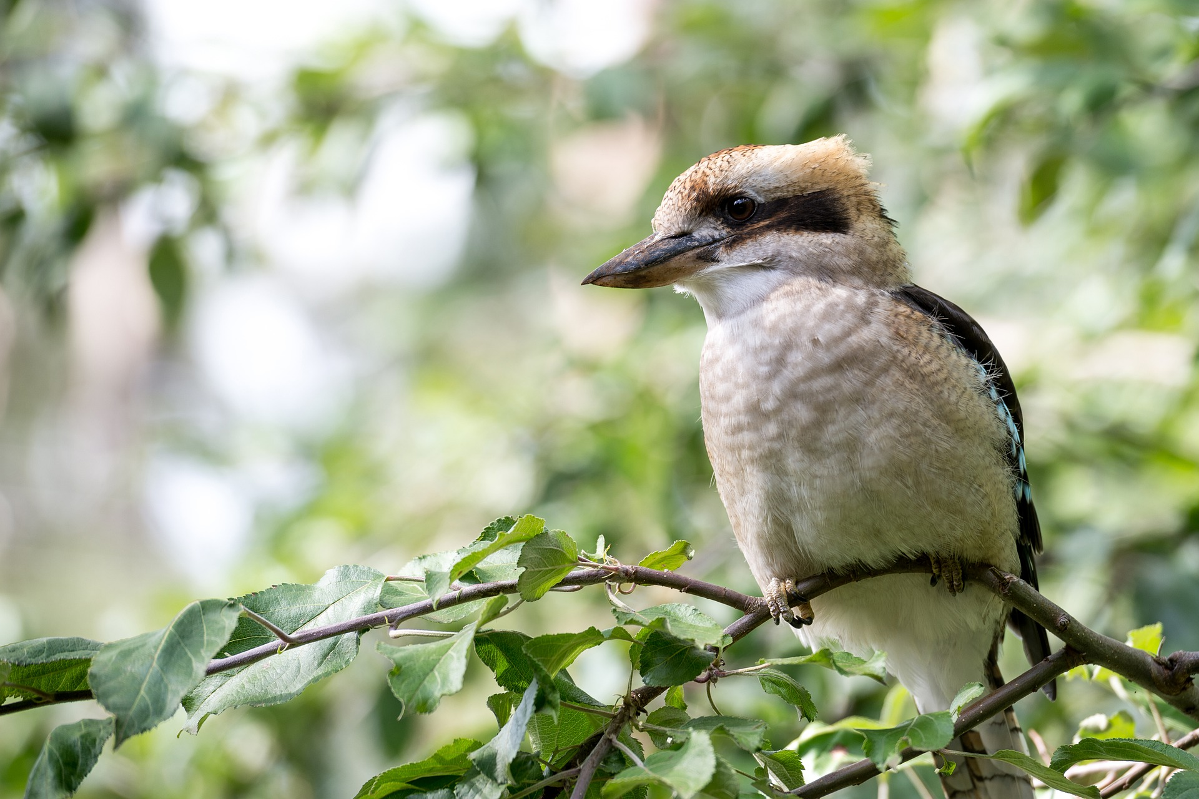
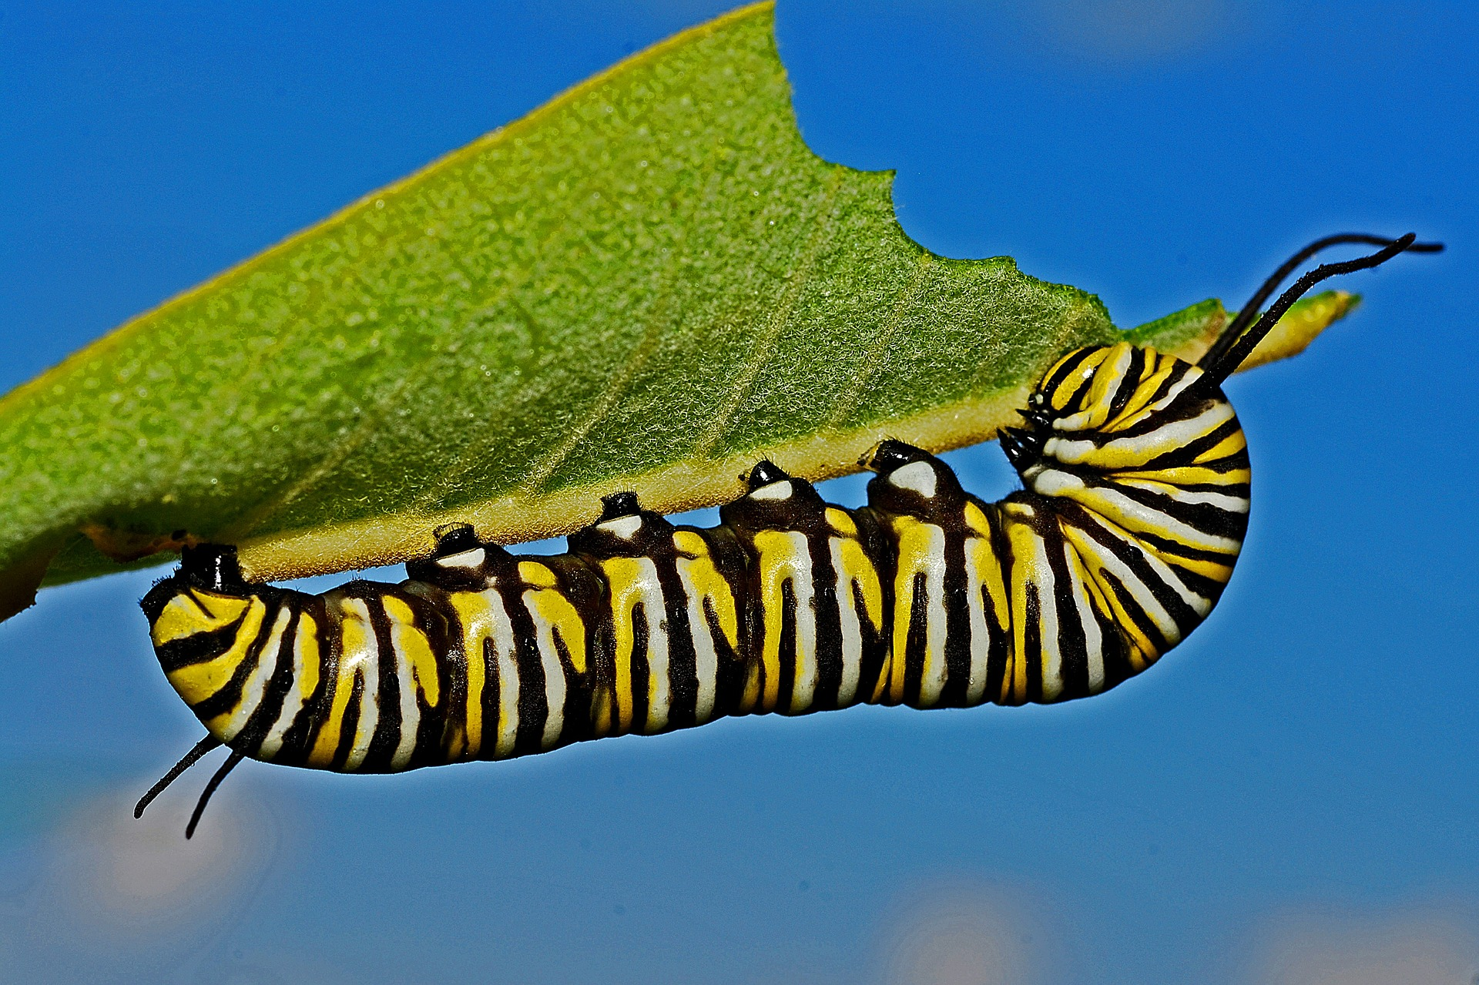
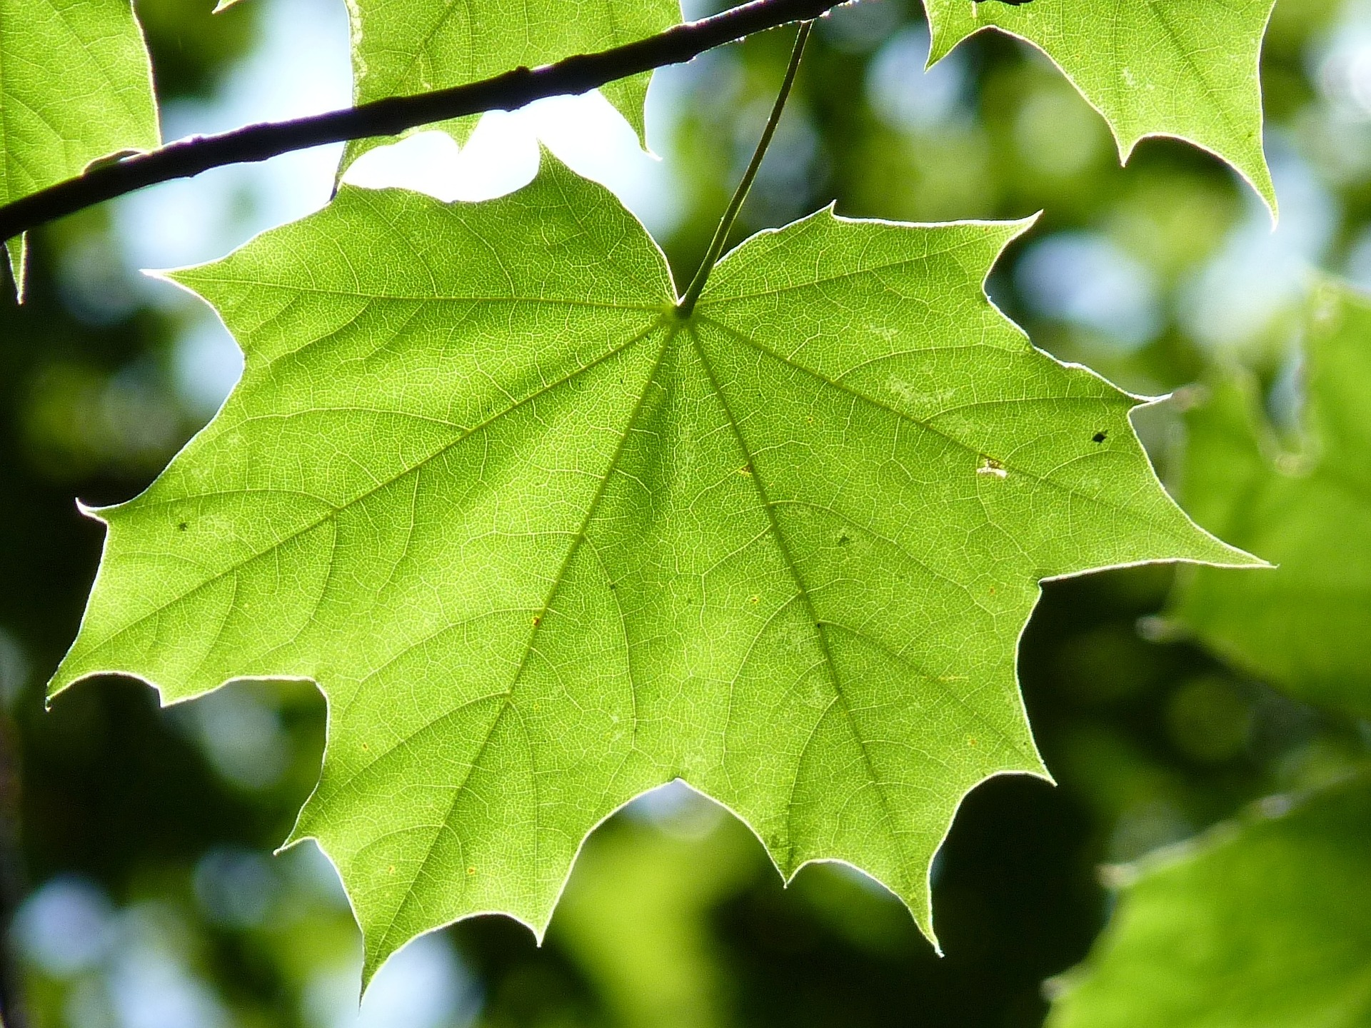
TERTIARY CONSUMER
SECONDARY CONSUMER
PRIMARY CONSUMER
PRODUCER
BIRD of PREY
BIRD
CATERPILLAR
TREE LEAF
BIOMASS (glucose/energy)

Slide 3

PRODUCERS

Slide 4
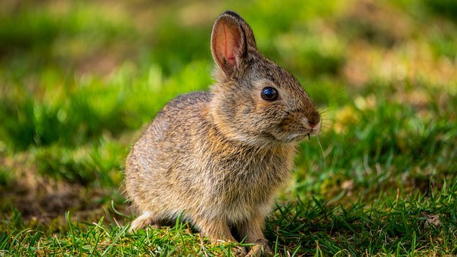
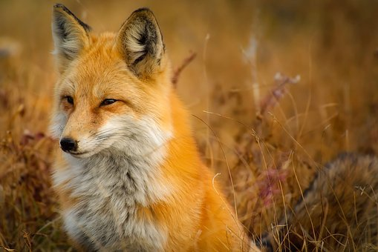
primary consumer
secondary consumer
herbivore
carnivore

Slide 5
TERTIARY CONSUMER
SECONDARY CONSUMER
PRIMARY CONSUMER
PRODUCER
BIRD of PREY
BIRD
CATERPILLAR
TREE LEAF

Slide 6
TERTIARY CONSUMER
SECONDARY CONSUMER
PRIMARY CONSUMER
PRODUCER
BIRD of PREY
BIRD
CATERPILLAR
TREE LEAF
Trophic level 4
Trophic level 3
Trophic level 2
Trophic level 1

Slide 7

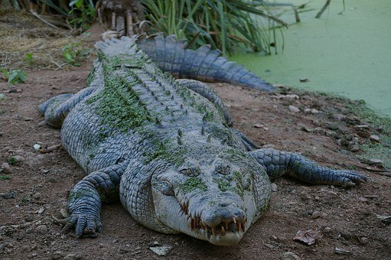
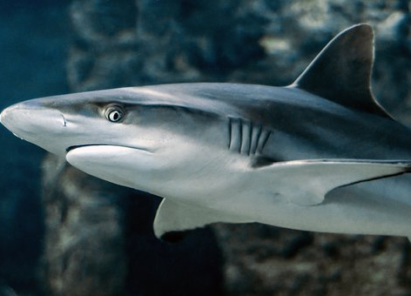

Slide 8
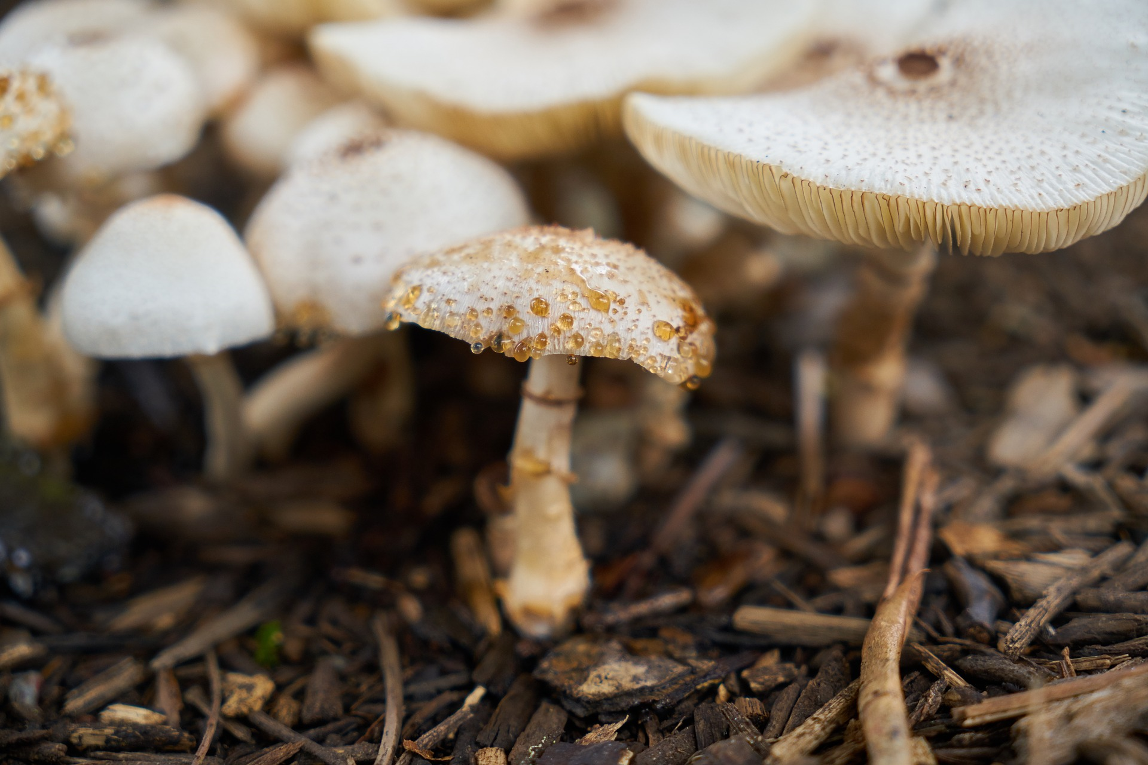

Slide 9
waste products
Mineral ions

Slide 10
waste products
enzymes
mineral ions

