Slide 1


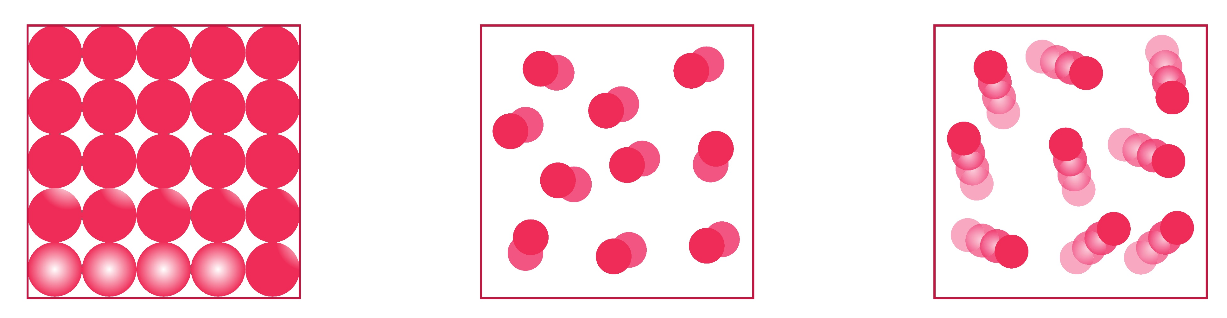
Mission Assignment: Describe the states of matter using a particle model
KS3-02-01
Modelling particles in a solid, liquid and gas
Label each of these three states of matter.
2. Use these words to fill in the gaps below for each statement
over compressed vibrate poured shape tightly far quickly
Gas | Liquid | Solid
The particles are very _____________ apart . The particles move very _______________ and can be ____________________. | The particles can move ___________one another. Liquids have a fixed volume and can be ___________________. | The particles are _____________ packed together and can only ______________. Solids have a fixed _______________.
Developing Experts Copyright 2023 All Rights Reserved

Slide 2
Mission Assignment: Describe the states of matter using a particle model
KS3-02-01
Modelling particles in a solid, liquid and gas
You have been provided with materials to use to create particle models of a solid, liquid and gas.
Sketch your models here and annotate them with the materials you used.
https://www.shutterstock.com/image-vector/changing-state-matter-solid-liquid-gas-1279186903
Questions.
1. How do your models help to understand how particles are arranged in a solid, a liquid, and a gas?
________________________________________________________________________________________________________________________________________________________________________________________________________________________________________________________________________________________________________________________________________________________________________________________________________________________________________________________________________________________________________________________________________________________________________________________________________________________________________________________________________________
Developing Experts Copyright 2023 All Rights Reserved

Slide 3
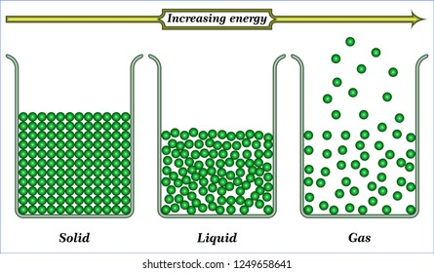
Mission Assignment: Describe the states of matter using a particle model
KS3-02-01
Modelling Particles in a solid, liquid and gas
2. What improvements could you make to your model?
________________________________________________________________________________________________________________________________________________________________________________________________________________________________________________________________________________________________________________________________________________________________________________________________________________________________________________________________________________________________________________________
Challenge
Compare your model to the drawn particle models above. What are their strengths and weaknesses?
______________________________________________________________________________________________________________________________________________________________________________________________________________________________________________________________________________________________________________________________________________________________________________________________________________________________________________________________________________________________________________________________________________________________________________________________
Developing Experts Copyright 2023 All Rights Reserved

Slide 4
Mission Assignment: Describe the states of matter using a particle model ANSWERS
KS3-02-01
Modelling particles in a solid, liquid and gas
Label each of these three states of matter.
solid
liquid
gas
2. Use these words to fill in the gaps below for each statement
over compressed vibrate poured shape tightly far quickly
Gas | Liquid | Solid
The particles are very _____________ apart . The particles move very _______________ and can be ____________________. | The particles can move ___________one another. Liquids have a fixed volume and can be ___________________. | The particles are _____________ packed together and can only ______________. Solids have a fixed _______________.
far
over
tightly
quickly
vibrate
poured
compressed
shape
Developing Experts Copyright 2023 All Rights Reserved

Slide 5
Mission Assignment: Describe the states of matter using a particle model ANSWERS
KS3-02-01
Modelling particles in a solid, liquid and gas
You have been provided with materials to use to create particle models of a solid, liquid and gas.
Sketch your models here and annotate them with the materials you used.
https://www.shutterstock.com/image-vector/changing-state-matter-solid-liquid-gas-1279186903
Students’ own answers – could also take photos if permitted
Questions.
1. How do your models help to understand how particles are arranged in a solid, a liquid, and a gas?
________________________________________________________________________________________________________________________________________________________________________________________________________________________________________________________________________________________________________________________________________________________________________________________________________________________________________________________________________________________________________________________________________________________________________________________________________________________________________________________________________________
Lots of possible answers, for example:
Show how particles are arranged
Particles close together in solid
In a regular pattern in solid
No room between particles in solid and liquid so cannot be compressed etc.
Developing Experts Copyright 2023 All Rights Reserved

Slide 6
Mission Assignment: Describe the states of matter using a particle model ANSWERS
KS3-02-01
Modelling Particles in a solid, liquid and gas
2. What improvements could you make to your model?
________________________________________________________________________________________________________________________________________________________________________________________________________________________________________________________________________________________________________________________________________________________________________________________________________________________________________________________________________________________________________________________
Students’ own answers – possibilities may not make 3D model, show movement of particles, solid not in a regular shape etc.
Challenge
Compare your model to the drawn particle models above. What are their strengths and weaknesses?
______________________________________________________________________________________________________________________________________________________________________________________________________________________________________________________________________________________________________________________________________________________________________________________________________________________________________________________________________________________________________________________________________________________________________________________________
Students’ own answers – possible answers:
Model 3D drawing 2D
Easier to draw picture that make 3D model
Developing Experts Copyright 2023 All Rights Reserved

