Slide 1


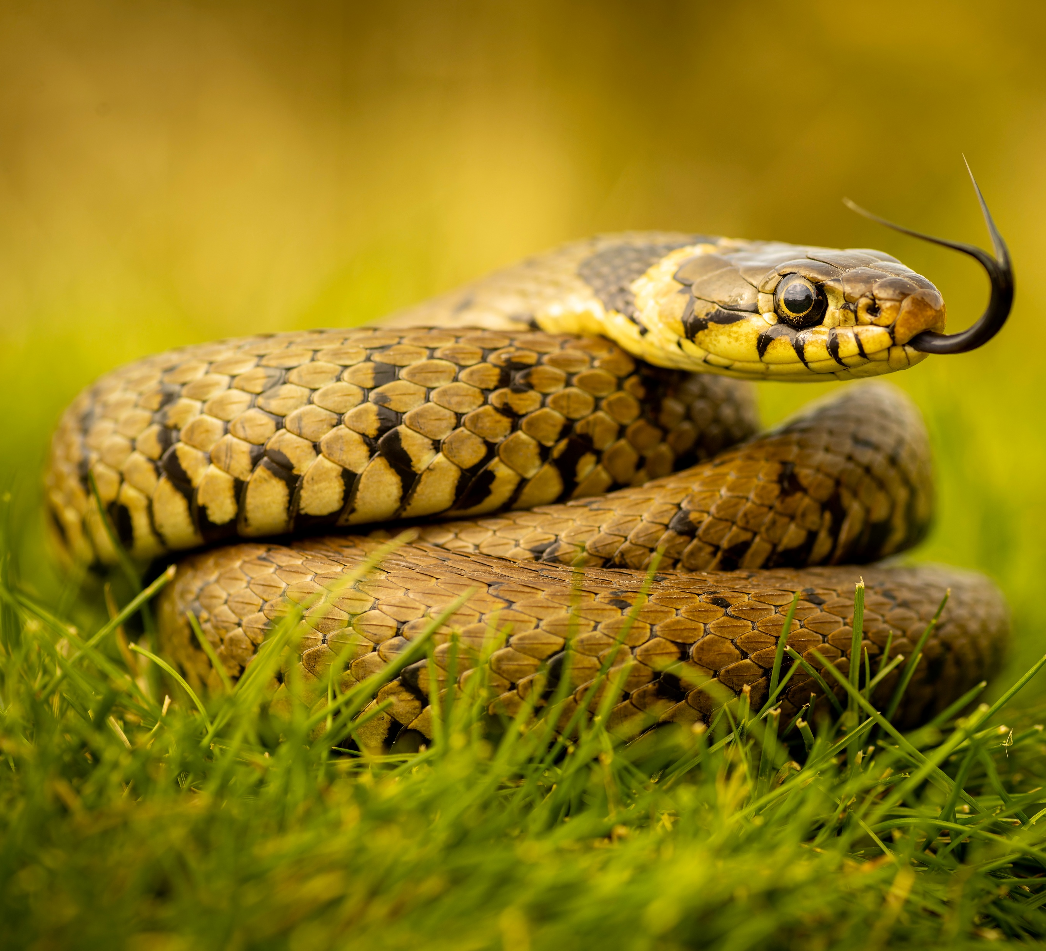
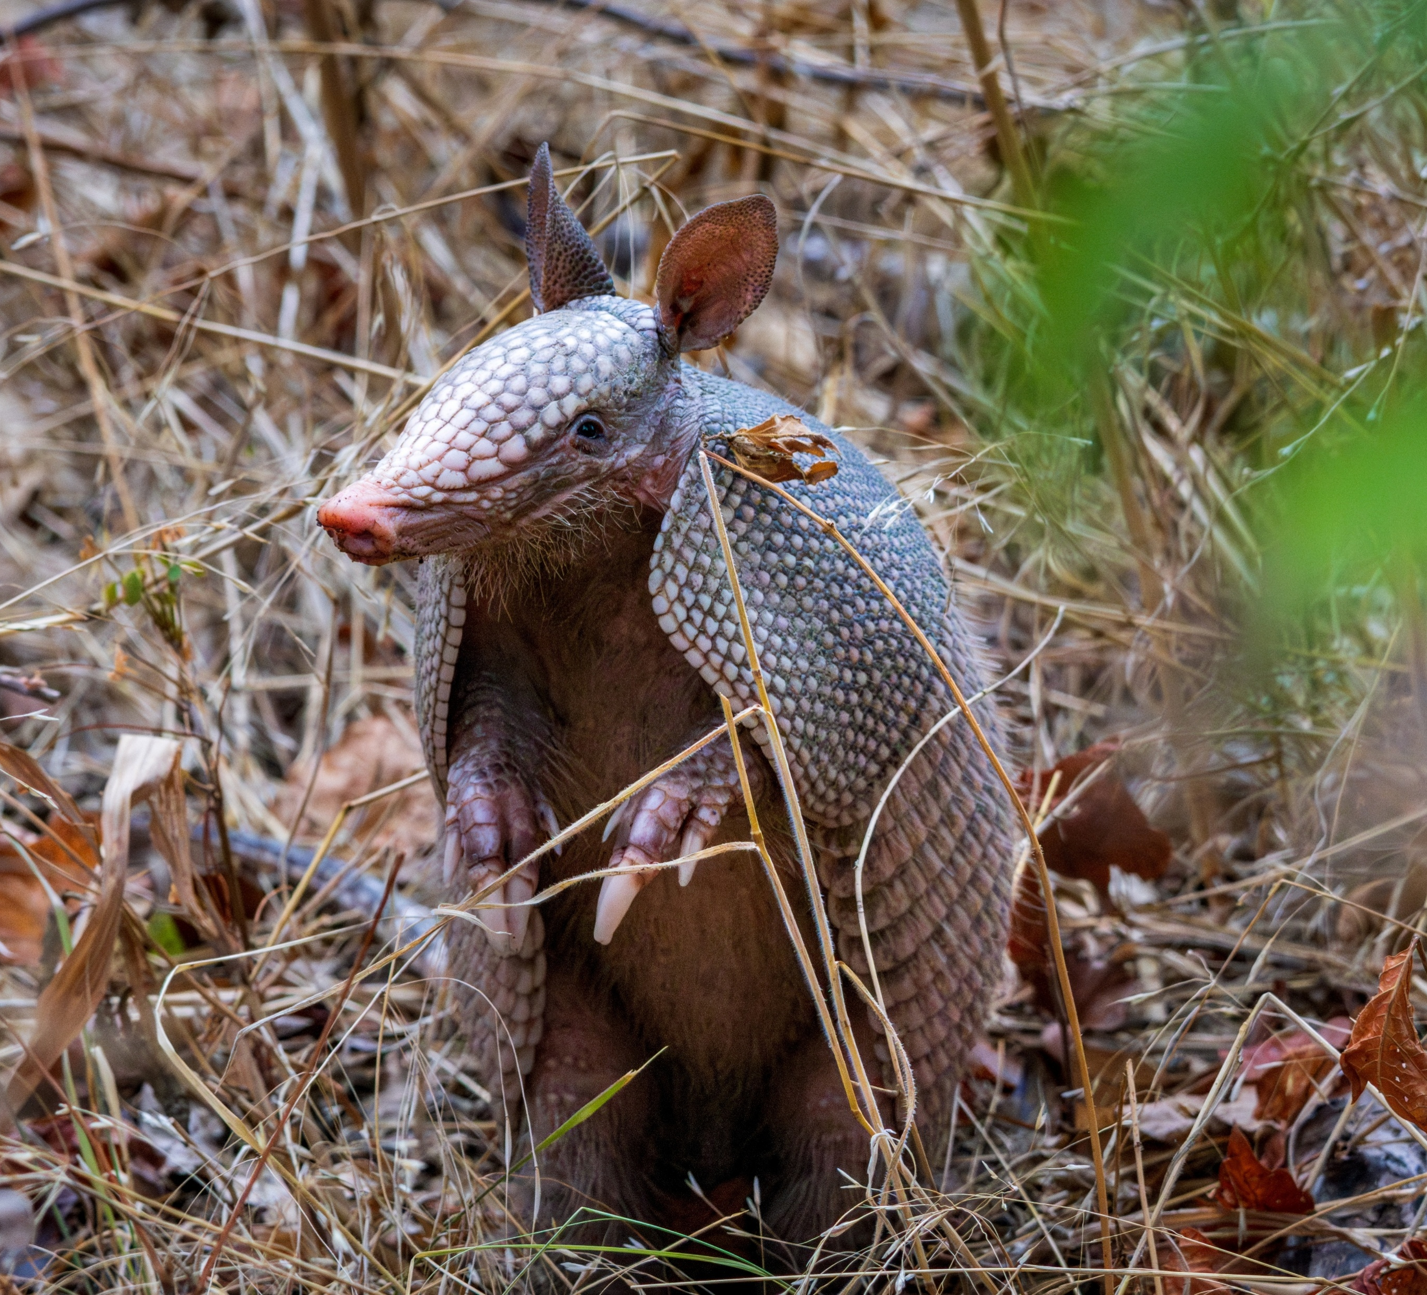
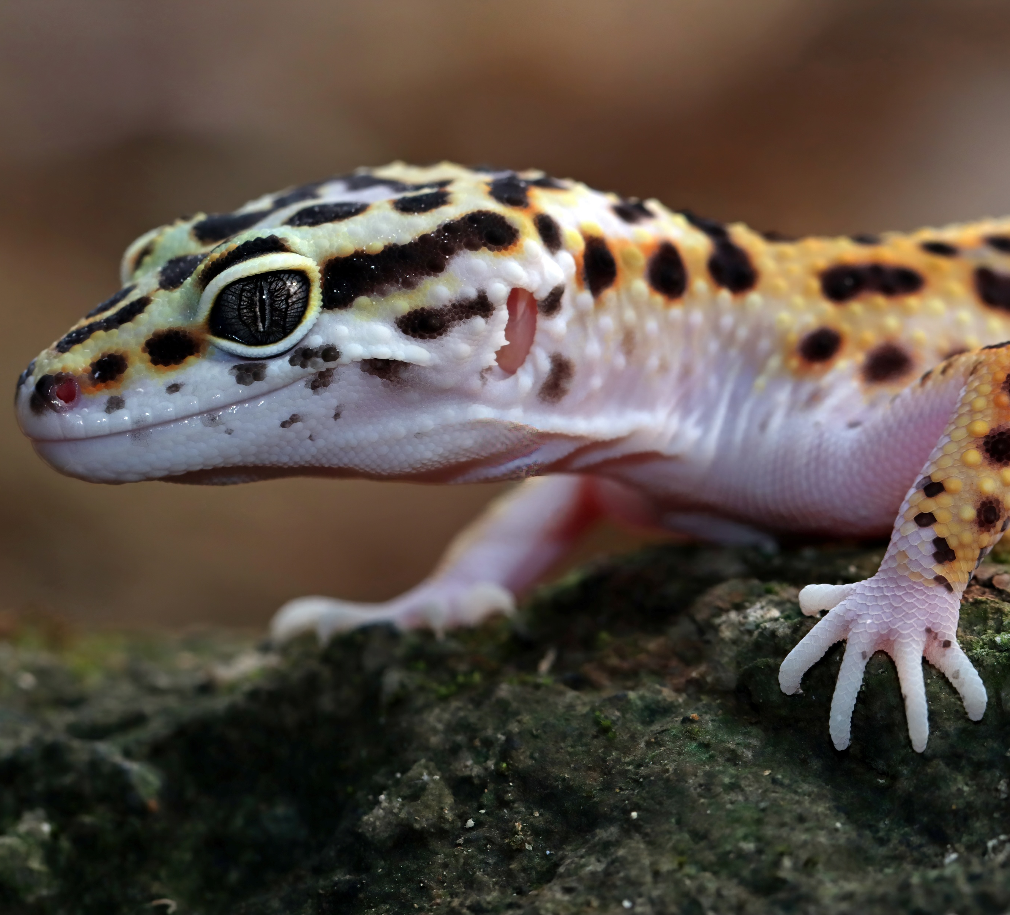
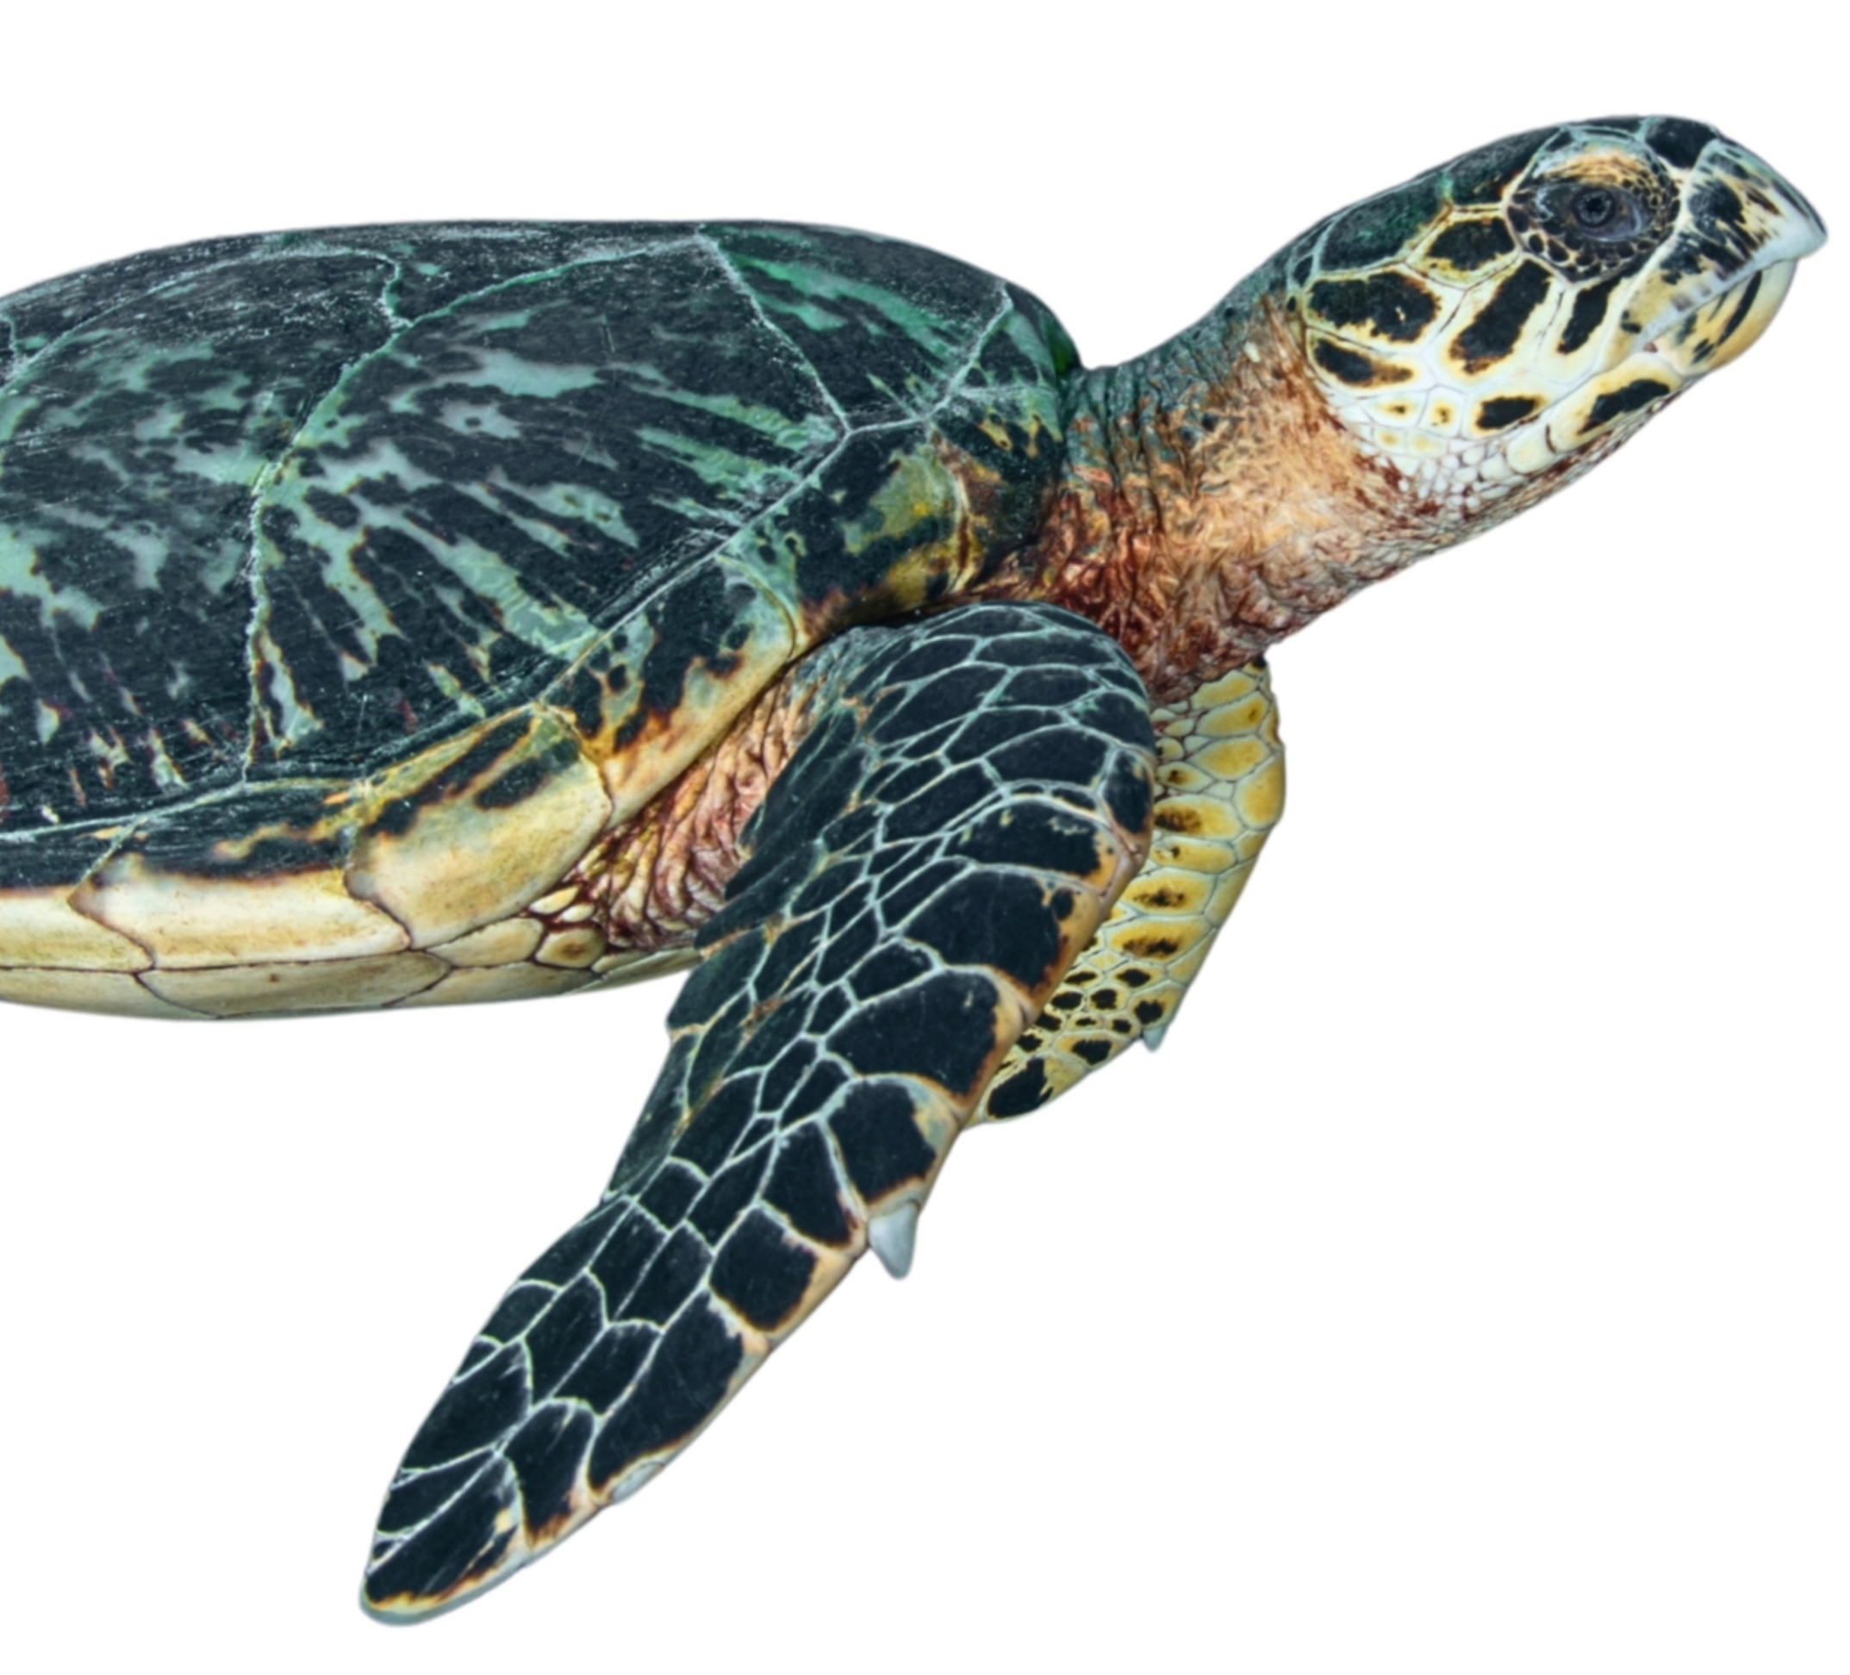
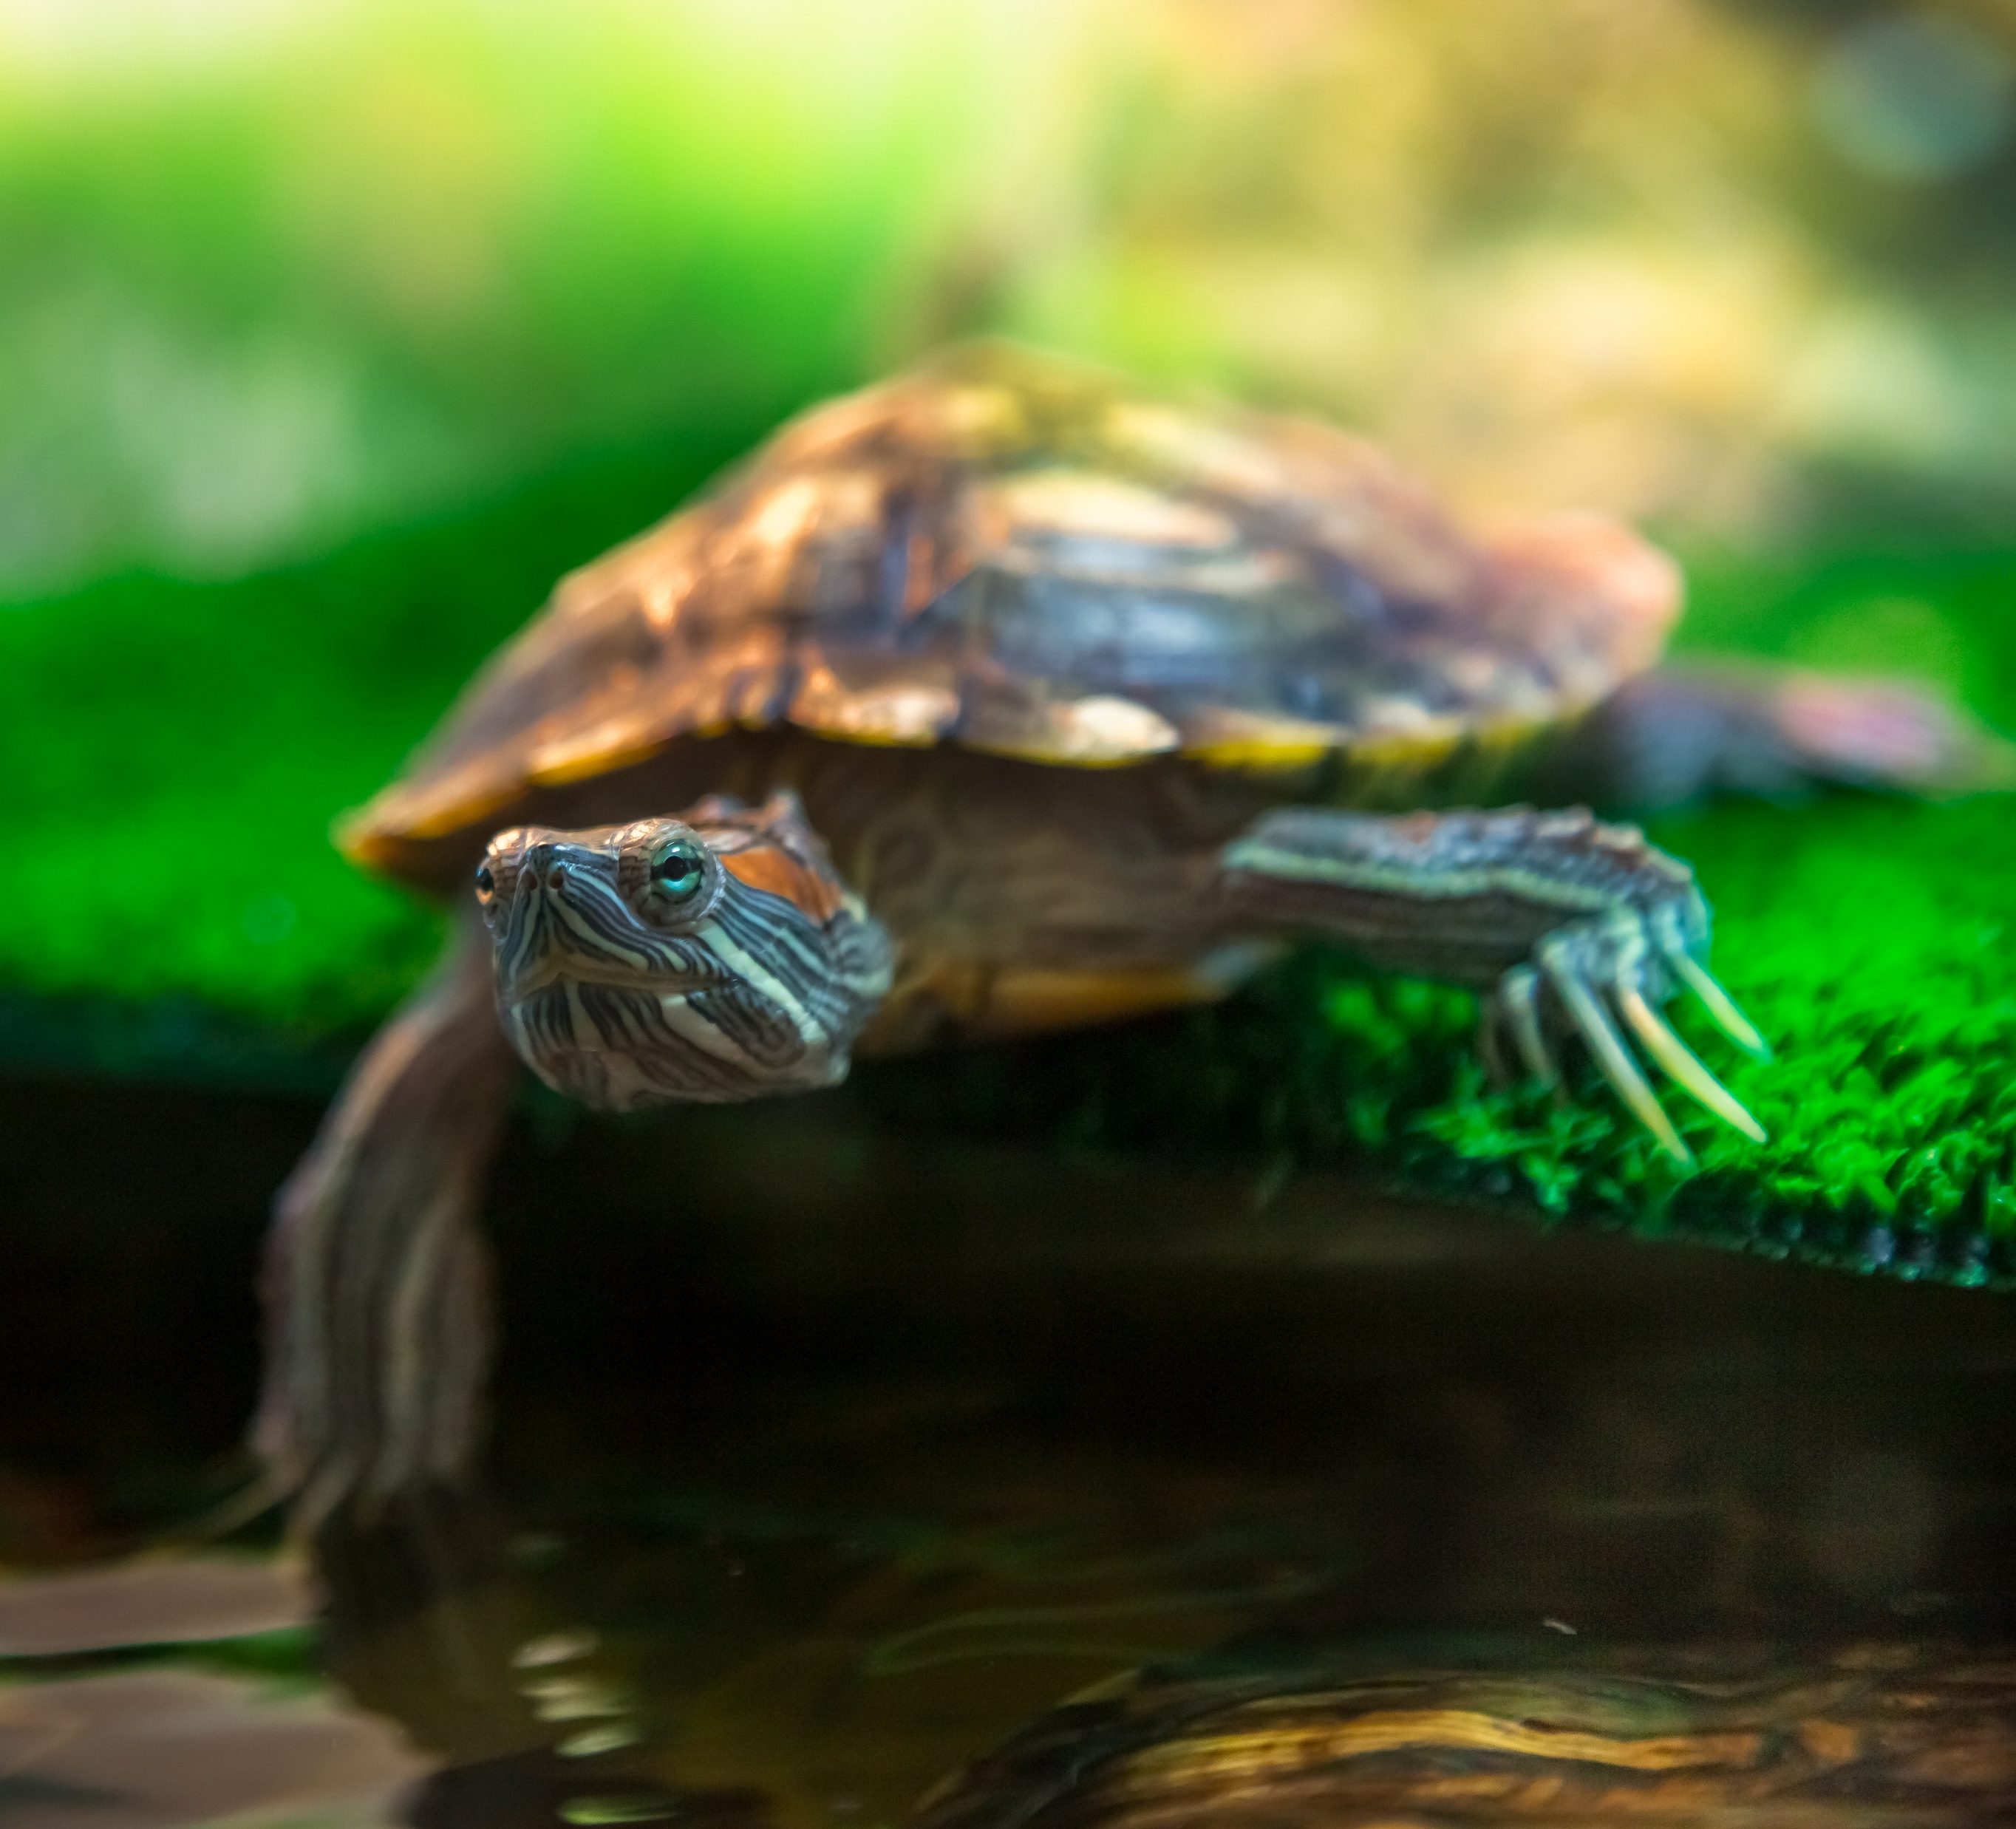
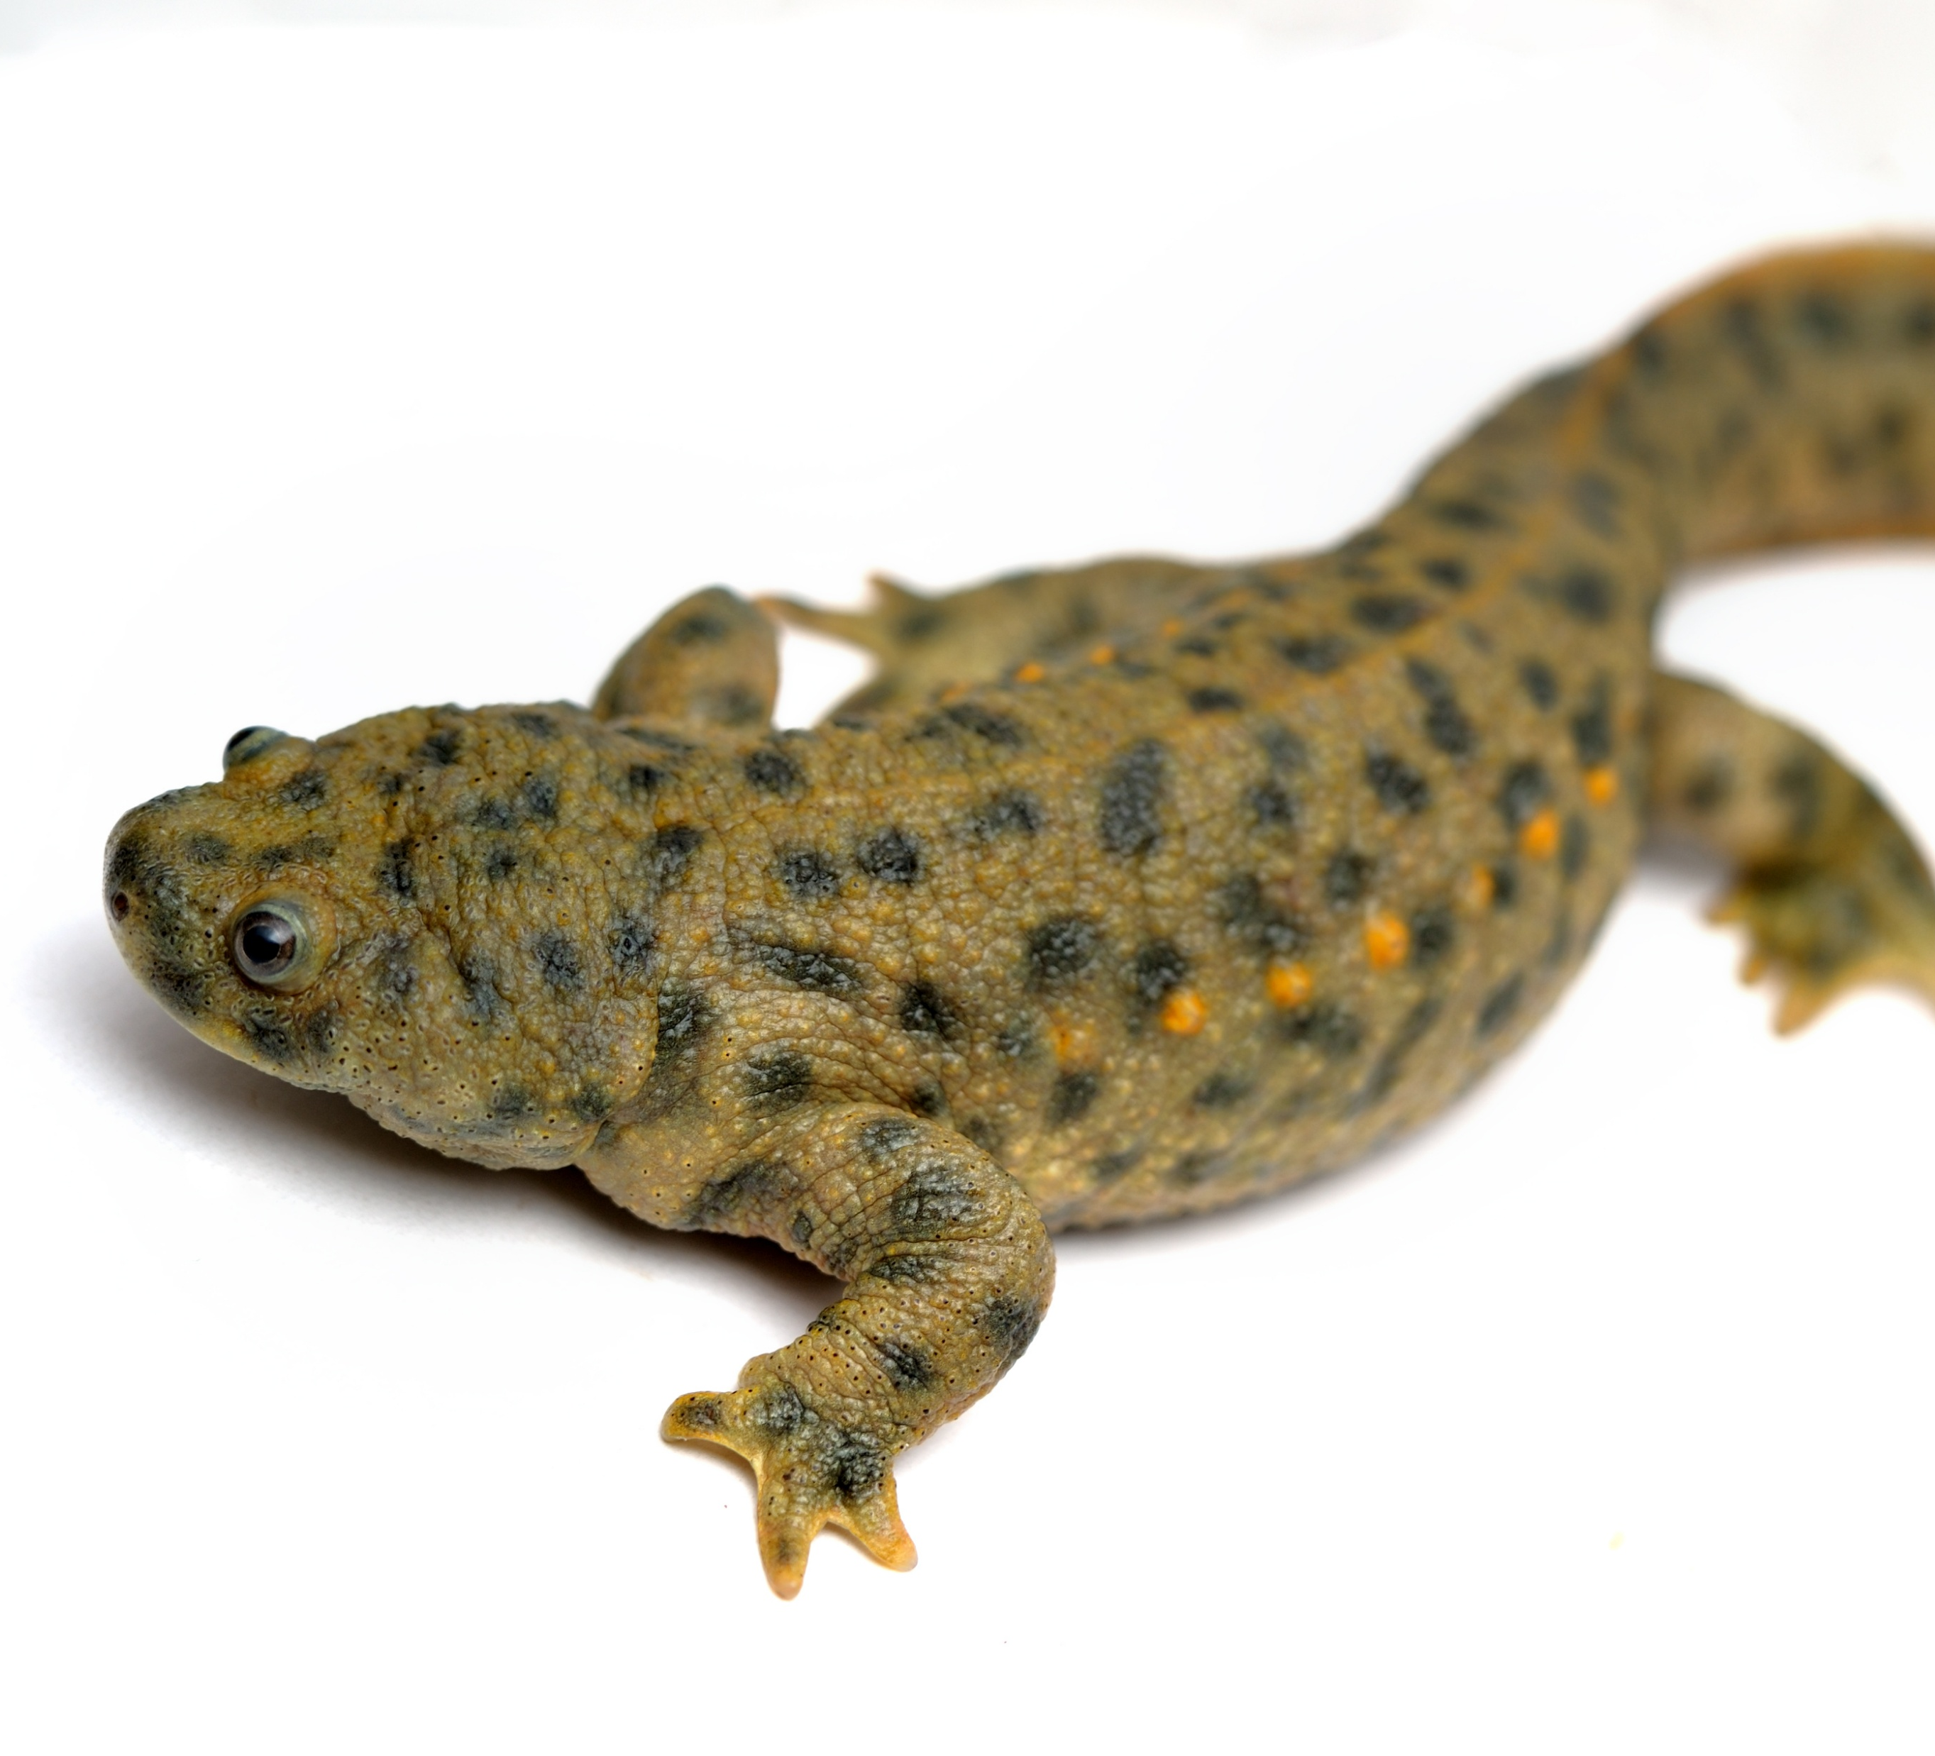
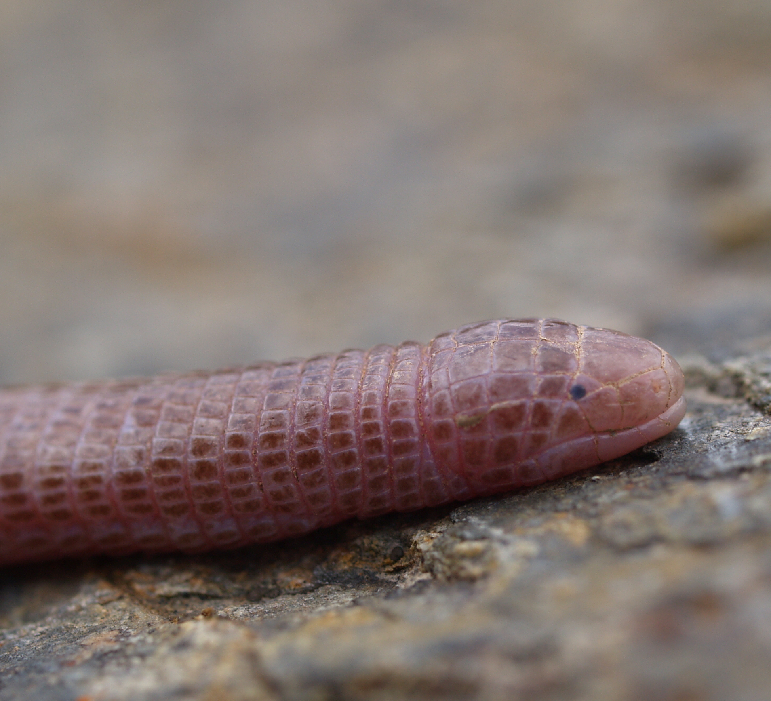
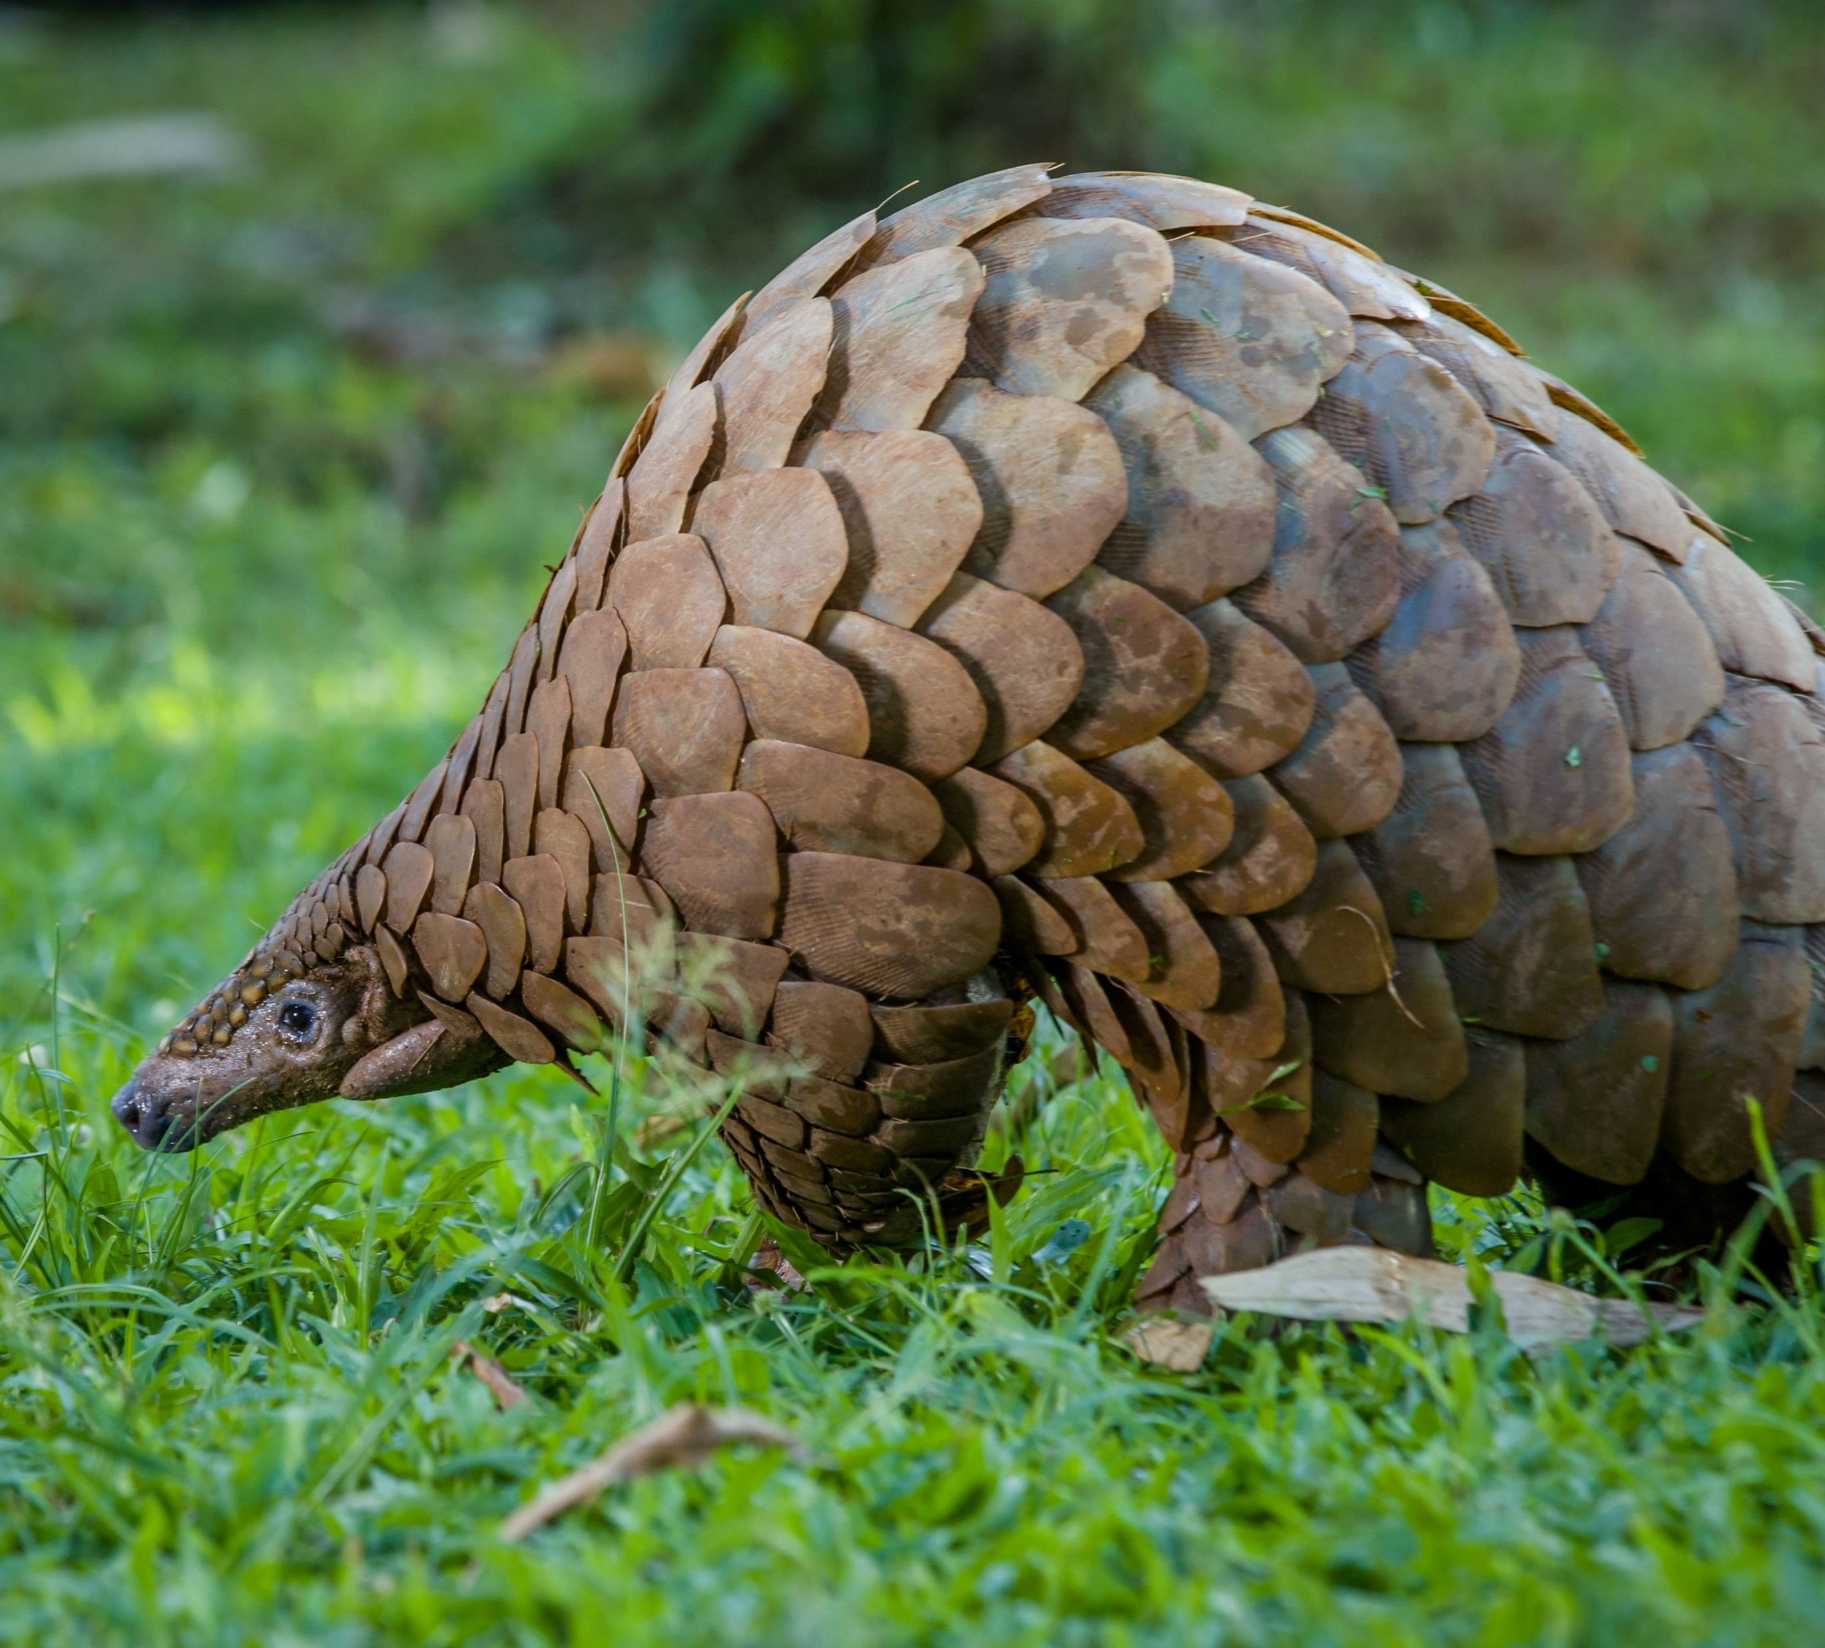
Science Week 2025
KS3 - From Scales to Tails: The Evolution and Adaptation of Reptiles – Answers
Session 2
Activity 1: Tick the reptiles.
✓
snake
✓
armadillo
✗
gecko
✓
turtle
✓
terrapin
✓
newt
✗
blanus
✓
pangolin
✗
Activity 2: Answer the questions below.
✓
1. In activity 1, you ticked the animals that are reptiles. Explain why the other animals aren’t reptiles. What type of animal are they? What are the features of a reptile? __________________________________________________________________________________________________________________________________________________________________________________________________________________________________________________________________________________________________________________________________________________________________________________________________________________________
2. Do all reptiles lay eggs? Why / why not? __________________________________________________________________________________________________________________________________________________________________________________________________________________________________________________________________________________________________________________________________________________________________________________________________________________________
Armadillos and pangolins are mammals, meaning they have fur and give birth to live young. Newts are amphibians, which means they have moist skin and spend part of their life in water and part on land. Reptiles are cold-blooded animals that have dry, scaly skin and breathe with lungs. They usually lay eggs, and their young look like smaller versions of the adults when they hatch.
No, not all reptiles lay eggs. While most reptiles, like turtles and many lizards, lay eggs, some give birth to live young. For example, some species of snakes and lizards, such as boa constrictors and some skinks, give birth to live offspring. This adaptation helps them survive in colder environments where eggs might not develop properly.
1
Developing Experts Copyright 2025 All Rights Reserved

Slide 2
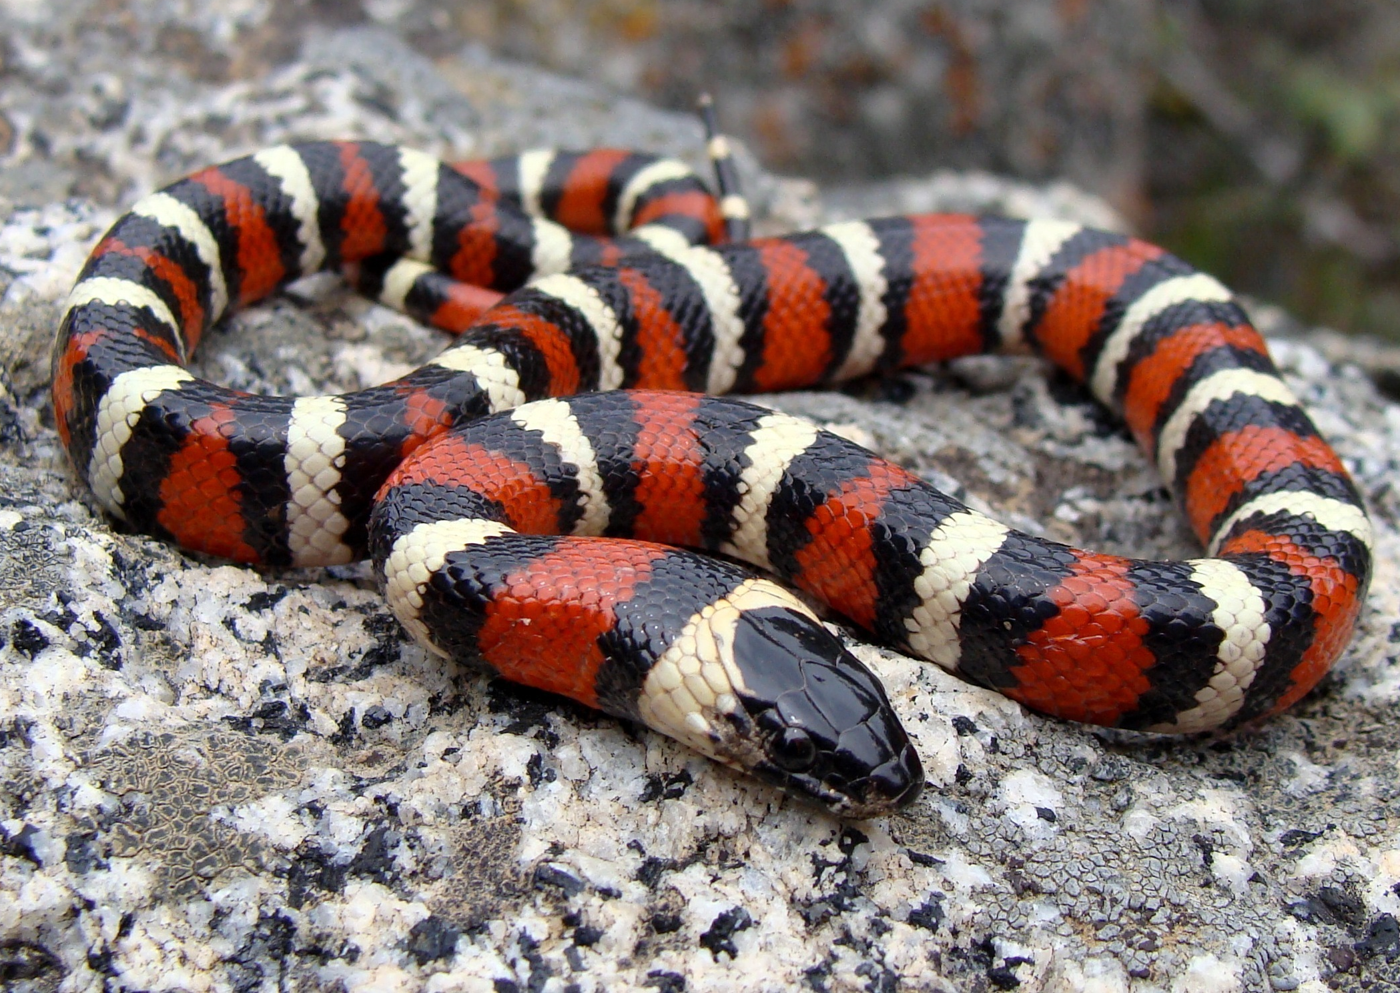
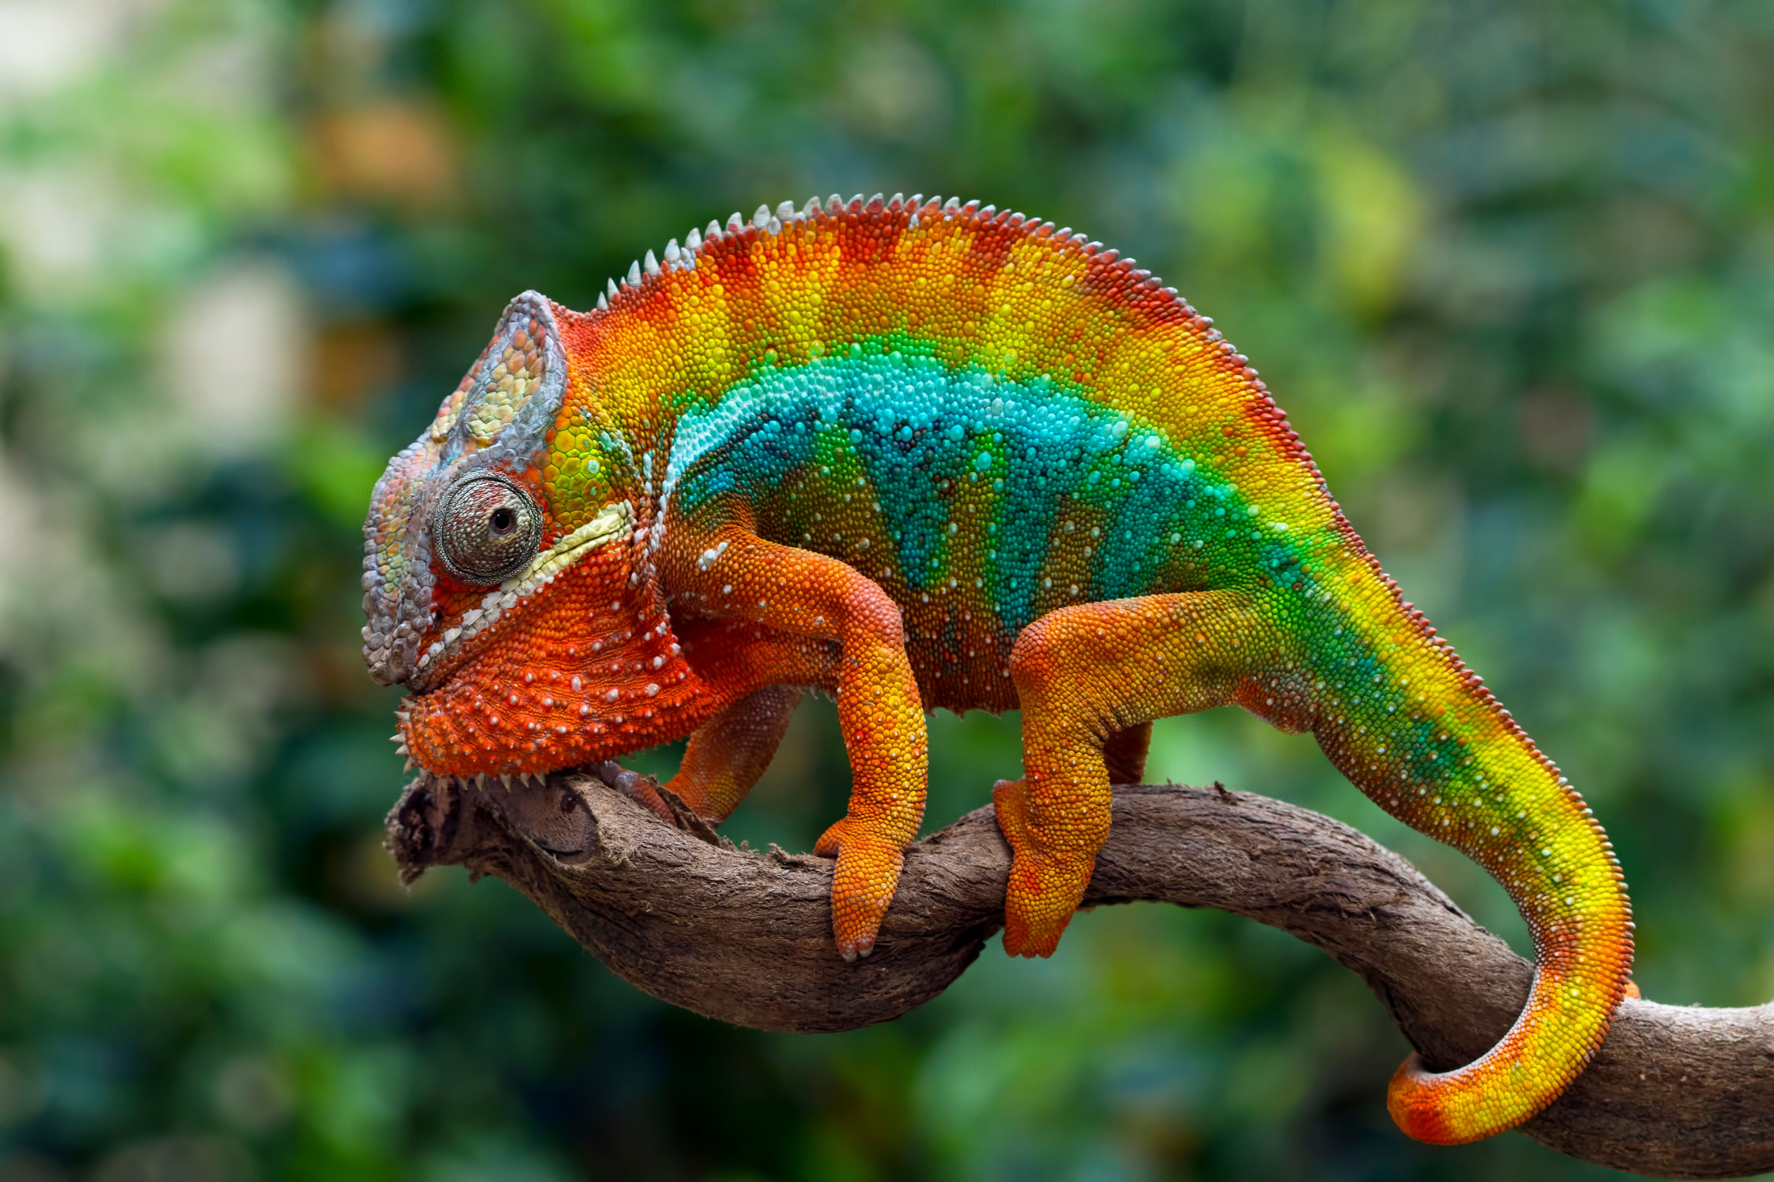
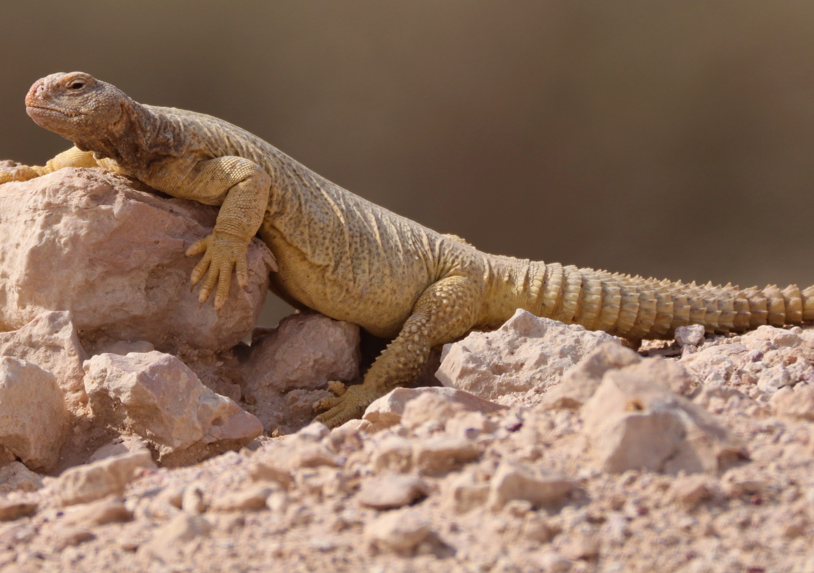
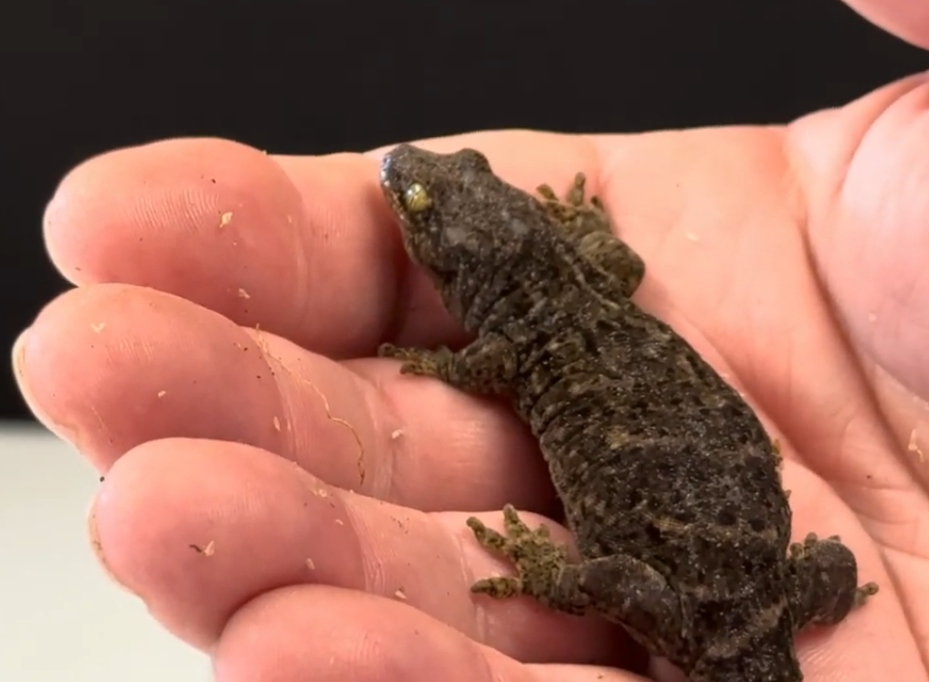
Science Week 2025
KS3 - From Scales to Tails: The Evolution and Adaptation of Reptiles - Answers
Session 2
Activity 3: Analyse adaptations. Each of the reptiles below have different adaptations and habitats. Underneath each image, describe the reptile’s habitat and how it has adapted for survival. You could include: their skin / scales; their limbs and movement; their feeding method; their defence mechanisms or how they reproduce.
king snake
chameleon
King snakes are found in forests, grasslands and deserts across North America. They have smooth, shiny scales and are powerful constrictors. Their diet includes rodents, birds and even other snakes, including venomous ones. As a defence mechanism, they mimic the appearance of venomous coral snakes to deter predators.
Chameleons are mainly found in warm, tropical regions. Their most well-known adaptation is their ability to change color for camouflage and communication. They have zygodactylous feet and a prehensile tail for gripping branches. Their eyes move independently, allowing them to spot prey and predators efficiently.
________________________________________________________________________________________________________________________________________________________________________________________________________________________________________________________________________________________________________________________
________________________________________________________________________________________________________________________________________________________________________________________________________________________________________________________________________________________________________________________
spiny-tailed mastigure
New Zealand gecko
Spiny-tailed lizards (Uromastyx) are found in arid, rocky deserts. They have thick, rough scales and a spiny tail, which they use for defence by whipping at predators.They can dig burrows to escape extreme heat and predators. Their ability to store fat in their tails helps them survive long periods without food.
New Zealand geckos are found in forests, rocky areas and coastal regions. They give birth to live young instead of laying eggs. They have sticky toe pads that allow them to climb vertical surfaces.Their defense mechanism includes dropping their tail when threatened, which later regrows.
________________________________________________________________________________________________________________________________________________________________________________________________________________________________________________________________________________________________________________________
________________________________________________________________________________________________________________________________________________________________________________________________________________________________________________________________________________________________________________________
2
Developing Experts Copyright 2025 All Rights Reserved

Slide 3
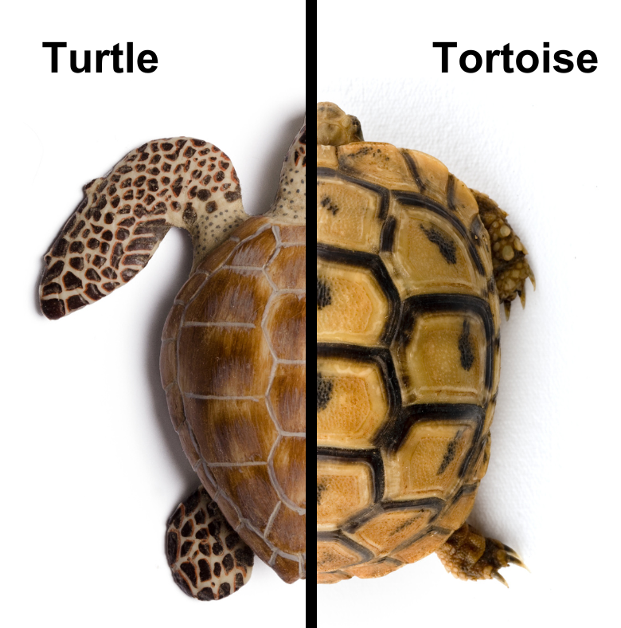

Science Week 2025
KS3 - From Scales to Tails: The Evolution and Adaptation of Reptiles – Answers
Session 2
Activity 4: Compare a turtle, tortoise and terrapin. Label the image below, including any adaptations.
Dome-shaped shell – provides protection from predators
________________
Flippers – adapted for swimming in water
Short, stumpy legs – adapted for walking on land
_____________
________________
Streamlined shell for efficient swimming
______________
What are the key differences between a turtle, tortoise and terrapin? _________________________________________________________________________________________________________________________________________________________________________________________________________________________________________________________________________________________________________________________________________________________________________________________________
Turtles are mainly aquatic, have flippers or webbed feet, and live in the ocean or freshwater. Tortoises live on land, have sturdy legs, and a domed shell for protection. Terrapins are semi-aquatic, living both in water and on land, with webbed feet and a more flexible lifestyle. Turtles and terrapins are omnivorous, while tortoises are mostly herbivorous.
terrapin
3
Developing Experts Copyright 2025 All Rights Reserved

Slide 4
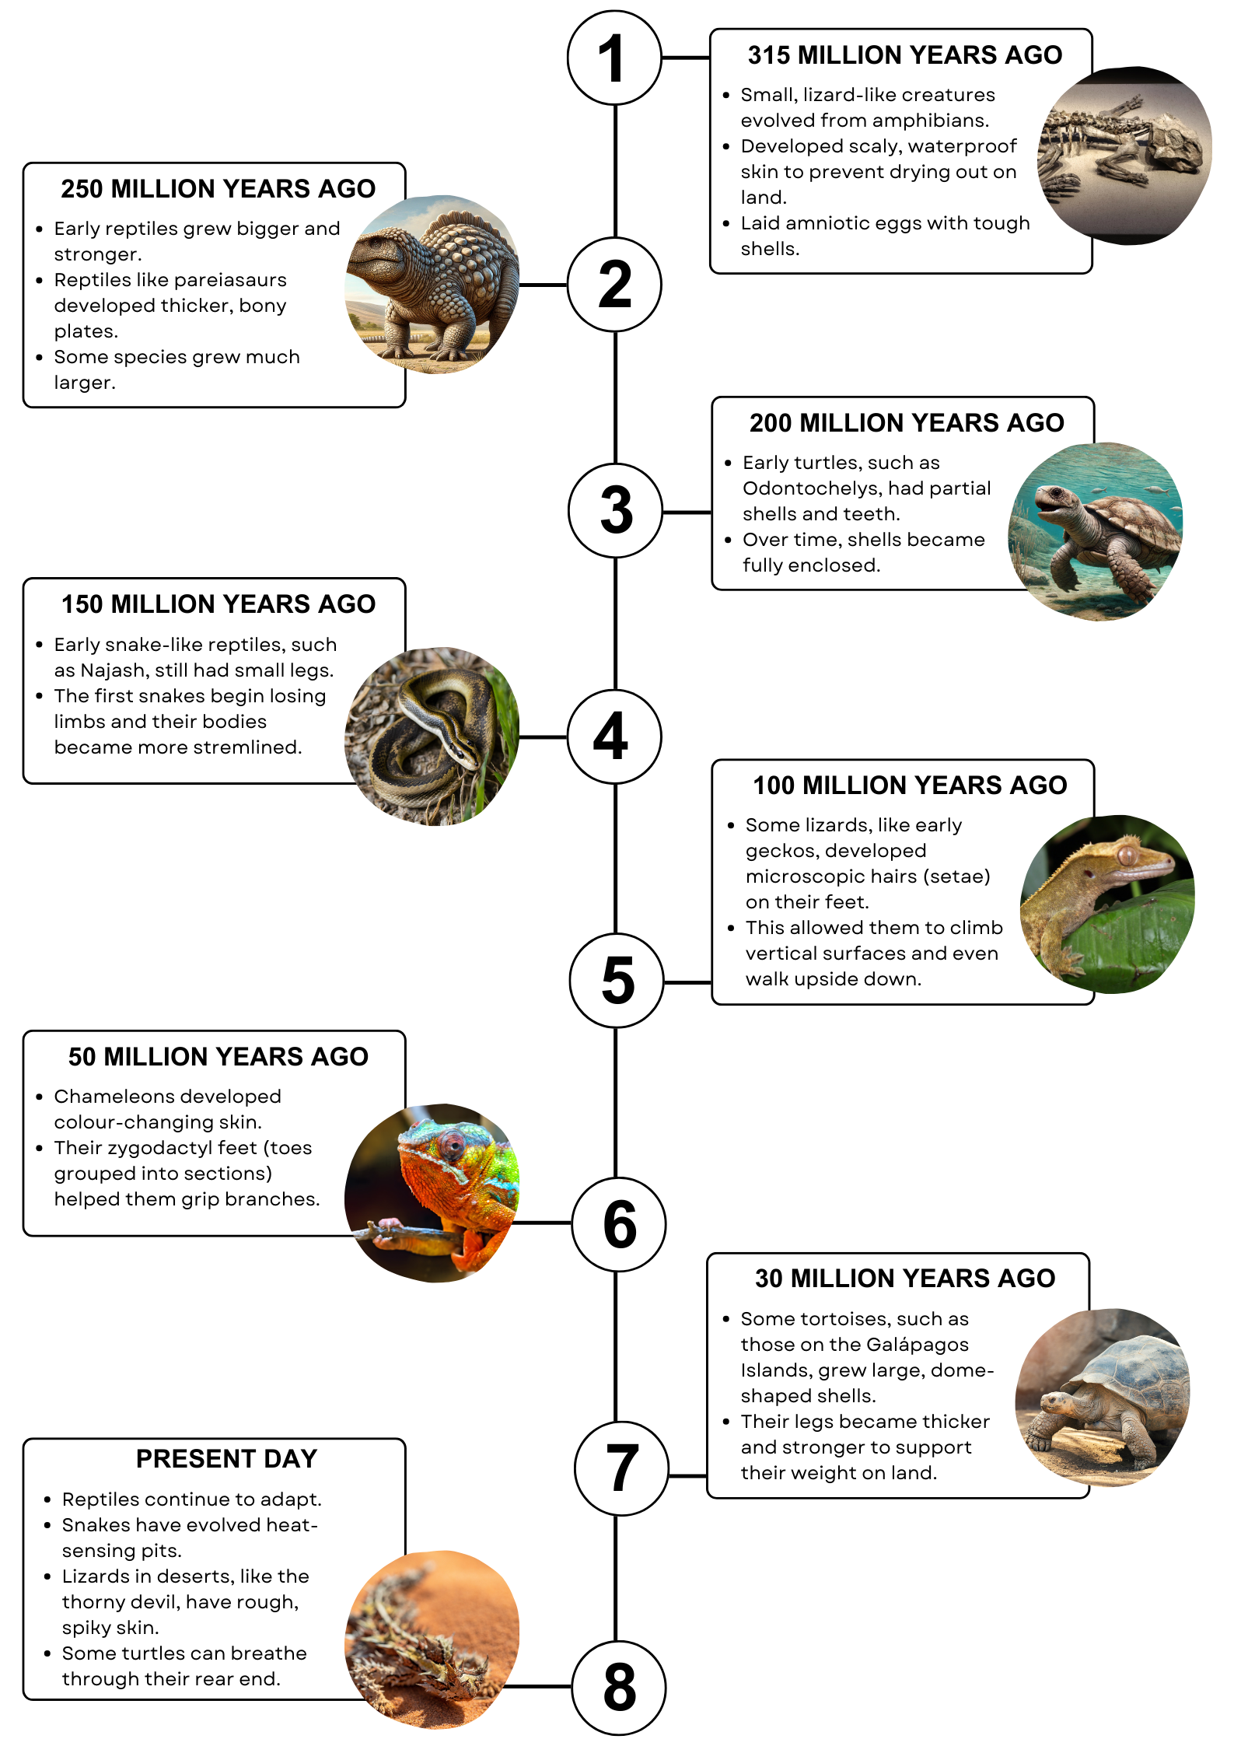
Science Week 2025
KS3 - From Scales to Tails: The Evolution and Adaptation of Reptiles - Answers
Session 2
Activity 5: Examine the reptile evolution timeline below. How did climate, predators and food sources affect these physical changes? What adaptations helped reptiles survive in different environments?
Discussion points provided on lesson plan.
4
Developing Experts Copyright 2025 All Rights Reserved

