Slide 1


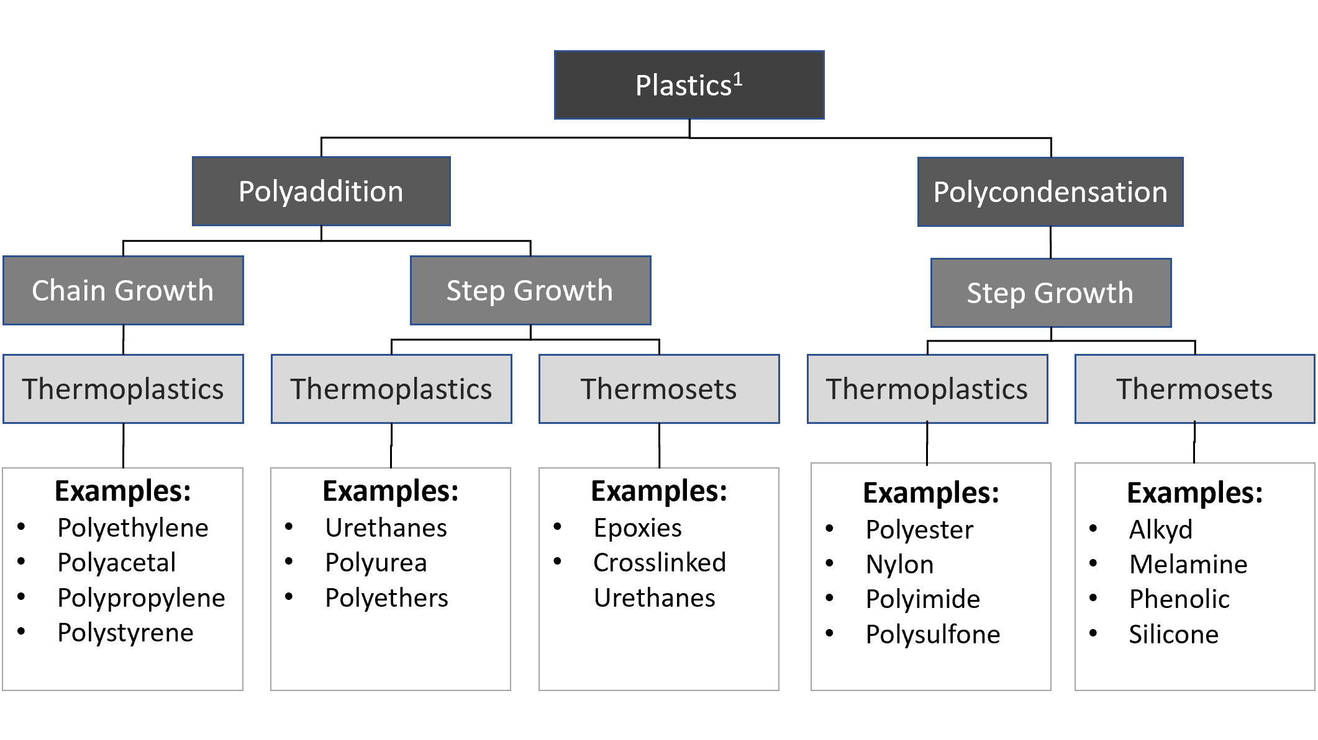
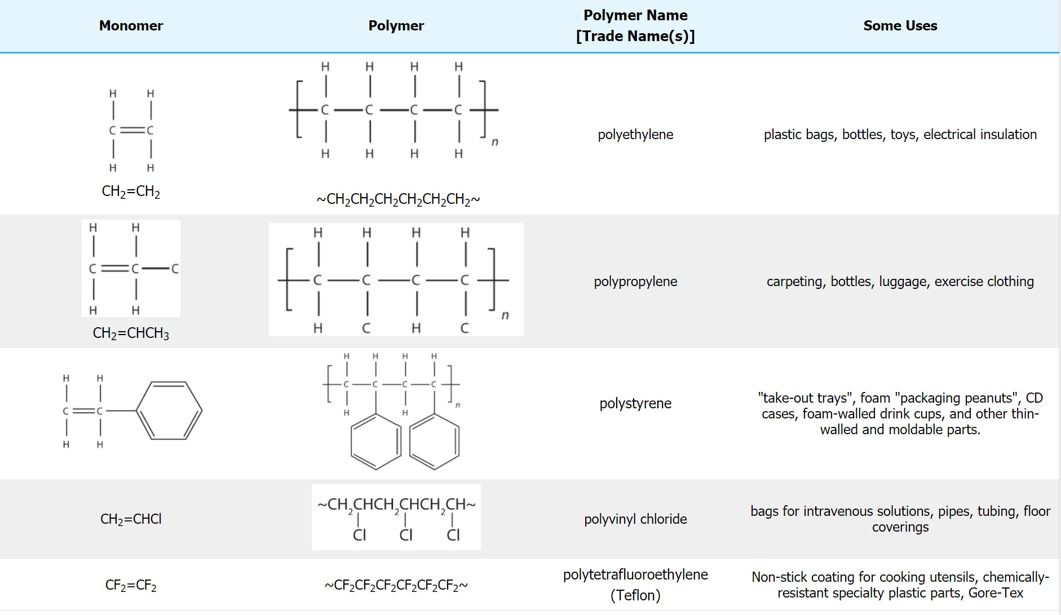
KS4-17-07: Using Resources - Explore polymers
● Describe the structure and the bonding of polymers
● Explain why polymers are solid at room temperature
Key Facts
Polymers are large molecules built by linking 50 or more smaller molecules called monomers
Each repeat unit is connected to the adjacent units via covalent bonds
Plastics
Monomer | Polymer | Polymer or Trade Name | Uses
 |  | polyethylene | Plastic bags, bottles, toys, electrical insultation.
 |  | polypropylene | Carpeting, bottles, luggage, exercise clothing.
 |  | polystyrene | Take-out trays, CD cases, foam-walled drink cups, moldable parts.
 |  | Polyvinyl chloride | Bags for intravenous solutions, pipes, tubing, floor covering.
 |  | Polytetrafluoroethylene (Teflon) | Non-stick coating for cooking utensils, Gore-Tex, chemically resistant specialty plastic parts.
CH2 =CHCH3
CH2 =CHCI
Developing Experts All rights reserved © 2021

Slide 2
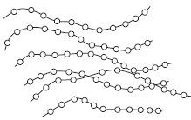
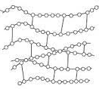
KS4-17-07: Using Resources - Explore polymers
● Describe the structure and the bonding of polymers
● Explain why polymers are solid at room temperature
Polymers are produced from crude oil.
Describe the structure and bonding in a thermosoftening polymer and explain why thermosoftening polymers melt when heated.
____________________________________________________________________________________________________________________________________________________________________________________________________________________________________________________________________________________________________________________________________________
PEX is a material that is used as an alternative to copper for hot water pipes.
PEX is made from poly(ethene).
(i) Describe how ethene forms poly(ethene).
____________________________________________________________________________________________________________________________________________________________________________________________________________________________________________________________________________________________________________________________________________
(ii) PEX is a shape memory polymer. What property does a shape memory polymer
have?
____________________________________________________________________________________________________________________________________________________________________________________________________________________________________________________________________________________________________________________________________________
(iii) The simplified structures of poly(ethene) and PEX are shown.
Poly(ethene) is a thermoplastic that softens easily when heated.
Suggest and explain how the structure of PEX changes this property.
____________________________________________________________________________________________________________________________________________________________________________________________________________________________________________________________________________________________________________________________________________
Polymer chains
Poly(ethene)
PEX
Some polymers are described as smart polymers. Suggest one property of a smart polymer that is different to that of an ordinary polymer.
____________________________________________________________________________________________________________________________________________________________________________________________________________________________________________________________
Developing Experts All rights reserved © 2021

Slide 3
KS4-17-07: Using Resources - Explore polymers
● Describe the structure and the bonding of polymers
● Explain why polymers are solid at room temperature
Explain how low density and high-density poly(ethene) are both produced from ethene.
____________________________________________________________________________________________________________________________________________________________________________________________________________________________________________________________________________________________________________________________________________
____________________________________________________________________________________________________________________________________________________________________________________________________________________________________________________________________________________________________________________________________________
Explain the difference between thermosoftening and thermosetting polymers in terms of their structures.
____________________________________________________________________________________________________________________________________________________________________________________________________________________________________________________________________________________________________________________________________________
____________________________________________________________________________________________________________________________________________________________________________________________________________________________________________________________________________________________________________________________________________
In the box below draw a product made from a polymer then explain how the properties of that material is related to their uses and select appropriate materials. Explain / show what would happen if the material was heated?
Developing Experts All rights reserved © 2021

