Slide 1


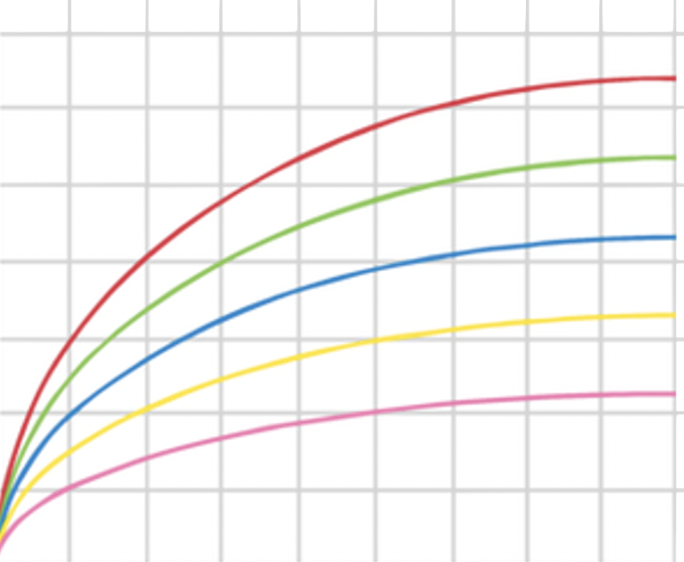
KS4-17-12: Using Resources - Explore making ammonia and the Haber process
● Describe the Haber process for the manufacture of ammonia, and if you are higher-tier student
● Explain how the conditions for the Haber process are selected to maximize the yield of ammonia
Manufacturing Process
Ammonia is manufactured using The Haber Process which occurs in five stages.
The reactants are hydrogen and nitrogen which are extracted from methane and the air respectively.
Stage 1: H2 and N2 gases are pumped into the compressor through pipes.
Stage 2: the gases are compressed to about 200 atmospheres inside the compressor.
Stage 3: the pressurised gases are pumped into a tank containing layers of catalytic iron beads at a temperature of 450°C. Some of the hydrogen and nitrogen react to form ammonia in the following reversible reaction:
N₂(g) + 3H₂(g) ⇌ 2NH₃(g)
Stage 4: unreacted H₂ and N₂ and product ammonia pass into a cooling tank. The ammonia is liquefied and removed to pressurised storage vessels.
Stage 5: the unreacted H₂ and N₂ gases are recycled back into the system and start over again.
Higher Tier Only
Dynamic Equilibrium
Reaction conditions such as temperature and pressure affect the rate of a reaction.
If the reaction is reversible then the position of equilibrium is also affected by changes in these conditions and often we must consider a trade-off between the rate of reaction and product yield.
The graph below illustrates the effects of changing temperature and pressure on the yield of ammonia obtained.
By following any of the curved lines on the graph it can be seen that as the pressure increases, so too does the yield at any given temperature.
By following any vertical line upwards from the x-axis, the graph shows that as the temperature decreases, the yield actually increases.
The actual conditions used must be chosen depending on a number of economical, chemical and practical considerations.
The yield of ammonia produced changes with changes made to temperature and pressure
70
0
60
350 C
0
50
400 C
0
40
450 C
Yield of Ammonia (%)
0
30
500 C
0
20
550 C
10
0
0
100
200
300
400
500
700
800
900
600
Pressure (Atmospheres)
Developing Experts All rights reserved © 2021

Slide 2
KS4-17-12: Using Resources - Explore making ammonia and the Haber process
● Describe the Haber process for the manufacture of ammonia, and if you are higher-tier student
● Explain how the conditions for the Haber process are selected to maximize the yield of ammonia
State where the raw materials in the Haber process come from.
________________________________________________________________________________________________________________________________________________________________________________________________________________________________________________________________________________________________________________________________________________
Describe the process for manufacturing ammonia.
________________________________________________________________________________________________________________________________________________________________________________________________________________________________________________________________________________________________________________________________________________
____________________________________________________________________________________
In the box below write a balanced symbol equation for the manufacture of ammonia. Use this to describe the reaction in terms of reactants, products, conditions and number of moles.
Recall the following topics:
• dynamic equilibrium
• temperature affecting the rate of a reaction
• pressure.
________________________________________________________________________________________________________________________________________________________________________________________________________________________________________________________________________________________________________________________________________________
Explain how each of these affects the Haber process reaction.
________________________________________________________________________________________________________________________________________________________________________________________________________________________________________________________________________________________________________________________________________________
____________________________________________________________________________________
Discuss the effect of the following conditions on the reaction:
• a high temperature
• a low temperature
• a high pressure
• a low pressure
• use of a catalyst
• no catalyst.
________________________________________________________________________________________________________________________________________________________________________________________________________________________________________________________________________________________________________________________________________________
________________________________________________________________________________________________________________________________________________________________________________________________________________________________________________________________________________________________________________________________________________
Developing Experts All rights reserved © 2021

