Slide 1


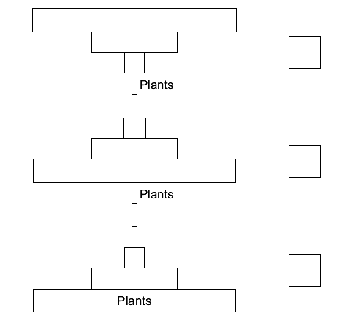
Mission Assignment: Explore pyramids of biodiversity
Code: KS4_07_20
Calculate the efficiency of biomass transfer between trophic levels in pyramids of biomass
Task 1. The picture shows a food chain.
(A) Which diagram shows a pyramid of biomass for the food chain in the picture?
(B) The plants at the start of the food chain absorb energy. Where does this energy come from? Draw a ring around one answer.
the water ` the sun minerals
(C) Some energy is lost at each stage of the food chain. Give two ways in which energy may be lost from the food chain.
1.__________________________________________________________________________________________________________________________________________________________________2.__________________________________________________________________________________________________________________________________________________________________
Developing Experts Copyright 2022 All Rights Reserved

Slide 2
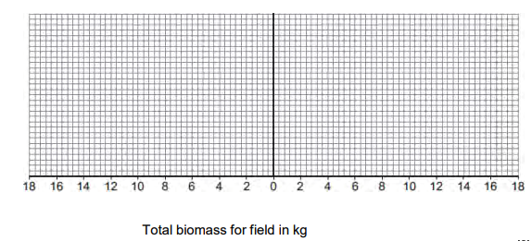
Mission Assignment: Explore pyramids of biodiversity
Code: KS4_07_20
Task 2. Scientists investigated a food chain in a wheat field immediately after the wheat had been harvested. Red kites are birds of prey.
The food chain for the wheat field is:
wheat grains
field mice
red kites
What is the source of energy for the food chain?
________________________________________________________________________________
(B) The table shows the data the scientists collected.
Organism | Estimated number in the field | Biomass of one organism in kg | Total biomass for field in kg
Fallen wheat grains | 40 000 | 0.0006 | 24.0
Red kites | 2 | 1.0 | -----
Field mice | 200 | 0.04 | -----
(i) Complete the table by calculating the total biomass of red kites and of field mice. Write your answers in the table.
(ii) Use data from your completed table to draw a pyramid of biomass for the food chain shown in the table.
(C) The scientists could not find the exact number of organisms in the wheat field. Suggest two reasons why.
1.__________________________________________________________________________________________________________________________________________________________________2.__________________________________________________________________________________________________________________________________________________________________
Developing Experts Copyright 2022 All Rights Reserved

