Slide 1
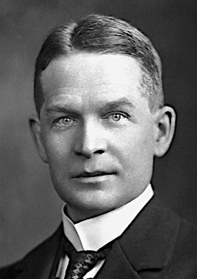
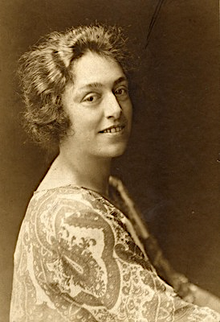
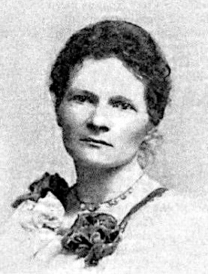
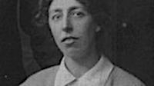
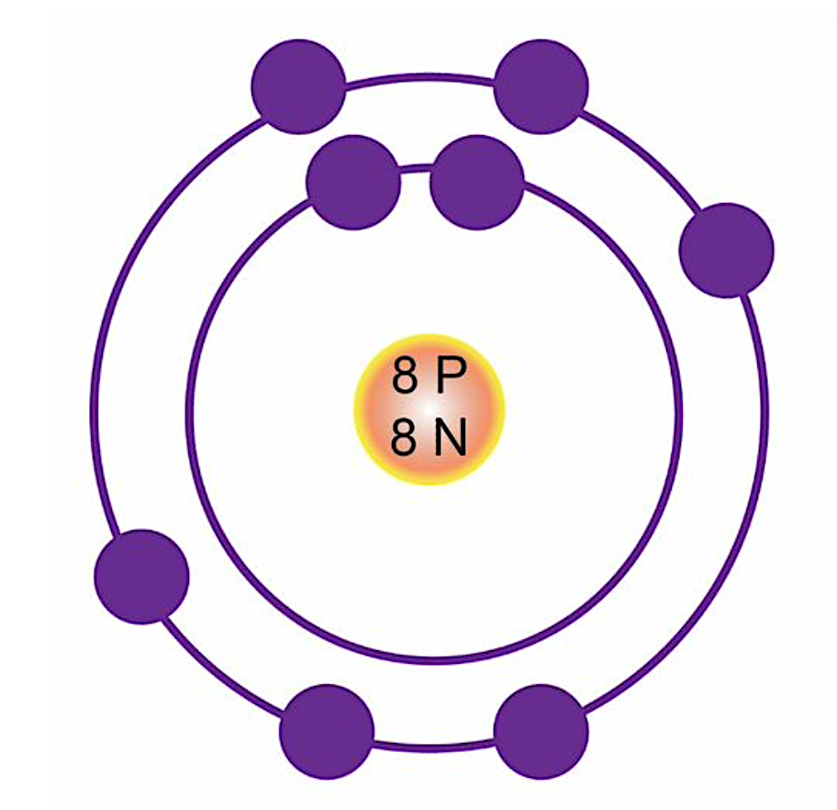
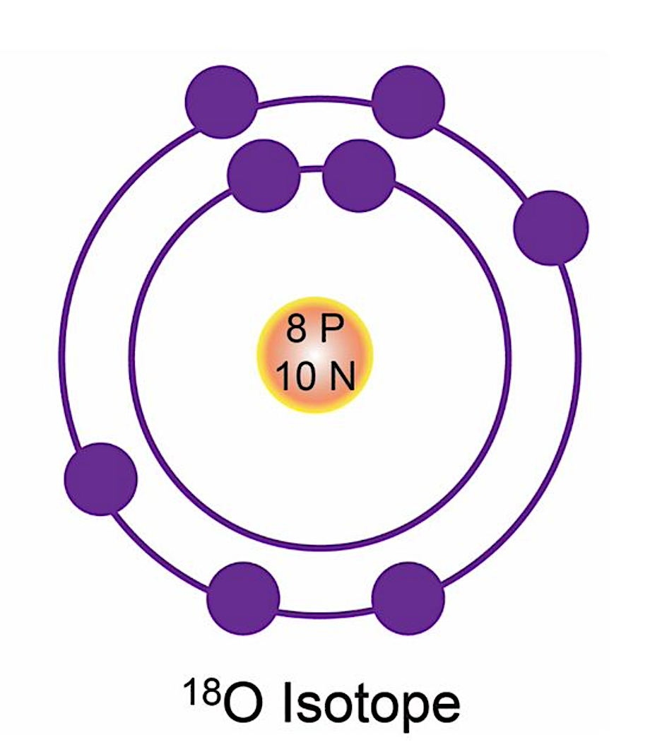
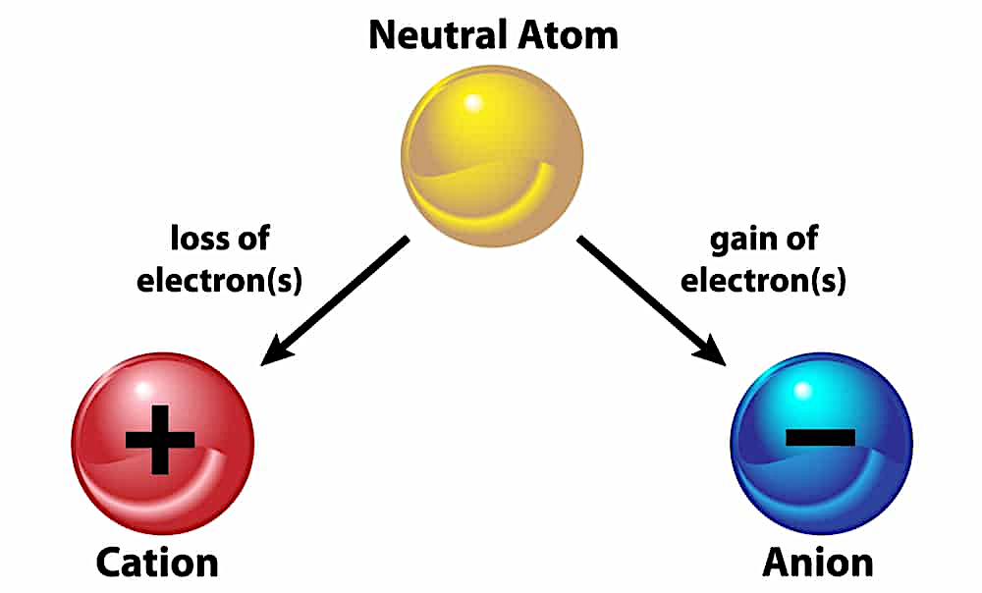
The Isotope or ‘same place’
Fredrick Soddy first worked and published papers with Ernest Rutherford between 1900-1902. Through these studies, they found anomalous behaviours in radioactive atoms as they decayed. During these years and the following decades, Soddy was ably assisted by two gifted female scientists; Ruth Pirret and Ada Hitchens from the University of Glasgow. In 1913, Soddy described the process where an element could have more than one atomic mass. He named these isotopes - meaning ‘the same place’ - because these took the same place on the periodic table. This name had been suggested to him by another influential female scientist - Margaret Todd.
The number of protons of an atom is the atomic number of that atom. Oxygen has 8 protons. Only the element of oxygen has 8 protons; that is the atomic number of oxygen.
The atomic mass of oxygen is 16, meaning that there are 8 neutrons + 8 protons.
Electrons are not counted in atomic mass.
An element can change the atomic mass when it loses or gains a neutron. It still has the same number of protons as it had before, so the element remains unchanged. These same elements with differing atomic mass are called isotopes. Here is an isotope of oxygen with an atomic mass of 18.
Gravitational
field strength
10N/kg
The electrons in an atom are on different energy levels or shells. The electrons in the furthest level from the nucleus have the most energy.
When an atom loses or gains an electron, the overall charge of that atom is no longer balanced. The atom becomes attracted to other atoms. We call that type of atom an ion.

Slide 2
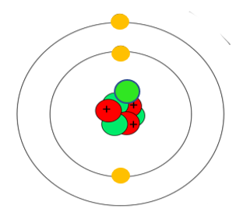
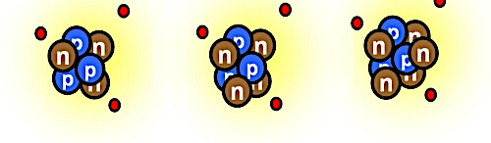
Practice
An atom has three particles; protons, neutrons and electrons. Protons have a positive charge, neutrons are neutral, and electrons have a negative charge.
A) Which particles make up the atomic mass of the atom? B) Draw a ring around the electron in this diagram that has the least charge. A)______________________________________________________________________
Which of the three particles gives us:- i) the atomic number of an element? ii) what else does that number generally indicate if this element is not an ion, and why? ____________________________________________________________________________________________________________________________________
23
Na
sodium
11
Here are three isotopes of lithium; lithium 6, lithium 7 and lithium 8. The element in the periodic table is lithium 7. Explain why the other two isotopes occur. ______________________________________________________________________________________________________________________________________________________
6
7
8
Li
Li
Li
lithium
lithium
lithium
3
3
3
Complete the nuclear number notation below with the information provided:-
12
6
11
_
_
3
40
18
C
B
Li
Ar
Protons =
Neutrons =
Electrons =
Protons =
Neutrons =
Electrons =
5
Protons =
Neutrons =
Electrons =
Protons =
Neutrons =
Electrons =
4
3

Slide 3
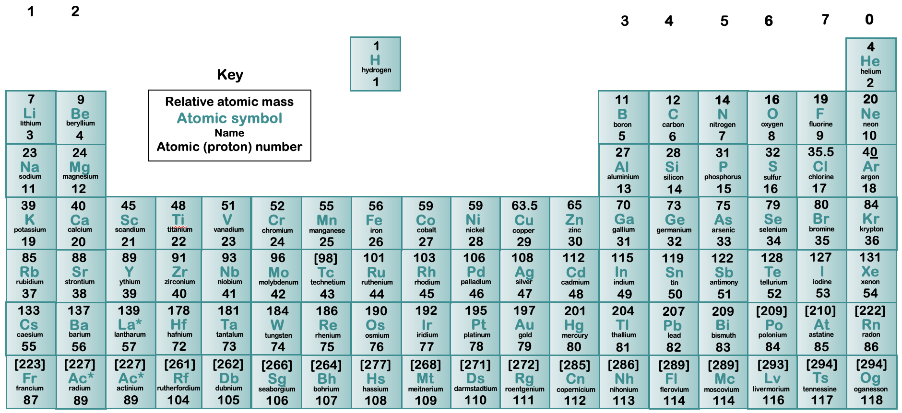
Calculation using the periodic table
To make our calculations easier for these lessons, round the atomic mass number up to the nearest whole number; i.e., in lithium (Li) atomic number = 3, atomic mass = 7
Complete the information in the table.
Atom | Isotope
Complete the data for these ions
7
3
6
3
Ion
Li
Li
-
Protons =
Neutrons =
Electrons =
3
Protons =
Neutrons =
Electrons =
Li
4
Protons =
Neutrons =
Electrons =
3
12
6
13
6
C
C
2+
Cu
Protons =
Neutrons =
Electrons =
Protons =
Neutrons =
Electrons =
Protons =
Neutrons =
Electrons =
24
12
26
12
Mg
Mg
3+
Al
Protons =
Neutrons =
Electrons =
12
Protons =
Neutrons =
Electrons =
Protons =
Neutrons =
Electrons =
12

