Slide 1

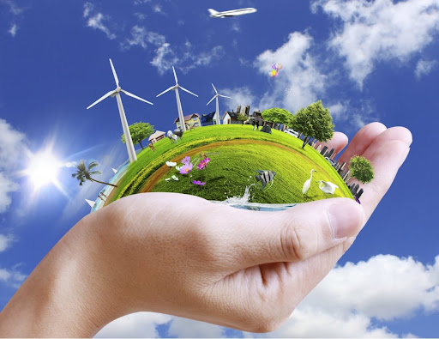
0001.01
Task
Task | Draw up a personal plan which sets out the changes you need to make at school and home to reduce your contributions to greenhouse emissions.
Developing skills | Reducing direct and indirect emissions from education and care buildings, driving innovation to meet legislative targets and providing opportunities for children and young people to engage practically in the transition to net zero.
Think about… | Using a computer, choose a large organisation to investigate.
COP26S-01_01
Getting back on track - What we can do at school and home

Slide 2
Draw up a personal plan which sets out the changes you need to make at school and home to reduce your contributions to greenhouse emissions.

