Slide 1

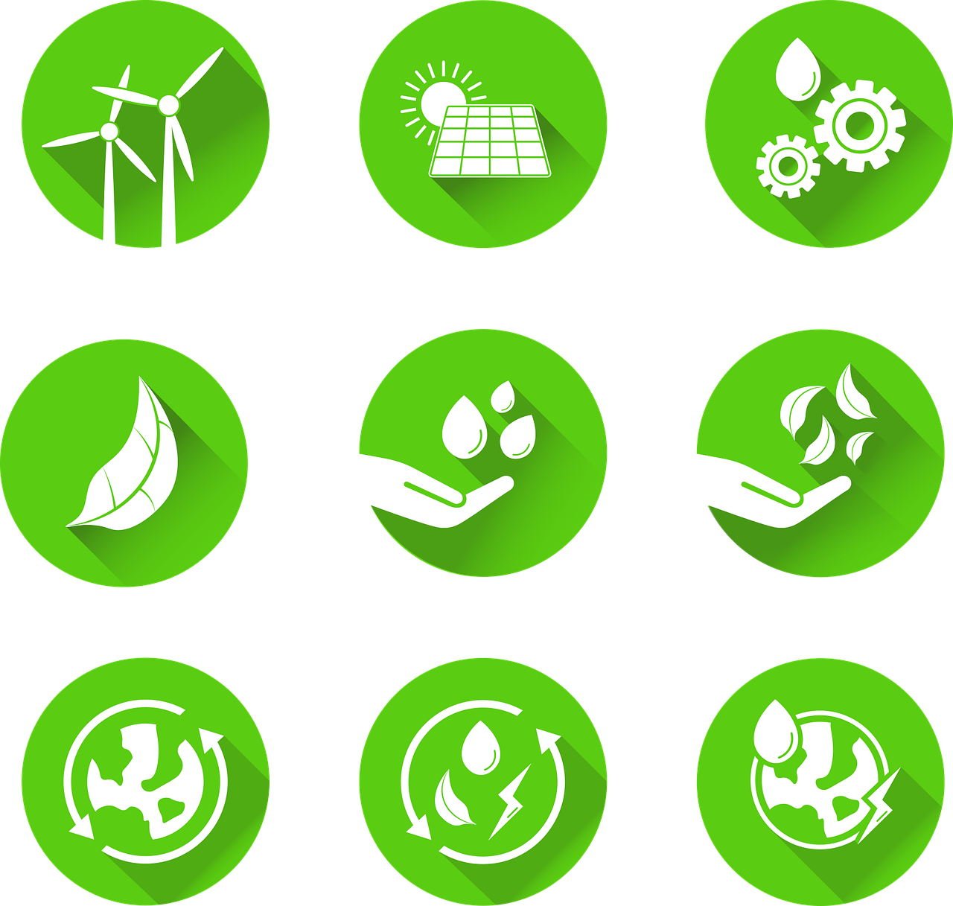
0001.01
Mission Assignment
Task | Using the handout, discuss the latest global targets that have been set by COP26. Are they achievable? How much more do we have to do as a country and as a world, to achieve a carbon-neutral future? Is this achievable through renewable energy resources alone?
Developing skills | Practise writing full answers to written questions. Use part of the question to commence your answer and make a statement to conclude with evidence.
Think about… | How much more do we have to do as a country, as a world, to achieve a carbon-neutral future? Is this achievable through renewable energy resources alone?
KS4-18-12:
Renewable energy

