Slide 1


Mission Assignment: Explore how to curtail deforestation
Code: COP26_01_03
Here are some ideas which show what we can do to stop deforestation.
Plant a tree where you can.
2. Go paperless at home and at school.
3. Buy recycled products and then recycle them again.
4. Buy certified wood products.
5. Support the products of companies that are committed to reducing deforestation.
6. Raise awareness in your community.
What could work for you in your school? What actions will you need to take to implement them? Create an action plan.
Area | Action plan
School
2
Developing Experts Copyright 2022 All Rights Reserved

Slide 2


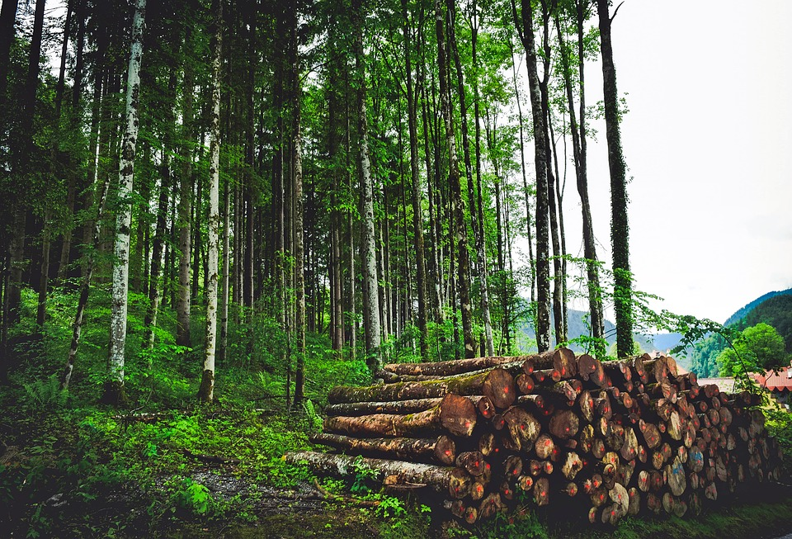
Mission Assignment: Explore how to curtail deforestation
Code: COP26_01_03
Challenge Task: Using the information you have gathered in your mission assignment, choose one of your actions and create a leaflet or poster to promote it.
Create an environmentally friendly brand to sponsor your campaign.
Plan your campaign in the table below:
Company name
Action to promote
Poster / campaign audience
Things to include
4
Developing Experts Copyright 2022 All Rights Reserved
Developing Experts Copyright 2022 All Rights Reserved

