Slide 1





Teacher answers
204
Pb
82
90
Y
39
235
Th
93
63
Cu
29
209
Bi
83

Slide 2

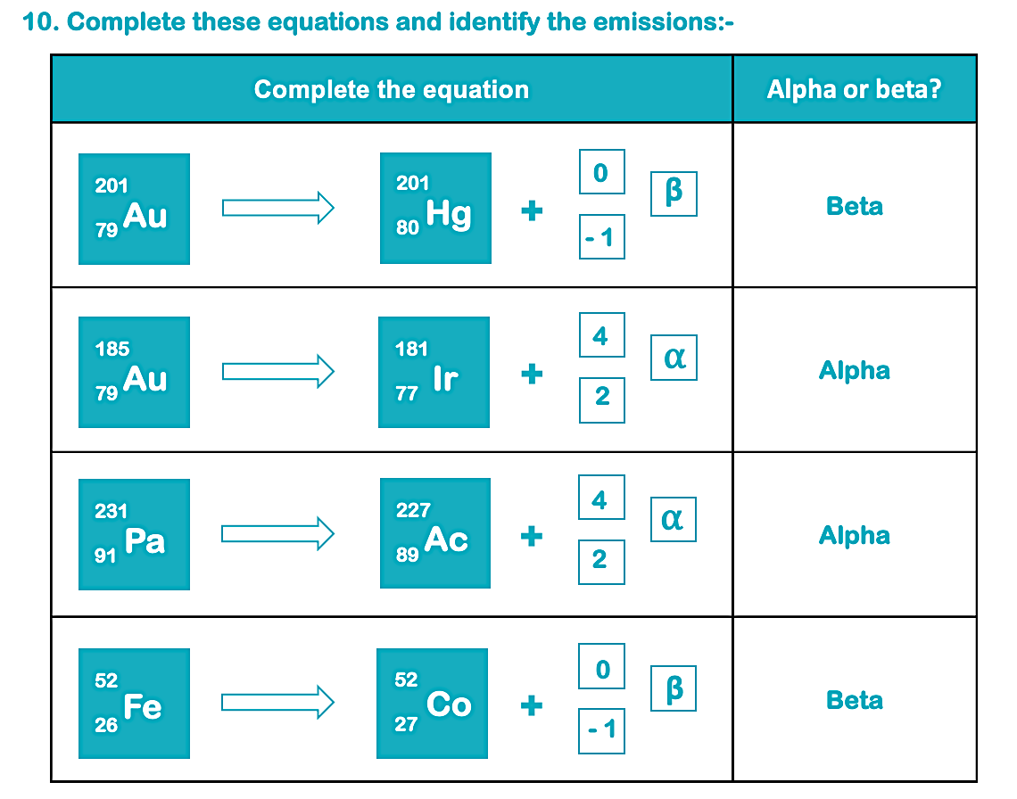
Teacher answers
224
Ra
86
220
Rn
84
2 half lives = 2.5mg
800mg
2135

