Slide 1



Mission Assignment: Describe gas pressure using a particle model
KS3-03-03
Gas Pressure
Help improve your understanding of pressure by completing the following questions.
Questions
Draw the gas particles onto the picture of the balloon.
Describe the movement of the gas particle in the balloon.
____________________________________________
____________________________________________
3. Complete the sentence using the words in the box.
volume colliding decreases pressure volume increases
The gas particles in the balloon are _______________ with the inside walls of the
balloon. This creates ________________ that keeps the balloon inflated. When a
balloon full of air is squeezed the ______________ of the balloon ____________. This
means that the particles have less space to move in. The lower the space the
more the pressure ___________. If the pressure increases too much the balloon
will pop.
Developing Experts Copyright 2023 All Rights Reserved

Slide 2
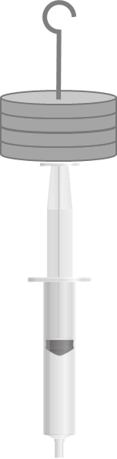
Mission Assignment: Describe gas pressure using a particle model
KS3-03-03
Gas Pressure
Investigate relationship between force applied and the volume of gas.
Method
Mount the syringe in a clamp stand with the
plunger is upright.
Pull the syringe back and forth a few times to
ensure the plunger doesn’t stick to the sides of
tube. Let the plunger settle and record the
volume of gas in the syringe.
Place a 100g slotted mass on to top the plunger (you can use another clamp to stabilise the slotted mass). Record the force applied using 100g is approximately 1N. Record the volume of gas in the syringe.
Continue adding slotted masses on top of the plunger and recording the volumes.
Analysis & Conclusion
Plot a scatter plot of force (x-axis) against volume in syringe (y-axis).
Draw a line of best fit.
What can you conclude about the relationship between the force applied and volume of a gas.
________________________________________________________________________________________________________________________
Equipment
Stand, 2 bosses, 2 clamps
Sealed 5 cm³ syringe
(sealed at approx. 3 cm³)
Slotted masses.
Force applied (N) | Volume in syringe (ml)
Challenge
Calculate the pressure inside the syringe using the formula (for a 5cm³ syringe).
Determine the relationship between pressure and volume of a gas.
Pressure (N/cm²) = 10N/cm² + | Force (N) x length of syringe (cm)
 | 5 cm³
Developing Experts Copyright 2023 All Rights Reserved

Slide 3
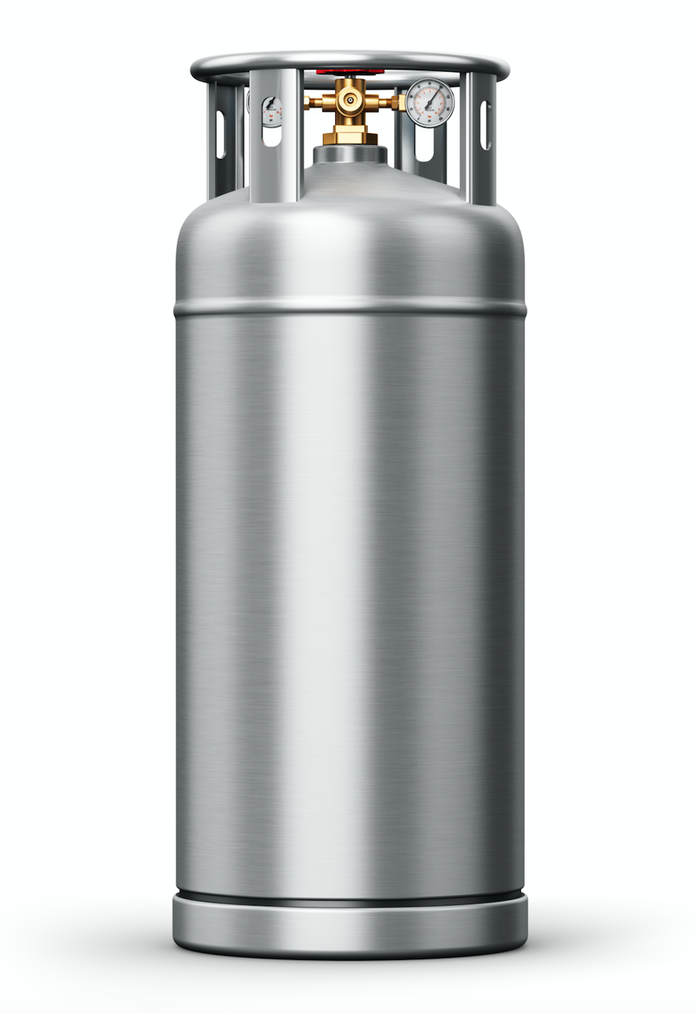
Mission Assignment: Describe gas pressure using a particle model
KS3-03-03
Gas Pressure
Read the information about gas pressure and complete the comprehension task
Compared to solids and liquids, the particles in a gas are more spread out. They move randomly and freely. Gas can be contained, for example in a canister. The particles of gas will hit the walls inside the canister. Because there are millions of particles hitting the walls at the same time, it creates force. This is called gas pressure.
If you force the particles into a smaller space, the particles hit the walls more often. This means the pressure has increased. A good example of this is if you pump up a beach ball – the more you pump the beach ball up, the more particles are forcing the beach ball to grow and therefore there is greater pressure inside the beach ball.
Another way to increase gas pressure is to increase the temperature because it gives them more energy to move about more quickly. When you remove gas from something, the pressure inside it will decrease. For example, a vacuum pump can withdraw pressure from another container, removing particles of gas and reducing the gas pressure.
How do the particles move in a gas?
____________________________________________________________________________________________________________________________________________________________
Where can gas be contained?
____________________________________________________________________________________________________________________________________________________________
What do the particles of gas do inside a container?
__________________________________________________________________________________________________________________________________________________________________________________________________________________________________________
Name two ways gas pressure increases?
______________________________________________________________________________________________________________________________________________
Explain what would happen if an inflatable is over-inflated.
Why does this happen?
________________________________________________________________
______________________________________________________________
______________________________________________________________
Developing Experts Copyright 2023 All Rights Reserved

Slide 4
Mission Assignment: Describe gas pressure using a particle model ANSWERS
KS3-03-03
Gas Pressure
Help improve your understanding of pressure by completing the following questions.
Random arrangement of particle spread out in balloon
Questions
Draw the gas particles onto the picture of the balloon.
Describe the movement of the gas particle in the balloon.
____________________________________________
____________________________________________
3. Complete the sentence using the words in the box.
Moving very quickly in all directions
volume colliding decreases pressure volume increases
The gas particles in the balloon are _______________ with the inside walls of the
balloon. This creates ________________ that keeps the balloon inflated. When a
balloon full of air is squeezed the ______________ of the balloon ____________. This
means that the particles have less space to move in. The lower the space the
more the pressure ___________. If the pressure increases too much the balloon
will pop.
colliding
pressure
volume
decreases
increases
Developing Experts Copyright 2023 All Rights Reserved

Slide 5
Mission Assignment: Describe gas pressure using a particle model ANSWERS
KS3-03-03
Gas Pressure
Investigate relationship between force applied and the volume of gas.
Method
Mount the syringe in a clamp stand with the
plunger is upright.
Pull the syringe back and forth a few times to
ensure the plunger doesn’t stick to the sides of
tube. Let the plunger settle and record the
volume of gas in the syringe.
Place a 100g slotted mass on to top the plunger (you can use another clamp to stabilise the slotted mass). Record the force applied using 100g is approximately 1N. Record the volume of gas in the syringe.
Continue adding slotted masses on top of the plunger and recording the volumes.
Analysis & Conclusion
Plot a scatter plot of force (x-axis) against volume in syringe (y-axis).
Draw a line of best fit.
What can you conclude about the relationship between the force applied and volume of a gas.
________________________________________________________________________________________________________________________
Equipment
Stand, 2 bosses, 2 clamps
Sealed 5 cm³ syringe
(sealed at approx. 3 cm³)
Slotted masses.
Force applied (N) | Volume in syringe (ml)
Students’ own answers
Should find as pressure increases volume decreases
Challenge
Calculate the pressure inside the syringe using the formula (for a 5cm³ syringe).
Determine the relationship between pressure and volume of a gas.
Pressure (N/cm²) = 10N/cm² + | Force (N) x length of syringe (cm)
 | 5 cm³
Developing Experts Copyright 2023 All Rights Reserved

Slide 6
Mission Assignment: Describe gas pressure using a particle model ANSWERS
KS3-03-03
Gas Pressure
Read the information about gas pressure and complete the comprehension task
Compared to solids and liquids, the particles in a gas are more spread out. They move randomly and freely. Gas can be contained, for example in a canister. The particles of gas will hit the walls inside the canister. Because there are millions of particles hitting the walls at the same time, it creates force. This is called gas pressure.
If you force the particles into a smaller space, the particles hit the walls more often. This means the pressure has increased. A good example of this is if you pump up a beach ball – the more you pump the beach ball up, the more particles are forcing the beach ball to grow and therefore there is greater pressure inside the beach ball.
Another way to increase gas pressure is to increase the temperature because it gives them more energy to move about more quickly. When you remove gas from something, the pressure inside it will decrease. For example, a vacuum pump can withdraw pressure from another container, removing particles of gas and reducing the gas pressure.
How do the particles move in a gas?
____________________________________________________________________________________________________________________________________________________________
Where can gas be contained?
____________________________________________________________________________________________________________________________________________________________
What do the particles of gas do inside a container?
__________________________________________________________________________________________________________________________________________________________________________________________________________________________________________
Name two ways gas pressure increases?
______________________________________________________________________________________________________________________________________________
Explain what would happen if an inflatable is over-inflated.
Why does this happen?
________________________________________________________________
______________________________________________________________
______________________________________________________________
Particles in a gas are more spread out. They move randomly and freely.
e.g. canister, gas cylinder
The particles of gas will hit the walls inside the canister.
Force the particles into a smaller space
increase the temperature
It would burst as the pressure would become too high
Developing Experts Copyright 2023 All Rights Reserved

