Slide 1

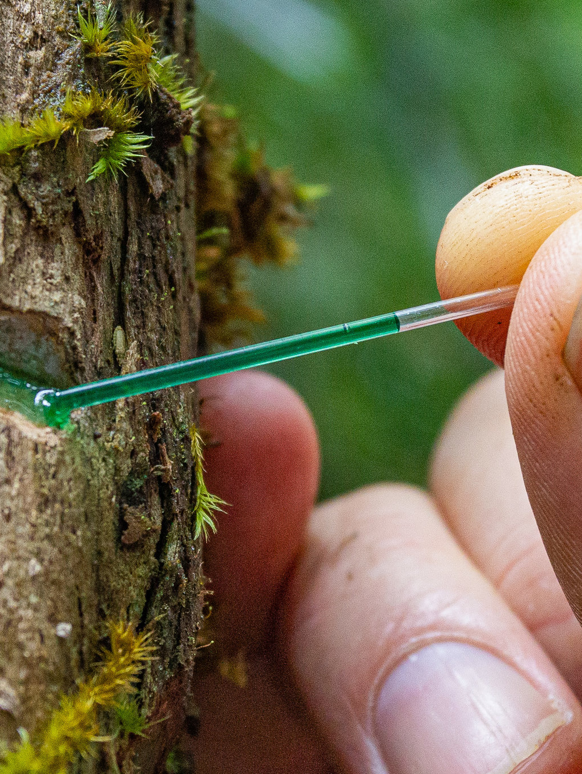
0001.01
Mission Assignment
Task
Developing skills
Think about…
Create a diagram which illustrates the process of phytomining.
Evaluate alternative biological methods of metal extraction, given appropriate information.
Describe ways to reduce the use of resources
KS4-17-04:
Using Resources - Explore phytomining and bioleaching

