Slide 1

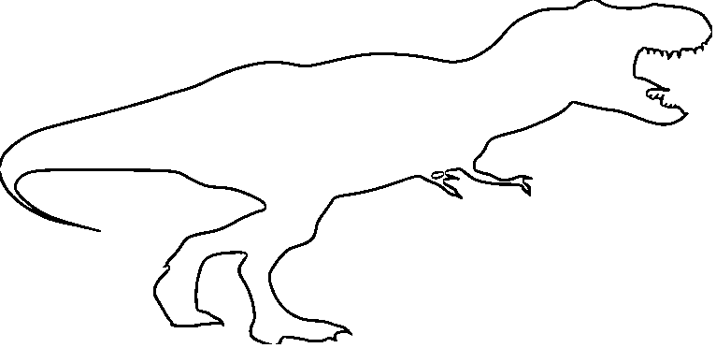

Resource Handout: S02.05.12 Handout
Learn about extinct animals.
Compare your size with that of a dinosaur.
Draw a picture of yourself on the grid below. What is your measurement in metres? Where should your head come up to?
5
4
3
2
1
0
height (m)
0 1 2 3 4 5 6 7 8 9 10 11 12 13
length (m)
Animal | Sabretooth | Mammoth | Dodo | Thylacine
Height | 1.2m | 3.0m | 1.0m | 0.6m
Length | 3.0m | 4.0m | 0.8m | 1.8m
Stretch:
Use the data in the table to draw the other extinct species onto the grid.
How tall is your teacher?
Draw them on the grid, too.
Challenge:
Use the data in the table to draw the some other extinct species onto the grid.
Developing Experts Ltd. © 2019

