Slide 1
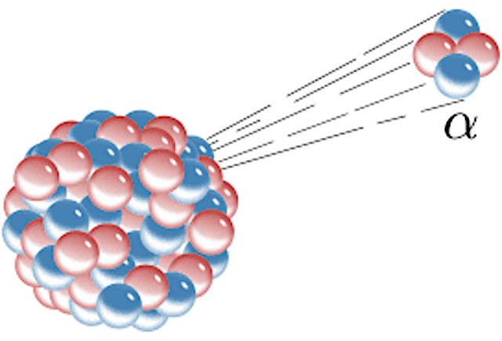
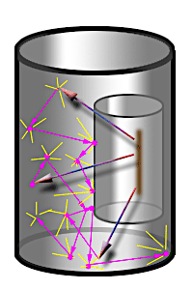
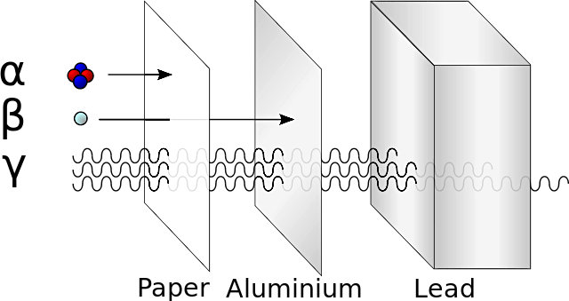
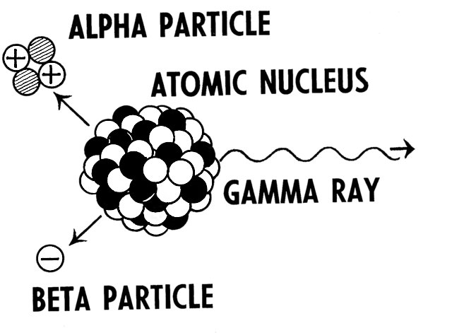

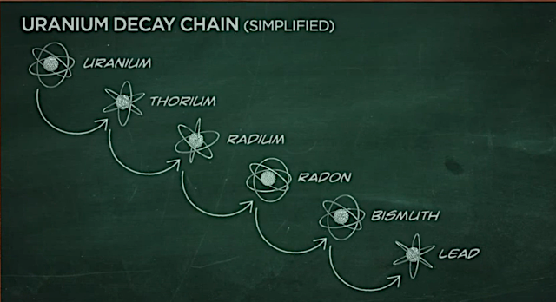

Rutherford & the alpha & beta particles
When Ernest Rutherford was conducting his early experiments at McGill University, he set out to isolate the large particles that were deflecting in the scattering experiment. He was already aware that Marie Curie had identified two types of radiation, one that passed through paper and another that did not. These had been named alpha and beta. He had the idea to contain the alpha particles within a thin-walled glass vessel that was in another thicker glass vessel. He noted that the particles had enough energy to pass through the first vessel, but not enough to travel any further. He also noted that after he had excited the particles with an electrical charge, they gave off the same lines as a helium atom.
We now know that the larger alpha particle has a positive charge of +2 and that the smaller beta particle has a negative charge of -1. We also know that the alpha particle can only travel a few centimetres and that the beta particle can travel three times as far. Furthermore, we know that alpha will be stopped by paper, and beta by aluminum foil.
Gamma Radiation & the Neutron
In 1900, Paul Villard identified a much more penetrating radiation that travelled in rays over a distance of metres. Rutherford went on to name this Gamma radiation. Finally, Chadwick identified the neutron in 1932. He and Rutherford had noted some mathematics that was not adding up during their mass spectrometry work at Cambridge University.
Gravitational
field strength
10N/kg
Radioactive decay
It was the collective and evolving hypotheses developed first by Becquerel, Marie and Pierre Curie, then by Rutherford and Soddy that has developed the theory of the radioactive decay of atoms. We know that this is an unpredictable process and that radioactive elements can change or transmute due to decay over time.

Slide 2
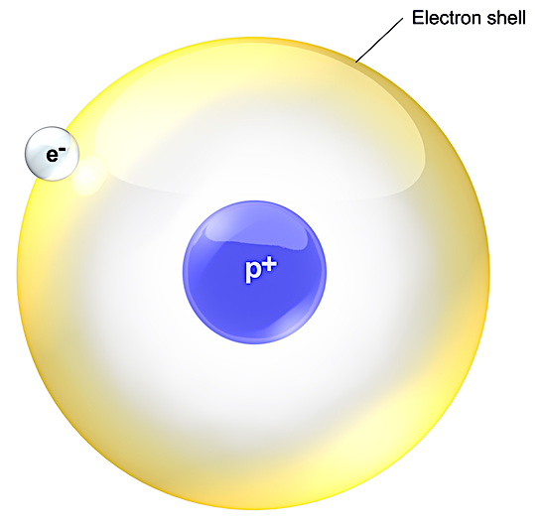
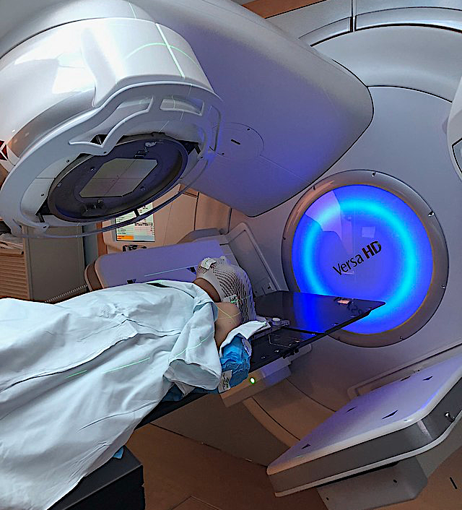
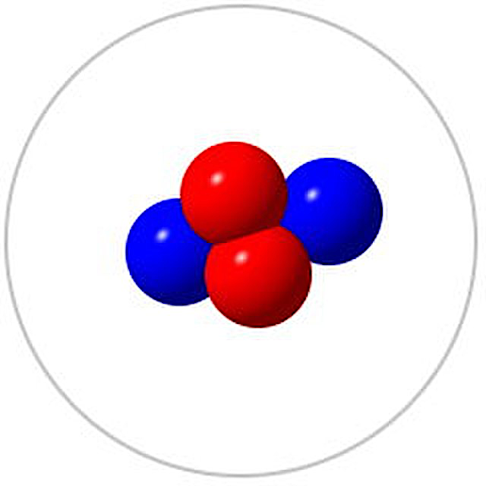
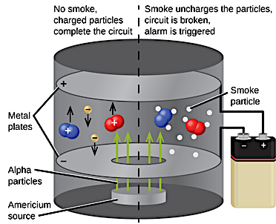
Practice
Which atom on the periodic table has no neutrons?__
What are the properties of gamma rays that make them effective at treating cancer? ____________________________________________________________________________________________________________________________________________________________________
Look at the picture. a) Identify this type of radiation particle. b) Describe its properties. ________________________________________________________________________________________________________________________________________________________________________________________________________
In the process of carbon dating, scientists measure the ratio of carbon-14 to carbon-12, which eventually decays to nitrogen. Tick the statement below that is true and illustrates that change from carbon-14 to nitrogen through beta radiation:-
Tick one box.
  The positive charge of the nucleus is reduced by 2.
  The number of protons decreases by 1.
  The mass number decreases by 1.
  The number of neutrons decreases by 1.
We use smoke alarms in houses that depend on alpha particles to enable smoke to be detected. Explain how this happens. ________________________________________________________________________________________________________________________ _____________________________________

Slide 3
Types of radiation
When caesium 137 goes through beta decay it becomes barium 137. As caesium 137, it has 55 protons and 82 neutrons. As barium 137, it has 56 protons and 81 neutrons.
  Write down the change of atomic mass.
  _____________________________________________________
  Give a full description of a beta particle.
  _______________________________________________________________________________________________________________________________________________________________
  Explain the relative ionising category of a beta particle.
  _______________________________________________________________________________________________________________________________________________________________
What is your definition of a nucleon? __________________________________________________________________________________________________________
From the given statement, identify the type of radiation
Statement | Type
Most ionising radiation. Can be sopped by paper
Has a low penetration power and is stopped in 6 cms of air
Very high penetration power but can be stopped by thick lead
Low penetration, can be stopped by aluminum foil

