Slide 1
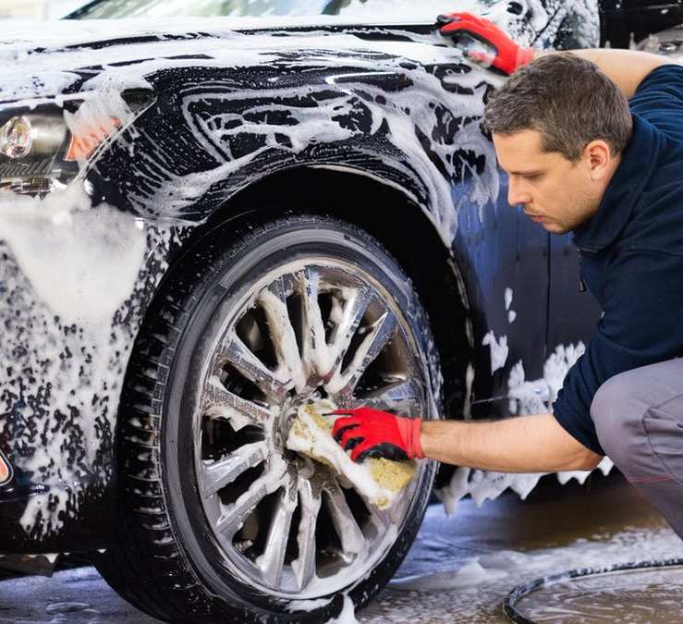


Developing Experts All rights reserved © 2021

Slide 2


Explore finite resources
Give examples of how humans use the Earth's resources.
Describe the difference between finite and renewable resources and give examples.
Developing Experts All rights reserved © 2021

Slide 3
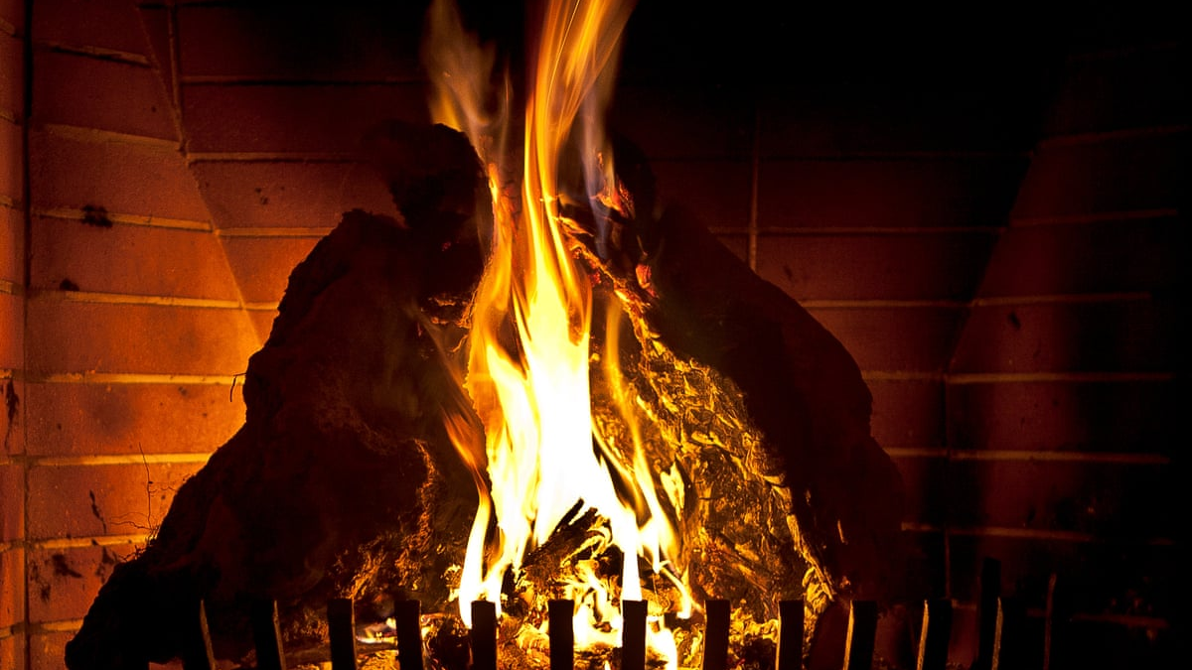

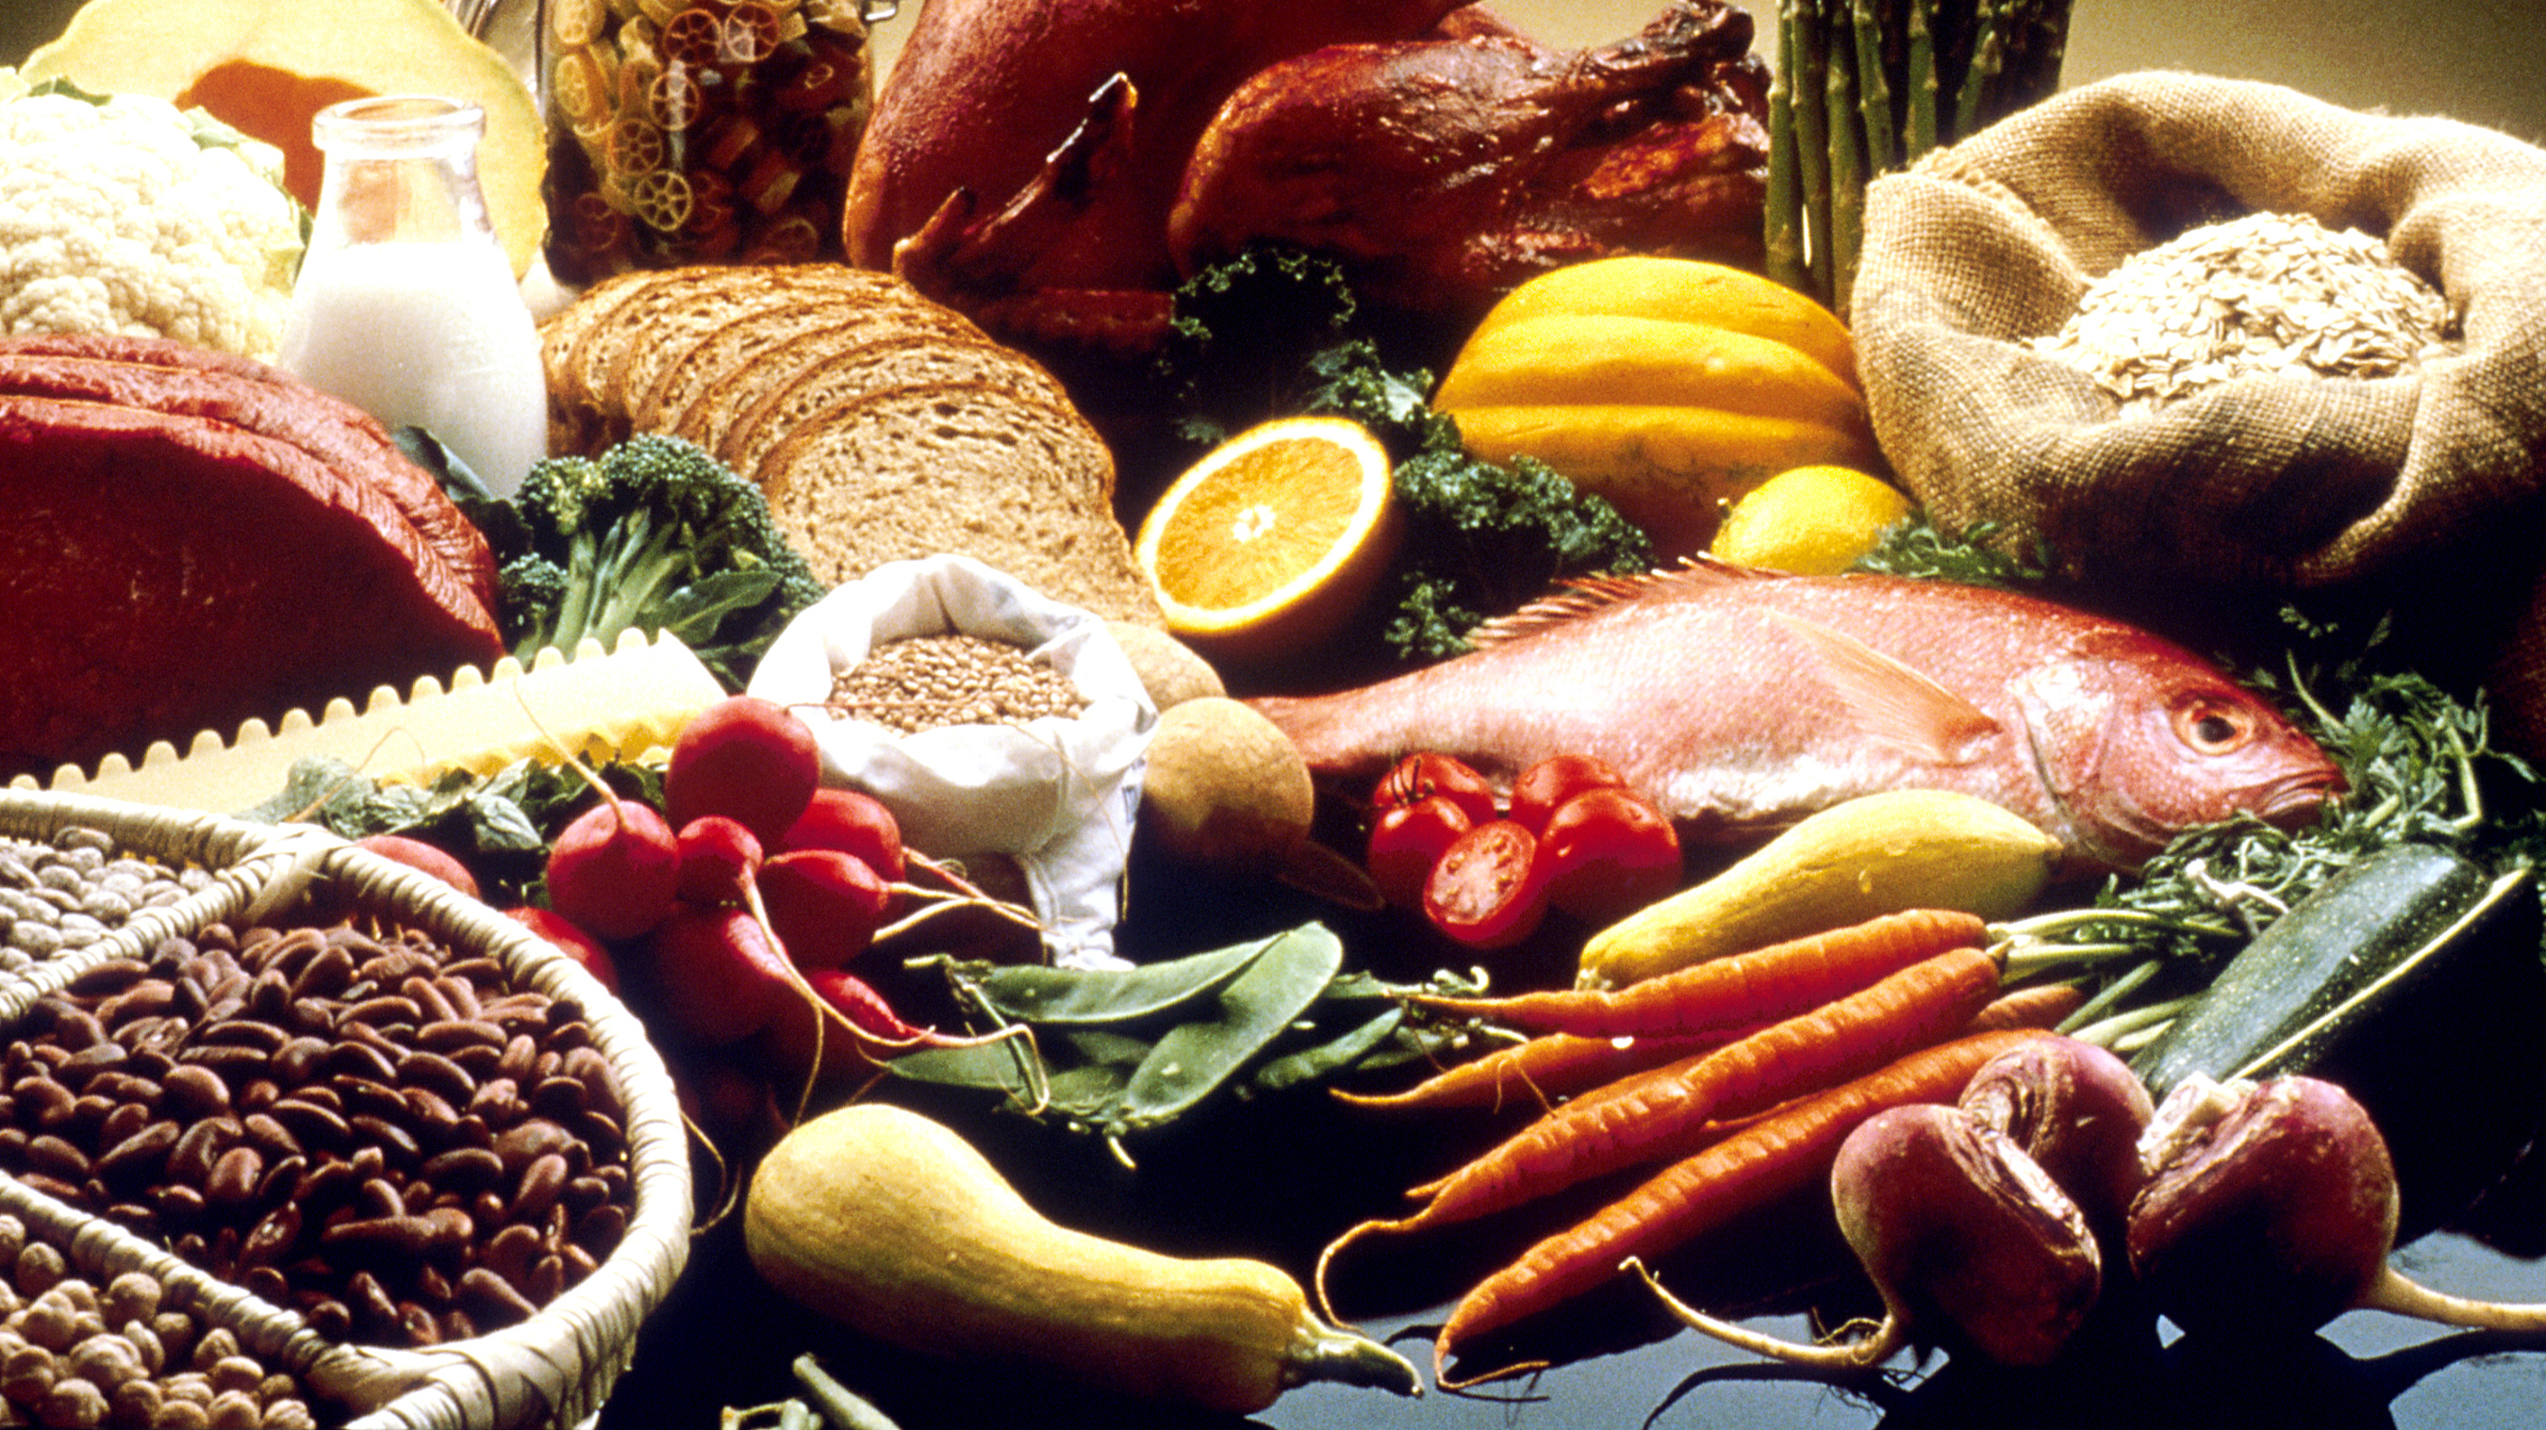
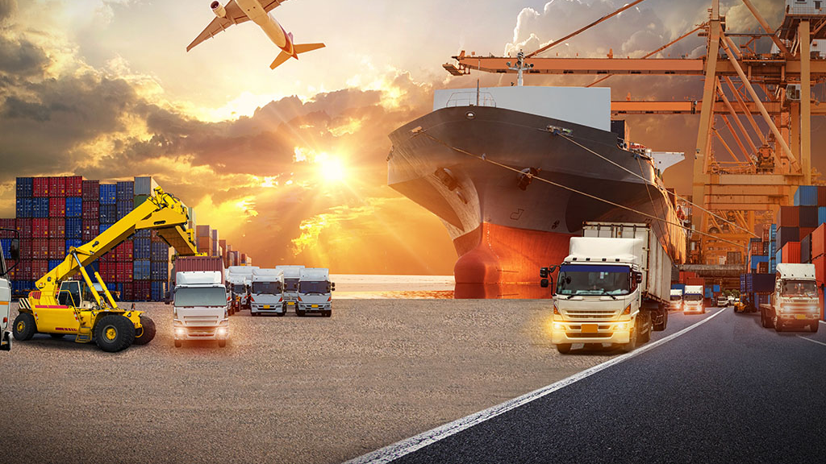
warmth
shelter
use of resources
food
transport
Developing Experts All rights reserved © 2021

Slide 4
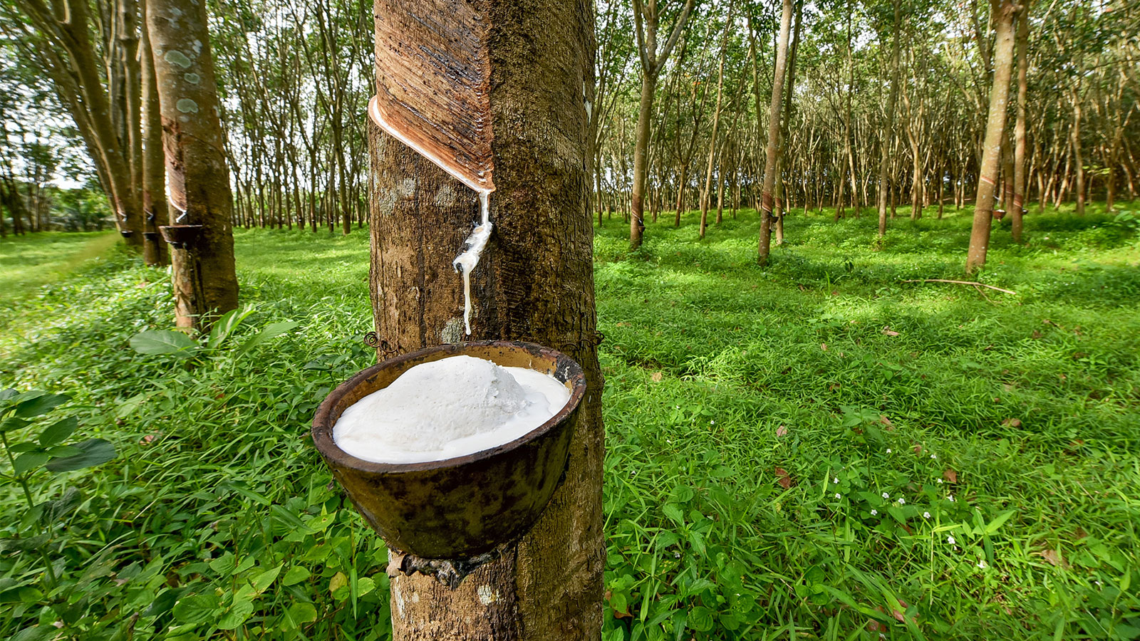
Developing Experts All rights reserved © 2021
Developing Experts All rights reserved © 2021
Developing Experts All rights reserved © 2021

Slide 5
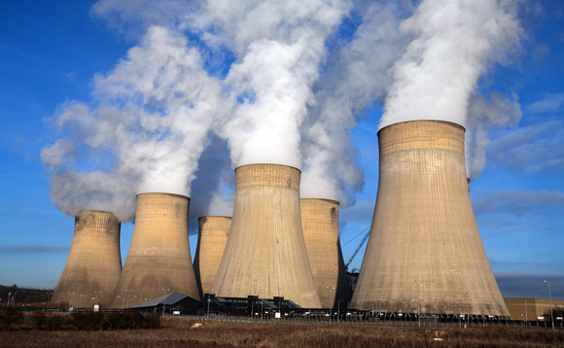
Developing Experts All rights reserved © 2021
Developing Experts All rights reserved © 2021

Slide 6
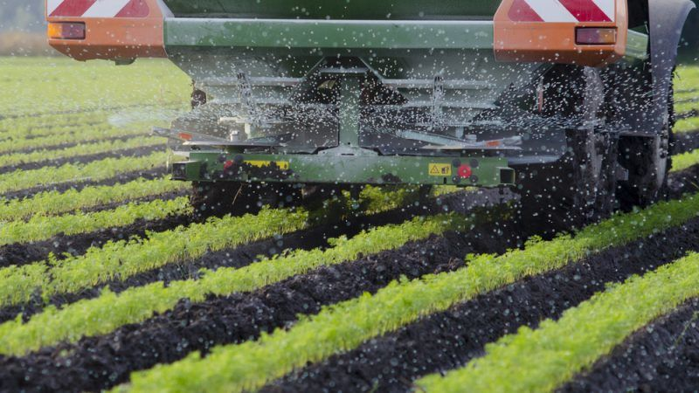
Developing Experts All rights reserved © 2021

Slide 7
Explore finite resources
Give examples of how humans use the Earth's resources.
Describe the difference between finite and renewable resources and give examples.
Developing Experts All rights reserved © 2021

