Slide 1

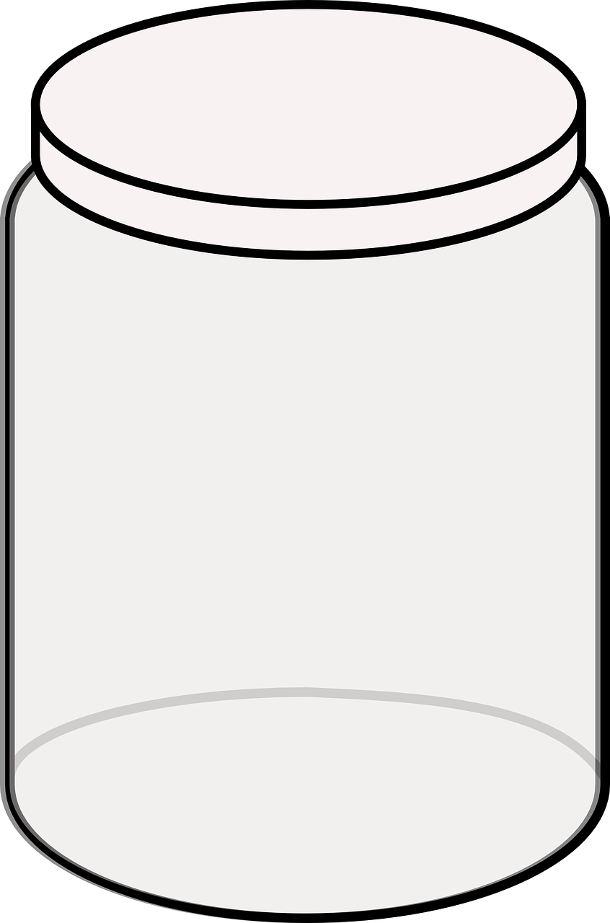
S04.04.04 Handout
Compare and group solids, liquids and gases
Complete the activity using the marbles in a jar and then explain
the differences between the three states of matter below.
solid
When I shake the jar of marbles…
____________________________________________________________________________________________________________________________________
In a solid, the molecules…
____________________________________________________________________________________________________________________________________
liquid
When I shake the jar of marbles…
____________________________________________________________________________________________________________________________________
In a liquid, the molecules…
____________________________________________________________________________________________________________________________________
gas
When I shake the jar of marbles a bit harder…
____________________________________________________________________________________________________________________________________
In a gas, the molecules…
____________________________________________________________________________________________________________________________________
Developing Experts Ltd. © 2022

