Slide 1
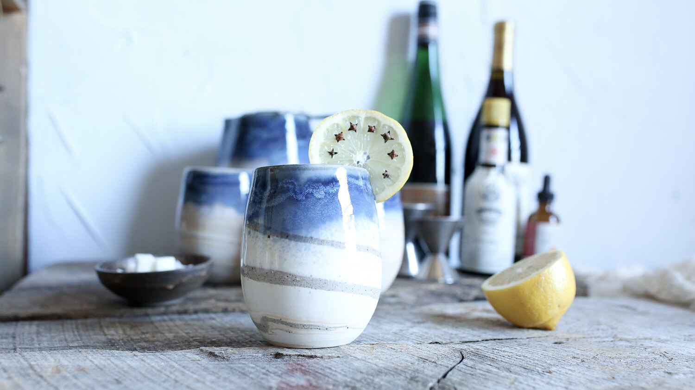
Developing Experts All rights reserved © 2021

Slide 2
Ceramics and glasses are very different materials.
Ceramics are crystalline, while glasses are amorphous. Glasses progressively soften upon heating and never melt. Ceramics almost always exhibit high melting temperatures and/or thermal stability.
Composite resins are less brittle than ceramics but have greater wear at the edges so may not last as long as a bonded ceramic restoration.
Developing Experts All rights reserved © 2021

Slide 3
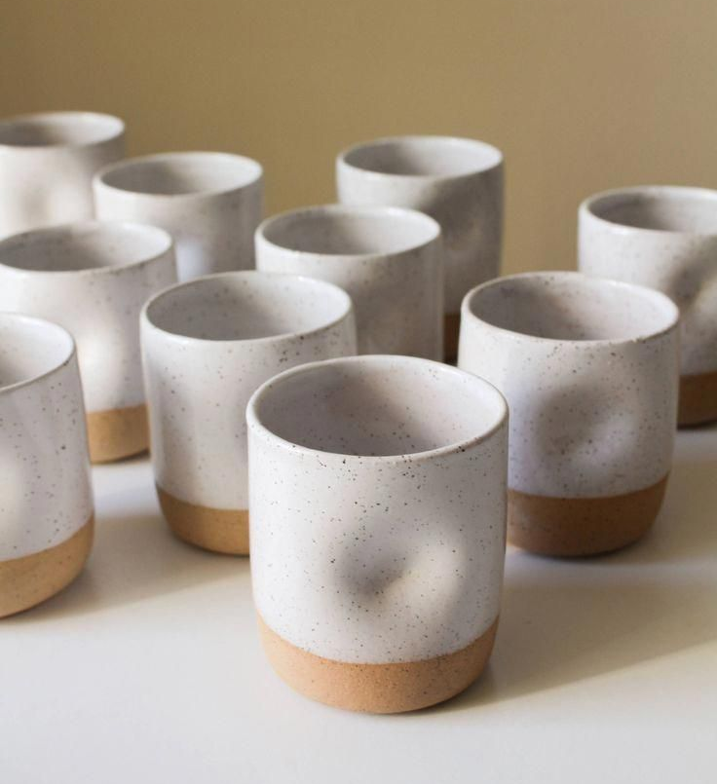
Explore glass, ceramics and composites
Describe how we make soda lime glass and borosilicate glass.
Describe how clay ceramics are formed.
Describe what's meant by a composite and give examples of composites.
Developing Experts All rights reserved © 2021

Slide 4
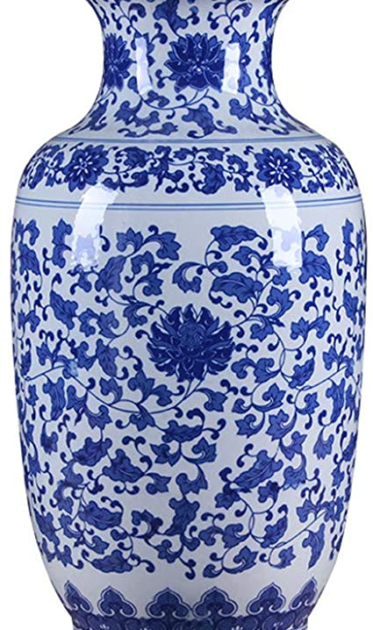

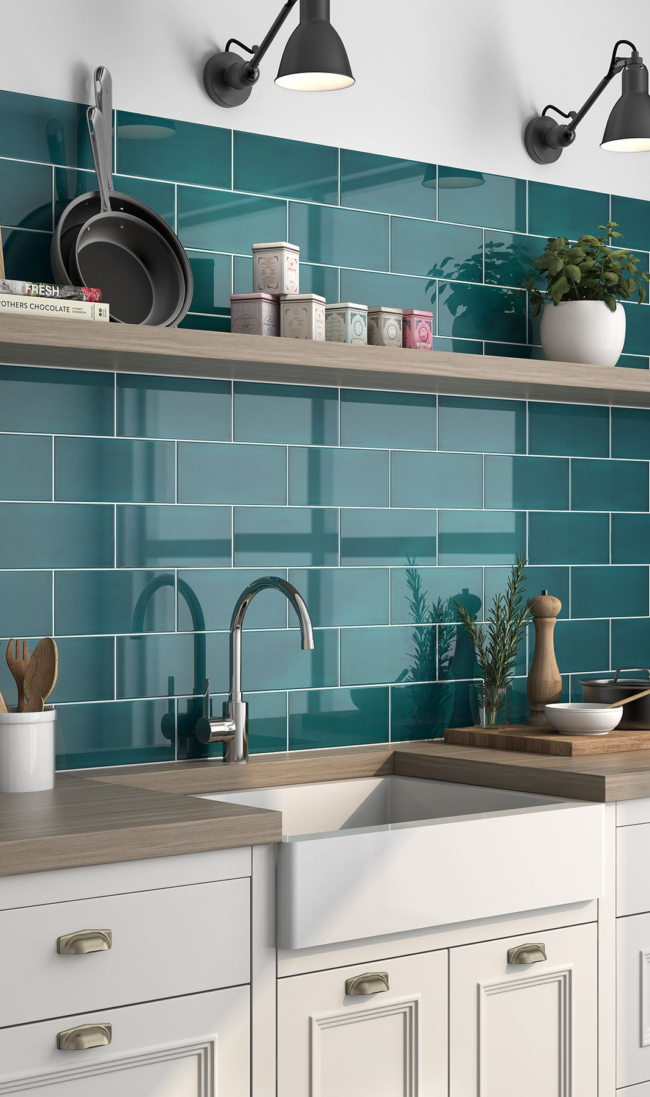
Developing Experts All rights reserved © 2021

Slide 5
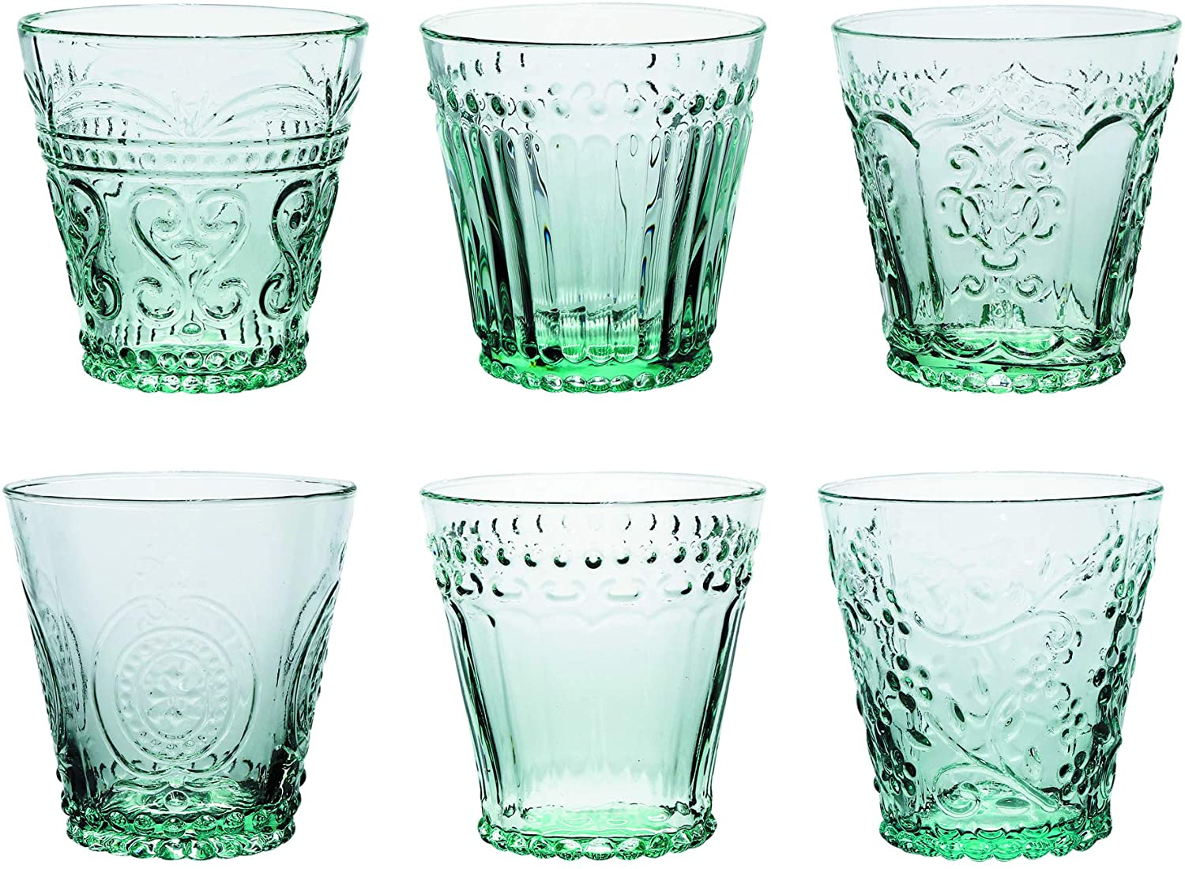
soda lime glass
Developing Experts All rights reserved © 2021

Slide 6
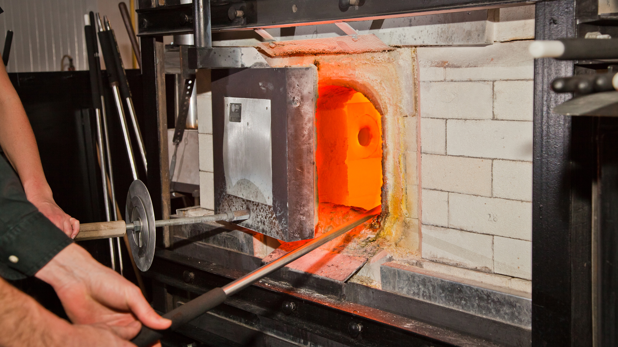
Developing Experts All rights reserved © 2021

Slide 7
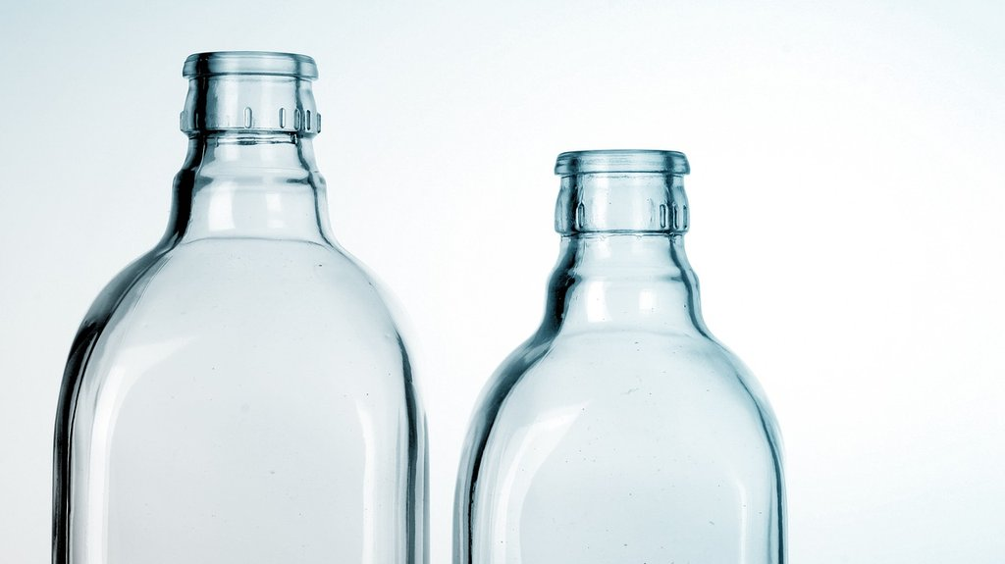
borosilicate glass
Developing Experts All rights reserved © 2021

Slide 8
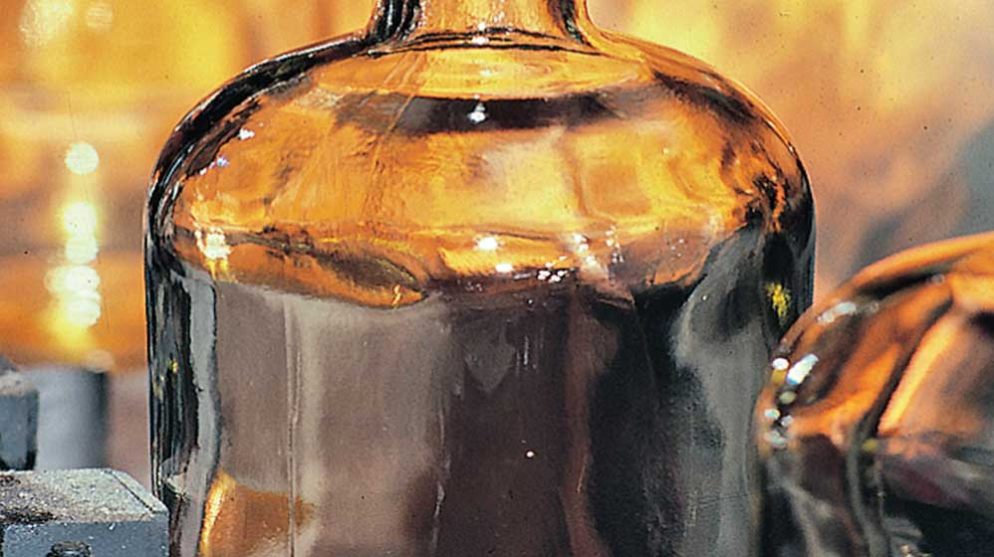
Developing Experts All rights reserved © 2021

Slide 9
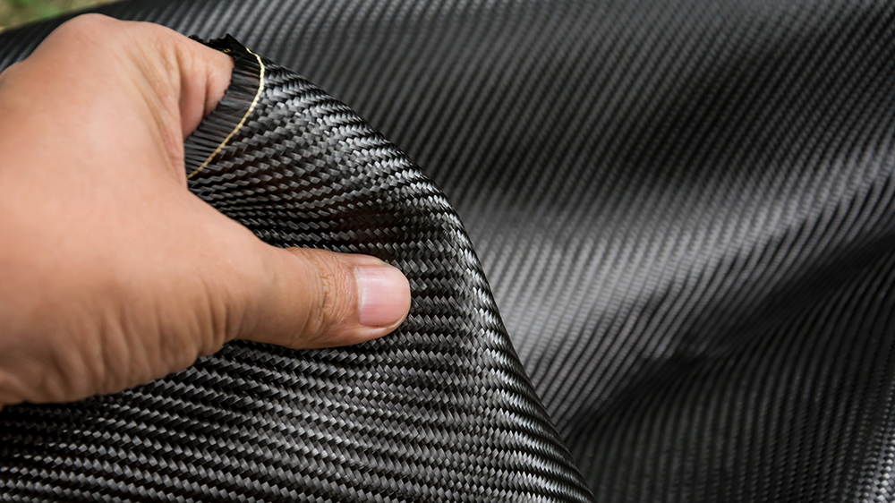
Developing Experts All rights reserved © 2021

Slide 10
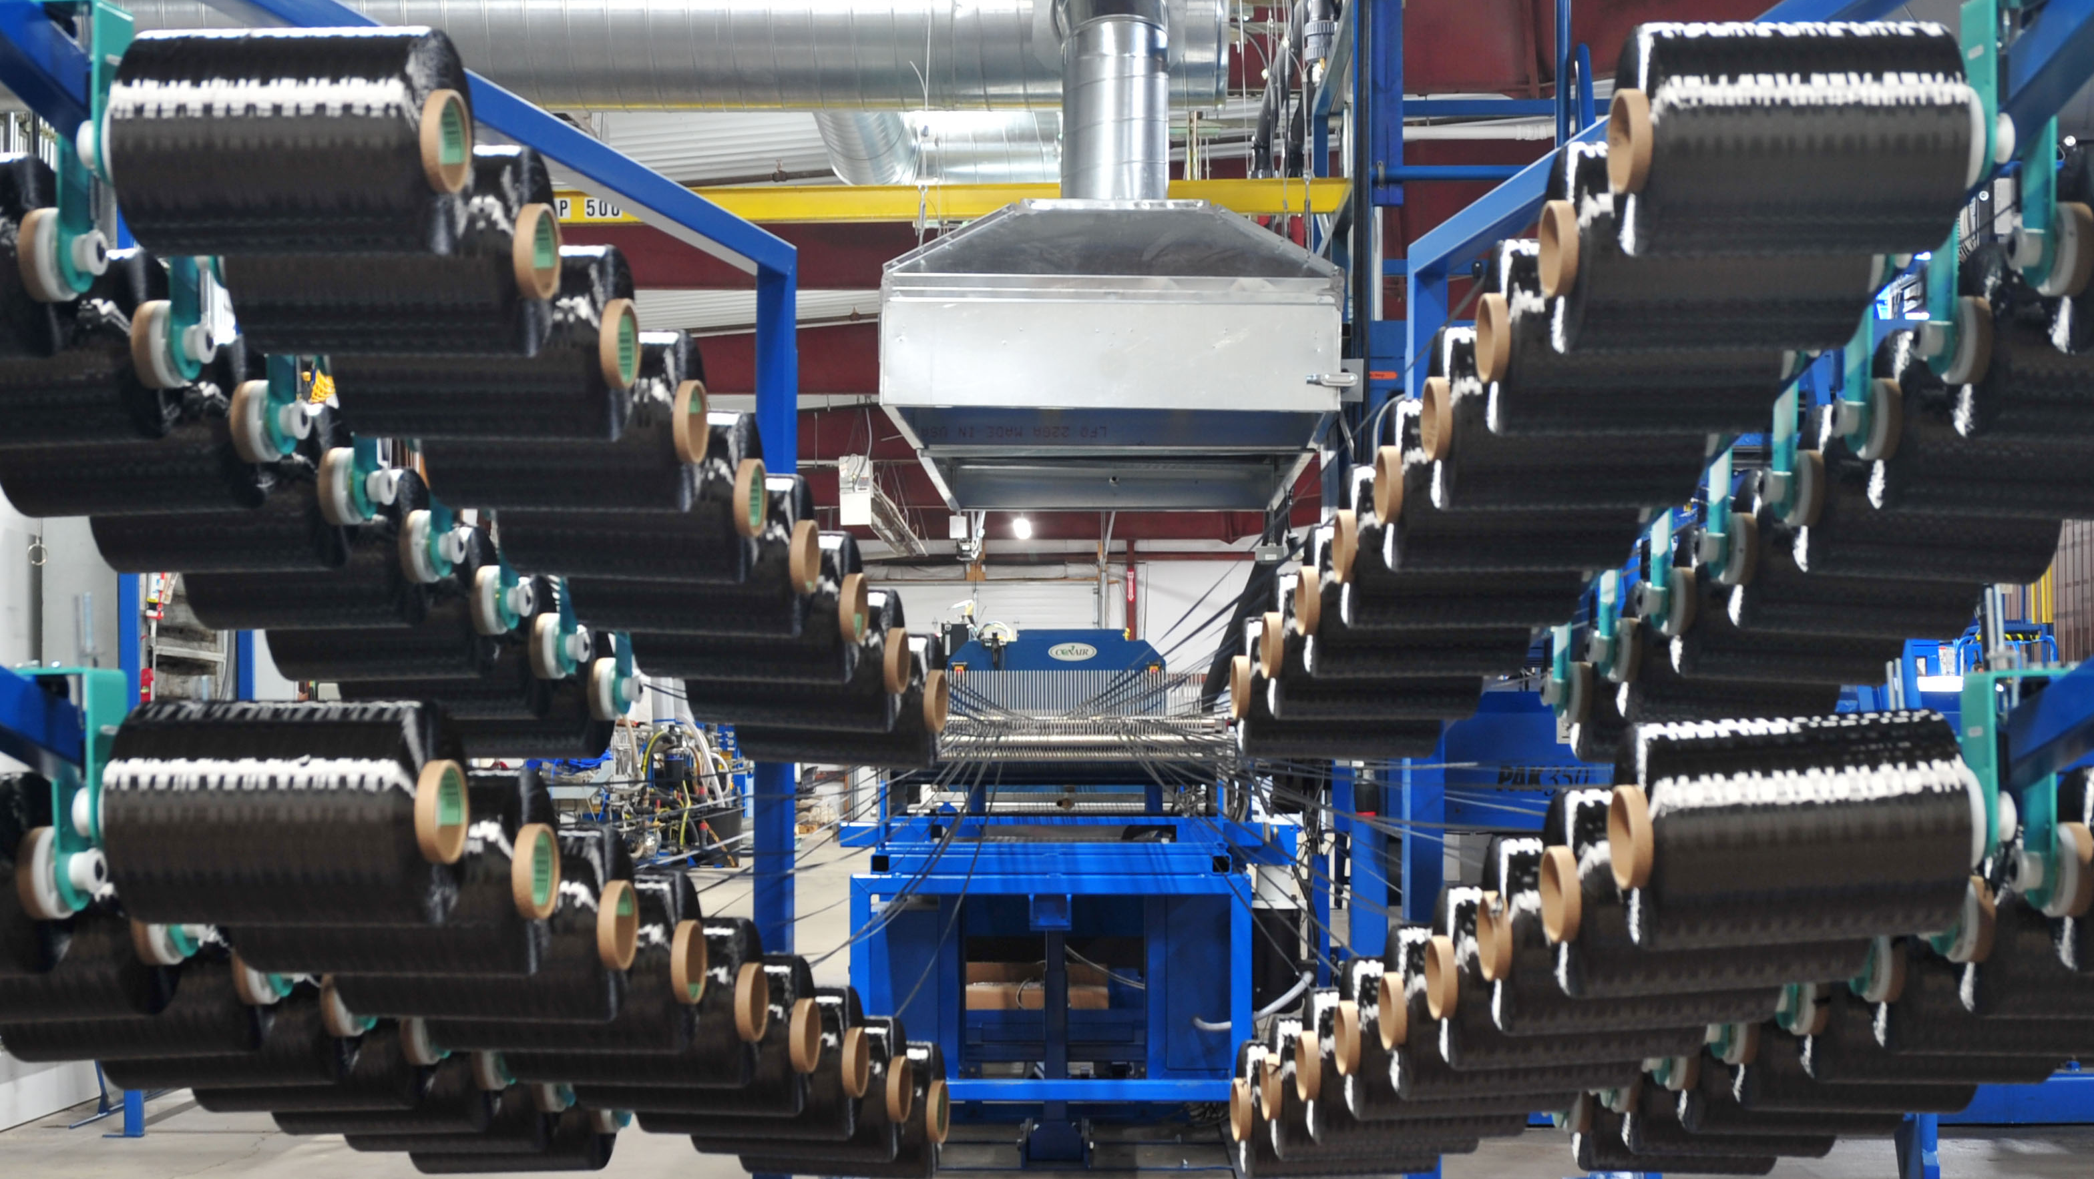
Developing Experts All rights reserved © 2021

Slide 11
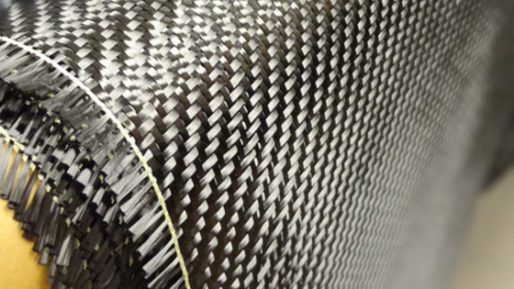
Developing Experts All rights reserved © 2021

Slide 12
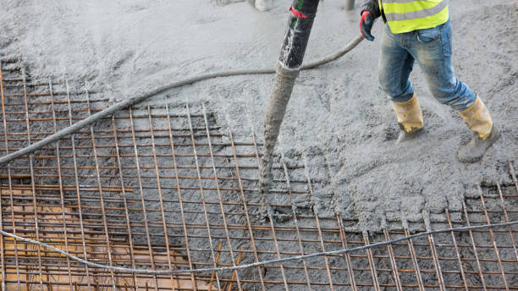
Developing Experts All rights reserved © 2021

