Slide 1
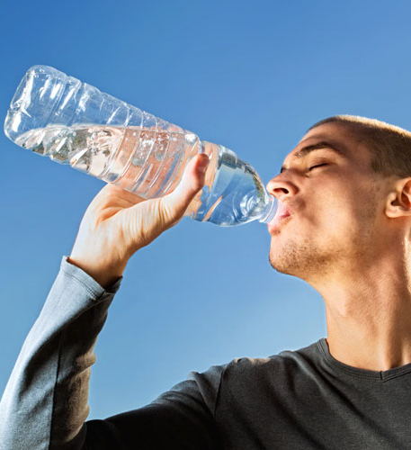

Explore water safe to drink
Describe the difference between potable and pure water.
Describe the steps used to produce potable water from fresh water and from salty water.
Developing Experts All rights reserved © 2021

Slide 2
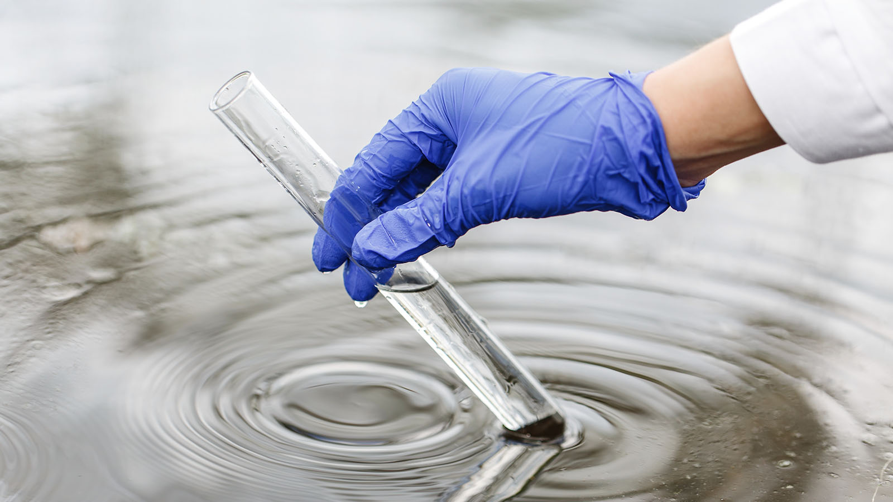
Developing Experts All rights reserved © 2021

Slide 3
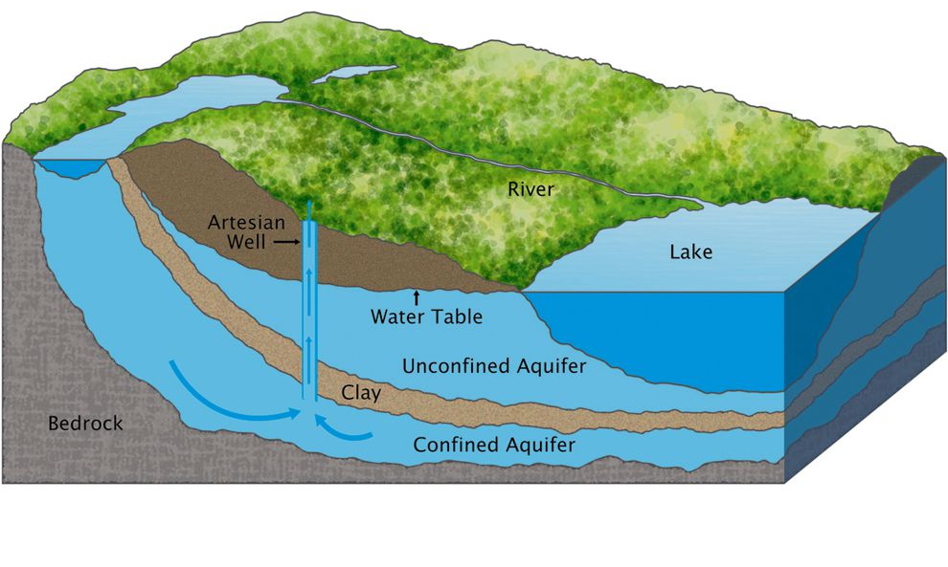
Aquifer
Developing Experts All rights reserved © 2021
Developing Experts All rights reserved © 2021

Slide 4
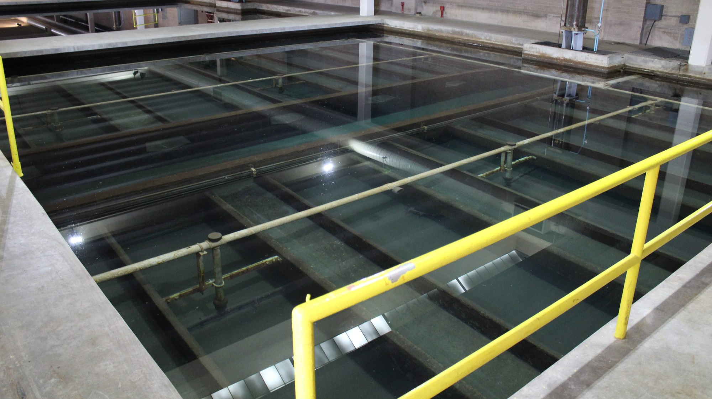
Developing Experts All rights reserved © 2021

Slide 5
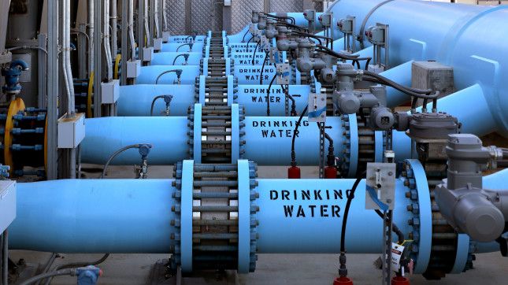
Developing Experts All rights reserved © 2021

Slide 6
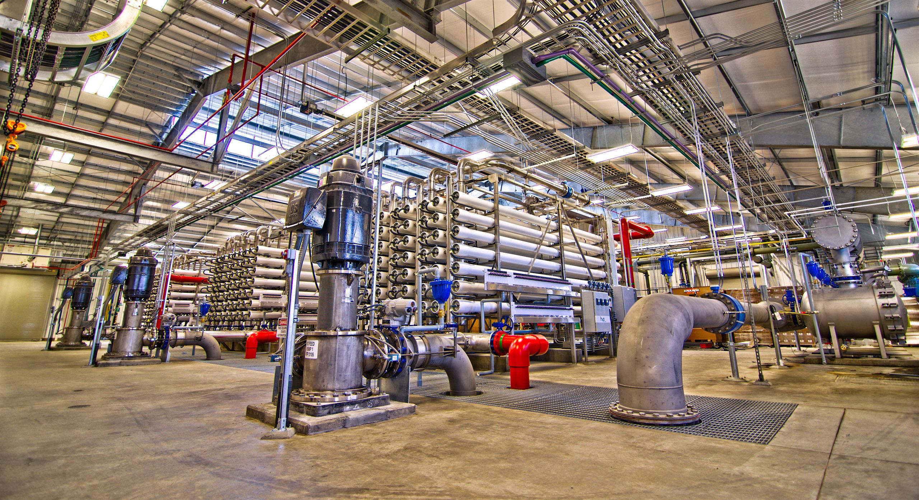
Developing Experts All rights reserved © 2021

