Slide 1

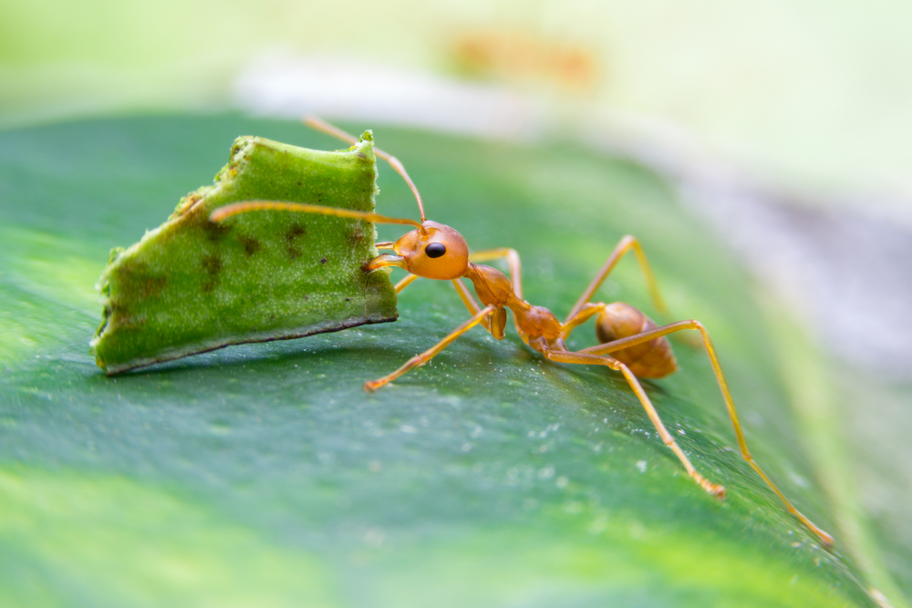
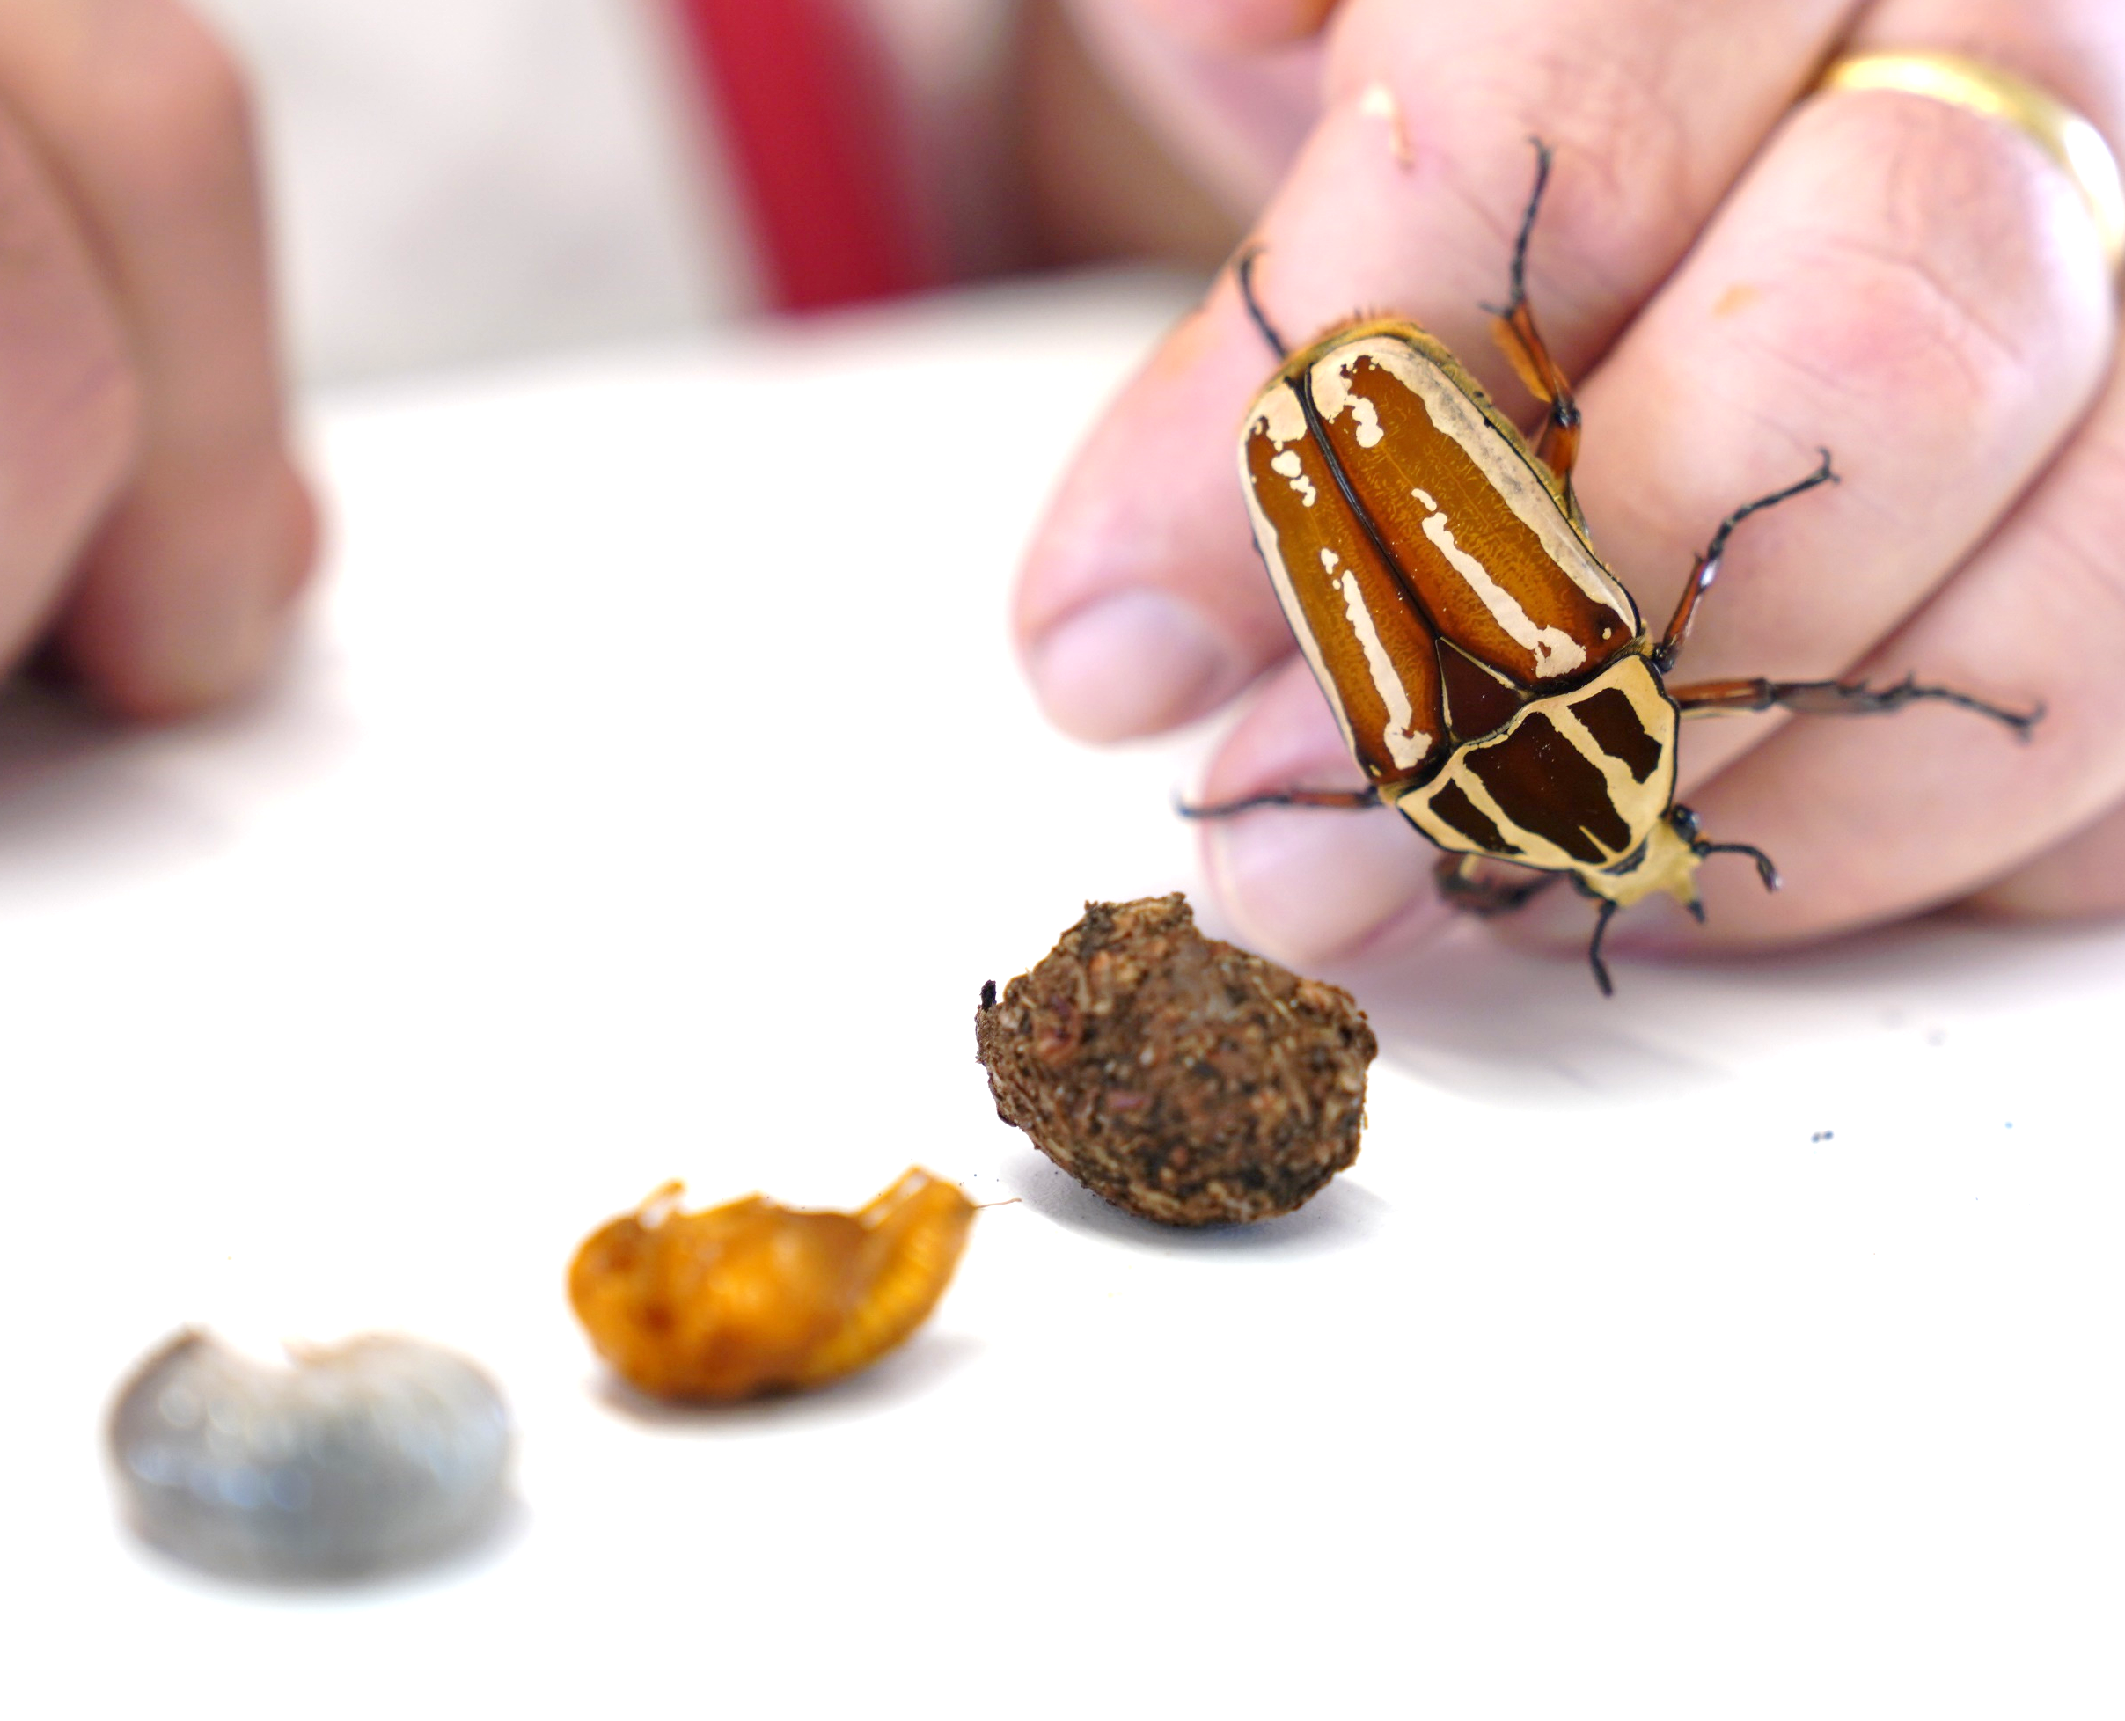
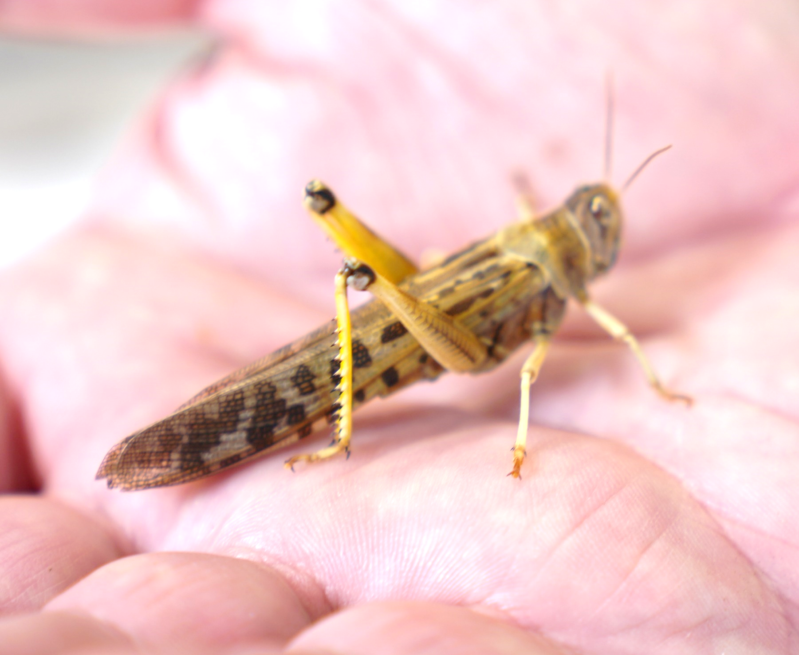
Mission Assignment: Ask relevant questions about the life of insects
Science Week 2024
Wildlife expert Mike Linley will be answering questions about the life of insects during a LIVE lesson. These insects will be featured. What questions do you have for him?
____________________________________________________________________________________________________________________________________________________________________________________________________________
leafcutter ant
____________________________________________________________________________________________________________________________________________________________________________________________________________
beetle
____________________________________________________________________________________________________________________________________________________________________________________________________________
locust
Ask your teacher to take a photo of your question and upload it to the Developing Experts platform in the exemplar work section. Mike will try to answer as many questions as possible during the LIVE lesson. Don’t forget to add your name and school!
Developing Experts Copyright 2024 All Rights Reserved

