Slide 1
Build a leaf compass.
Fill a wide bowl with water.
Gently stroke a paperclip or needle with a magnet.
Gently place your leaf on the water so it floats in the middle of the bowl.
Gently place the magnetised needle on the leaf.
Let the leaf move freely and the needle will point North.
Equipment
bowl
water
leaf
needle
bar magnet
Stretch & Challenge:
Does is make a difference which end of the magnet points at the compass? Explain your idea.
What do you think will happen if you put your magnet near your compass? _____________________________________________________________________________________________________________________________________________________________________
Draw what happens when you put magnet near your compass.

Slide 2
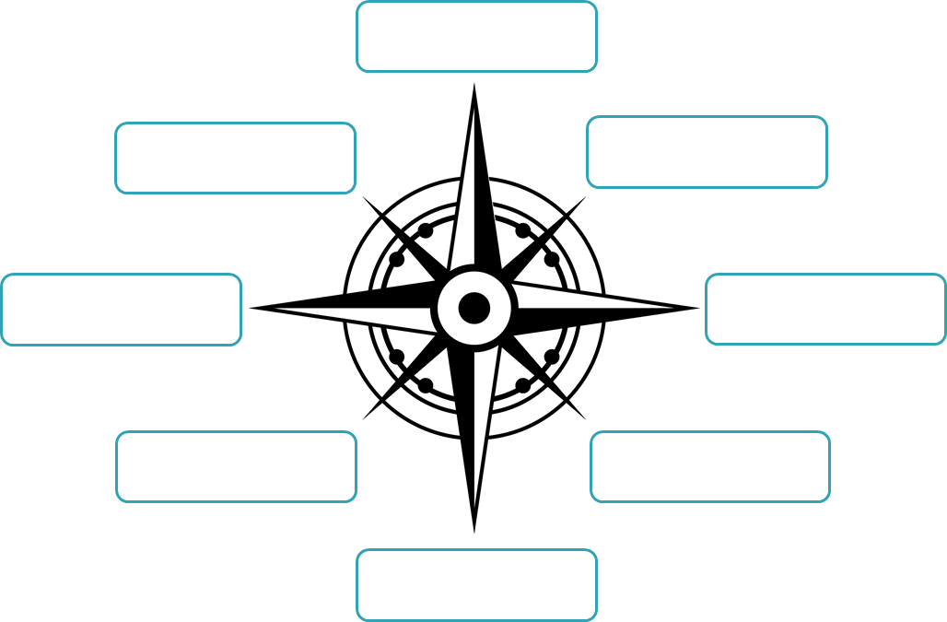
Add the direction labels to the compass.
North (N)
South (S)
West (W)
East (E)
Northwest (NW)
Southwest (SW)
Northeast (NE)
Southeast (SE)
Explain why a compass is important in navigation.
__________________________________________________________________________________________________________________________________________________________________
Explain how to make a magnetic compass.
__________________________________________________________________________________________________________________________________________________________________
Explain why the magnetic compass point North.
__________________________________________________________________________________________________________________________________________________________________

