Slide 1


Exothermic Reactions Endothermic Reactions
Exothermic Reaction
Endothermic Reaction
Developing Experts All rights reserved © 2021

Slide 2
Exothermic and Endothermic Reactions
Describe what's meant by an exothermic or an endothermic reaction
Draw energy profiles showing exothermic and endothermic reactions
Describe what's meant by the activation energy for a reaction
Exothermic Reaction
Endothermic Reaction
Developing Experts All rights reserved © 2021

Slide 3
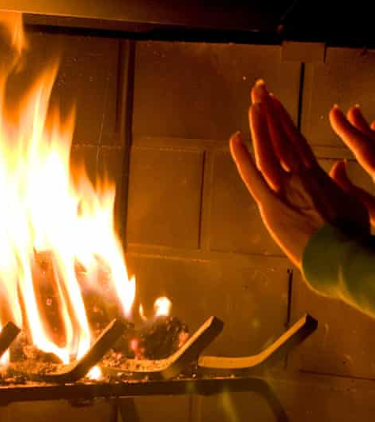
Exothermic Reactions
Exothermic Reaction

Slide 4

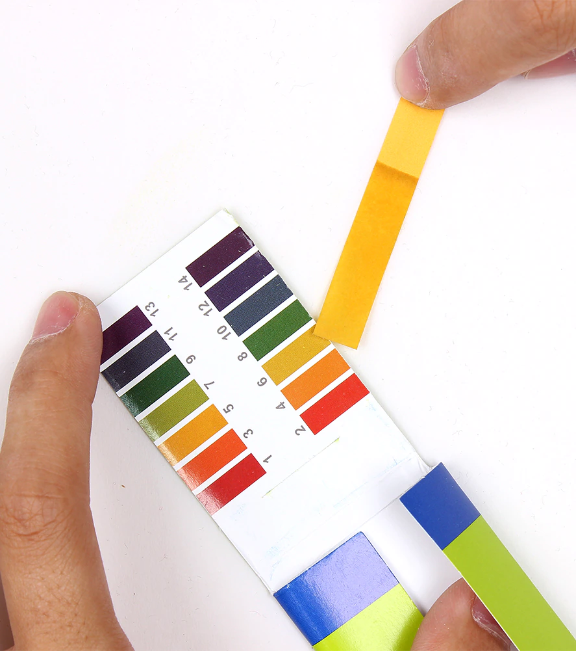
oxidation
neutralization
Developing Experts All rights reserved © 2021

Slide 5
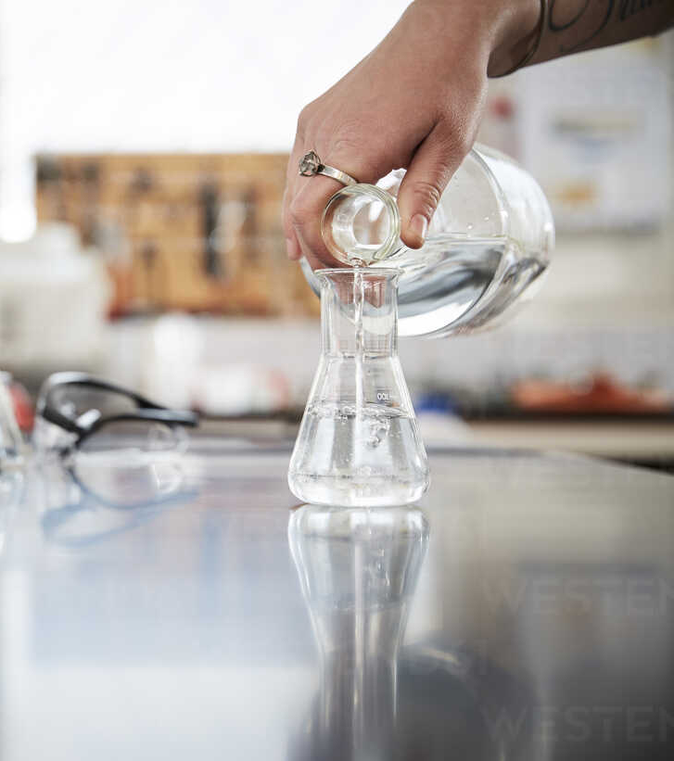
Exothermic Reactions
reactants
Energy
products
Time of Reaction
Developing Experts All rights reserved © 2021

Slide 6
Exothermic Reactions
reactants
Energy
products
energy transferred to surroundings
Time of Reaction
Developing Experts All rights reserved © 2021

Slide 7
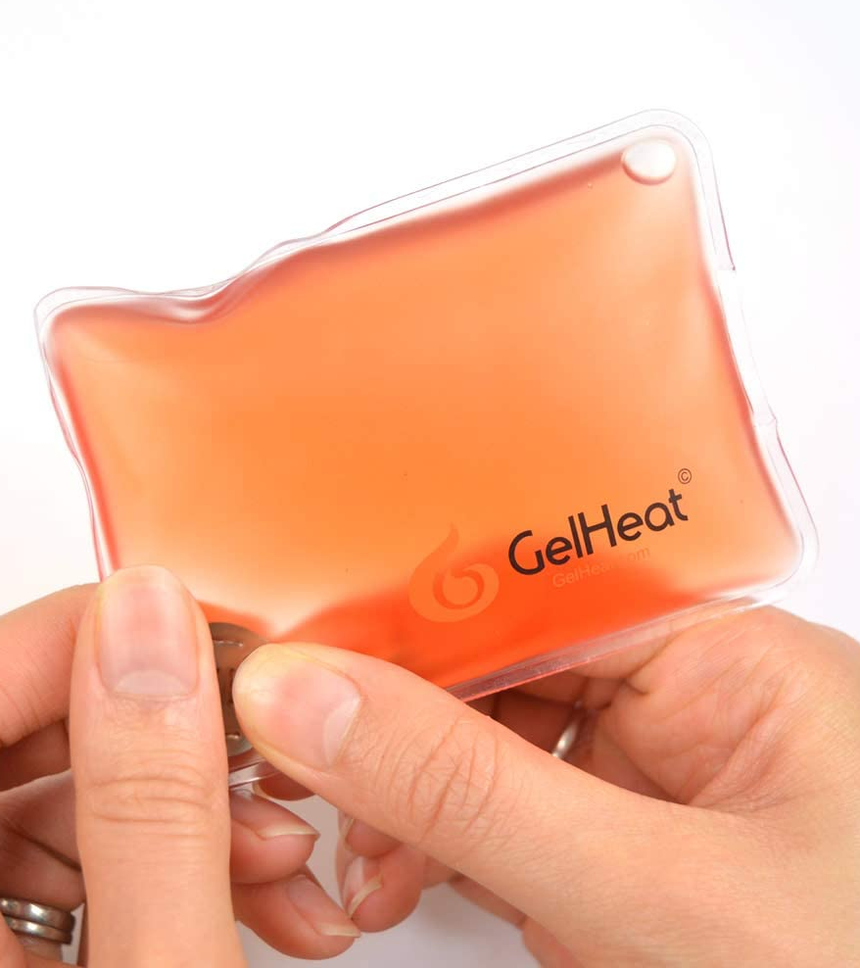
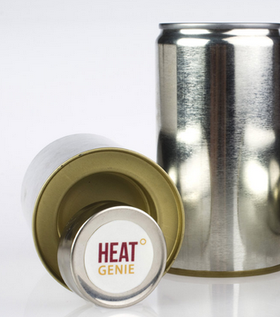
Exothermic Reactions
handwarmer
self heating cans
Developing Experts All rights reserved © 2021

Slide 8
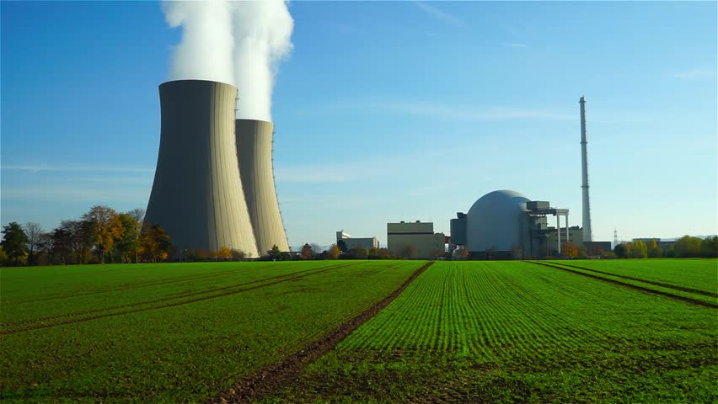
nuclear power stations use both
Exothermic and Endothermic Reactions
Developing Experts All rights reserved © 2021

Slide 9
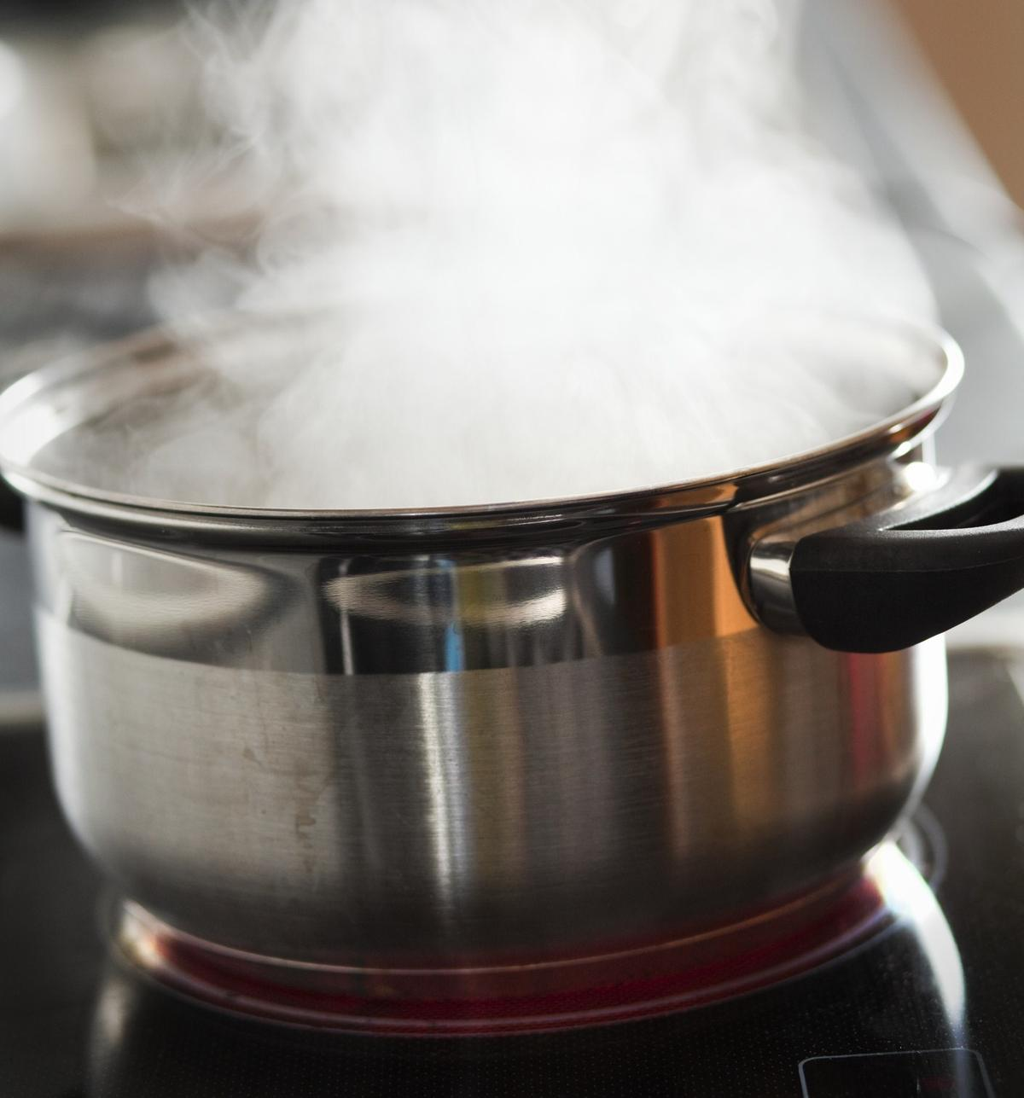
Endothermic Reactions
products
Energy
reactants
Time of Reaction
Developing Experts All rights reserved © 2021

Slide 10
Endothermic Reactions
products
Energy
reactants
energy transferred to surroundings
Time of Reaction
Developing Experts All rights reserved © 2021

Slide 11
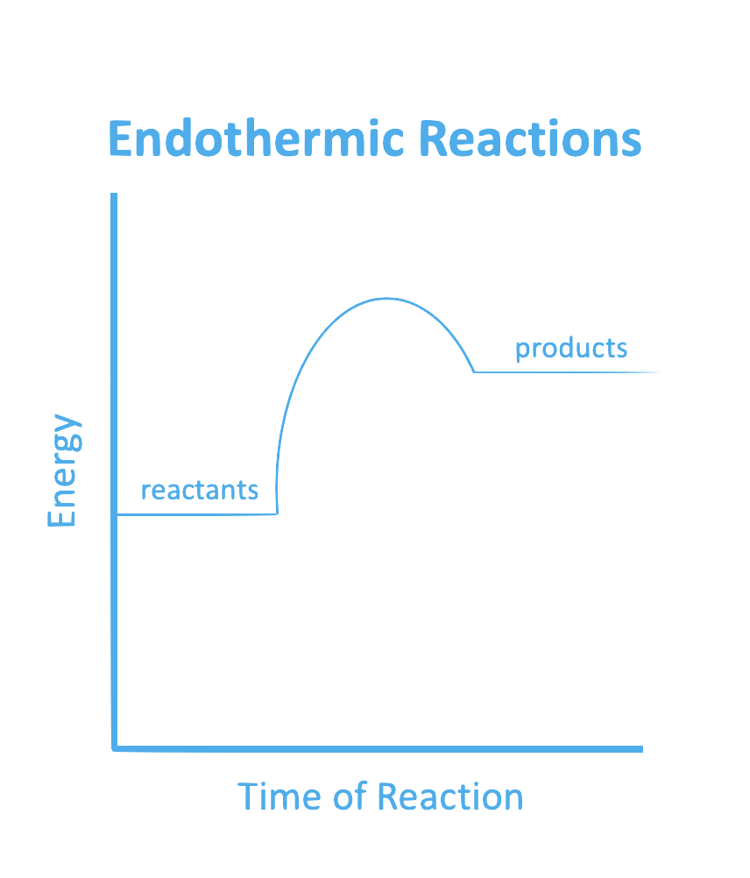
Exothermic Reactions
reactants
Energy
products
Time of Reaction
Developing Experts All rights reserved © 2021

Slide 12
Exothermic Reactions
Endothermic Reactions
products
reactants
Energy
Energy
products
reactants
Time of Reaction
Time of Reaction
Developing Experts All rights reserved © 2021

Slide 13
Activation Energy
Exothermic Reactions
Endothermic Reactions
products
reactants
Energy
Energy
products
reactants
Time of Reaction
Time of Reaction
Developing Experts All rights reserved © 2021

