Slide 1
What type of radiation from a radioactive substance is negatively charge?
Where does this charge come from?
Alpha
Gamma
Beta
Developing Experts All rights reserved © 2021

Slide 2
What type of radiation from a radioactive substance is negatively charge?
Where does this charge come from?
Alpha
Gamma
Beta
Developing Experts All rights reserved © 2021

Slide 3
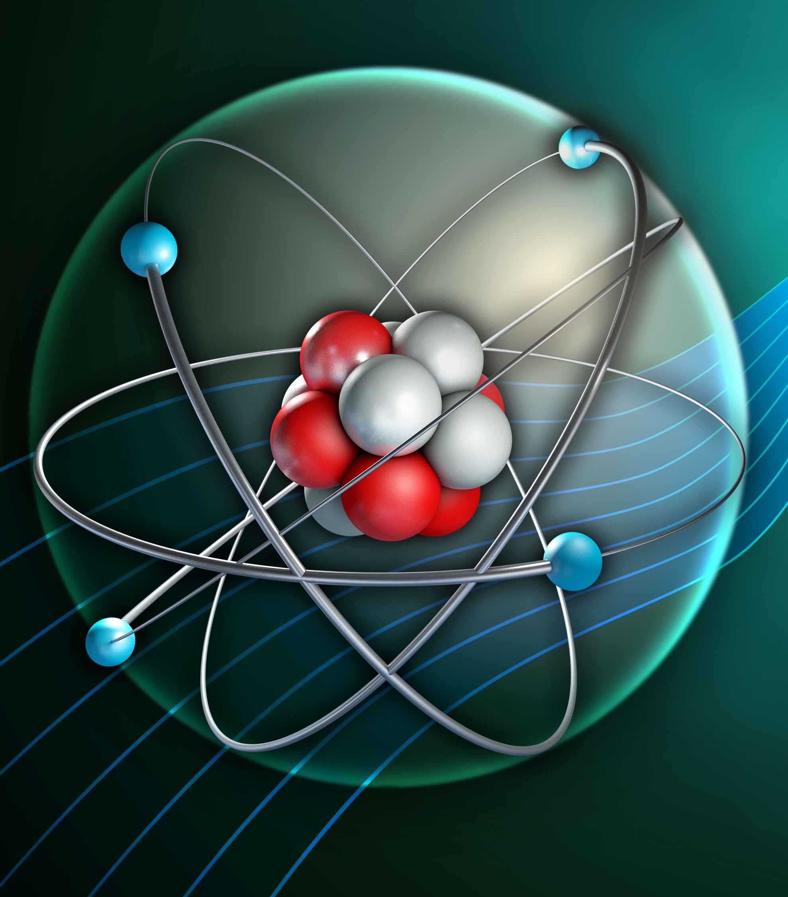
Nuclear equations
Use symbols to represent alpha and beta particles
Describe alpha and beta decay using equations
Explain why alpha and beta decay cause changes to the nucleus of atoms
Apply knowledge of radioactivity to explain why gamma emission does not lead to change in the nucleus mass and proton number

Slide 4
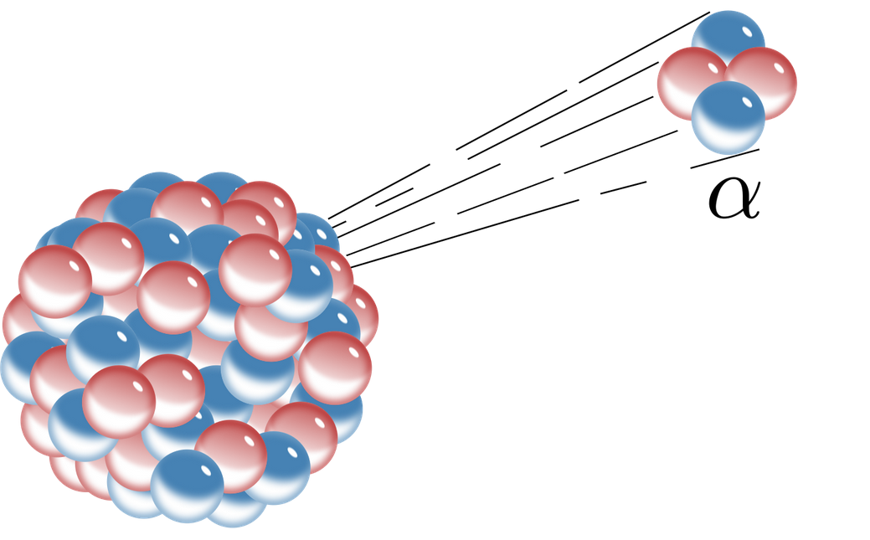
Developing Experts All rights reserved © 2021

Slide 5

Alpha Decay
mass number = protons + neutrons
4
2
He
atomic number = protons
Developing Experts All rights reserved © 2021

Slide 6
Alpha Decay
226
88
4
2
Ra
Rn
+
He
Radium
Radon
Alpha
Developing Experts All rights reserved © 2021

Slide 7
Alpha Decay
226
88
4
2
Ra
Rn
+
He
86
Radium
Radon
Alpha
Developing Experts All rights reserved © 2021

Slide 8
Alpha Decay
226
88
4
2
Ra
Rn
+
He
Radium
Radon
Alpha
86
Developing Experts All rights reserved © 2021

Slide 9
Alpha Decay
222
226
88
4
2
Rn
Ra
86
+
He
Radium
Radon
Alpha
Developing Experts All rights reserved © 2021

Slide 10
Alpha Decay
?
241
95
4
2
Am
Np
+
He
?
Americium
Neptunium
Alpha
Developing Experts All rights reserved © 2021

Slide 11
Alpha Decay
241
95
237
4
2
Am
Np
+
He
93
Americium
Neptunium
Alpha
Developing Experts All rights reserved © 2021

Slide 12
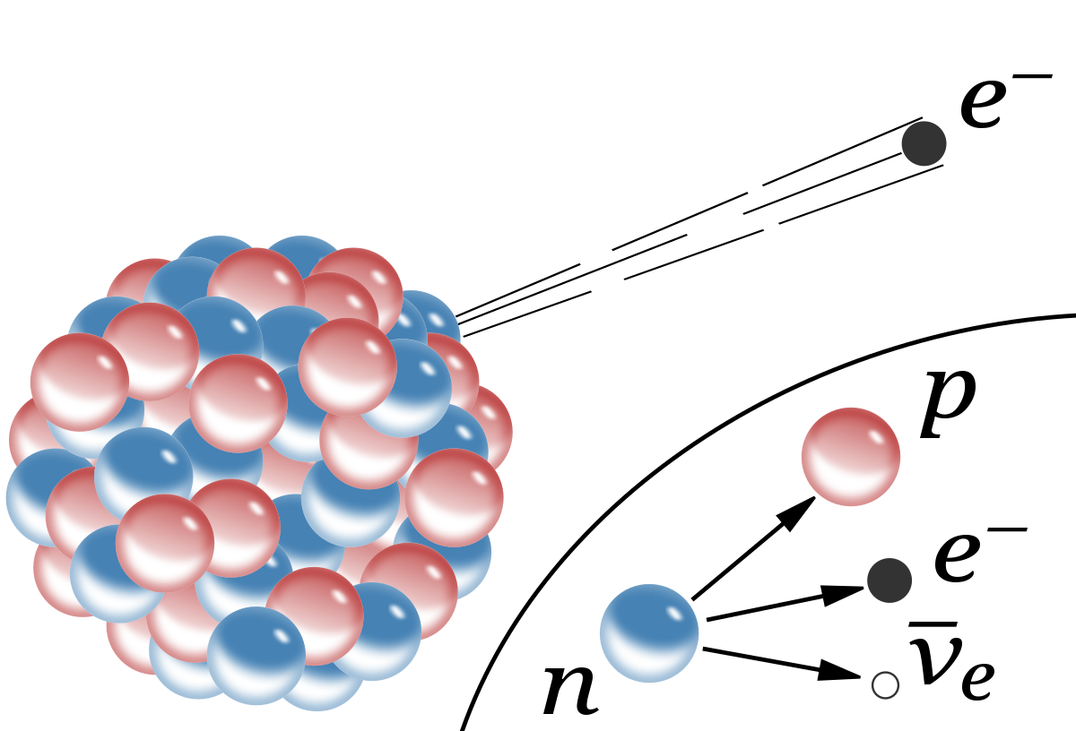
Developing Experts All rights reserved © 2021

Slide 13
Beta Decay
?
29
13
0
-1
Al
Si
+
e
?
Aluminium
Silicon
beta
Developing Experts All rights reserved © 2021

Slide 14
Beta Decay
29
13
29
0
-1
Al
Si
+
e
14
Aluminium
Silicon
beta
Developing Experts All rights reserved © 2021

Slide 15
Beta Decay
131
53
?
0
-1
l
Xe
+
e
?
Iodine
Xenon
beta
Developing Experts All rights reserved © 2021

Slide 16
Beta Decay
131
53
131
0
-1
l
Xe
+
e
54
Iodine
Xenon
beta
Developing Experts All rights reserved © 2021

Slide 17
Beta Decay
137
56
137
0
0
Ba(m)
Ba
+
γ
56
‘excited’ (meta-stable) barium
Barium
gamma
Developing Experts All rights reserved © 2021

