Slide 1
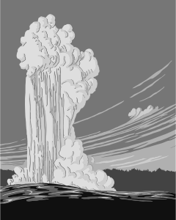
Resource Handout: S06.10.06 Handout 1 – Energy Sources
Explore the benefits and problems of renewable energy sources
Cut out the facts below, identify which type of energy they are describing, and stick them into the relevant spaces in the grid provided on the next page. Add any missing pros or cons about these different types of energy in the empty spaces.
Only certain parts of the world have the right kind of rocks needed near the surface to produce enough thermal energy.
It’s a very clean fuel because it uses what’s already there. It’s cheap and renewable, as the Earth’s core is always hot.
It’s very expensive to set up and run. It’s non-renewable. It can produce very dangerous radioactive substances that are very difficult to get rid of and are potentially a huge threat to human health unless properly stored for a long time. Waste can be used to produce nuclear weapons.
Non-renewable, with the exception of coal, most fossil fuels are running out fast (and coal will too eventually). They release a lot of carbon dioxide when burned, which contributes to climate change.
It’s a clean and renewable energy source. Dams can prevent downstream areas from flooding.
It’s relatively cheap and we already have all the technology needed to extract it. There are still large reserves of coal left.
There are limited suitable sites, not always where the energy is needed. Takes up huge amounts of space, often in beautiful mountain countryside, which then gets destroyed. Blocks flow of rivers, floods large areas, can displace large numbers of people and wildlife.
Produces no
climate-changing harmful gases. Compared to coal and gas, there are adequate supplies for the medium term.
Developing Experts Ltd. Copyright 2018 All rights reserved.

Slide 2
Resource Handout: S06.10.06 Handout 1 – Energy Sources
Explore the benefits and problems of renewable energy sources
Energy Source | Disadvantages | Advantages
BIOMASS
NUCLEAR
FOSSIL FUELS
GEOTHERMAL
HYDROELECTRIC
Developing Experts Ltd. Copyright 2018 All rights reserved.

Slide 3
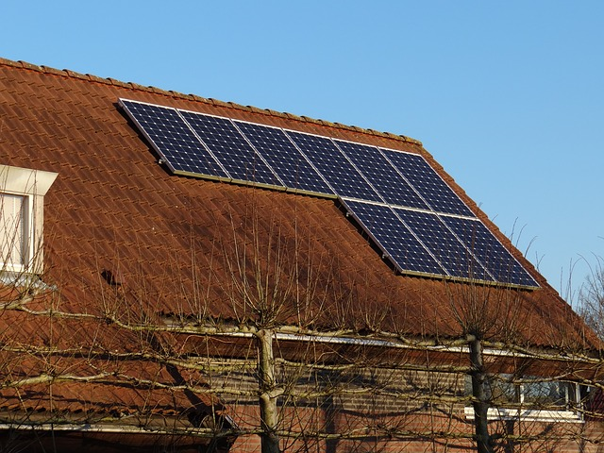
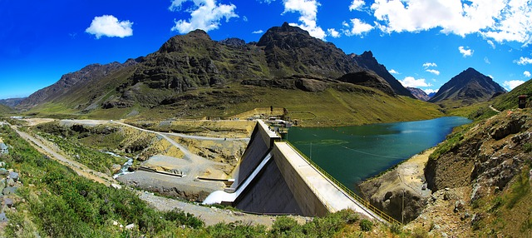
Resource Handout: S06.10.06 Handout 1 – Energy Sources
Explore the benefits and problems of renewable energy sources
Discuss the benefits and potential problems for the renewable energy sources pictured below.
wind
____________________________________________________________________________________________________________________________________________
Stretch:
Identify the benefits and potential problems for the wider society for a range of renewable energy sources.
__________________________________________________________________________________________________________________________________________________________________________________________________________________________________________________________
solar
____________________________________________________________________________________________________________________________________________
Challenge:
Identify the benefits and potential problems for a range of renewable energy sources.
__________________________________________________________________________________________________________________________________________________________________________________________________________________________________________________________
hydroelectric
____________________________________________________________________________________________________________________________________________
__________________________________________________________________________________________________________________________________________________________________________________________________________________________________________________________
Developing Experts Ltd. Copyright 2018 All rights reserved.

