Slide 1









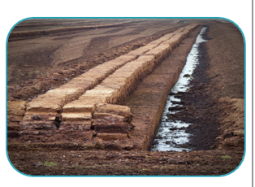
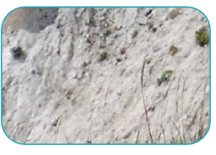
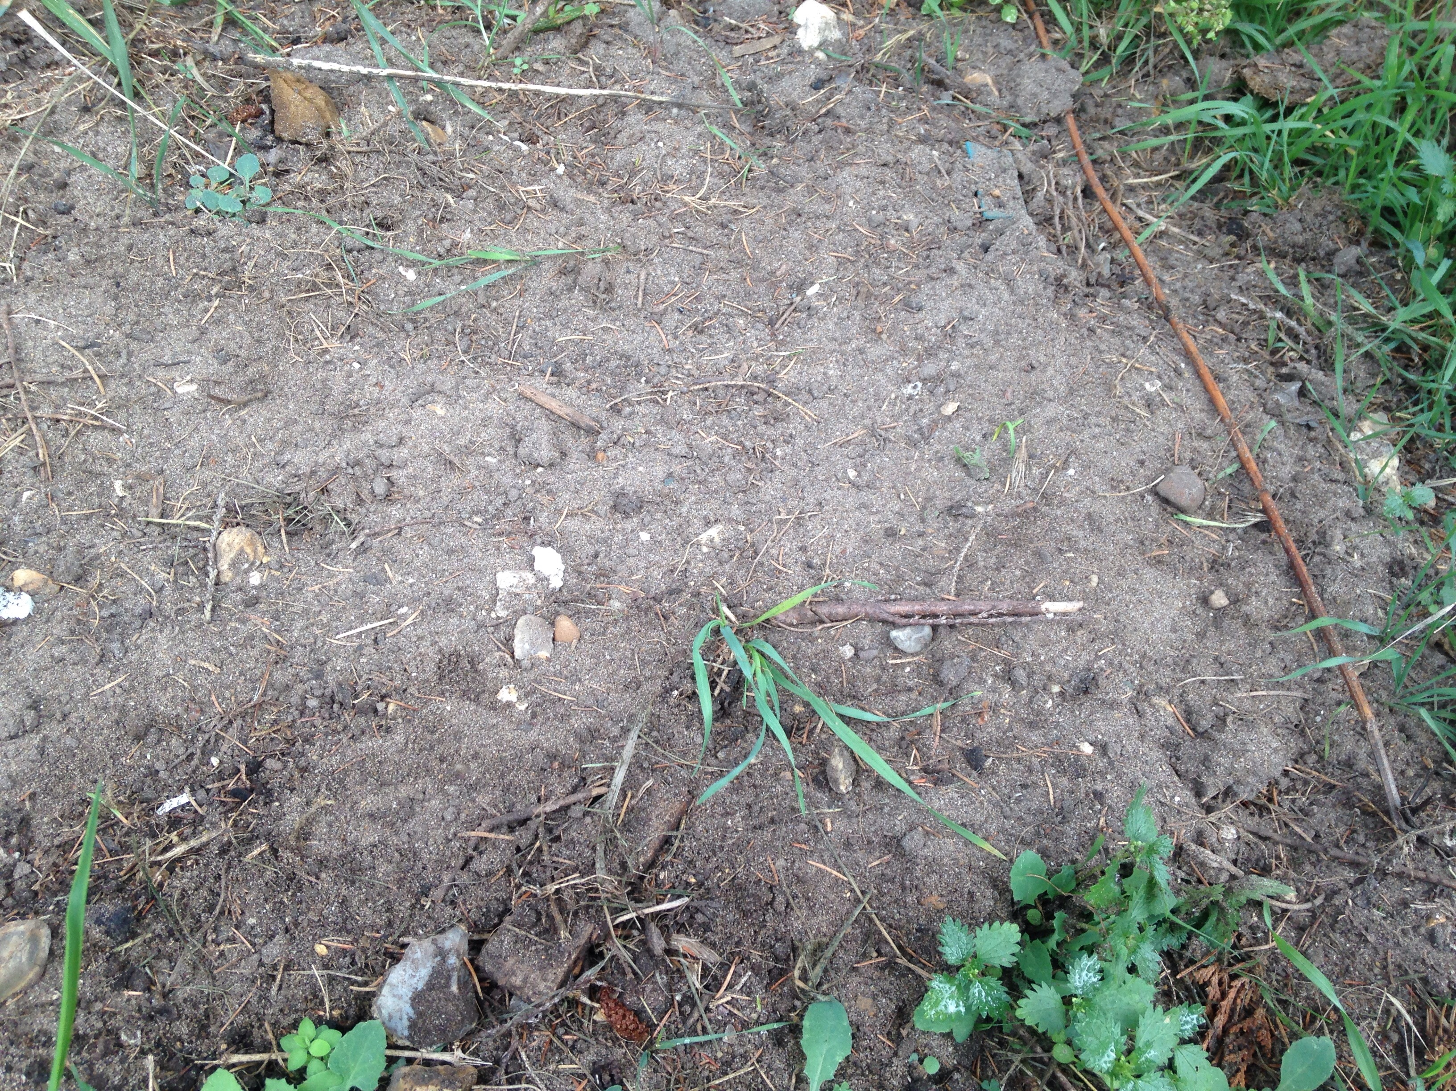
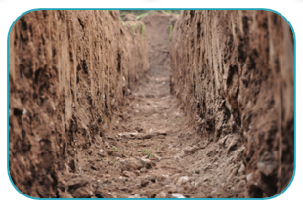
Mission Assignment: Understand what fossils are
MA Code: S03_04_03
Write descriptions of each type of soil using the word bank.
Use these to help you with the next task.
peat
chalky soil
sandy soil
clay soil
Rocket your writing with these words!
thick crusty dark nutrients crumbly
fine loose dry wet sticky
Developing Experts Copyright 2022 All Right Reserved

Slide 2
Mission Assignment: Understand what fossils are
MA Code: S03_04_03
Fill the Venn diagram with words to describe two chosen soil types. Then write a comparison between them using connectives.
Soil A: ________________
Soil B: _________________
______________ has a ______________ texture and feels___ ______________________________________________________
However, _____________________________________________
______________________________________________________
_______________ is useful for ___________________________
Whereas, ___________________ can be used to __________
______________________________________________________
Rocket your writing with these words!
thick crusty dark nutrients crumbly
fine loose dry wet sticky
Developing Experts Copyright 2022 All Right Reserved

