Slide 1
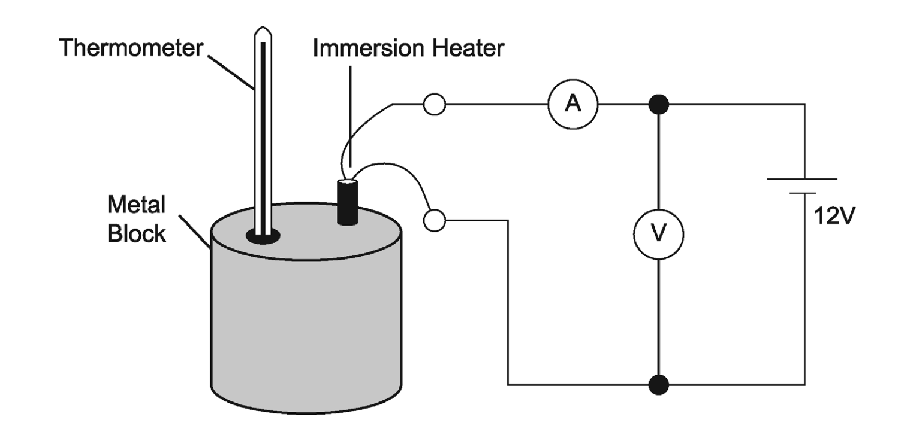
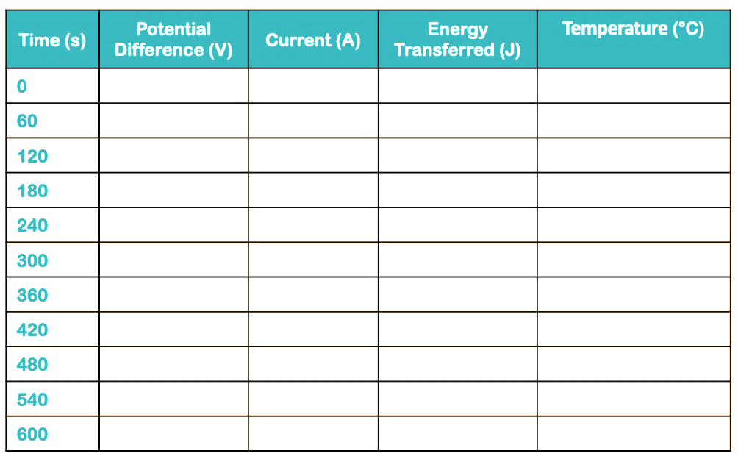
Specific Heat Capacity – Required Practical
Planning:
Consider the method
  What are we investigating?
  How might we find the answers?
Make a risk assessment:-
  What are the hazards?
  What measures will you take to manage risk?
Variables:-
  What controls do we need?
  What are the dependent variables?
  What are the independent variables?
Determine for accuracy and for error:-
  What is the calibration of the thermometer?
  What is the resolution of the thermometer?
  What is the time interval between reading the data?
  What is the range of energy (work done)?
Objective:
To determine the specific heat capacity of three different metals.
Equation:
𝛥E = m X c X 𝛥𝜽
𝛥E – Change in energy (J)
M – Mass (kg)
C – Specific Heat Capacity (J/kg°C)
𝛥𝜽 – Change in temperature (°C)
Rearrange the equation
𝛥E
________
m X c X 𝛥𝜽
Calculate:
Use your data table to calculate SHC: OR
Gravitational
field strength
10N/kg
Use a graph to calculate SHC:
Draw a graph and plot the energy transferred on the x axis, and temperature on the y axis.
Plot your data. Draw a line of best fit. Determine the gradient – y ÷ x
Use this formula to calculate SHC
𝛥E
________
m X 𝛥𝜽
= c
1
______________
Gradient X m
= c

Slide 2
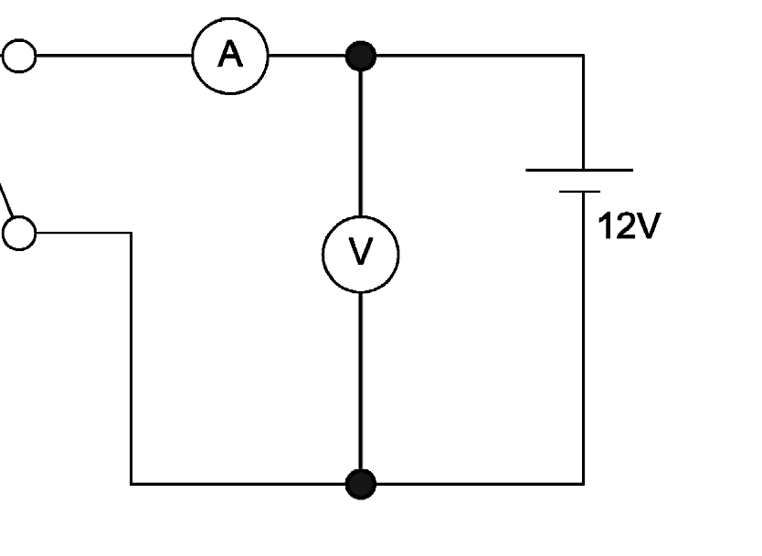
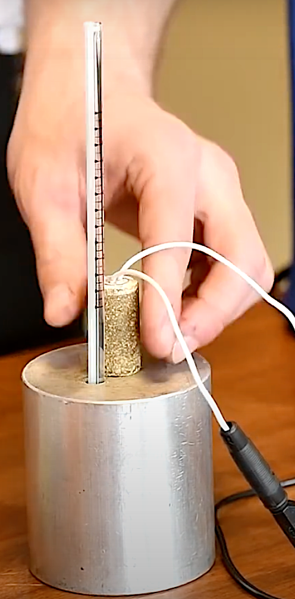
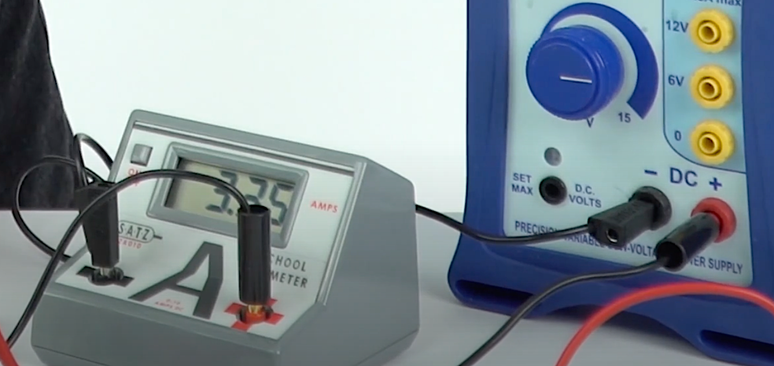
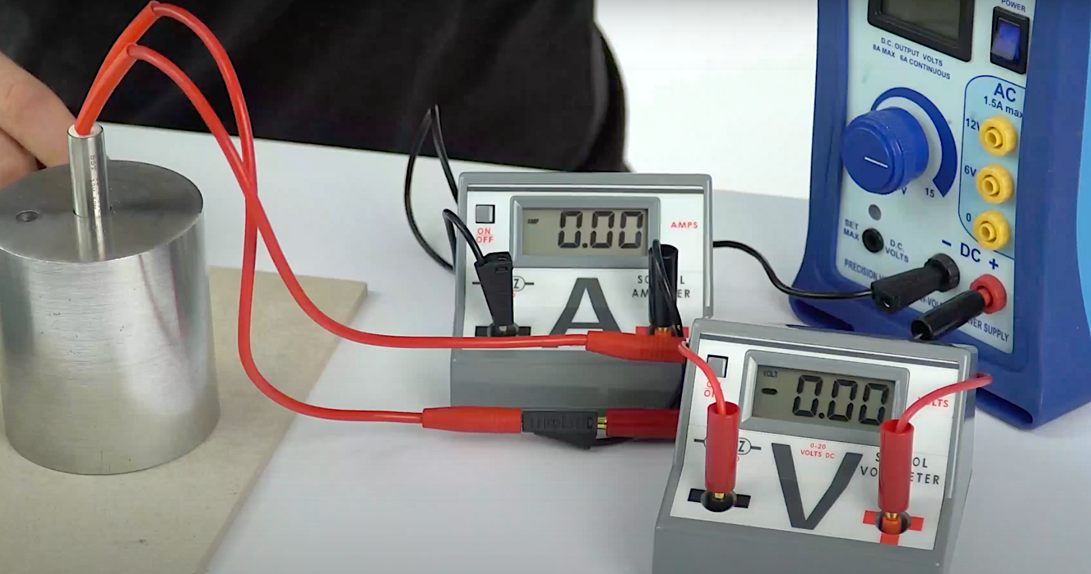
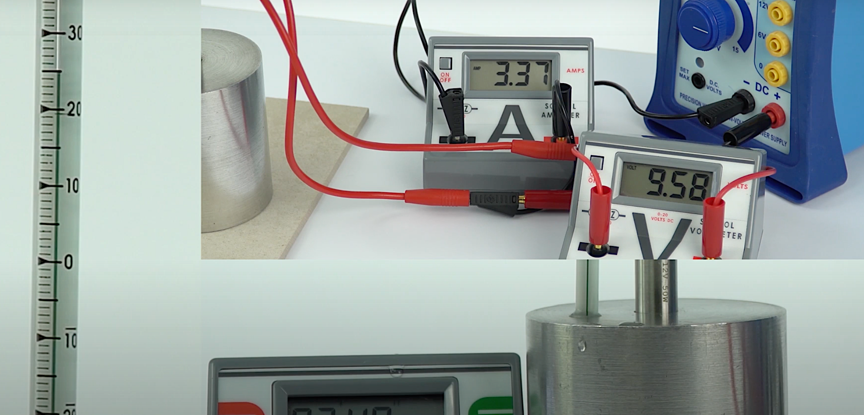
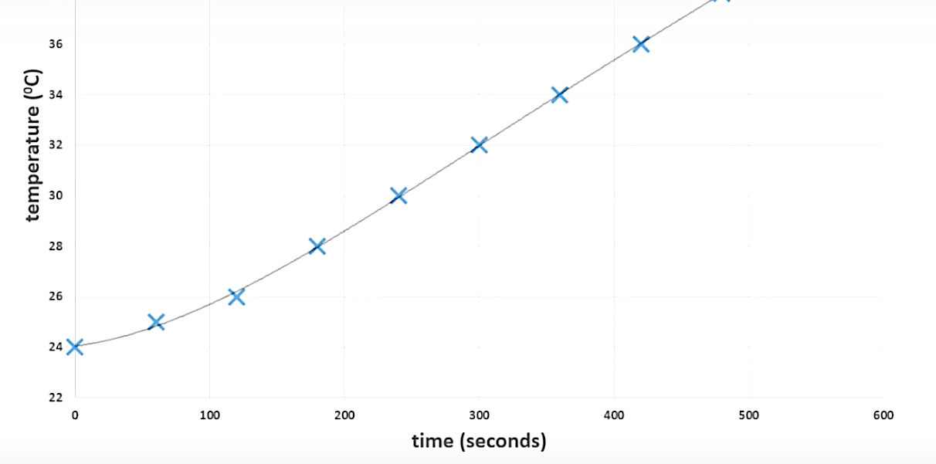
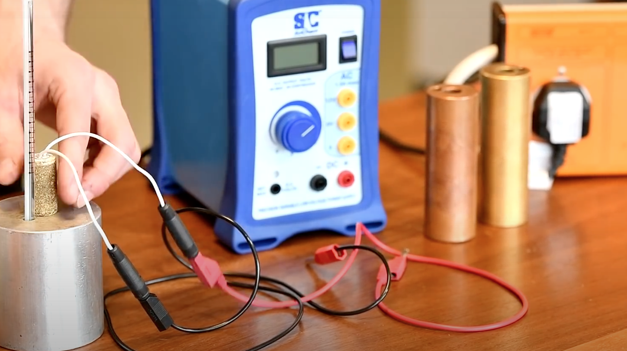
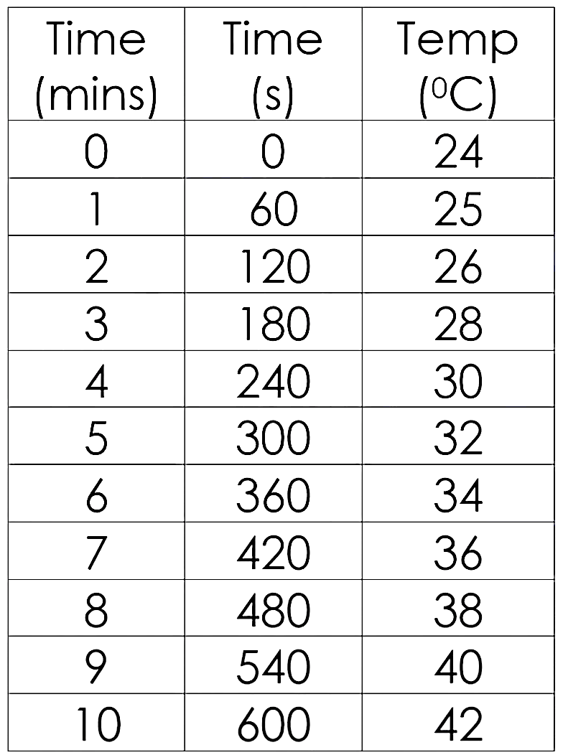
Method
Set the balance to zero.
Measure the mass of the metal block.
Put a few drops of water in the small hole to make sure there is full immersion of the thermometer.
Place the immersion heater into the central hole.
Set the circuit up to the diagram above
  A joulemeter can be used.
  For accuracy, use an ammeter in series, and a voltmeter in parallel across the component.
Set the power pack to 10v, check that the voltmeter is reading as 10v.
You can calculate the work done (J) by the electrical power supply with this formula:-
Power = Potential X Current
Difference
P = V X I
Then by using this formula for calculating energy transferred:-
Energy (J) = Power (W) X Time (s)
Think of all of the hazards
Turn on the power supply and start your timer.
Record the current, potential difference and the temperature.
Repeat every 60 seconds for 10 minutes.
Use the formula to calculate power and energy.
Consider all the sources of error carefully

Slide 3
Planning Sheet
Plan an experiment for measuring the Specific Heat Capacity of a metal block.
Organise (What is the method) _______________________________________________________________________________________________________________________________________________________________________________________________________________________________________________________________________________________________________________________________________________________________
Equation
Energy = mass X SHC X temperature rise
Rearrange the formula to find SHC. What is the SI unit for SHC?
_____________
_____________
Risk Assessment ________________________________________________________________________________________________________________________
Sources of Error ________________________________________________________________________________________________________________ ____________________________________

Slide 4

Calculate the SHC to 3 sig. fig.
Data Analysis
Time (s) | Potential Difference (V) | Current (A) | Energy Transferred (J) (I X V X time) | Temperature (°C)
0
60
120
180
240
300
360
420
480
540
600
ºC
The heat capacity is 1/gradient
Temperature
Work done (energy)
If the quantity is less than 1kg you may need to scale-up your answer.
(J)

