Slide 1

Mission Assignment: Describe the stages of the menstrual cycle
KS3-09-03
Draw a storyboard to show what happens at each stage of the menstrual cycle, from day 1 to day 28.
You should pay particular attention to how the lining of the uterus changes and what happens to the egg during each stage.
Developing Experts Copyright 2023 All Rights Reserved

Slide 2
Mission Assignment: Describe the stages of the menstrual cycle
Mission Assignment: Describe the stages of the menstrual cycle
KS3-09-03
Discuss the advantages and disadvantages of different sanitary products. You can use books, magazines or the internet to help. If you find any product that has not been mentioned, add it in the ‘Other’ box at the bottom of the table.
Name | Image | Advantages | Disadvantages
Sanitary pads
Tampons
Menstrual cups
Period underwear
Other
Developing Experts Copyright 2023 All Rights Reserved

Slide 3
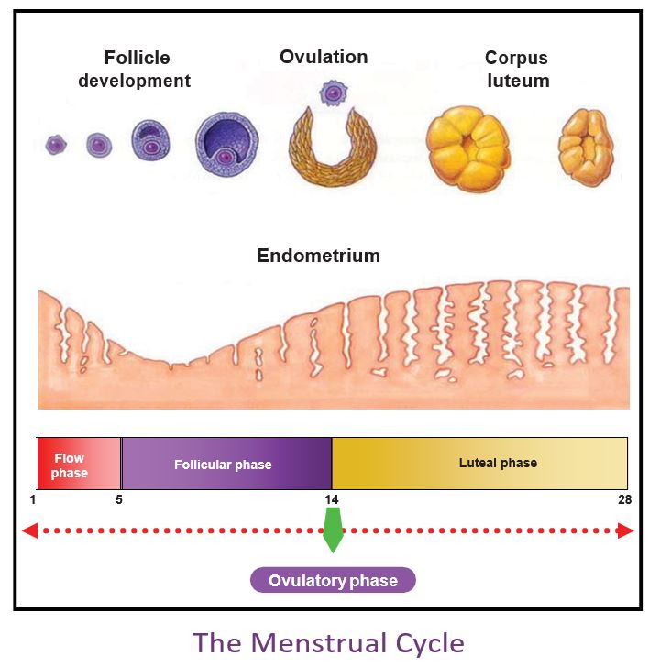
Mission Assignment: Describe the stages of the menstrual cycle
ANSWERS
KS3-09-03
Draw a storyboard to show what happens at each stage of the menstrual cycle, from day 1 to day 28.
You should pay particular attention to how the lining of the uterus changes and what happens to the egg during each stage.
Needs images similar to diagram below, as example for students/ teachers, in each box
Day 1-7 (approximately) | Day 8-13
Day 14-17 | Day 18-25
Day 26-28
Developing Experts Copyright 2023 All Rights Reserved

Slide 4
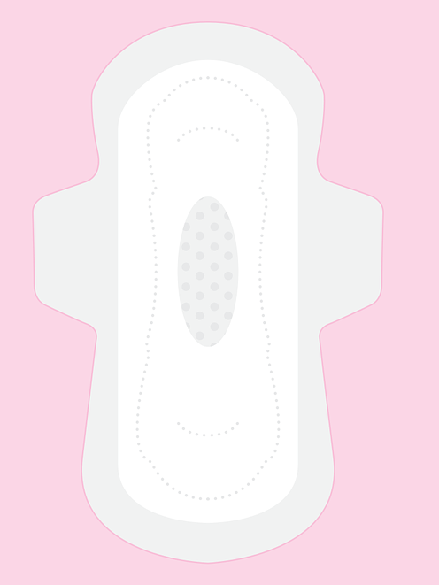
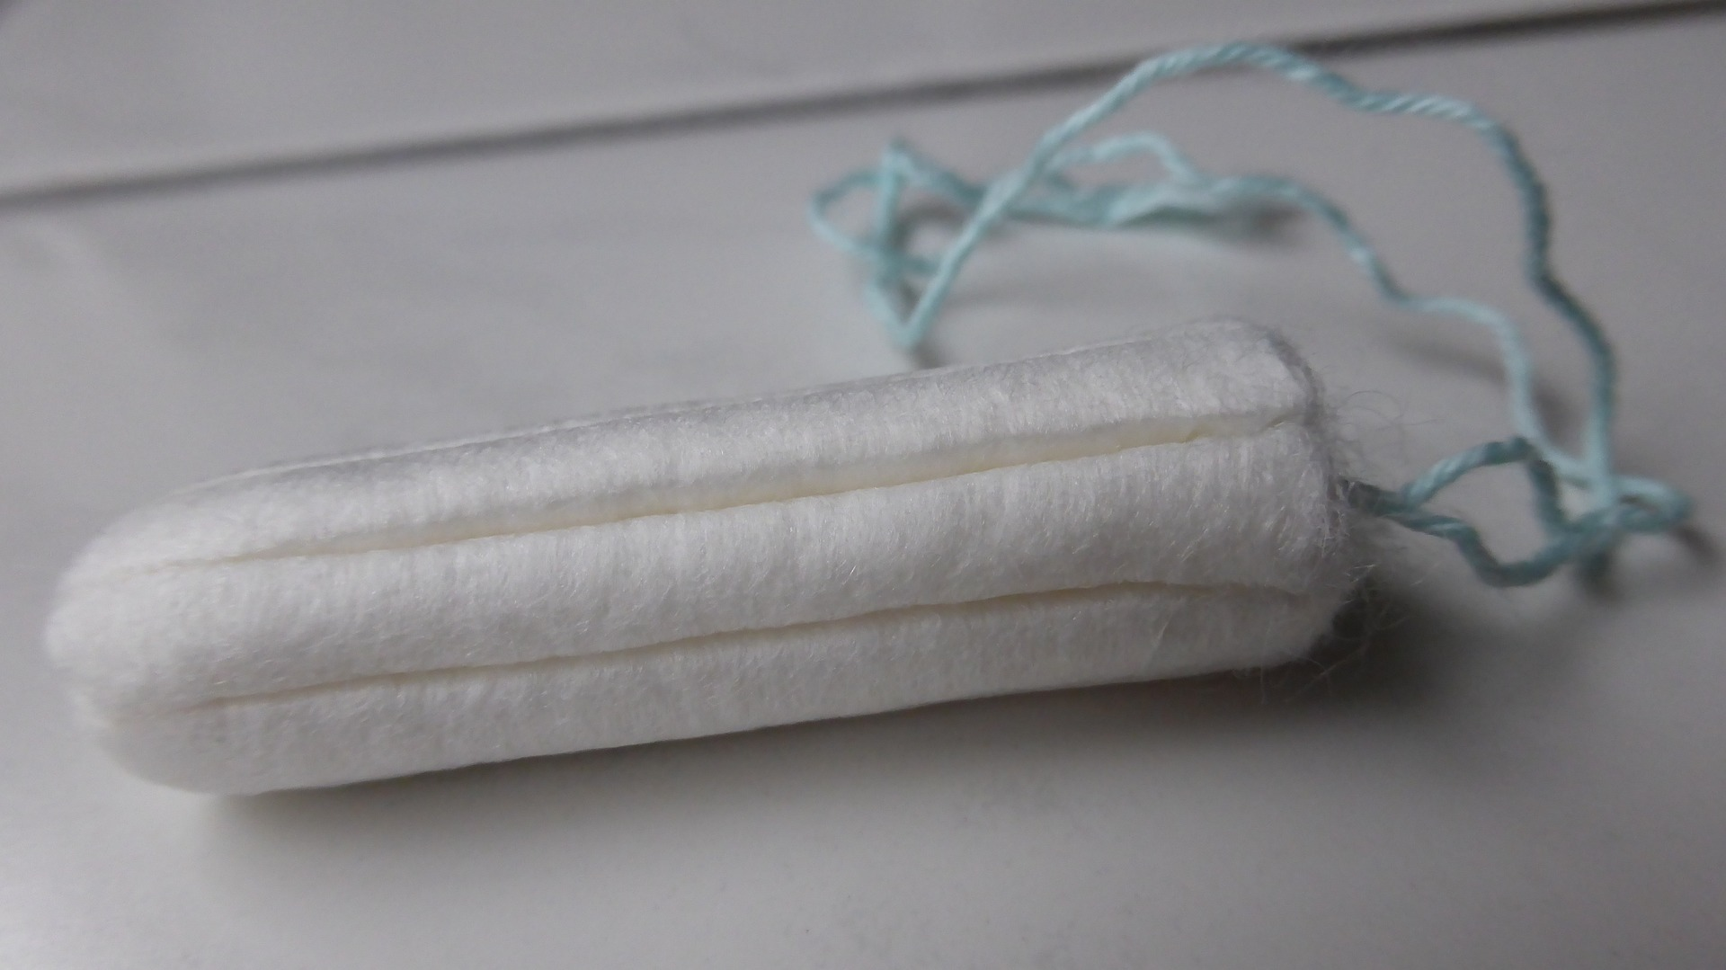
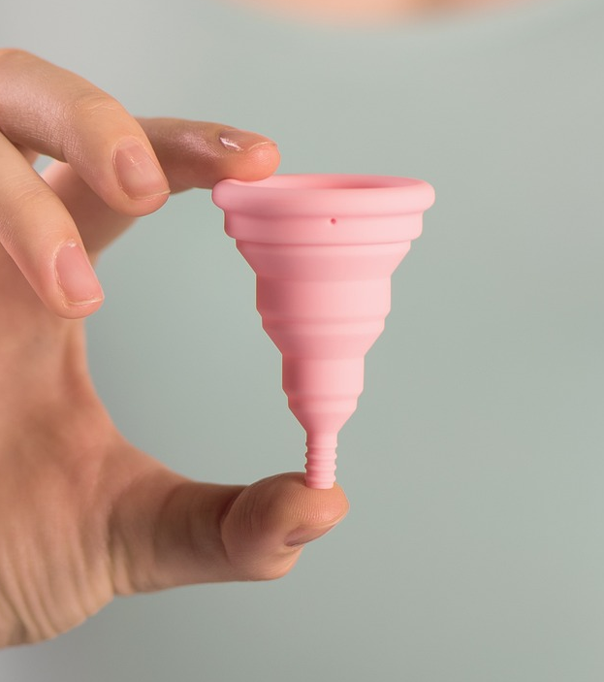
Mission Assignment: Describe the stages of the menstrual cycle
ANSWERS
KS3-09-03
Discuss the advantages and disadvantages of different sanitary products. You can use books, magazines or the internet to help. If you find any product that has not been mentioned, add it in the ‘Other’ box at the bottom of the table.
Name | Image | Advantages | Disadvantages
Sanitary pads |  | -some women find these more comfortable - volume and flow rate is more visible | -can be uncomfortable - produces waste for landfill - the wearer cannot participate in swimming -can be an irritant
Tampons |  | -some women find these more comfortable -the wearer can still participate in swimming -more discrete | -volume and flow rate less clear - produces waste for landfill - easy to forget, leading to toxic shock
Menstrual cups |  | -some women find these more comfortable -variety of shapes/sizes -no waste is produced -can be used for longer than pads/tampons -very clear indication of volume -the wearer can still participate in swimming | -needs practice to insert -more expensive to purchase initially - some women don’t want to see the blood
Period underwear |  | -some women find these more comfortable -can be worn in the lead up to the start of the period and during it -can be worn for longer time -no waste produced -provides protection against leaks -swimming versions are available -more discrete | -costs more initially -needs to be washed after use
Other
Developing Experts Copyright 2023 All Rights Reserved

