Slide 1
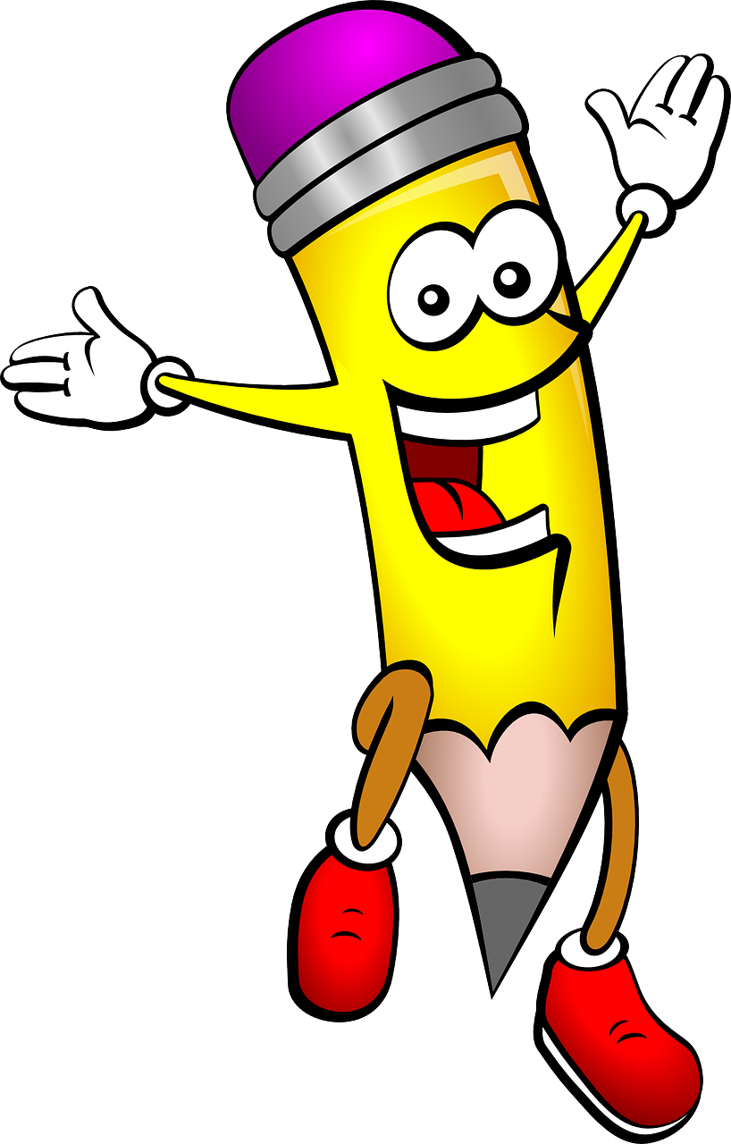
S03.08.01 – Mission to Write!
Explore about animals
change over time
Describe your predator and explain how it would survive in its environment. Use the sentence starters to help.
Picture of my predator
Describe Your Predator
My predator is called _______
________________________________________________________
It lives _____________________
________________________________________________________
Its body is __________________
____________________________
____________________________
Its prey is __________________
____________________________
It is a good predator because ____________________________________________________________________________________
____________________________
Explain how your predator would survive in its habitat
Rocket your writing with these words!
predator prey habitat environment evolve
carnivore omnivore features blend
Developing Experts Ltd. Copyright 2018 All rights reserved.

