Slide 1

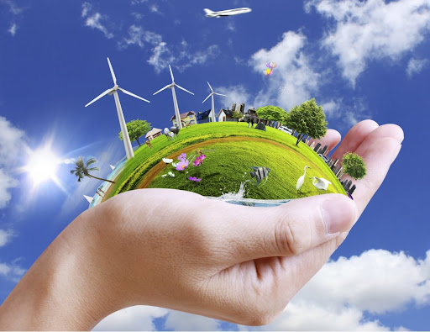
0001.01
Task
Task | Draw up a personal plan which sets out the changes you need to make at school and home to reduce your contributions to greenhouse emissions.
Developing skills | Planning different types of scientific enquiries to answer questions, including recognising and controlling variables where necessary
Think about… | Can you rank your responses in order of priority?
COP26-01_01
Getting back on track - What we can do at school and home

Slide 2
Draw up a personal plan which sets out the changes you need to make at school and home to reduce your contributions to greenhouse emissions.

