Slide 1

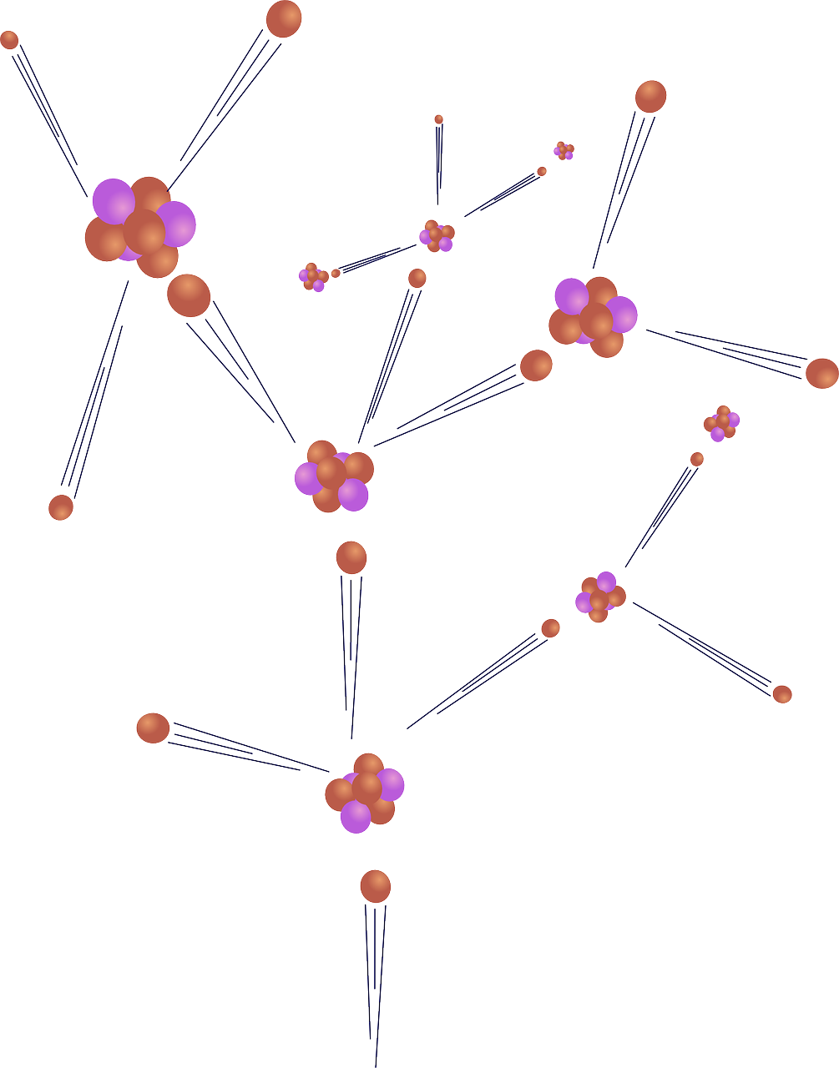
0001.01
Mission Assignment
Task | Draw two diagrams; one of the fission process and one of the fusion process. Clearly illustrate the process and label objects and actions.
Developing skills | Practise drawing diagrams to answer examination questions – name parts, identify processes and indicate how the size of different objects relate.
Think about… | How much information can be communicated in effective diagrams, as opposed to the limits of written communication?
KS4-21-10:
Explore Fission and Fusion

