Slide 1

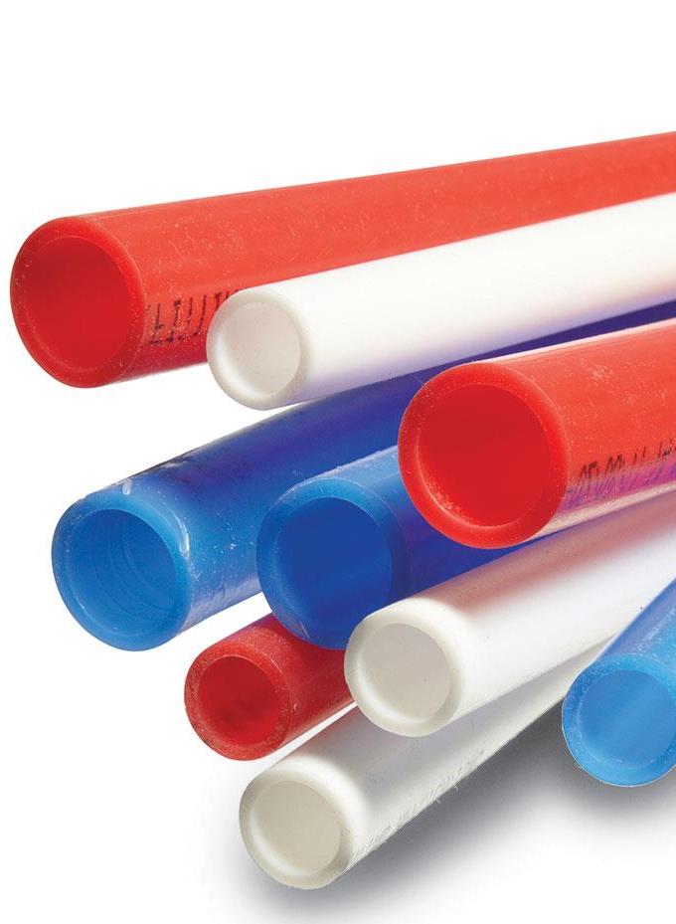
0001.01
Mission Assignment
Task
Developing skills
Think about…
Draw a product made from a polymer then explain how the properties of that material is related to their uses and select appropriate materials.
Explain how the properties of materials are related to their uses and select appropriate materials.
Explain show what would happen if the material was heated?
KS4-17-07:
Using Resources - Explore polymers

