Slide 1
For each of the objects test to see if can be twisted, squashed, bent, bounced or soak up water.
Put a tick or cross in the table to show what you have found out.
The first one has been done for you.
name of object | does it twist? | does it bend? | does it soak up water? | does it bounce? | can it be squashed?
paperclip | ✓ | ✓ | X | X | X
sponge
paper
ball
rubber band
pencil

Slide 2
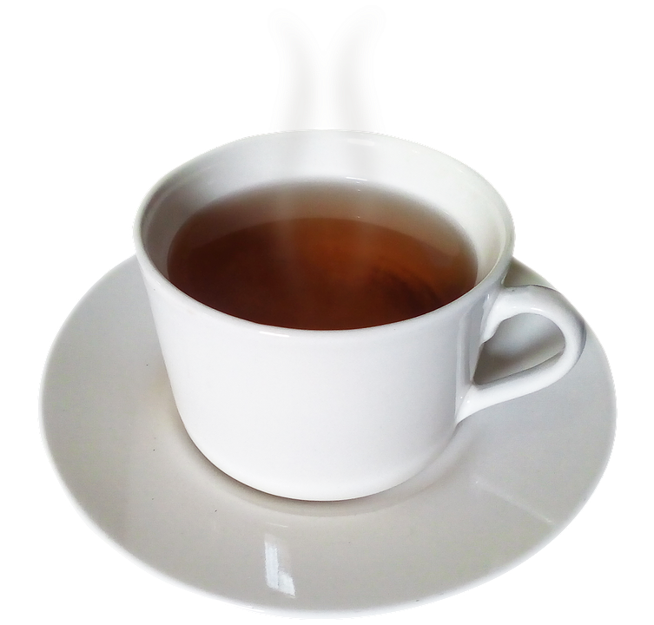
Choose the words which best describe each item.
Use the words in the word bank to help you.
This cup is
_______________ and _____________.
word bank:
shiny
dull
rough smooth
brittle
hard
clear
This rock is
______________ and ______________.
This trophy is
______________ and ______________.
This glass is
______________ and ______________.
Stretch:
Draw the chair you are sat on and write a sentence to describe it.
________________________________________________________________________________________________________________________________________________________________
Challenge:
Draw the chair you are sat on and write 3 words to describe it.
plastic

